Slide 1

Chapter 4
Network Layer:
Data Plane
Computer Networking: A Top-Down Approach
8th edition
Jim Kurose, Keith Ross
Pearson, 2020
Acknowledgement: Based on the textbook’s website: https://gaia.cs.umass.edu/kurose_ross/index.php
Notes:
Version History
8.0 (May 2020)
All slides reformatted for 16:9 aspect ratio
All slides updated to 8th edition material
Use of Calibri font, rather that Gill Sans MT
Add LOTS more animation throughout
added new 8th edition material on middleboxes (and Internet arch), Net neutrality, buffering …
lighter header font
8.2 (July 2023), changes from 8.0:
some minor updates (e.g., IPv6 stats updated) but not much has changed.

Slide 2
Network layer: our goals
understand principles behind network layer services, focusing on data plane:
  network layer service models
  forwarding versus routing
  how a router works
  addressing
  generalized forwarding
  Internet architecture
instantiation, implementation in the Internet
  IP protocol
  NAT, middleboxes

Slide 3

Network layer: “data plane” roadmap
Network layer: overview
  data plane
  control plane
What’s inside a router
  input ports, switching, output ports
  buffer management, scheduling
IP: the Internet Protocol
  datagram format
  addressing
  network address translation
  IPv6
Generalized Forwarding, SDN
  Match+action
  OpenFlow: match+action in action
Middleboxes

Slide 4








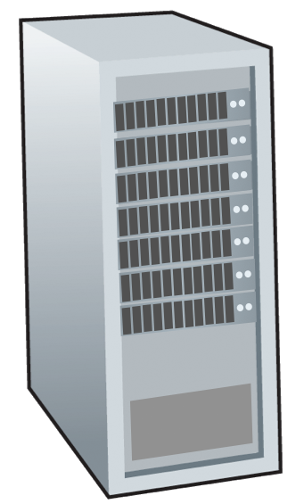







Network-layer services and protocols
transport segment from sending to receiving host
  sender: encapsulates segments into datagrams, passes to link layer
  receiver: delivers segments to transport layer protocol
network layer protocols in every Internet device: hosts, routers
routers:
  examines header fields in all IP datagrams passing through it
  moves datagrams from input ports to output ports to transfer datagrams along end-end path
mobile network
national or global ISP
application
transport
network
link
physical
network
link
physical
network
link
physical
network
link
physical
network
link
physical
network
link
physical
datacenter
network
application
transport
network
link
physical
enterprise
network

Slide 5

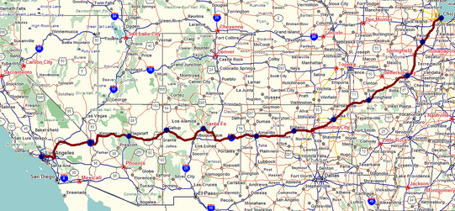
Two key network-layer functions
IMPORTANT
network-layer functions:
forwarding: move packets from a router’s input link to appropriate router output link
analogy: taking a trip
forwarding: process of getting through single interchange
routing: process of planning trip from source to destination
routing: determine route taken by packets from source to destination
  routing algorithms
forwarding
routing

Slide 6
Network layer: data plane, control plane
IMPORTANT
Data plane:
local, per-router function
determines how datagram arriving on router input port is forwarded to router output port
Control plane
network-wide logic
determines how datagram is routed among routers along end-end path from source host to destination host
values in arriving
packet header
two control-plane approaches:
  traditional routing algorithms: implemented in routers
  software-defined networking (SDN): implemented in (remote) servers
0111
1
3
2

Slide 7

Per-router control plane
IMPORTANT
Individual routing algorithm components in each and every router interact in the control plane
Routing
Algorithm
control
plane
data
plane
values in arriving
packet header
0111
1
3
2

Slide 8
Software-Defined Networking (SDN) control plane
IMPORTANT
Remote controller computes, installs forwarding tables in routers
Remote Controller
control
plane
data
plane
CA
CA
CA
CA
CA
values in arriving
packet header
0111
1
3
2

Slide 9
Network service model
IMPORTANT
Q: What service model for “channel” transporting datagrams from sender to receiver?
example services for individual datagrams:
guaranteed delivery
guaranteed delivery with less than 40 msec delay
example services for a flow of datagrams:
in-order datagram delivery
guaranteed minimum bandwidth to flow
restrictions on changes in inter-packet spacing

Slide 10
Network-layer service model
IMPORTANT
Quality of Service (QoS) Guarantees ?
Network
Architecture
Internet
ATM
ATM
Internet
Internet
Service
Model
best effort
Constant Bit Rate
Available Bit Rate
Intserv Guaranteed
(RFC 1633)
Diffserv (RFC 2475)
Bandwidth
none
Constant rate
Guaranteed min
yes
possible
Loss
no
yes
no
yes
possibly
Order
no
yes
yes
yes
possibly
Timing
no
yes
no
yes
no
Internet “best effort” service model
No guarantees on:
  successful datagram delivery to destination
  timing or order of delivery
  bandwidth available to end-end flow

Slide 11
Network-layer service model
Quality of Service (QoS) Guarantees ?
Network
Architecture
Internet
ATM
ATM
Internet
Internet
Service
Model
best effort
Constant Bit Rate
Available Bit Rate
Intserv Guaranteed
(RFC 1633)
Diffserv (RFC 2475)
Bandwidth
none
Constant rate
Guaranteed min
yes
possible
Loss
no
yes
no
yes
possibly
Order
no
yes
yes
yes
possibly
Timing
no
yes
no
yes
no

Slide 12
Reflections on best-effort service:
IMPORTANT
simplicity of mechanism has allowed Internet to be widely deployed adopted
sufficient provisioning of bandwidth allows performance of real-time applications (e.g., interactive voice, video) to be “good enough” for “most of the time”
replicated, application-layer distributed services (datacenters, content distribution networks) connecting close to clients’ networks, allow services to be provided from multiple locations
congestion control of “elastic” services helps
It’s hard to argue with success of best-effort service model

