Slide 1
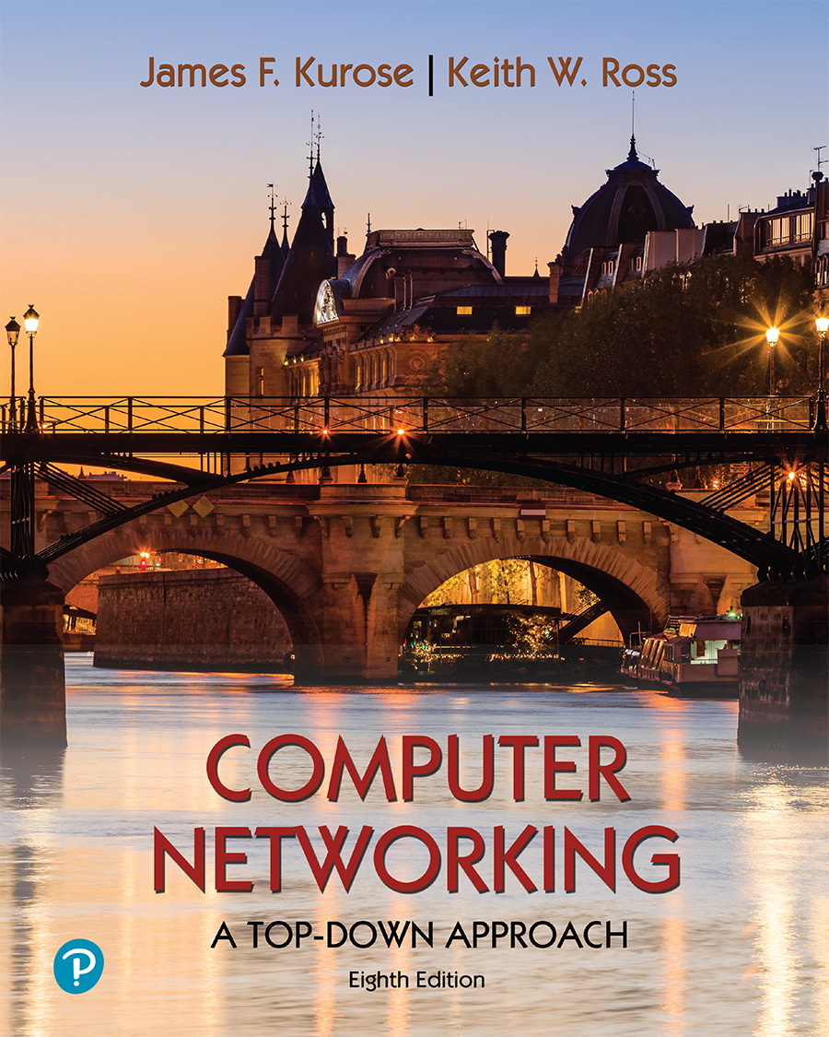
Chapter 3
Transport Layer
Computer Networking: A Top-Down Approach
8th edition
Jim Kurose, Keith Ross
Pearson, 2020
Acknowledgement: Based on the textbook’s website: https://gaia.cs.umass.edu/kurose_ross/index.php
Notes:
Version History
8.0 (April 2020)
All slides reformatted for 16:9 aspect ratio
All slides updated to 8th edition material
Use of Calibri font, rather that Gill Sans MT
Add LOTS more animation throughout
added new 8th edition material on QUIC, CUBIC, delay-based congestion control
lighter header font
8.2 (July 2023): changes from 8.0
minor updates throughout, but not much changes from 8.0

Slide 2

Chapter 3: roadmap
Transport-layer services
Multiplexing and demultiplexing
Connectionless transport: UDP
Principles of reliable data transfer
Connection-oriented transport: TCP
Principles of congestion control
TCP congestion control
Evolution of transport-layer functionality

Slide 3
UDP: User Datagram Protocol
IMPORTANT
Why is there a UDP?
“no frills,” “bare bones” Internet transport protocol
“best effort” service, UDP segments may be:
  lost
  delivered out-of-order to app
no connection establishment (which can add RTT delay)
simple: no connection state at sender, receiver
small header size
no congestion control
  UDP can blast away as fast as desired!
  can function in the face of congestion
connectionless:
  no handshaking between UDP sender, receiver
  each UDP segment handled independently of others

Slide 4
UDP: User Datagram Protocol
UDP use:
  streaming multimedia apps (loss tolerant, rate sensitive)
  DNS
  SNMP
  HTTP/3
if reliable transfer needed over UDP (e.g., HTTP/3):
  add needed reliability at application layer
  add congestion control at application layer

Slide 5
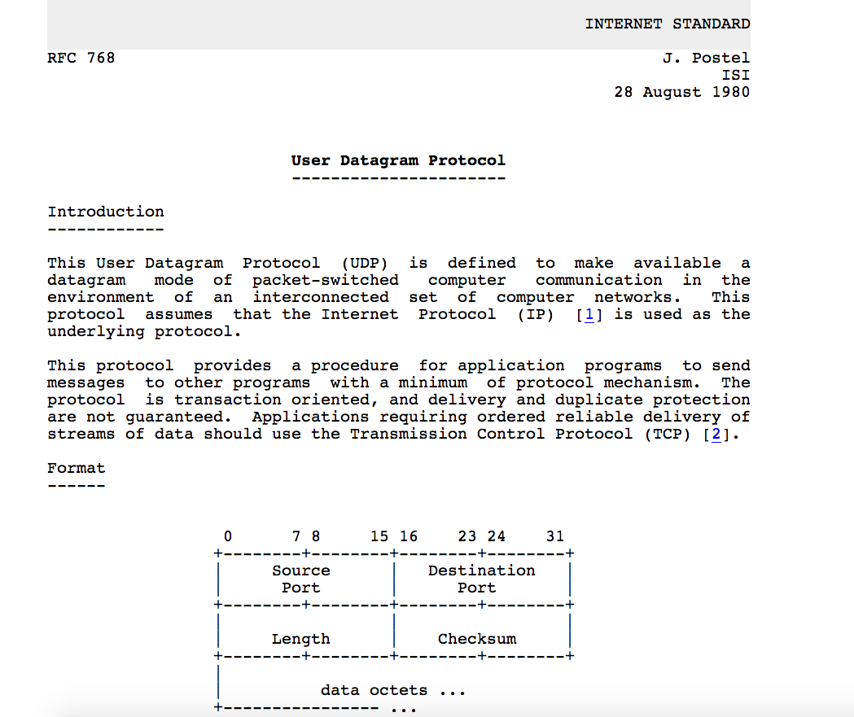
UDP: User Datagram Protocol [RFC 768]
Notes:
read this RFC – it’s only 2.5 pages!

Slide 6
UDP: Transport Layer Actions
IMPORTANT
SNMP client
SNMP server
application
application
transport
(UDP)
transport
(UDP)
network (IP)
network (IP)
link
link
physical
physical

Slide 7
UDP: Transport Layer Actions
IMPORTANT
SNMP client
SNMP server
UDP sender actions:
application
application
is passed an application-layer message
SNMP msg
transport
(UDP)
transport
(UDP)
determines UDP segment header fields values
UDP_{h}
SNMP msg
UDP_{h}
creates UDP segment
network (IP)
network (IP)
passes segment to IP
link
link
physical
physical

Slide 8
UDP: Transport Layer Actions
IMPORTANT
SNMP client
SNMP server
UDP receiver actions:
application
receives segment from IP
application
checks UDP checksum header value
transport
(UDP)
transport
(UDP)
SNMP msg
extracts application-layer message
network (IP)
network (IP)
SNMP msg
UDP_{h}
demultiplexes message up to application via socket
link
link
physical
physical

Slide 9
UDP segment header
IMPORTANT
32 bits
source port #
dest port #
length
checksum
application
data
(payload)
length, in bytes of UDP segment, including header
data to/from application layer
UDP segment format

Slide 10

UDP checksum
IMPORTANT
Goal: detect errors (i.e., flipped bits) in transmitted segment
1st number
2nd number
sum
Transmitted: 5 6 11
Received: 4 6 11
receiver-computed
checksum
=
sender-computed
checksum (as received)

Slide 11
Internet checksum
IMPORTANT
Goal: detect errors (i.e., flipped bits) in transmitted segment
sender:
treat contents of UDP segment (including UDP header fields and IP addresses) as sequence of N-bit integers, where N may be 4, 8, 16…
checksum: addition of segment content, then flip all the bits (one’s complement sum)
checksum value put into UDP checksum field
receiver:
compute checksum of received segment
check if computed checksum equals checksum field value:
  not equal - error detected
  equal - no error detected. But maybe errors nonetheless? More later ….

Slide 12
Internet checksum: an example
IMPORTANT
example: add two N=16-bit integers
1 1 1 0 0 1 1 0 0 1 1 0 0 1 1 0
1 1 0 1 0 1 0 1 0 1 0 1 0 1 0 1
wraparound
1 1 0 1 1 1 0 1 1 1 0 1 1 1 0 1 1
sum
1 0 1 1 1 0 1 1 1 0 1 1 1 1 0 0
checksum
0 1 0 0 0 1 0 0 0 1 0 0 0 0 1 1
Note: when adding numbers, a carryout from the most significant bit needs to be added to the result
* Check out the online interactive exercises for more examples: http://gaia.cs.umass.edu/kurose_ross/interactive/

Slide 13
Internet checksum: weak protection!
IMPORTANT
example: add two N=16-bit integers
0 1
1 1 1 0 0 1 1 0 0 1 1 0 0 1 1 0
1 0
1 1 0 1 0 1 0 1 0 1 0 1 0 1 0 1
wraparound
1 1 0 1 1 1 0 1 1 1 0 1 1 1 0 1 1
Even though numbers have changed (bit flips), no change in checksum!
sum
1 0 1 1 1 0 1 1 1 0 1 1 1 1 0 0
checksum
0 1 0 0 0 1 0 0 0 1 0 0 0 0 1 1

Slide 14
Quiz
IMPORTANT
https://gaia.cs.umass.edu/kurose_ross/interactive/internet_checksum.php

Slide 15
Summary: UDP
“no frills” protocol:
  segments may be lost, delivered out of order
  best effort service: “send and hope for the best”
UDP has its plusses:
  no setup/handshaking needed (no RTT incurred)
  can function when network service is compromised
  helps with reliability (checksum)
build additional functionality on top of UDP in application layer (e.g., HTTP/3)

