Slide 1

Chapter 2
Application Layer
Computer Networking: A Top-Down Approach
8th edition n
Jim Kurose, Keith Ross
Pearson, 2020
Acknowledgement: Based on the textbook’s website: https://gaia.cs.umass.edu/kurose_ross/index.php
Notes:
Version History
8.1. Updates throughout, including a lot more animations. These are the ppt files used to make Chapter 2 online lectures in Sept. 2020.
8.0 (April 2020)
All slides reformatted for 16:9 aspect ratio
All slides updated to 8th edition material
Use of Calibri font, rather that Gill Sans MT
Add LOTS more animation throughout

Slide 2

Application Layer: Overview
P2P applications
video streaming and content distribution networks
socket programming with UDP and TCP
Principles of network applications
Web and HTTP
E-mail, SMTP, IMAP
The Domain Name System DNS

Slide 3
DNS: Domain Name System
IMPORTANT
people: many identifiers:
  SSN, name, passport #
Internet hosts, routers:
  IP address (32 bit) - used for addressing datagrams
  “name”, e.g., cs.umass.edu - used by humans
Q: how to map between IP address and name, and vice versa ?
Domain Name System (DNS):
distributed database implemented in hierarchy of many name servers
application-layer protocol: hosts, DNS servers communicate to resolve names (address/name translation)
  note: core Internet function, implemented as application-layer protocol
  complexity at network’s “edge”

Slide 4
DNS: services, structure
IMPORTANT
DNS services:
hostname-to-IP-address translation
host aliasing
  canonical, alias names
mail server aliasing
load distribution
  replicated Web servers: many IP addresses correspond to one name
Q: Why not centralize DNS?
single point of failure
traffic volume
distant centralized database
maintenance
A: doesn‘t scale!
Comcast DNS servers alone: 600B DNS queries/day
Akamai DNS servers alone: 2.2T DNS queries/day

Slide 5

Thinking about the DNS
IMPORTANT
humongous distributed database:
~ billion records, each simple
handles many trillions of queries/day:
many more reads than writes
performance matters: almost every Internet transaction interacts with DNS - msecs count!
organizationally, physically decentralized:
millions of different organizations responsible for their records
“bulletproof”: reliability, security

Slide 6
DNS: a distributed, hierarchical database
IMPORTANT
Root DNS Servers
Root
…
…
.com DNS servers
.org DNS servers
.edu DNS servers
Top Level Domain
…
…
…
…
yahoo.com
DNS servers
amazon.com
DNS servers
pbs.org
DNS servers
nyu.edu
DNS servers
umass.edu
DNS servers
Authoritative
Client wants IP address for www.amazon.com; 1st approximation:
client queries root server to find .com DNS server
client queries .com DNS server to get amazon.com DNS server
client queries amazon.com DNS server to get IP address for www.amazon.com

Slide 7
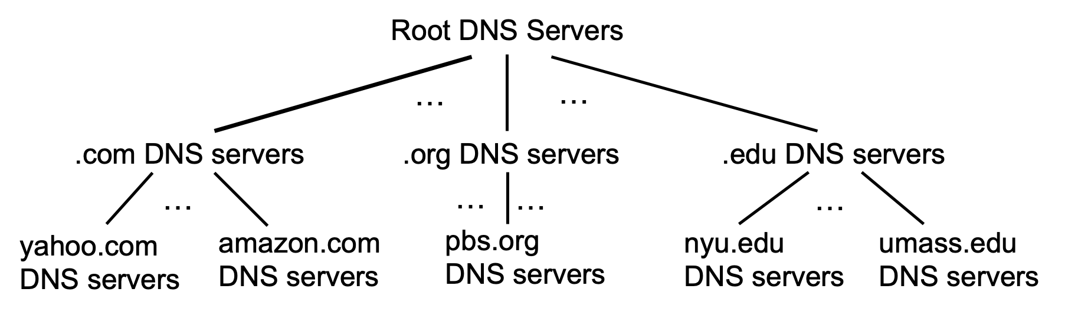
DNS: root name servers
IMPORTANT
official, contact-of-last-resort by name servers that can not resolve name

Slide 8
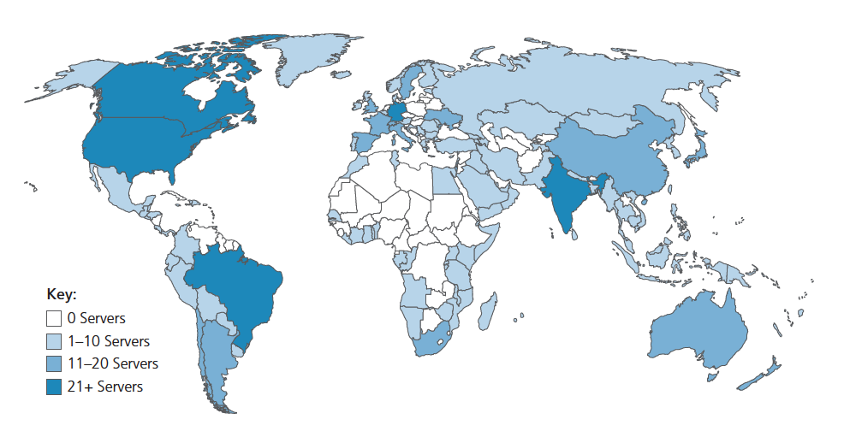
DNS: root name servers
IMPORTANT
official, contact-of-last-resort by name servers that can not resolve name
incredibly important Internet function
  Internet couldn’t function without it!
  DNSSEC – provides security (authentication, message integrity)
ICANN (Internet Corporation for Assigned Names and Numbers) manages root DNS domain
13 logical root name “servers” worldwide each “server” replicated many times (~200 servers in US)

Slide 9
Top-Level Domain, and authoritative servers
IMPORTANT
Top-Level Domain (TLD) servers:
  responsible for .com, .org, .net, .edu, .aero, .jobs, .museums, and all top-level country domains, e.g.: .cn, .uk, .fr, .ca, .jp
  Network Solutions: authoritative registry for .com, .net TLD
  Educause: .edu TLD
authoritative DNS servers:
  organization’s own DNS server(s), providing authoritative hostname to IP mappings for organization’s named hosts
  can be maintained by organization or service provider

Slide 10
Local DNS name servers
IMPORTANT
when host makes DNS query, it is sent to its local DNS server
  Local DNS server returns reply, answering:
    from its local cache of recent name-to-address translation pairs (possibly out of date!)
    forwarding request into DNS hierarchy for resolution
  each ISP has local DNS name server; to find yours:
    MacOS: % scutil --dns
    Windows: >ipconfig /all
local DNS server doesn’t strictly belong to hierarchy

Slide 11

DNS name resolution: iterated query
IMPORTANT
root DNS server
Example: host at engineering.nyu.edu wants IP address for gaia.cs.umass.edu
2
3
TLD DNS server
Iterated query:
contacted server replies with name of server to contact
“I don’t know this name, but ask this server”
1
4
8
5
requesting host at
engineering.nyu.edu
local DNS server
dns.nyu.edu
gaia.cs.umass.edu
7
6
authoritative DNS server
dns.cs.umass.edu

Slide 12
DNS name resolution: recursive query
IMPORTANT
root DNS server
Example: host at engineering.nyu.edu wants IP address for gaia.cs.umass.edu
2
3
7
6
Recursive query:
puts burden of name resolution on contacted name server
heavy load at upper levels of hierarchy?
1
TLD DNS server
8
requesting host at
engineering.nyu.edu
local DNS server
dns.nyu.edu
5
4
gaia.cs.umass.edu
authoritative DNS server
dns.cs.umass.edu

Slide 13
Caching DNS Information
once (any) name server learns mapping, it caches mapping, and immediately returns a cached mapping in response to a query
  caching improves response time
  cache entries timeout (disappear) after some time (TTL)
  TLD servers typically cached in local name servers
cached entries may be out-of-date
  if named host changes IP address, may not be known Internet-wide until all TTLs expire!
  best-effort name-to-address translation!

Slide 14
DNS security
DDoS attacks
bombard root servers with traffic
  not successful to date
  traffic filtering
  local DNS servers cache IPs of TLD servers, allowing root server bypass
bombard TLD servers
  potentially more dangerous
Spoofing attacks
intercept DNS queries, returning bogus replies
  DNS cache poisoning
  RFC 4033: DNSSEC authentication services

