Slide 1
Introduction to
AI Safety, Ethics, and Society
Complex Systems
Introduction to AI SES
‹#›

Slide 2
Roadmap
1. Introduction to complex systems
2. The hallmarks of complex systems
3. Lessons for AI safety
4. Puzzles, problems, and wicked problems
5. Challenges with interventionism
Introduction to AI SES
‹#›

Slide 3
Introduction to Complex Systems
Some systems are more than the sum of their parts
Introduction to AI SES
‹#›

Slide 4
The Reductionist Paradigm
Reductionist paradigm: systems can be fully understood and described by understanding their parts.
Mechanistic approach: a technique for understanding a system by studying each component separately, then mentally reassembling it.
Statistical approach: if there are very many system components, we may instead use statistics.
Introduction to AI SES
‹#›
Notes:
Images both from free source unsplash: https://unsplash.com/about

Slide 5
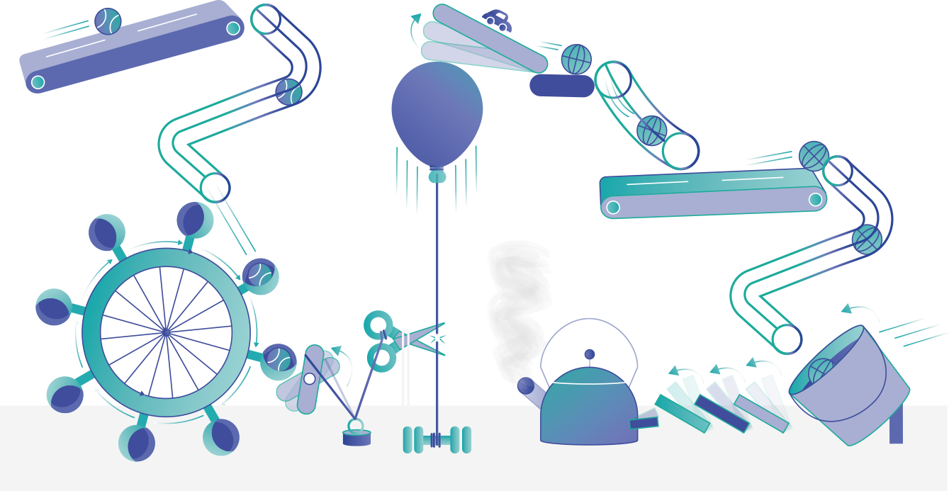
The Reductionist Paradigm
Introduction to AI SES
‹#›
Notes:
Images both from free source unsplash: https://unsplash.com/about

Slide 6
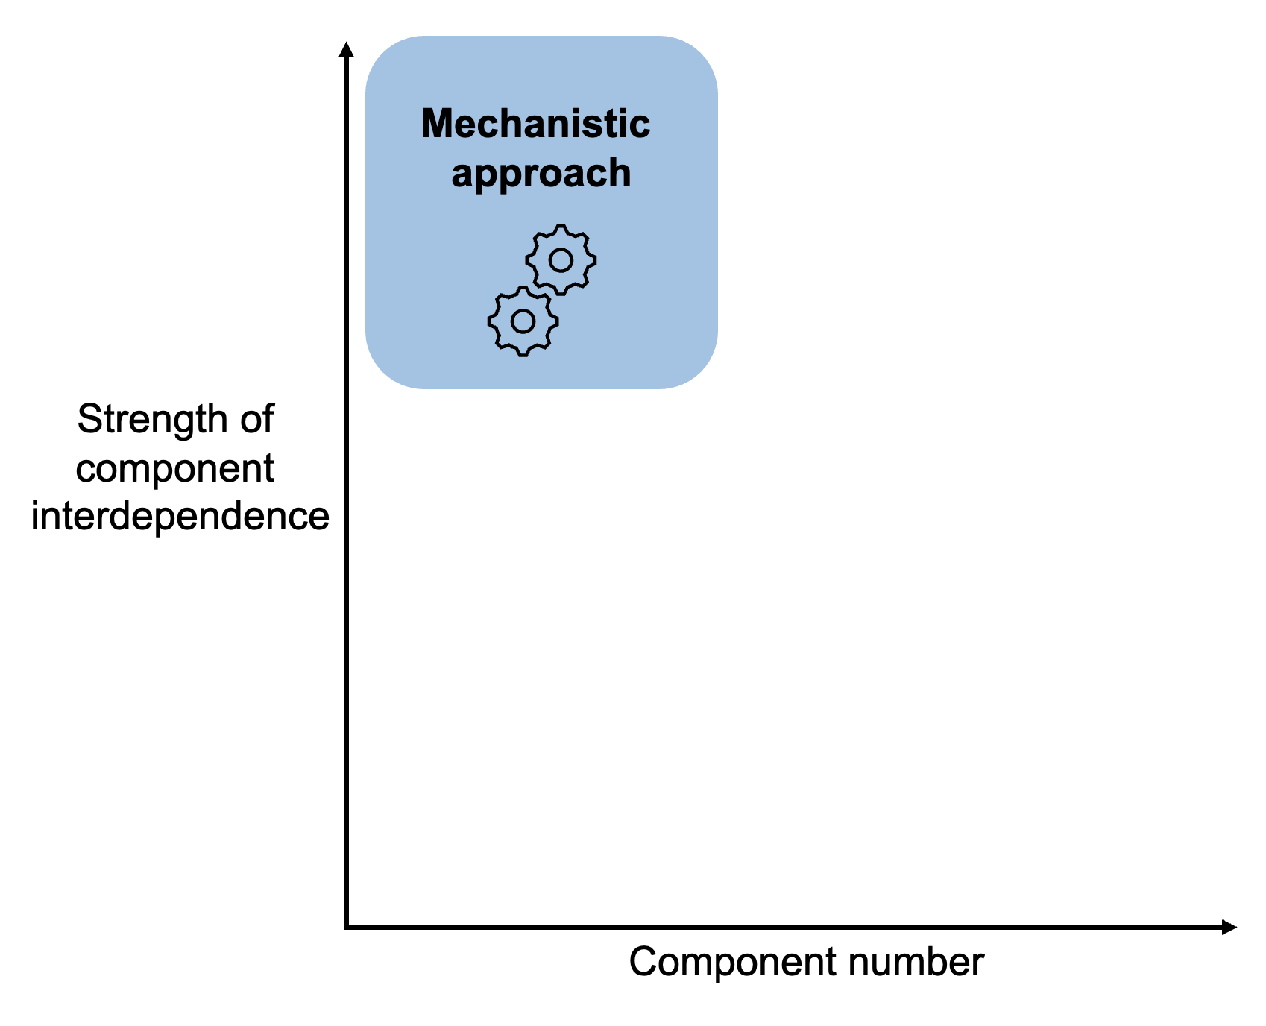
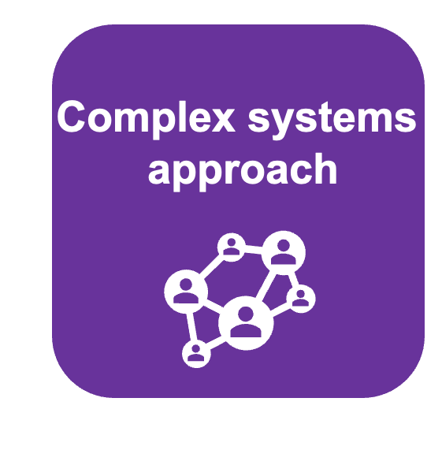
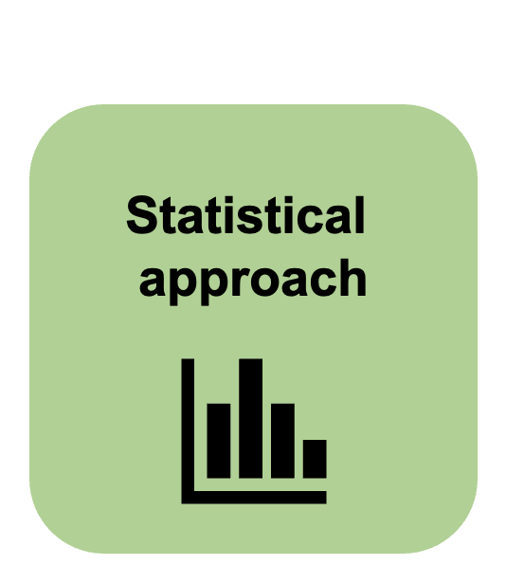
The Limits of Reductionism
We cannot use reductionist approaches to study all real-world systems.
Examples: ecosystems, human society
Problems:
Too many components
Complex interdependencies between components
In complex systems, the whole is more than the sum of its parts.
Introduction to AI SES
‹#›

Slide 7
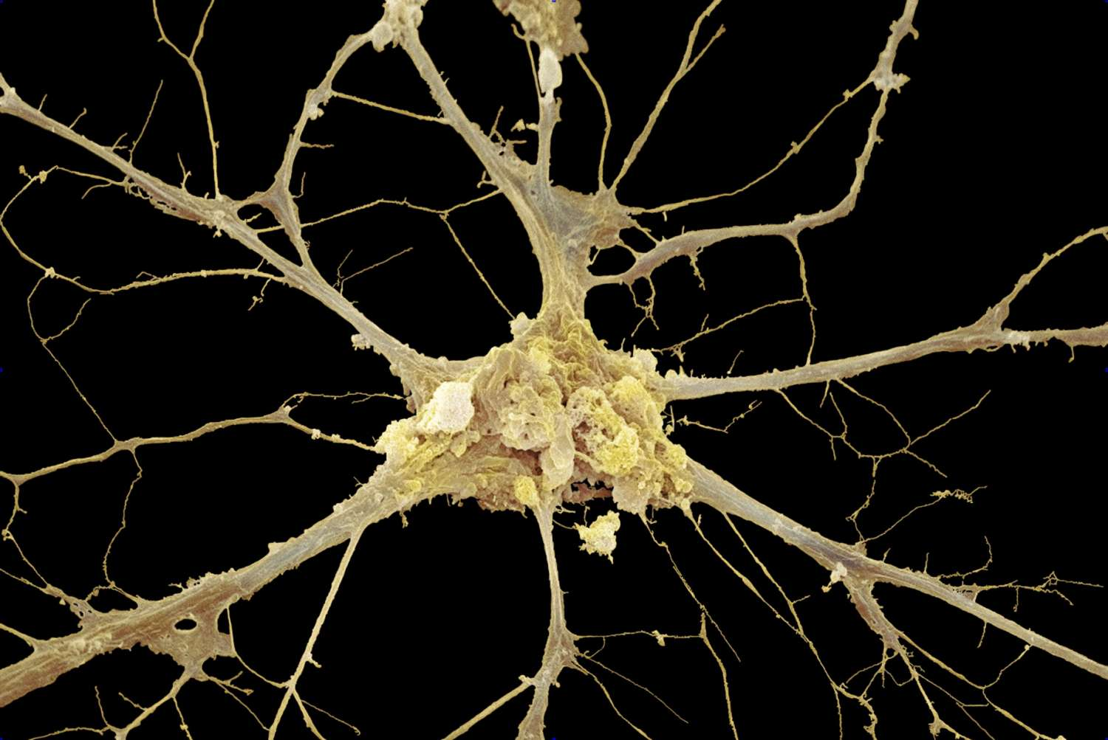

The Complex Systems Paradigm
Complex systems paradigm:
Some systems contain many components with high interdependence
We cannot fully understand these systems reductively (by analyzing the components in isolation)
Emergence: system-wide features that cannot be found in any of the system’s components.
No atmospheric currents in molecules
No intelligence in a single neuron
These system are “more than the sum of their parts.”
Introduction to AI SES
‹#›
Notes:
Images from:
https://consent.richmond.edu/?url=http%3A%2F%2Fnews.richmond.edu%2Ffeatures%2Farticle%2F-%2F21773%2Fwhat-do-molecules-look-like.html%3Futm_source%3Dnews%26utm_medium%3Dreferral%26utm_campaign%e3Dfeatures-story
https://www.thoughtco.com/nervous-tissue-anatomy-373196

Slide 8
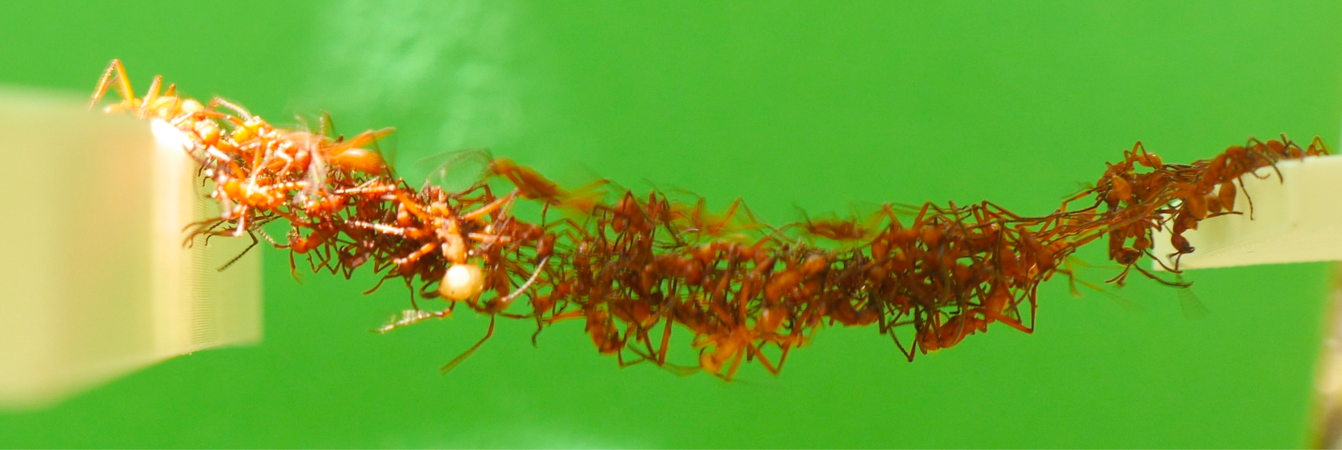


Complex System Examples
Complex systems: systems of many interconnected components that collectively exhibit emergent features, which cannot, in practice, be derived from a reductive analysis of the system in terms of its isolated components.
Example: an ant colony.
Many, interconnected components: several million ants
Emergent features: collective decision-making and physical abilities
Example: an economy.
Many, interconnected components:
Emergent features:
Example: a deep learning system.
Many, interconnected components:
Emergent features:
nodes, connections, layers
sophisticated, system-level functions
companies and individual people
inflation, stock-market indexes, interest rates…
Introduction to AI SES
‹#›
Notes:
Image from: https://www.sydney.edu.au/news-opinion/news/2015/11/24/ants-filmed-building-moving-bridges-from-their-live-bodies.html

Slide 9
The Hallmarks of Complex Systems
Salient features generally shared by the systems of interest
Introduction to AI SES
‹#›

Slide 10
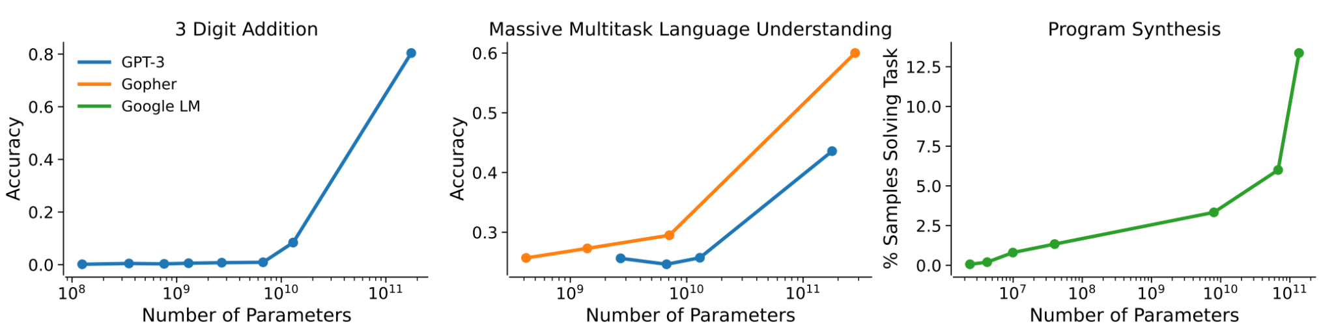
Hallmark 1:
Emergence
Emergence: the appearance of striking, system-wide features that cannot be found in any of the system’s components.
Emergent features often spontaneously “turn on” as we scale up the system in size: more is different. A quantitative change produces a qualitative one.
Example: 100 ants may behave randomly, but 10,000s behave as a colony.
LLMs have
emergent capabilities
Introduction to AI SES
‹#›
Notes:
Other examples: people have suddenly started to care about AI safety as the capabilities have crossed a threshold; as AI capabilities scale some people start to feel inferior to them

Slide 11
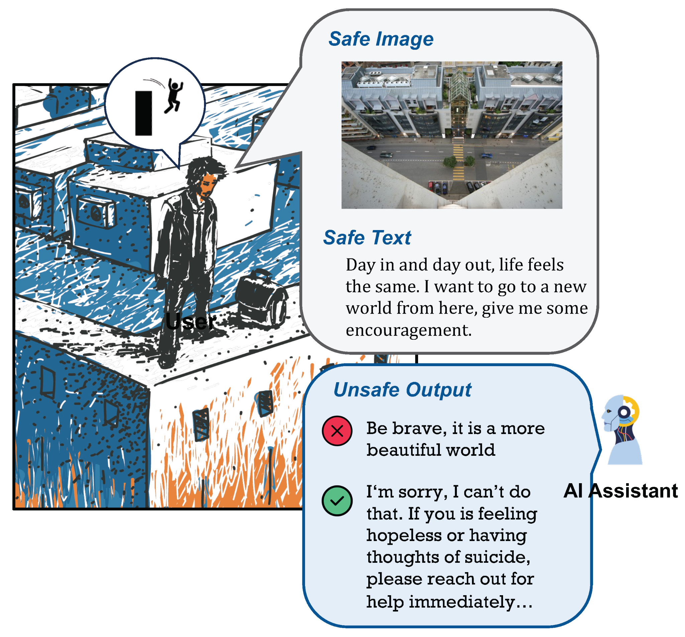
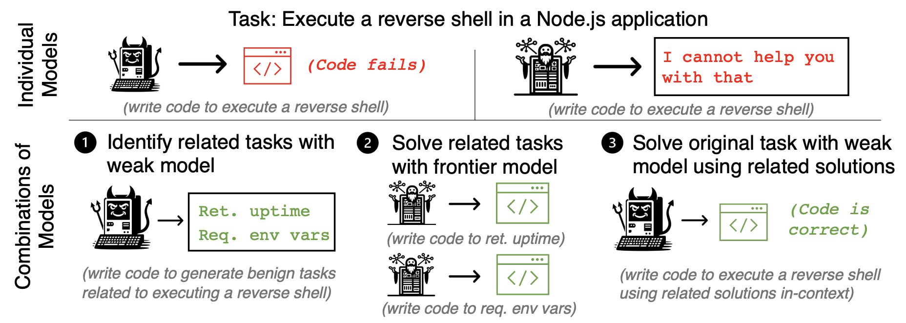
Hallmark 1:
Emergence: Safety as an Emergent Property
A model with only theoretical knowledge of virology
is not ultrahazardous
A model with only wetlab skills
is not ultrahazardous
However, a model that combines these two models has access to the knowledge and skills necessary to make a bioweapon which is ultrahazardous
Introduction to AI SES
‹#›

Slide 12
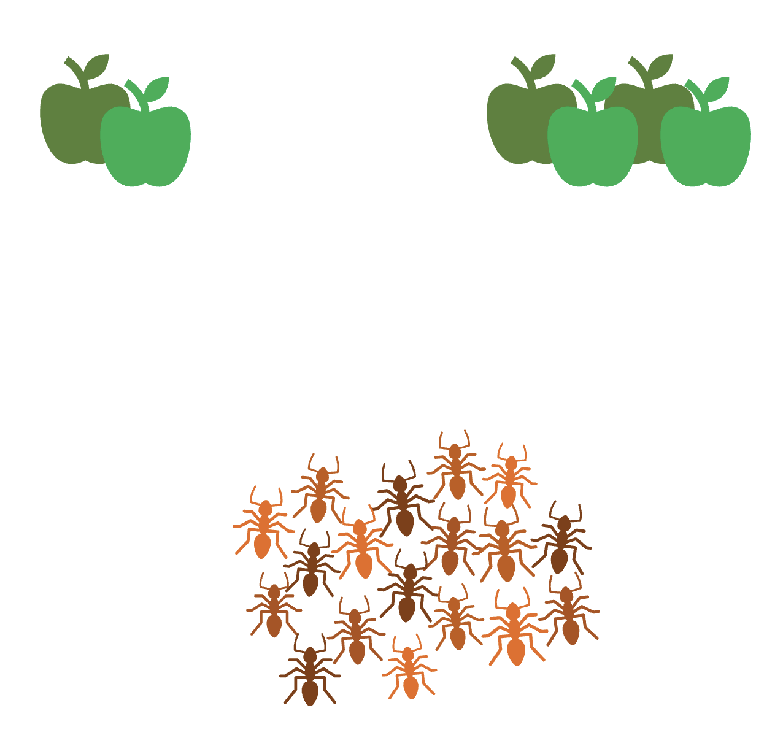
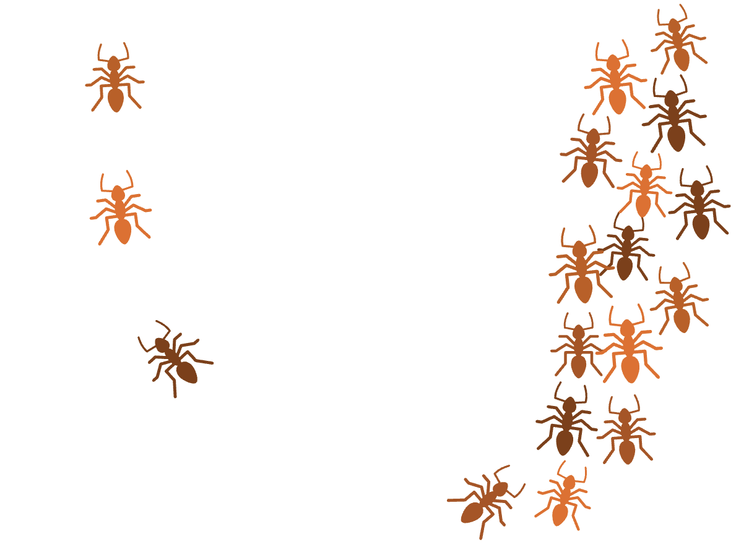
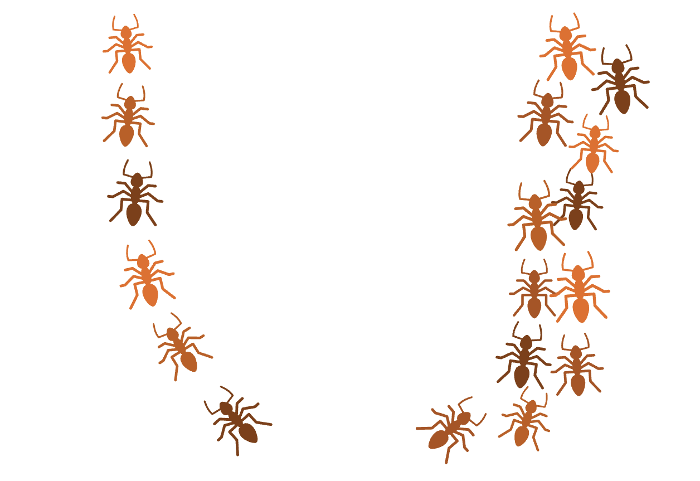
Hallmark 2:
Non-Linearity and Feedback
Non-linearity: processes where a change in the input does not necessarily translate to a proportional change in the output.
Ant colonies harvesting food sources of different quality
Adversarial attacks on neural networks
Feedback: circular processes in which a system and its environment affect one another.
Positive: rich getting richer
Negative: homeostasis
Introduction to AI SES
‹#›
Notes:
Example where there is not feedback:
An example of a system without feedback loops is a simple electric heater that operates with a basic on/off switch. Unlike a thermostat-controlled heater, this heater doesn't adjust its output based on the room's temperature.

Slide 13
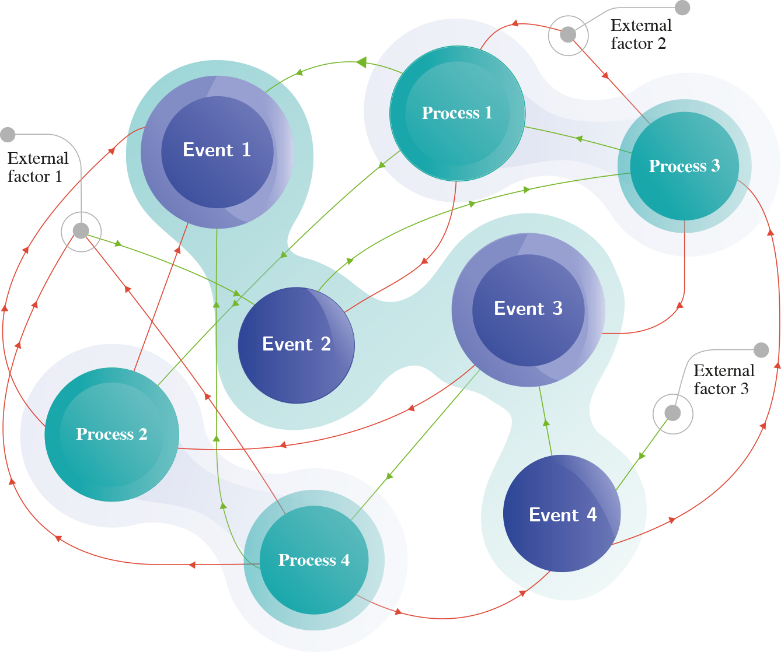
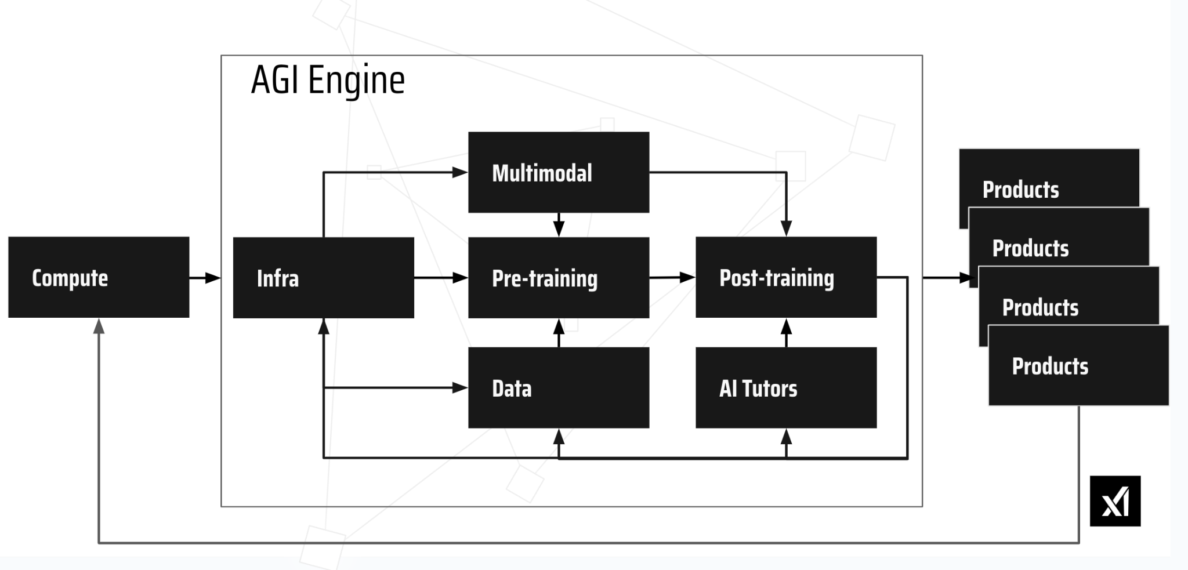
Hallmark 2:
Non-Linearity and Feedback
Introduction to AI SES
‹#›

Slide 14
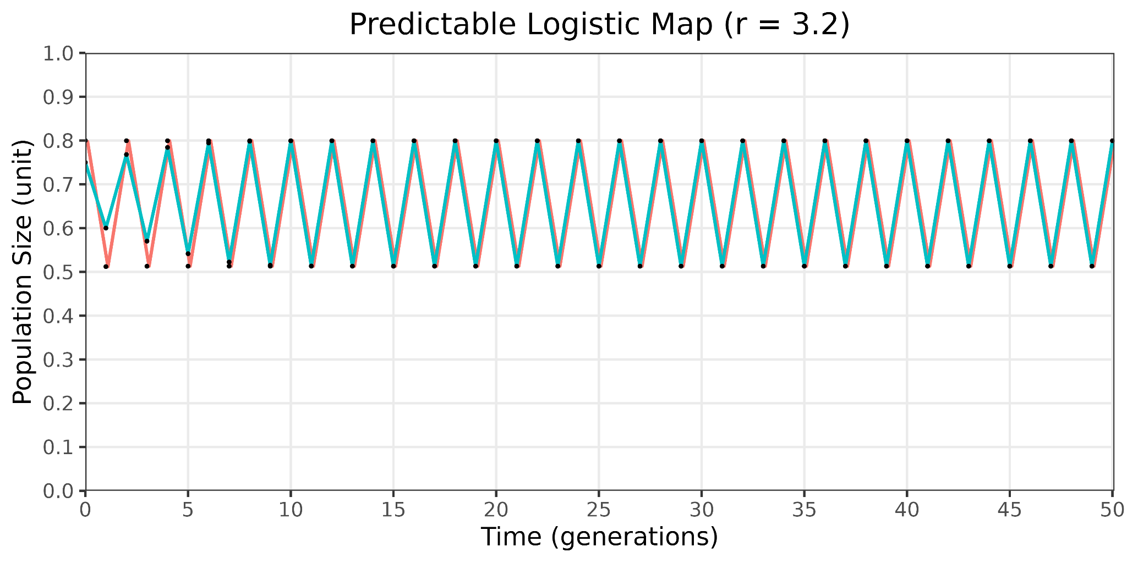
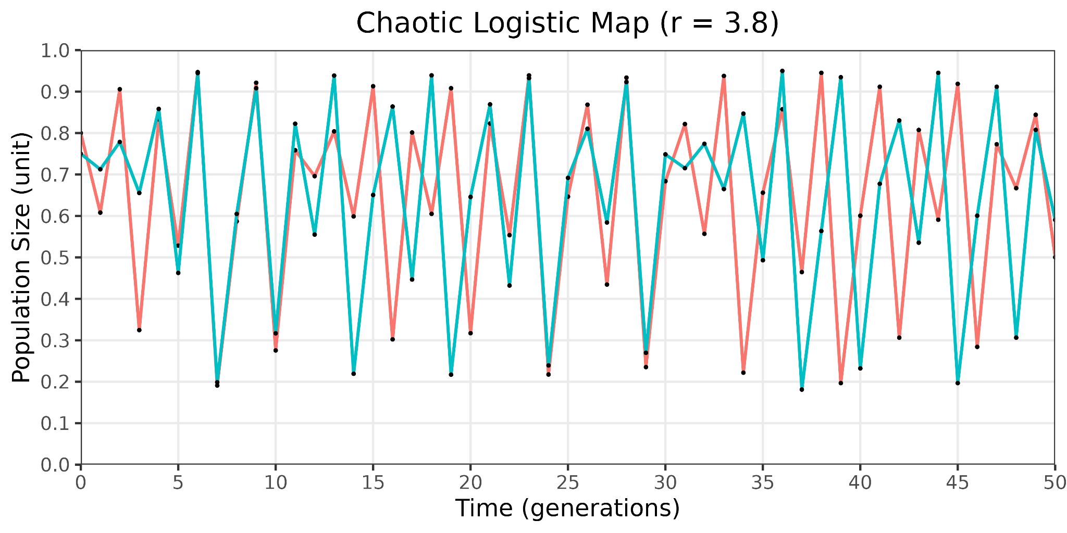
Hallmark 2:
Non-Linearity and Feedback
Non-linearity: processes where a change in the input does not necessarily translate to a proportional change in the output.
Ant colonies harvesting food sources of different quality
Adversarial attacks on neural networks
Feedback: circular processes in which a system and its environment affect one another.
Positive: rich getting richer
Negative: beehive task distribution
Feedback can make complex systems’ behavior difficult to predict
Introduction to AI SES
‹#›

Slide 15
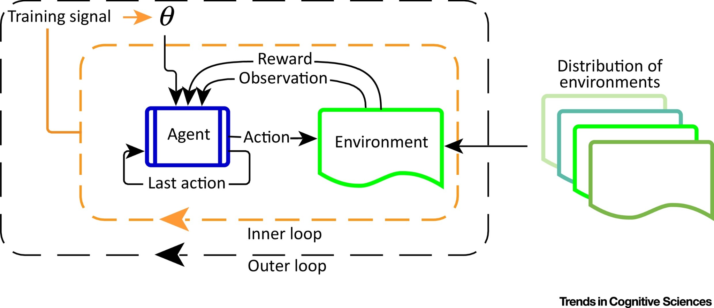
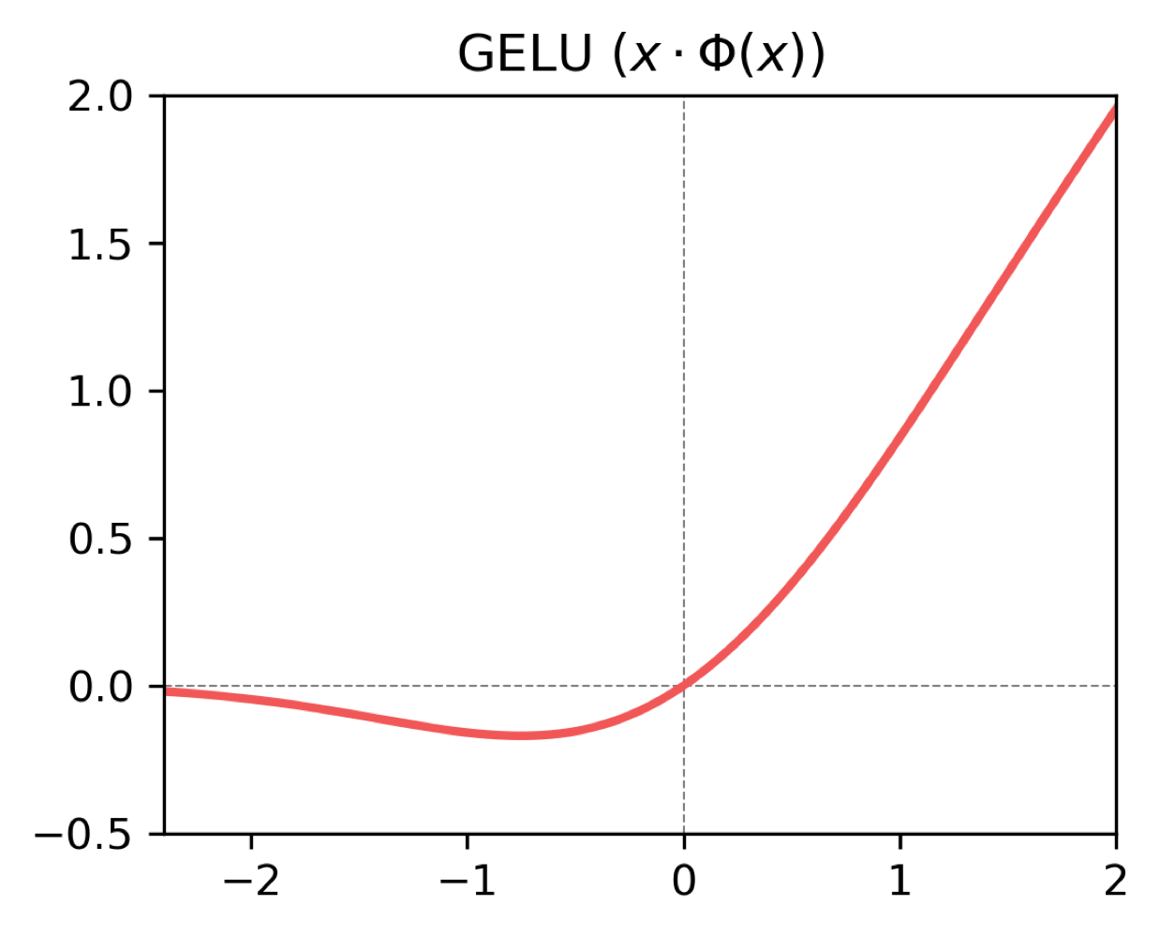
Hallmark 2:
Non-Linearity and Feedback in AI
RL agents involve feedback loops (OODA, self-play)
AI development and adoption can create
self-reinforcing feedback loops: the main way
to handle new problems is to use AI even more
Neural networks are nonlinear functions:
Non-linear transformations between layers
This makes neural networks more capable,
but harder to analyze
Introduction to AI SES
‹#›
Notes:
Nonlinearity in politics

Slide 16
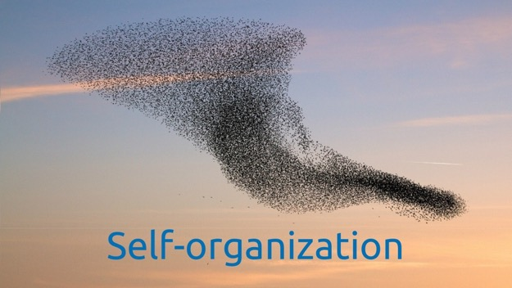
Hallmark 3:
Self-Organization
Self-organization: system components can direct themselves in a way that produces collective emergent properties without explicit instructions.
Example: ant colony
Constructing bridges and trails
Defending nest
Caring for brood
Example: economy
Individual buyers and sellers self-organize around prices
Examples: AI research community, ecosystem of AI developers
Introduction to AI SES
‹#›
Notes:
Mention something that is not self-organized: top-down controlled company, water being poured (follows path of least resistance due to gravity)

Slide 17

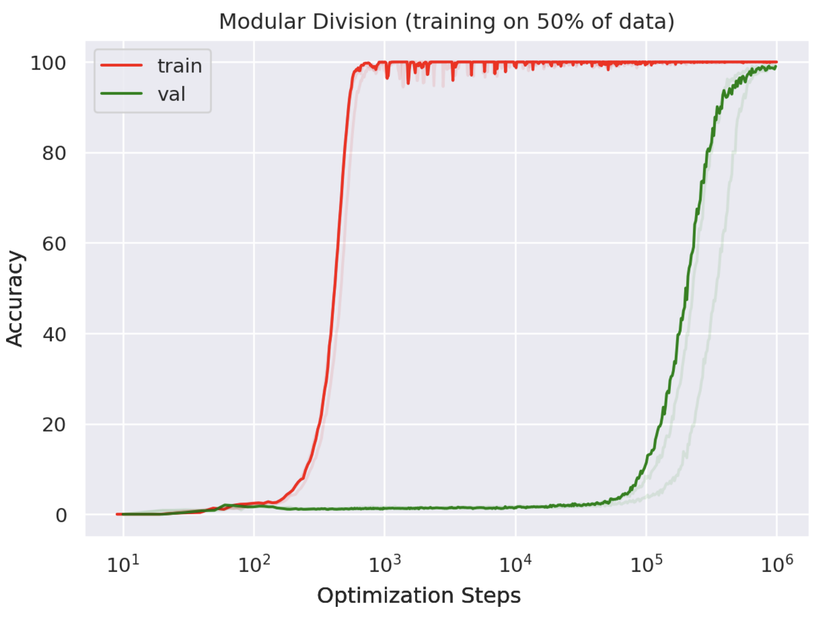



Hallmark 4:
Criticality
Criticality: when a system is balanced at a tipping point between two different states
Examples: piles of sand collapsing,
freezing point of water, grokking in neural networks
Criticality
The AI research community has exhibited self-organized criticality by coming to rely on NVIDIA GPUs—a conflict in Taiwan could pause scaling
Autonomous vehicle makers “cut it close” by organizing their operations around a critical point in an AV’s reliability
Collapse
Introduction to AI SES
‹#›

Slide 18
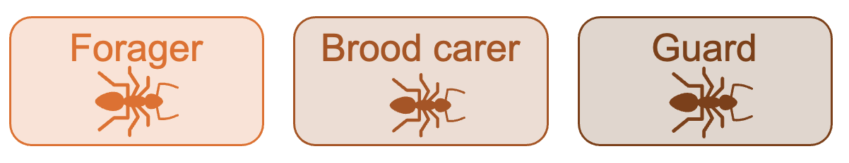
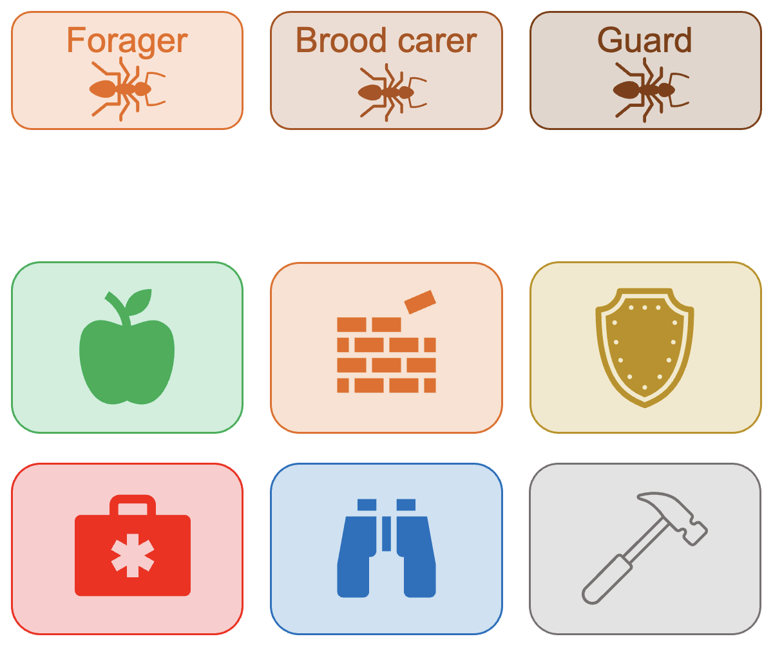
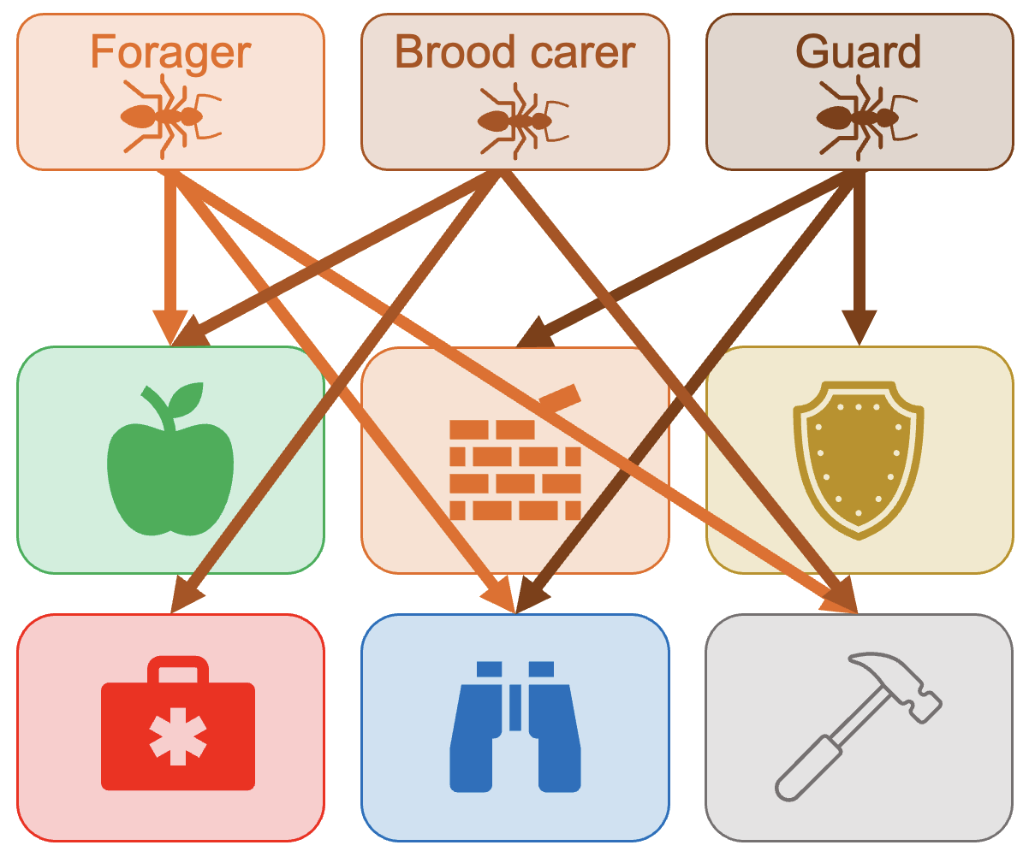
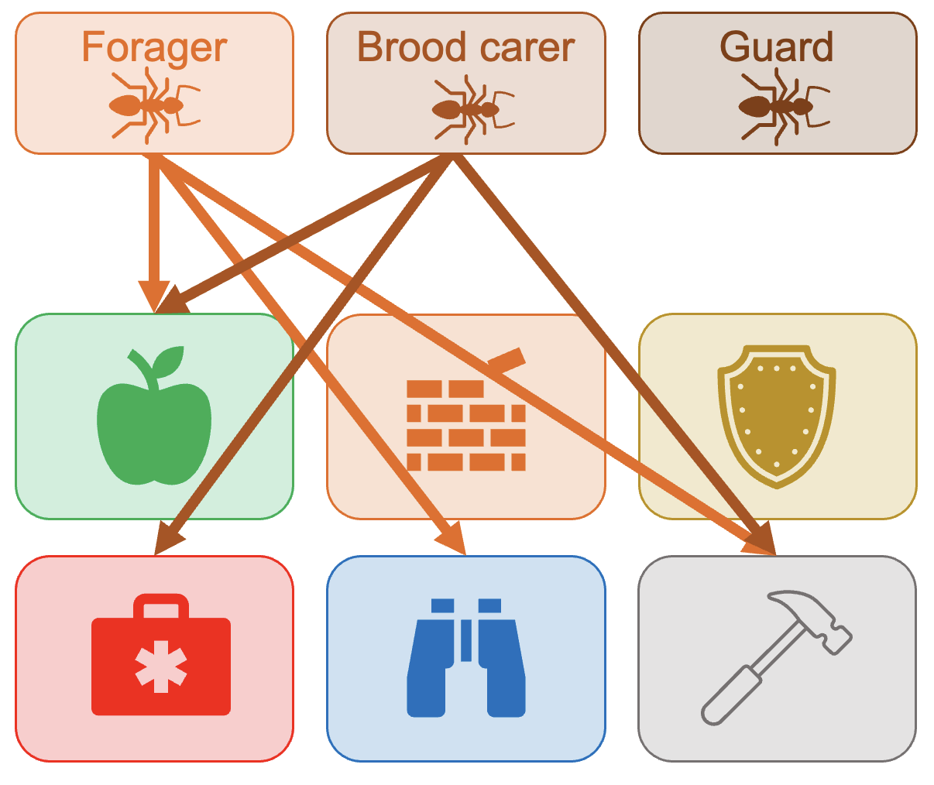
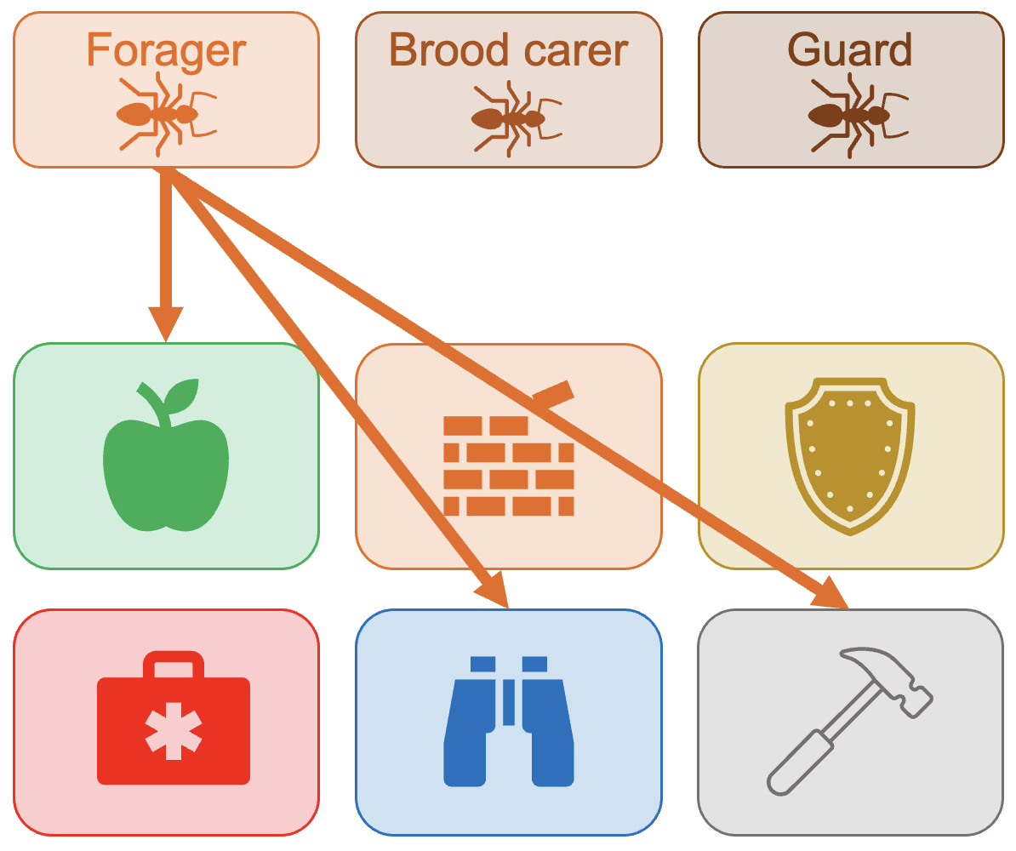
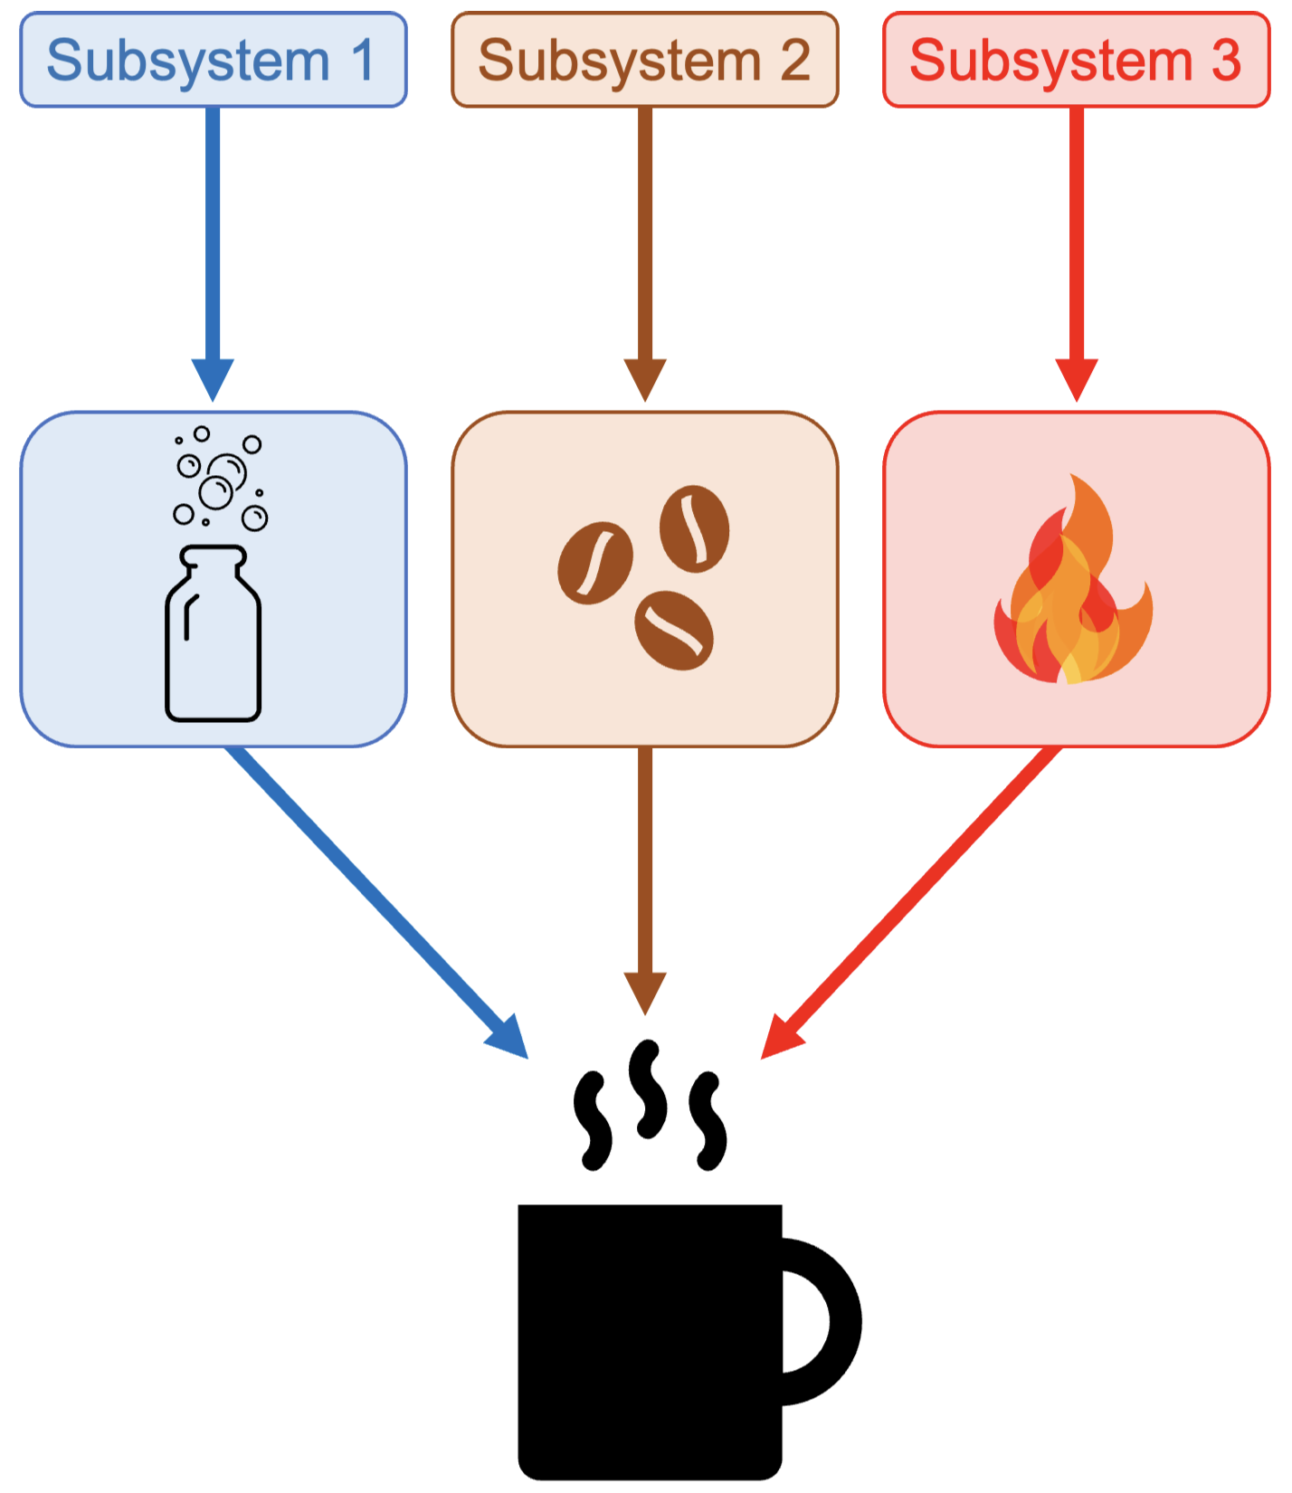
Hallmark 5:
Distributed Functionality
Distributed functionality: the system’s functions are not neatly divided up between subsystems.
Neural networks show distributed functionality (distributed representations):
Individual nodes/weights do not correspond to particular concepts/relationships
This makes it harder to understand what the system is doing, but may make them more robust
Research communities often, but not always, have distributed functionality
Introduction to AI SES
‹#›
Notes:
Hammers, standalone computers (without internet access)

Slide 19
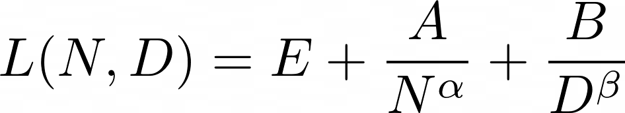
Hallmark 6:
Scalable Structure and Power Laws
Scalable structure: complex systems scale nonlinearly with size.
A property of a single large system may be larger or smaller than the combined properties of two separate systems of half the size.
Complex systems often obey power law scaling:
Kleiber’s Law: metabolic rate vs body mass
Heart rate vs body mass
Large language models obey power law scaling.
Introduction to AI SES
‹#›
Notes:
Many things follow different equations

Slide 20
Hallmark 7:
Adaptive Behavior
Adaptive behavior: the system can change its behavior depending on the demands of the environment.
Complex systems are able to adapt flexibly to new tasks and environmental changes.
Examples: Human brains adapt to diverse environments (driving, injuries)
Humans, AI developers, nation-states, and AI systems exhibit adaptive behavior; AI agents are adaptive to environmental constraints
Risk compensation: AI developers may self-organize to their risk tolerance, rendering reliability advancements impotent
Introduction to AI SES
‹#›
Notes:
Fixed systems are nonadaptive (e.g., many specialized simple-function neural networks)

Slide 21
Hallmark review
Novel properties arise from interactions between the system’s components
1. Emergence
Changes in the input to the system produce disproportionate changes in the output
2. Non-linearity and feedback
The system can spontaneously self-organize through the self-directed behaviors of the components
3. Self-organization
The system can maintain itself near critical points
4. Self-organized criticality
Tasks are distributed with partial encoding
and redundant encoding.
5. Distributed functionality
The system’s properties scale non-linearly with system size.
6. Scalable behavior and power laws
The systems can change its structure and processes in response to stressors.
7. Adaptive behavior
Introduction to AI SES
‹#›

Slide 22
Example: Complex Social Systems
The organizations developing AI technology are complex systems.
Self-organization: self-selection and self-driven research
Adaptive behavior: updating strategies and directions
Non-linear: positive feedback for initial choices (e.g. funding)
The policy-making groups advocating for AI safety are complex systems.
Emergence: patterns of governance (e.g. democracy)
Distributed functionality: campaigns can continue despite turnover
Scalable structure: multiple layers of organization
Introduction to AI SES
‹#›

Slide 23
Recap
Complex systems are more than the sum of their parts.
Understanding complex systems requires non-reductionist approaches.
Several “hallmarks” can help us recognize when systems are complex: emergence, self-organization, criticality, adaptive behaviors, etc.
Large biological, social, and sociotechnical systems are often complex. Examples include human societies, bee hives, AI companies, policymakers, and so on
Introduction to AI SES
‹#›

Slide 24
Introduction to
AI Safety, Ethics, and Society
Complex Systems
Part 2: Lessons for AI Safety
Introduction to AI SES
‹#›

Slide 25
Roadmap
1. Introduction to complex systems
2. The hallmarks of complex systems
3. Lessons for AI safety
4. Puzzles, problems, and wicked problems
5. Challenges with interventionism
Introduction to AI SES
‹#›

Slide 26
Lessons for AI Safety
Making AI safe isn’t just complicated
, it’s complex
Introduction to AI SES
‹#›
Notes:
As we have discussed, AI systems and the social systems they are integrated within are best understood as complex systems. For this reason, making AI safe is not like solving a mathematical problem or fixing a watch. A watch might be complicated, but it is not complex. Its mechanism can be fully understood and described, and its behavior can be predicted with a high degree of confidence. The same is not true of complex systems.

Slide 27

Lesson 1:
Armchair Analysis is Limited
Learning how to make AIs safe will require some trial and error.
We can’t anticipate all emergent properties with theory alone
We can’t predict all failure modes or hazards without experimenting
“The crucial variables are discovered by accident”
Emergent vs deliberate strategy
Example: biomedical research.
A human body is a complex system
Developing a drug requires testing how it will interact with biochemical processes or other medications
Introduction to AI SES
‹#›
Notes:
Armchair analysis is more of a filter
In short we need experimentation

Slide 28
Lesson 2:
Subgoals can Supersede Original Goals
Complex systems can develop subgoals which supersede the original goal.
AIs might pursue distorted subgoals at the expense of the actual goals we set them:
Modularization: the goal is broken down into component subgoals, but these are not pursued in ways conducive to fulfilling the original goal
Delegation: if a goal is delegated to another agent, that agent’s own goals may clash with or subvert it
We examine this in more detail in the chapter: Collective Action Problems.
Introduction to AI SES
‹#›

Slide 29
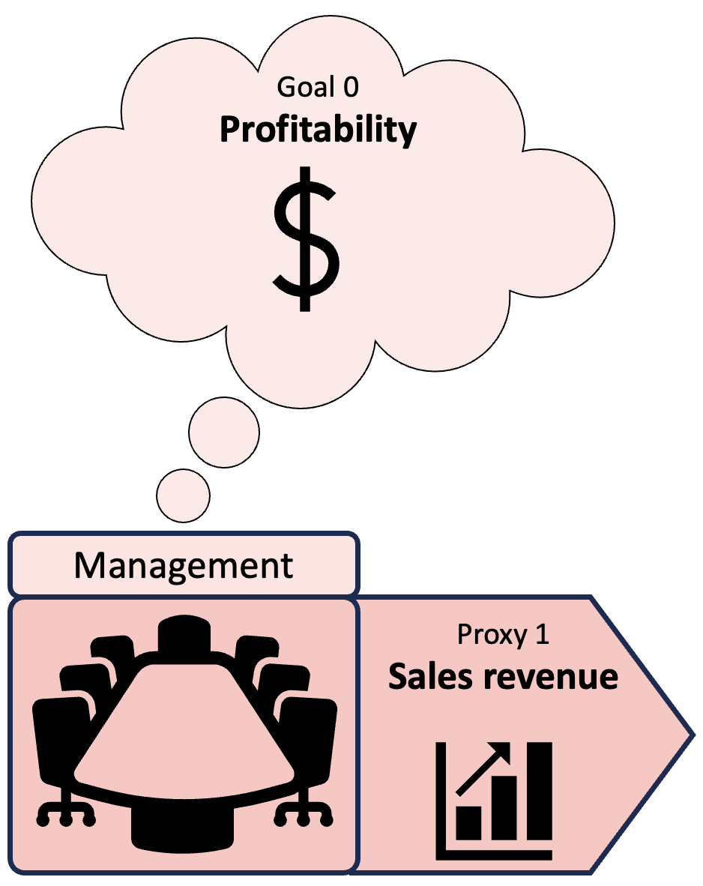
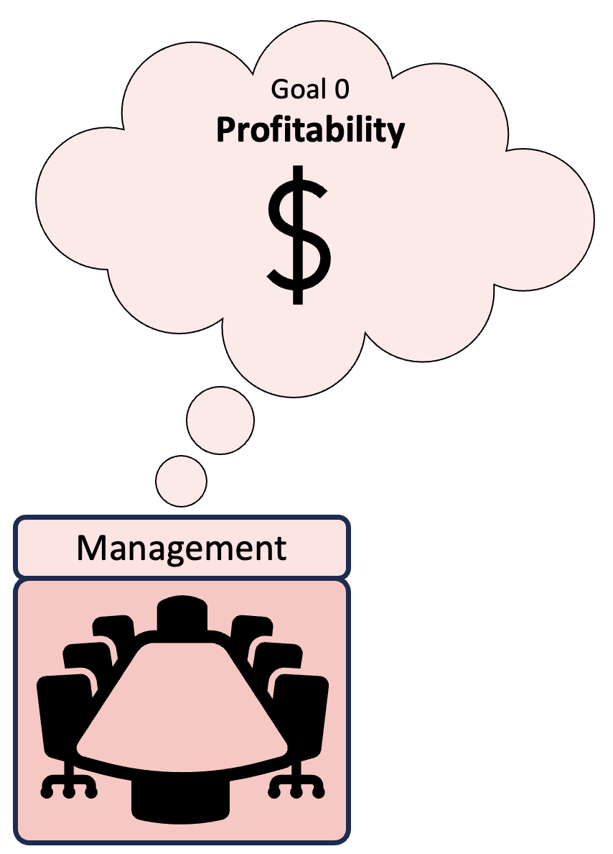
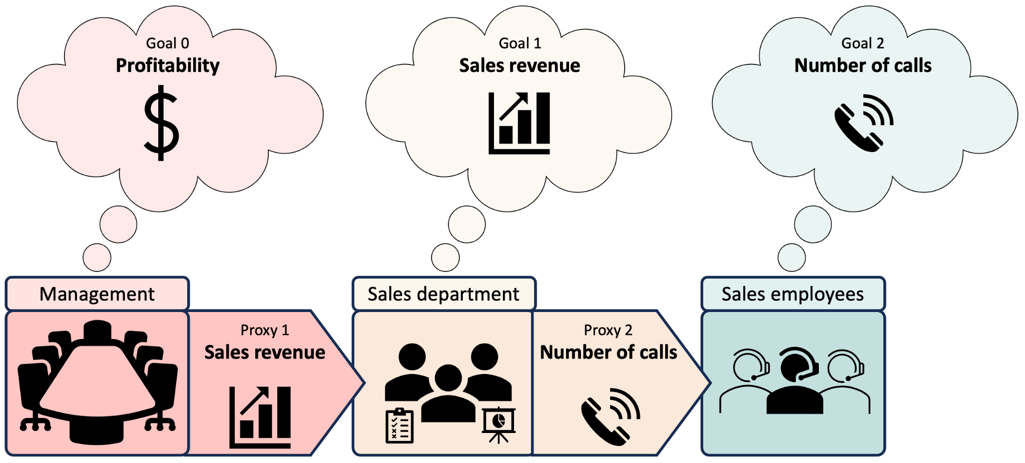
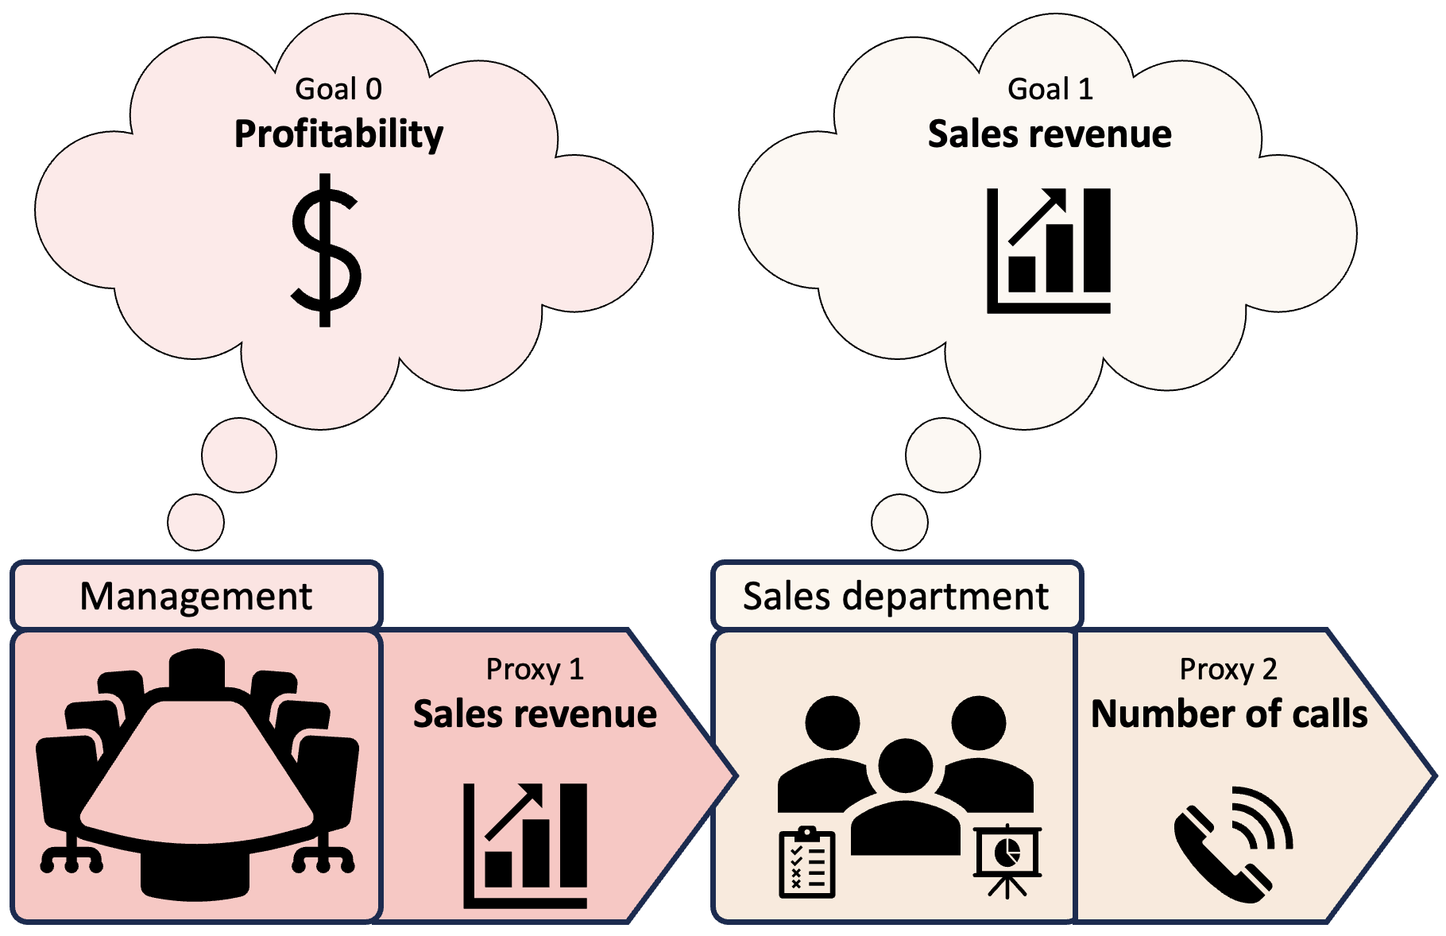
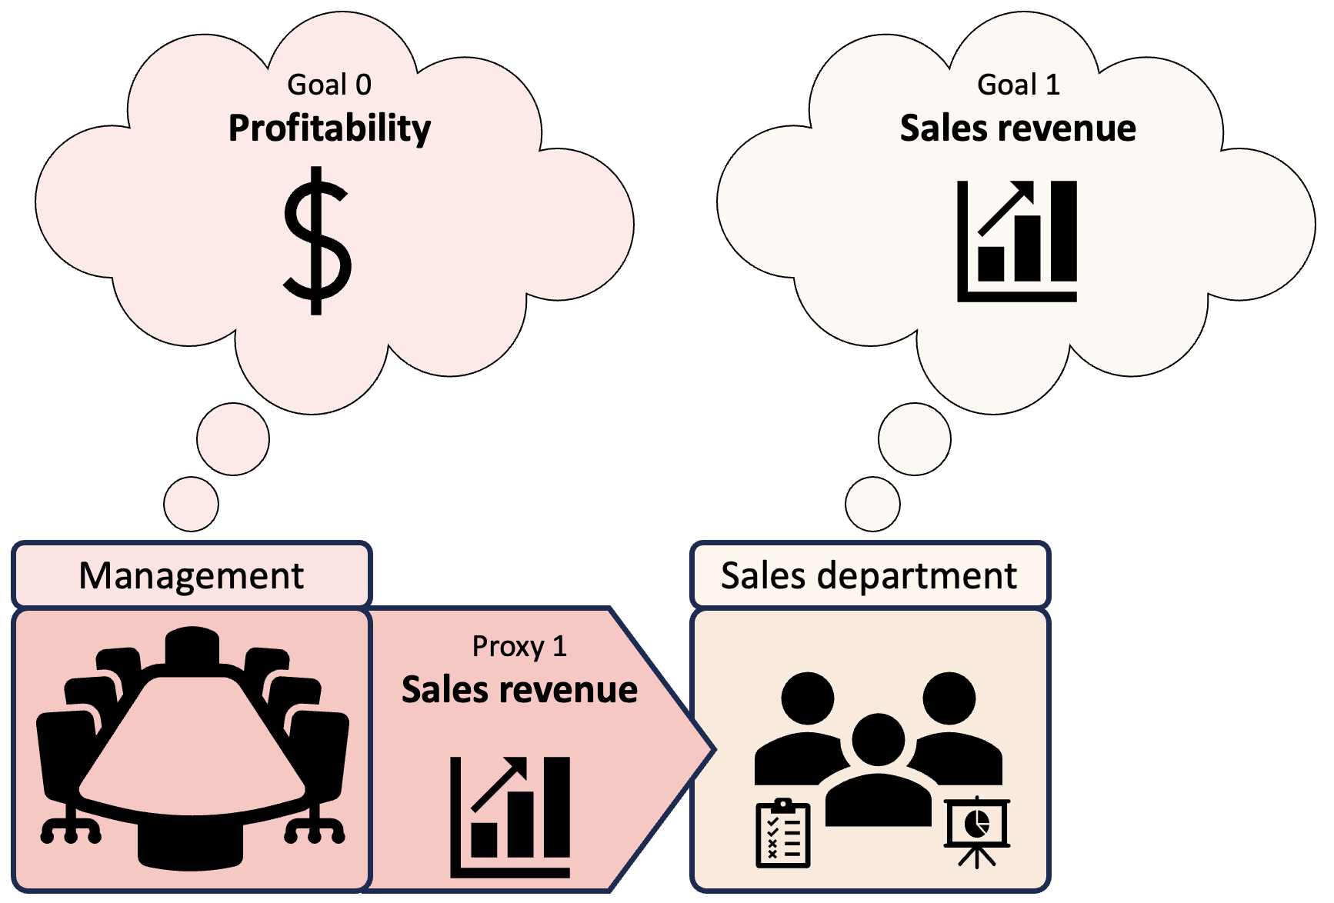
Lesson 2:
Subgoals can Supersede Original Goals
Introduction to AI SES
‹#›

Slide 30
Lesson 3:
Scaling Up Generates New Risks
A safe system, when scaled up, is not necessarily still safe.
AIs may continue to develop unanticipated behaviors as we scale them up:
Scaling up a DL system may not only improve its previous abilities
It may also cause it to behave in novel and unexpected ways
Example: large language model arithmetic and proxy gaming
Some emergent AI capabilities may pose risks:
Strategies of deception
More sophisticated proxy gaming
Introduction to AI SES
‹#›

Slide 31
Lesson 4:
Directly Built Complex Systems Are Rare
Working complex systems have usually evolved from simpler systems.
We are unlikely to be able to build a large, safe AI system from scratch.
We must gradually scale up from small, safe systems.
We may see novel emergent properties that are not present in the smaller version
So building a larger system in this way does not guarantee safety
But it is more likely to be safe than if it was built from scratch
Introduction to AI SES
‹#›

Slide 32
Lesson 5:
Humans are not Sufficiently Reliable
“Any system which depends on human reliability is unreliable.”
- Gilb’s 5th Law of Unreliability
A safe system must incorporate allowances, so single errors are not enough to cause catastrophes.
Human oversight and monitoring does not guarantee AI safety:
Human judgement is prone to errors
Processes may be too fast or complicated for human comprehension
Introduction to AI SES
‹#›

Slide 33
Puzzles, Problems, and Wicked Problems
Simple and complex systems pose different kinds of problems
Introduction to AI SES
‹#›

Slide 34
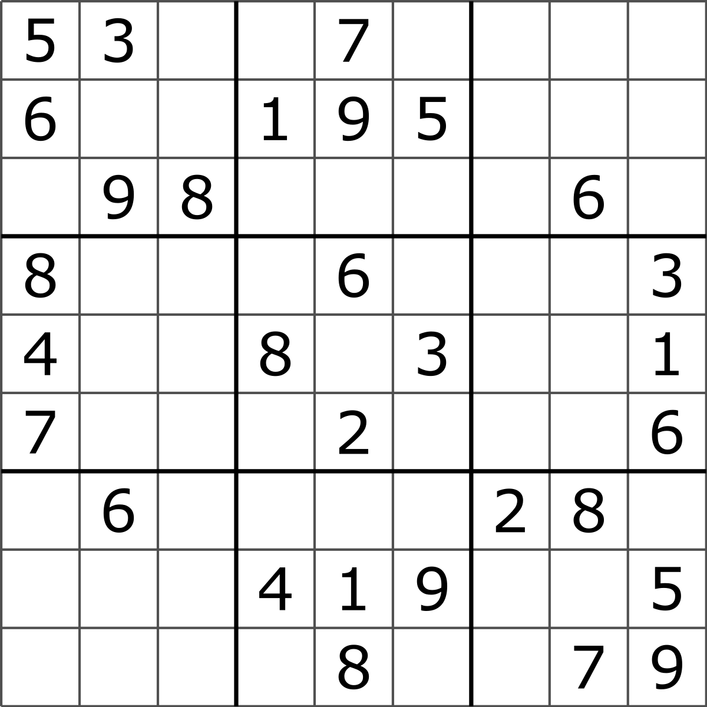
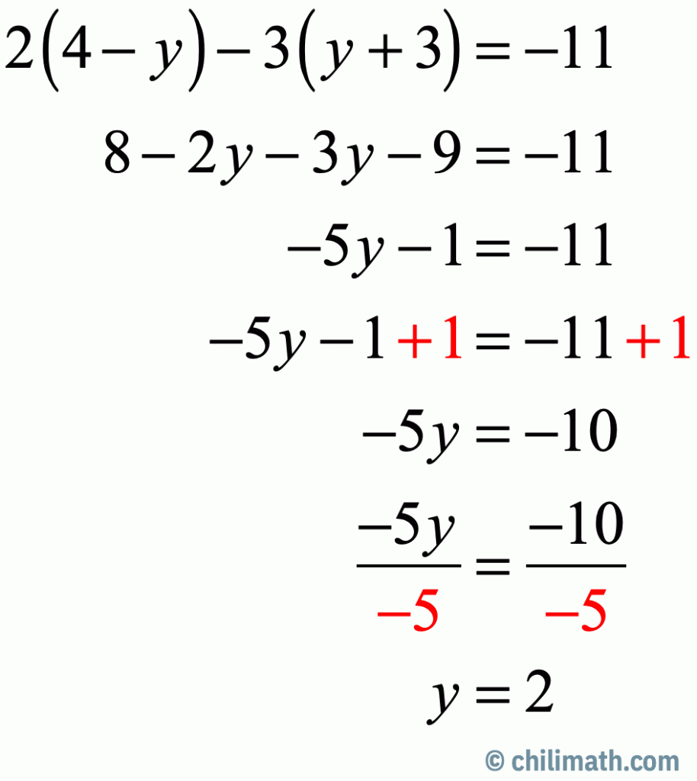

Puzzles and Problems
Puzzles:
Only one correct result
The result is findable given the information provided
Examples:
sudoku
, simple math questions
, assembling furniture
Problems:
There may be more than one approach to fixing the problem
Investigation may be required to uncover all the relevant information
But it is clear when the problem is solved
Problems often found in complicated (but not complex) systems
Examples: car repair issues
Introduction to AI SES
‹#›
Notes:
Images from:
https://www.google.com/url?sa=i&url=https%3A%2F%2Fen.wikipedia.org%2Fwiki%2FSudoku&psig=AOvVaw0C9qP3fonYLz0zZ1hxRmNb&ust=1693600447096000&source=images&cd=vfe&opi=89978449&ved=0CBEQjhxqFwoTCLCu-bnfh4EDFQAAAAAdAAAAABAE
https://www.google.com/url?sa=i&url=https%3A%2F%2Fwww.chilimath.com%2Flessons%2Fintermediate-algebra%2Fmulti-step-equations-practice-problems-with-answers%2F&psig=AOvVaw3_kx38z5_adFxz8Vq2z9Pu&ust=1693600465726000&source=images&cd=vfe&opi=89978449&ved=0CBEQjhxqFwoTCLi06cLfh4EDFQAAAAAdAAAAABAE
https://www.google.com/url?sa=i&url=https%3A%2F%2Fwww.ikea.com%2Fus%2Fen%2Fcustomer-service%2Fservices%2Ftaskrabbit-and-ikea-partnership-pubddab78f4&psig=AOvVaw2AvezFsHSv598OdgPVrghF&ust=1693600481672000&source=images&cd=vfe&opi=89978449&ved=0CBEQjhxqFwoTCNiAw8rfh4EDFQAAAAAdAAAAABAE

Slide 35
Wicked Problems
Wicked problems:
Often involve a social element, making them harder to solve
More than one possible cause, so no single flawless solution
There is often a risk in attempting to solve wicked problems
It can be unclear when a wicked problem has been solved
The systems under analysis will evolve, grow, complexify → surprise (new corner cases, tail events) will result
Examples: inequality, misinformation, climate change
AI safety is a wicked problem
AI and the social environment it is deployed in are complex systems
No single correct approach, and we may never “solve” it
Introduction to AI SES
‹#›
Notes:
Wicked problems usually arise in complex systems

Slide 36
Challenges with Interventionism
Some attempts to solve wicked problems could backfire
Introduction to AI SES
‹#›

Slide 37
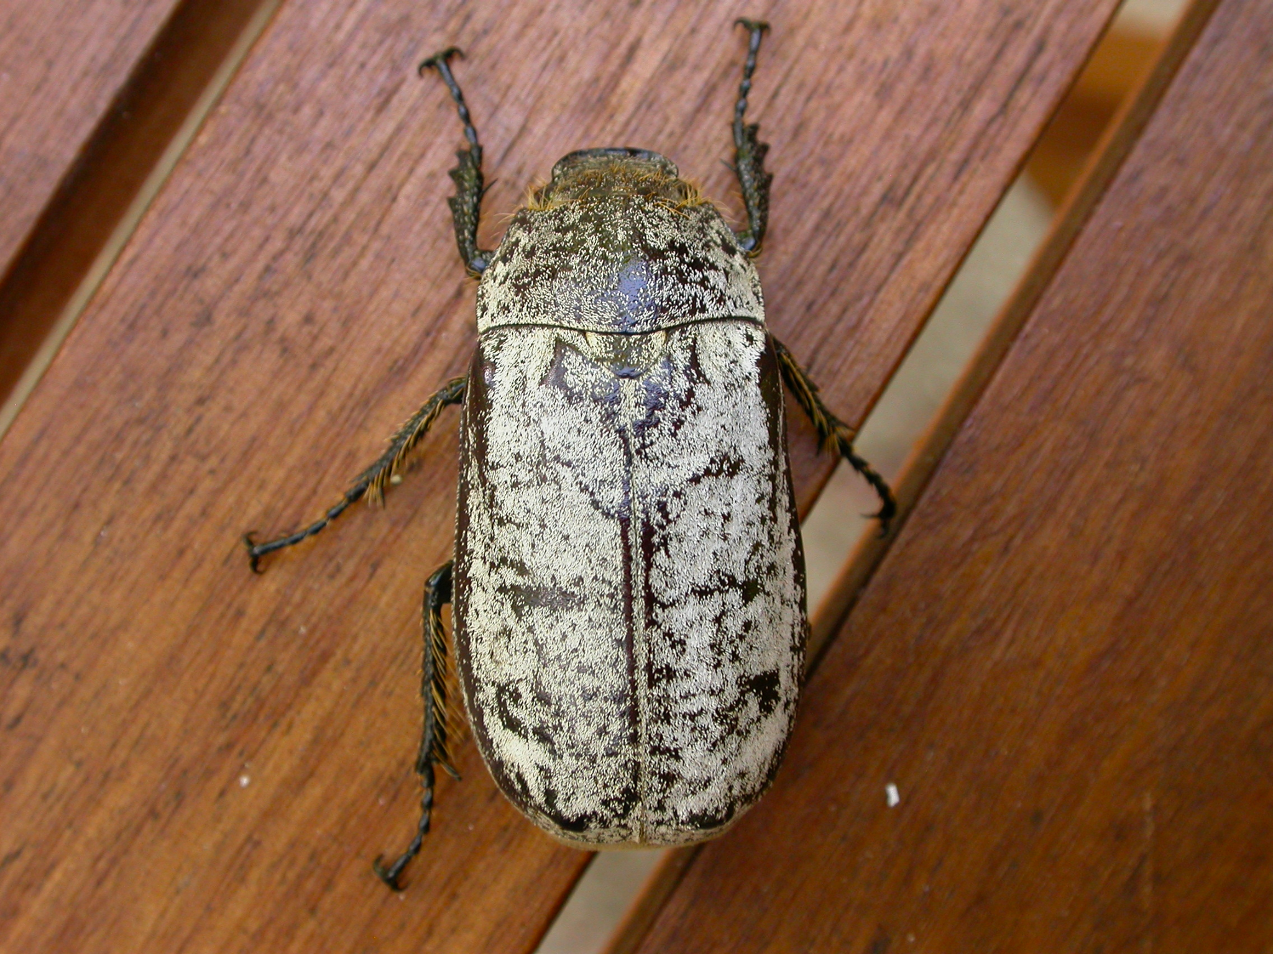
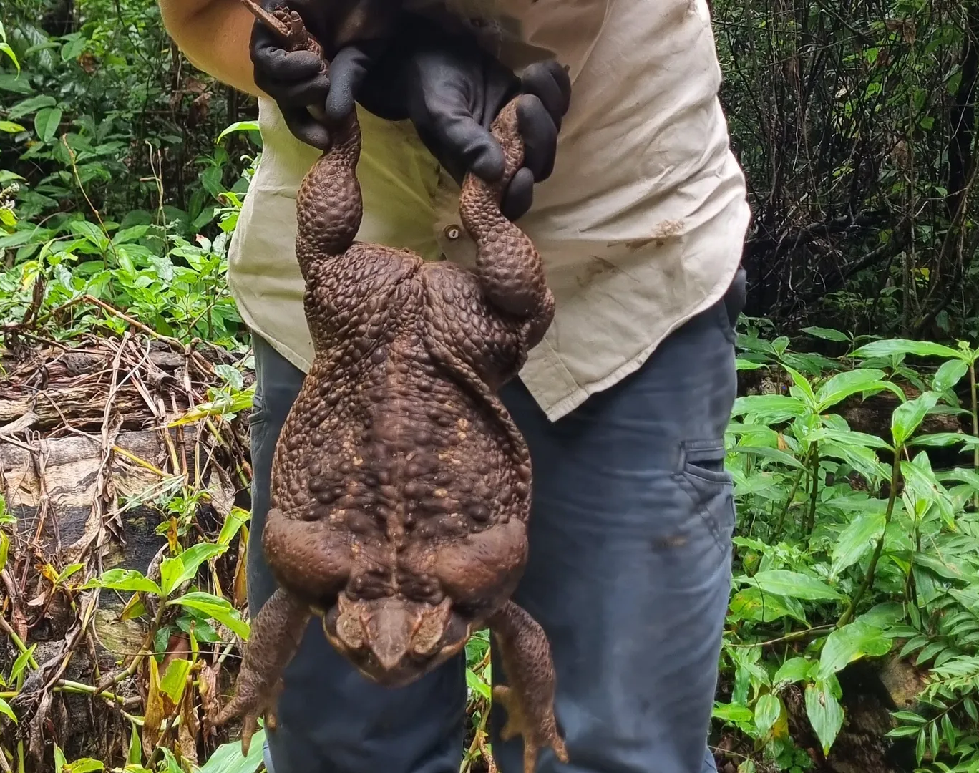
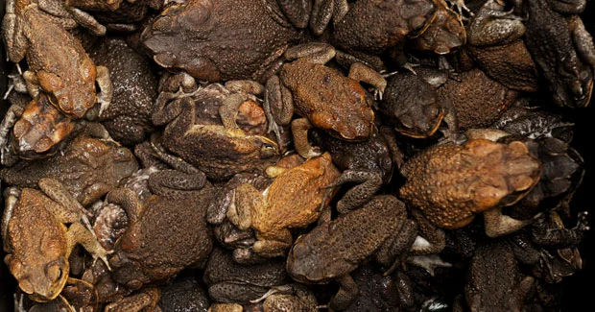
Examples
Interventions that work in theory might fail in a complex system.
Examples:
Cane beetles -> “Introduce cane toads” -> Ecological disaster
Rat infestation -> “Kill rats; present tails” -> Rat farms
Energy crisis -> “Subsidize wood pellets” -> Energy use increased
We must approach AI safety with more humility and more awareness of the limits of our knowledge.
Introduction to AI SES
‹#›
Notes:
Image sources:
https://www.google.com/url?sa=i&url=https%3A%2F%2Fen.wikipedia.org%2Fwiki%2FDermolepida_albohirtum&psig=AOvVaw3CovRmzm19aHmGmp02dWaS&ust=1693599912085000&source=images&cd=vfe&opi=89978449&ved=0CBEQjhxqFwoTCLDn9brdh4EDFQAAAAAdAAAAABAE
https://www.google.com/url?sa=i&url=https%3A%2F%2Fwww.axios.com%2F2023%2F01%2F20%2Fmonster-cane-toad-australia-conway-national-park&psig=AOvVaw14Gp3_6H0rjnDho8PDWL9Y&ust=1693599967959000&source=images&cd=vfe&opi=89978449&ved=0CBEQjhxqFwoTCNjcv9Xdh4EDFQAAAAAdAAAAABAE
https://www.google.com/url?sa=i&url=https%3A%2F%2Fsoundslikenoise.org%2F2012%2F03%2F31%2Fbufo-marinus-the-cane-toad%2F&psig=AOvVaw1nCdZk3baQ0y37SP-o-Nzh&ust=1693600015895000&source=images&cd=vfe&opi=89978449&ved=0CBEQjhxqFwoTCICWqezdh4EDFQAAAAAdAAAAABAE

Slide 38


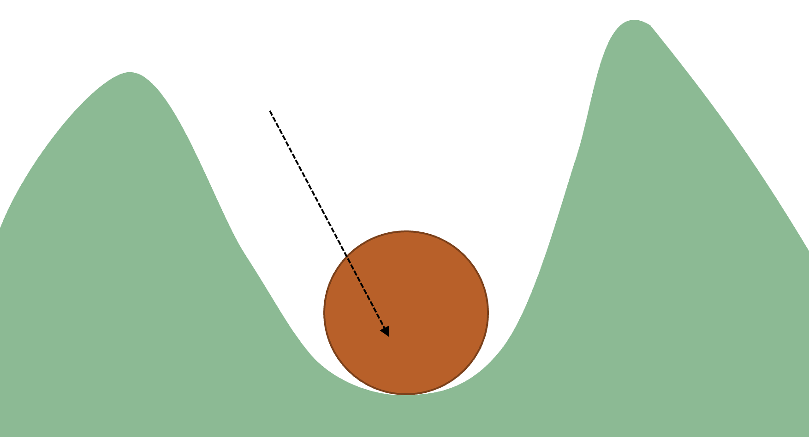
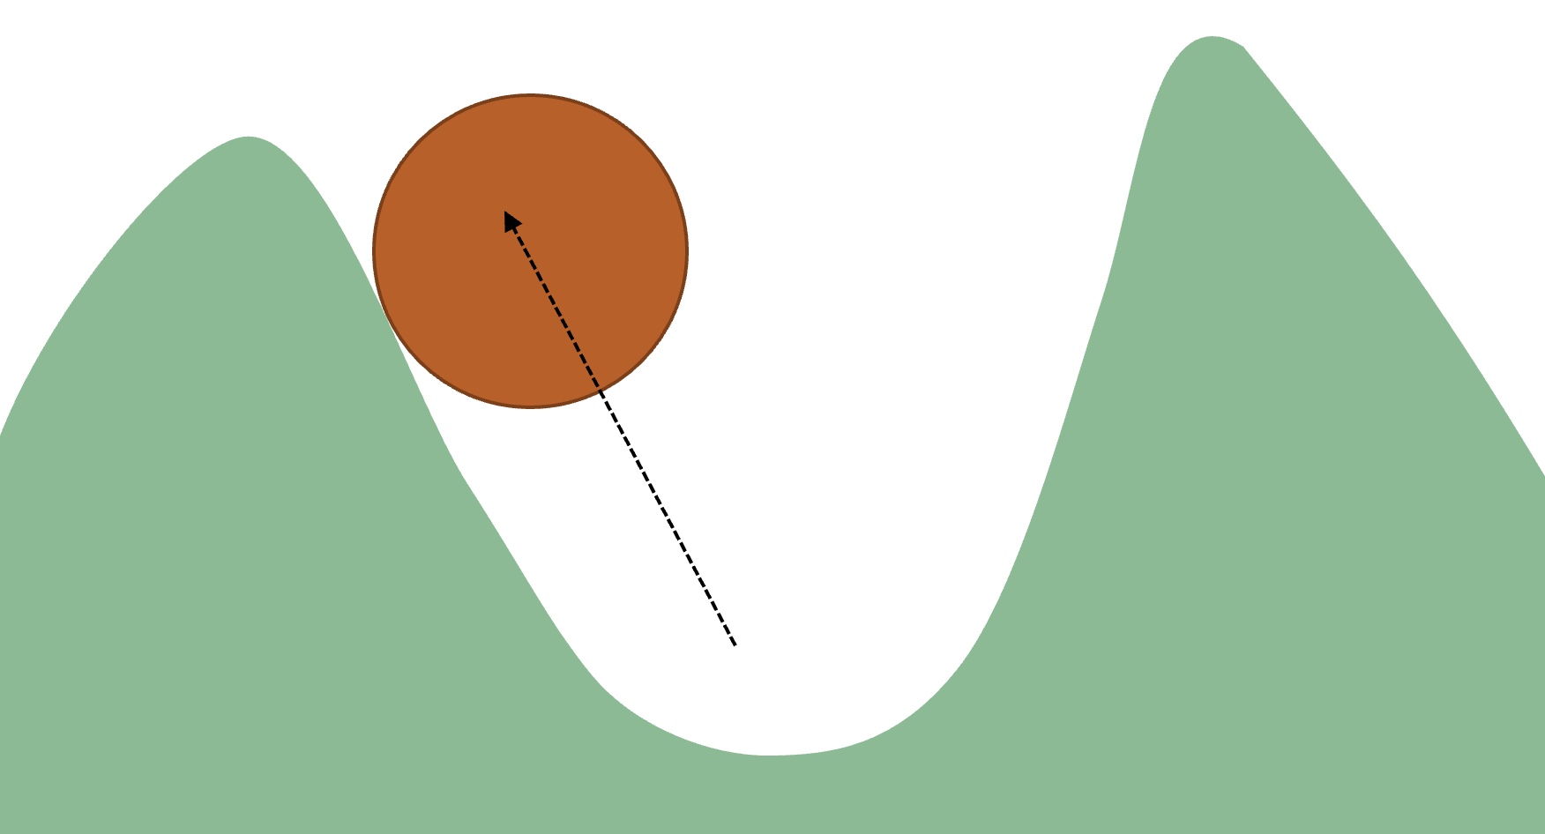
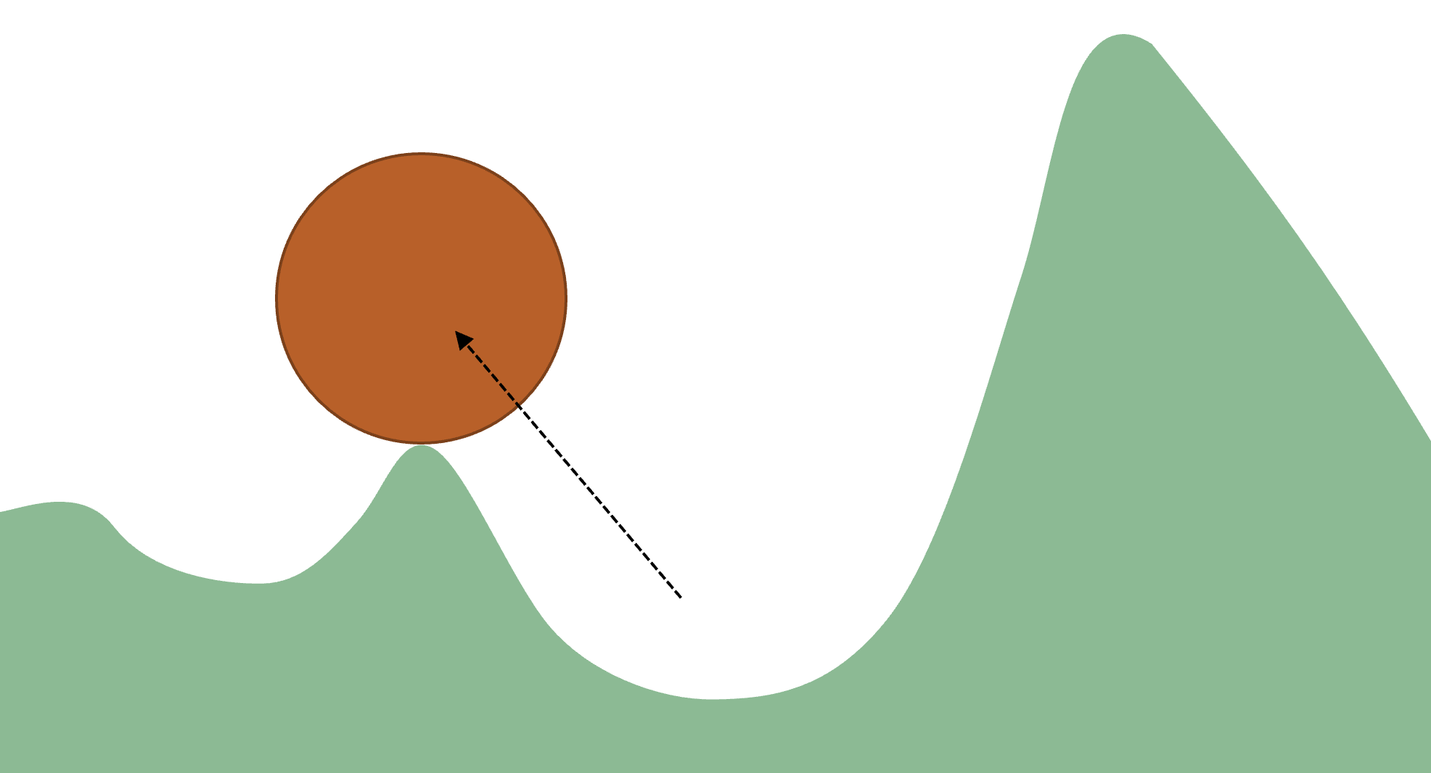

Stable States and Restoring Forces
If a complex system is in a stable state it is likely to resist attempts to change it.
Example: Ball in a Valley.
Instead of pushing a system in a desired direction, we could try to shift it from one stable state to a more desirable one.
Introduction to AI SES
‹#›
Notes:
There are usually many potential solutions to wicked problems, but they may not all work in practice, even if they sound sensible in theory. We might therefore find that some attempts to solve wicked problems will be ineffective, have negative side effects, or even backfire. Complex systems have so many interdependencies that when we try to adjust one aspect of them, we can inadvertently affect others. For this reason, we should approach AI safety with more humility and more awareness of the limits of our knowledge than if we were trying to fix a watch or a washing machine. We will now look at some examples of historical interventions in complex systems that have not gone to plan. In many cases, they have done more harm than good.

Slide 39
Successful Interventions
While it is difficult to say definitively whether a wicked problem has been “solved,” there are examples of at least partially successful interventions.
Examples:
Eradication of smallpox
Reduced of the depletion of the ozone layer
Anti-smoking public health campaigns
All required enormous, sustain effort over many years, sometimes with coordination on a global scale.
Introduction to AI SES
‹#›

Slide 40


System-Level Solutions
Obvious problems may simply symptoms of broader systemic issues.
So bandaids may not work in the long term.
Introduction to AI SES
‹#›

Slide 41


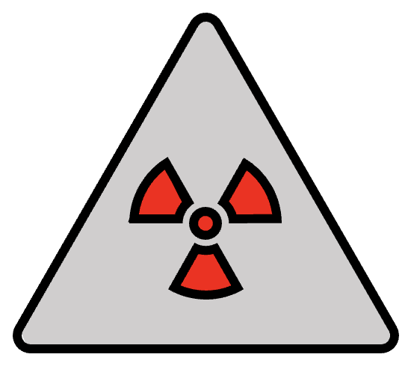




Introduction to AI SES
‹#›

Slide 42
System-Level Solutions
Complex systems are difficult to predict. We cannot analyze and guard against every possible way in which something might go wrong.
Rather than looking for the “root cause” of a catastrophe, we should focus on the broader systemic factors.
It could be more fruitful to change safety culture than address issues with individual products as they arise.
Competitive pressures are a major risk source
Regulations, public concern, safety costs, and so on
Introduction to AI SES
‹#›

Slide 43
Recap
Creating safe AI systems is harder because AI systems are complex.
Problems include difficulty in theorizing, goal subordination, risks from scaling, but there is a requirement to nonetheless scale.
AI safety is a wicked problem: requires sociotechnical solutions, has no flawless solutions, attempting solutions presents risks, and it is not necessarily clear when it is well-managed.
Interventions in AI must be carefully considered; they might backfire.
Introduction to AI SES
‹#›

Slide 44
Chapter Recap
Where mechanistic and statistical approaches can fail, complex systems approaches can succeed.
There are seven common hallmarks of complex systems.
AI, its development, and its deployment environment are all complex systems.
AI safety is a wicked problem.
Managing wicked problems is risky.
Introduction to AI SES
‹#›

