Slide 1
Introduction to
AI Safety, Ethics, and Society
Artificial Intelligence Fundamentals
Introduction to AI SES
‹#›

Slide 2
Roadmap
Artificial Intelligence: Definitions, history, and types.
Machine Learning: Models, tasks, data, and learning types.
Deep Learning: The preeminent paradigm.
Scaling Laws: Many AI systems change predictably with scale.
Speed of AI Development: xxx
Introduction to AI SES
‹#›

Slide 3
Artificial Intelligence
Definitions, history, and types
Introduction to AI SES
‹#›

Slide 4
Definition of AI
There is no single universally-accepted definition of “artificial intelligence.” It is used to describe different (but related) ideas:
Branch of computer science
Type of machine
Tool
Component of a business model
Philosophical idea
Our definition: computer systems that perform tasks typically associated with intelligence such as problem solving, decision making, forecasting.
Introduction to AI SES
‹#›

Slide 5
Modern History of AI
Symbolic AI
First
AI winter
Advancements
in ML
Deep
learning
Recovery
1950
1960
1970
1980
1990
2000
2010
2020
Dartmouth
conference
“ELIZA”
(First chatbot)
“Expert” systems
WWW
invented
Deep Blue
beats
Kasparov
ImageNet
AlphaGo
AlexNet
Transformer
+
LLMs
“Perceptron”
(First neural
network)
Developments:
TBAs, PGMs, and SVMs
ChatGPT
Introduction to AI SES
‹#›

Slide 6
Types of AI
Narrow AI: capable of performing specific tasks only.
Artificial General Intelligence (AGI): capable of performing many cognitive tasks across multiple domains, at human or superhuman levels.
Human-level AI (HLAI): capable of doing virtually everything humans do.
Transformative AI (TAI): systems with a dramatic impact on the world at the level of the industrial revolution.
Superintelligence (ASI): capable of outclassing human performance on virtually all intellectual tasks.
Introduction to AI SES
‹#›

Slide 7
Machine Learning
The models, tasks, data, and types of learning
Introduction to AI SES
‹#›

Slide 8
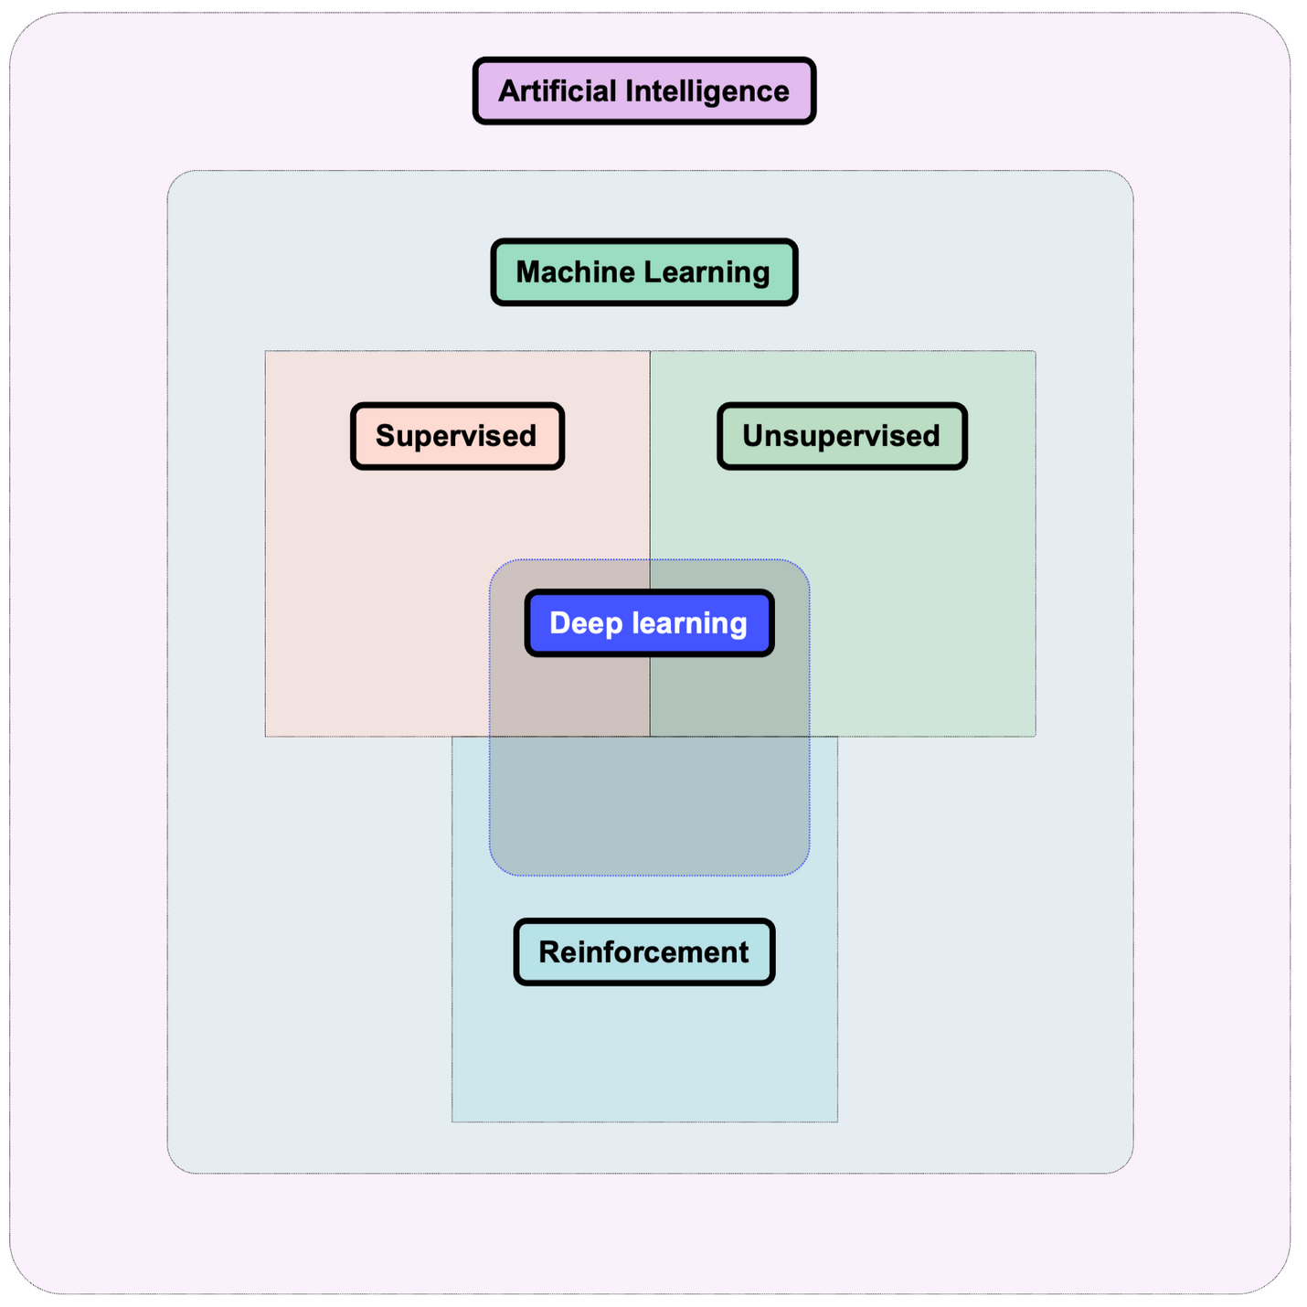
Machine Learning Definitions
Introduction to AI SES
‹#›

Slide 9
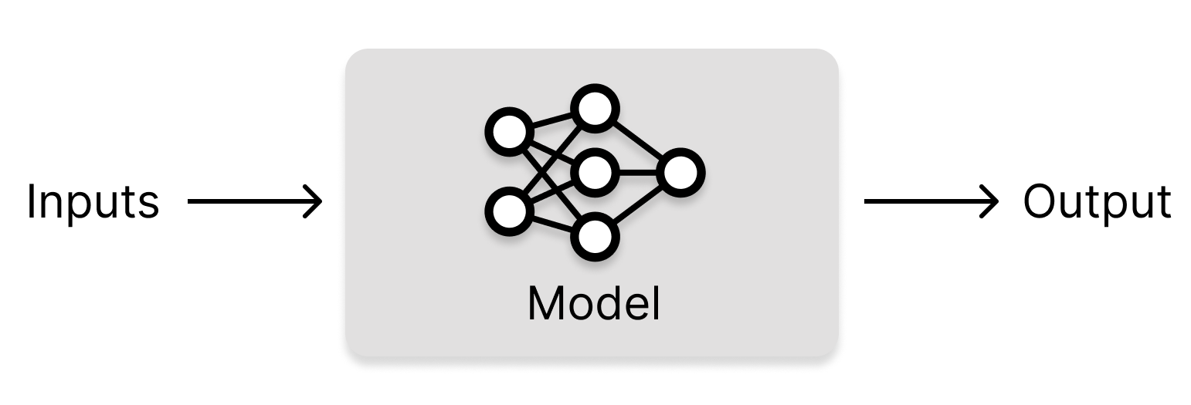
Machine Learning Definitions
Machine learning (ML): developing computer systems that can learn directly from data without following explicit pre-set instructions.
Algorithm: a procedure (recipe) for accomplishing a task.
ML model: an algorithm designed to learn automatically from data by identifying patterns and relationships to make predictions or decisions.
Training data: the data from which ML models learn.
Introduction to AI SES
‹#›

Slide 10
Model Access
Model developers can grant different levels of access to the public.
Closed Models: Operate in a closed system, not accessible for external use or modification, often used internally by organizations.
API Models: Accessible through an interface with usage restrictions, allowing users to query the model without viewing or modifying the underlying model.
Open Models: Fully accessible and modifiable, often part of open-source projects, allowing users to use, modify, and distribute freely.
Introduction to AI SES
‹#›

Slide 11

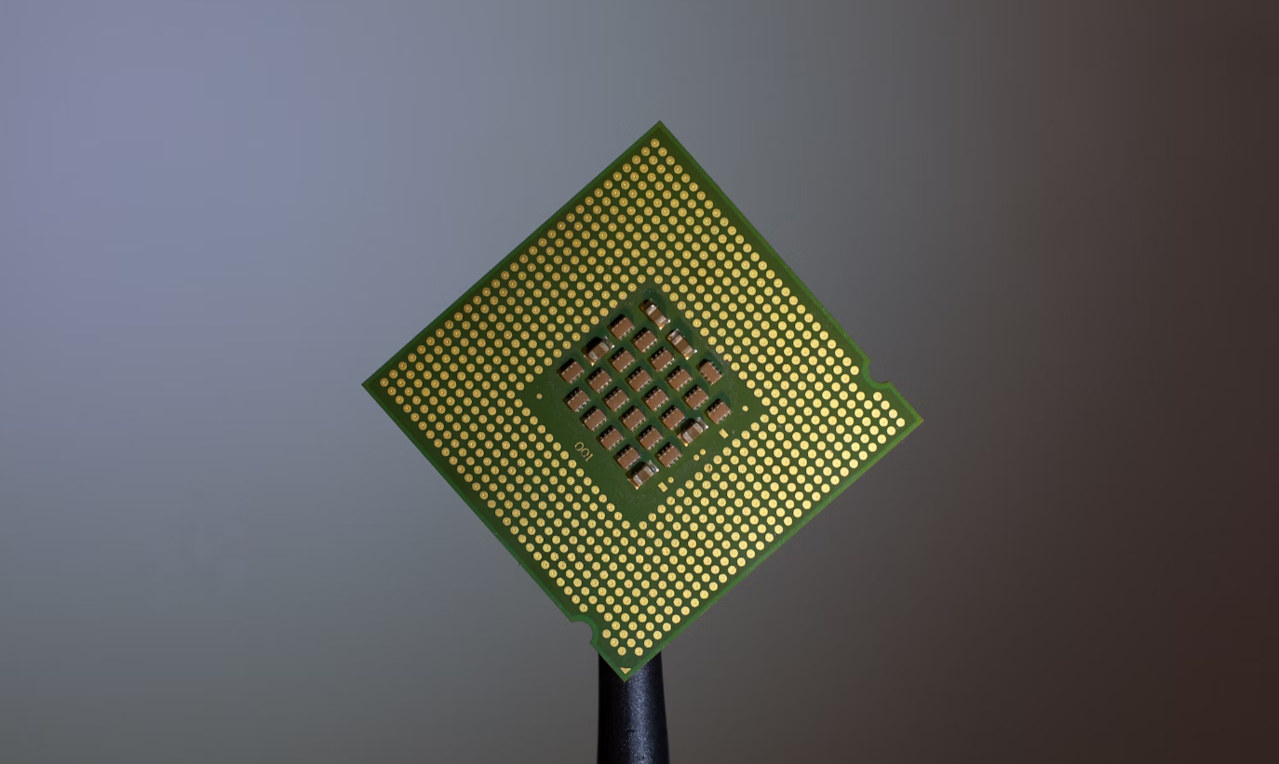
Computational Resources
Compute in ML: Essential for handling the large datasets and complex calculations in machine learning, with GPUs and CPUs being primary examples.
GPUs (Graphics Processing Units):
Parallel processing
CPUs (Central Processing Units):
Sequential processing
Introduction to AI SES
‹#›

Slide 12
Tasks, Inputs, Outputs
Task: What is the primary goal of the ML model?
Inputs: What data does the ML system receive?
Outputs: What does the ML system produce?
Introduction to AI SES
‹#›
Notes:
ML models can be intricate and varied, making understanding their characteristics and distinctions a challenge. It can be helpful to focus on key high-level aspects that almost all ML systems have, to abstract away from the details.

Slide 13

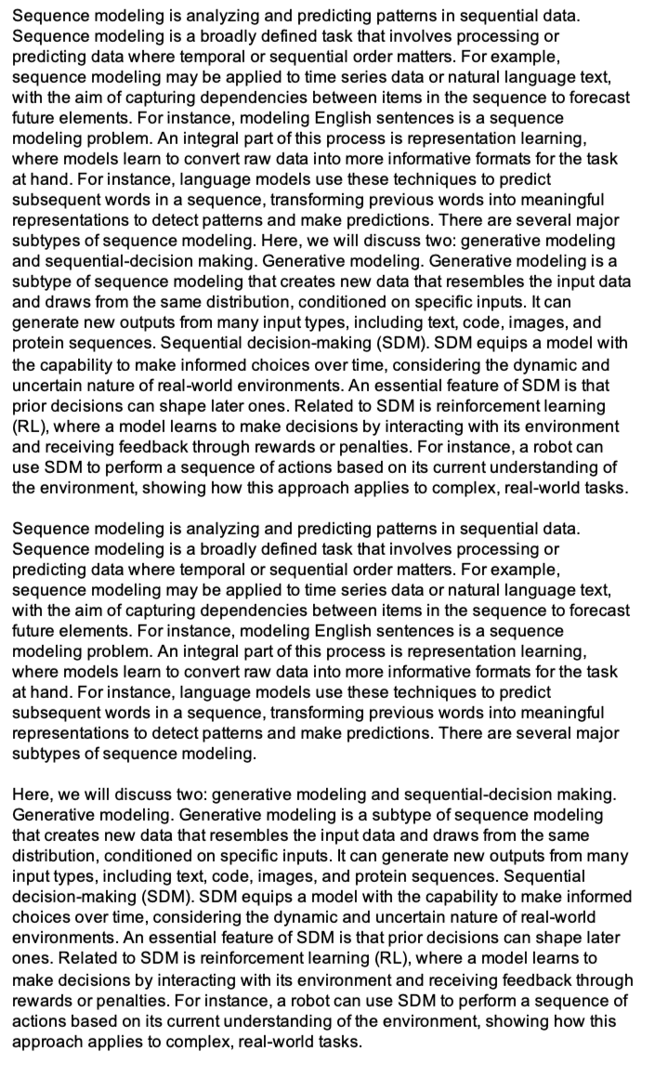
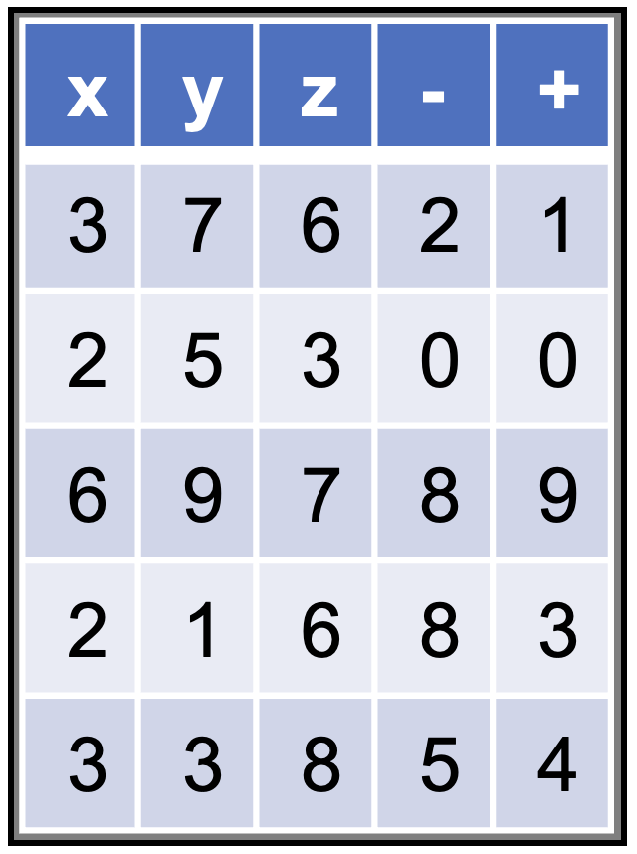

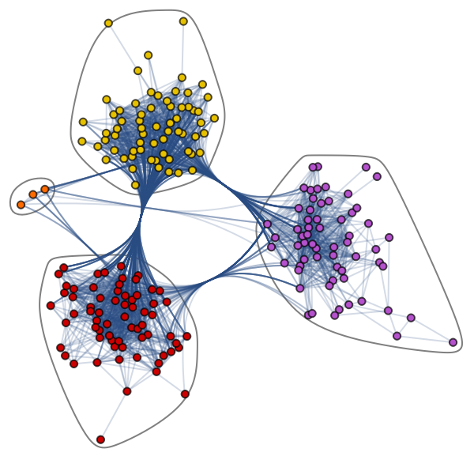
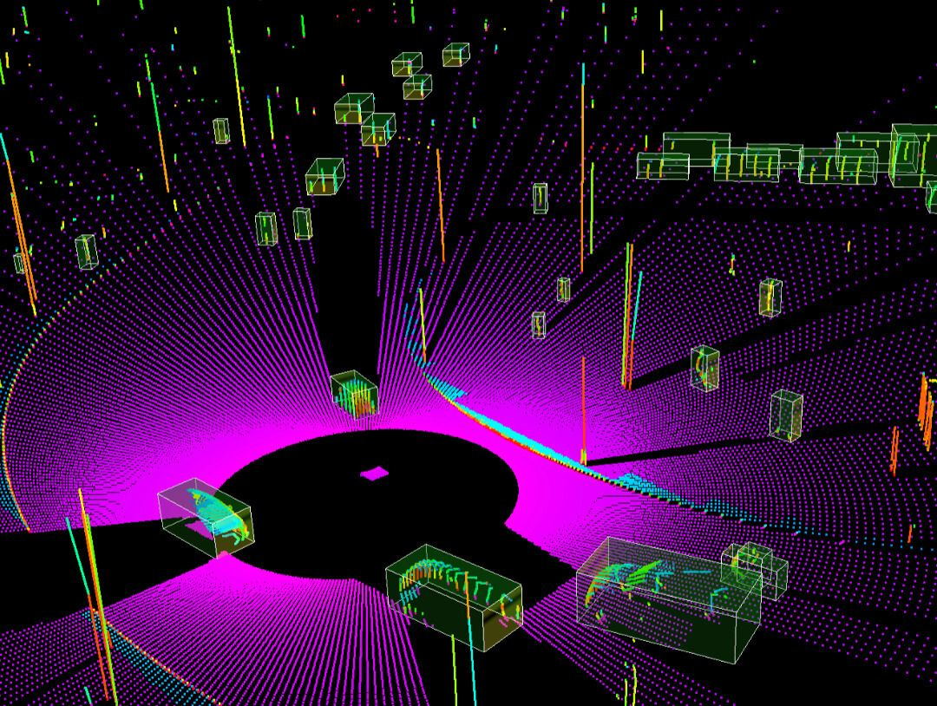
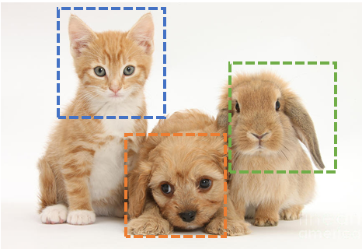
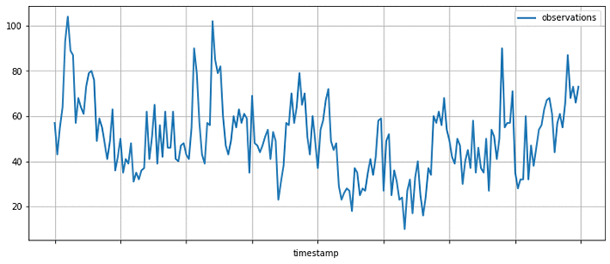
Types of Input Data
Modality: a type of input to an ML model
Major modalities in machine learning:
Tables
Text
Images
Video
Audio
Time series
Graphs
Set values
Introduction to AI SES
‹#›
Notes:
Image classification image from: https://research.aimultiple.com/image-classification/
Graph from: https://www.datacamp.com/tutorial/comprehensive-introduction-graph-neural-networks-gnns-tutorial
Lidar image from: https://www.thinkautonomous.ai/blog/lidar-datasets/

Slide 14
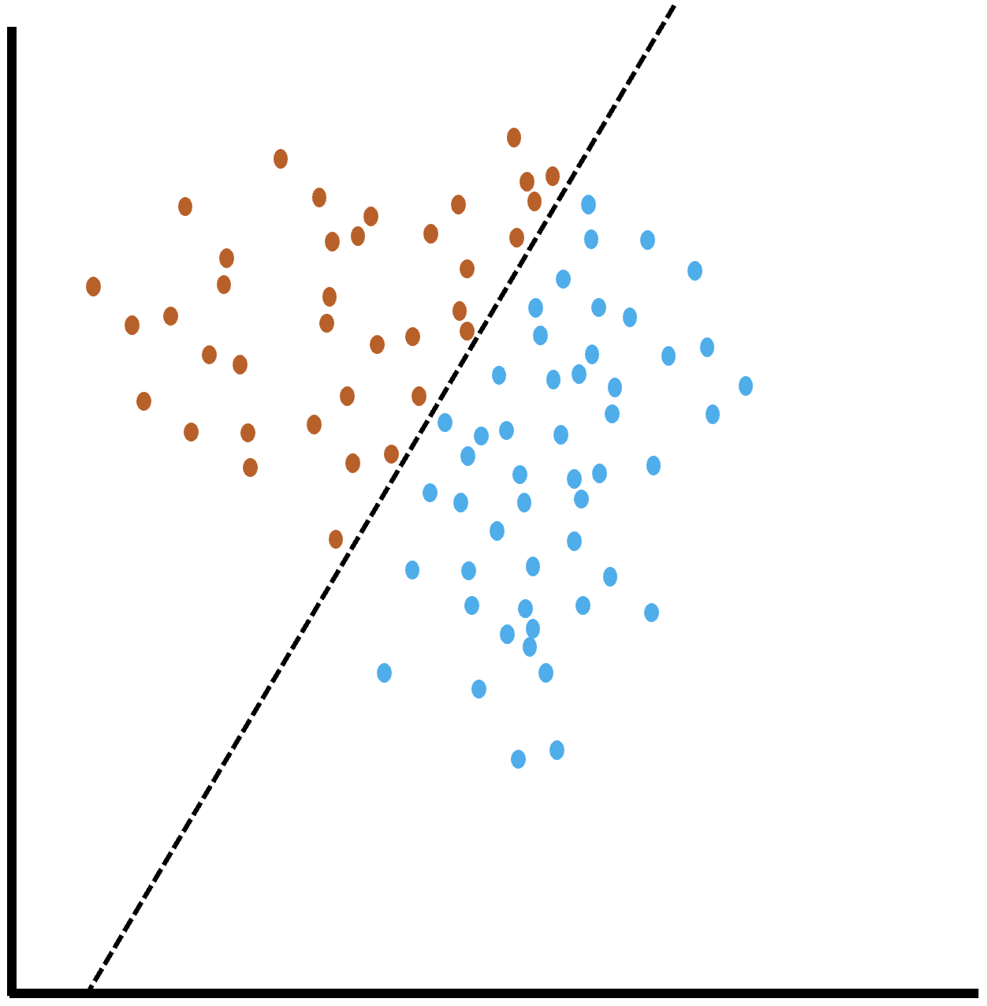
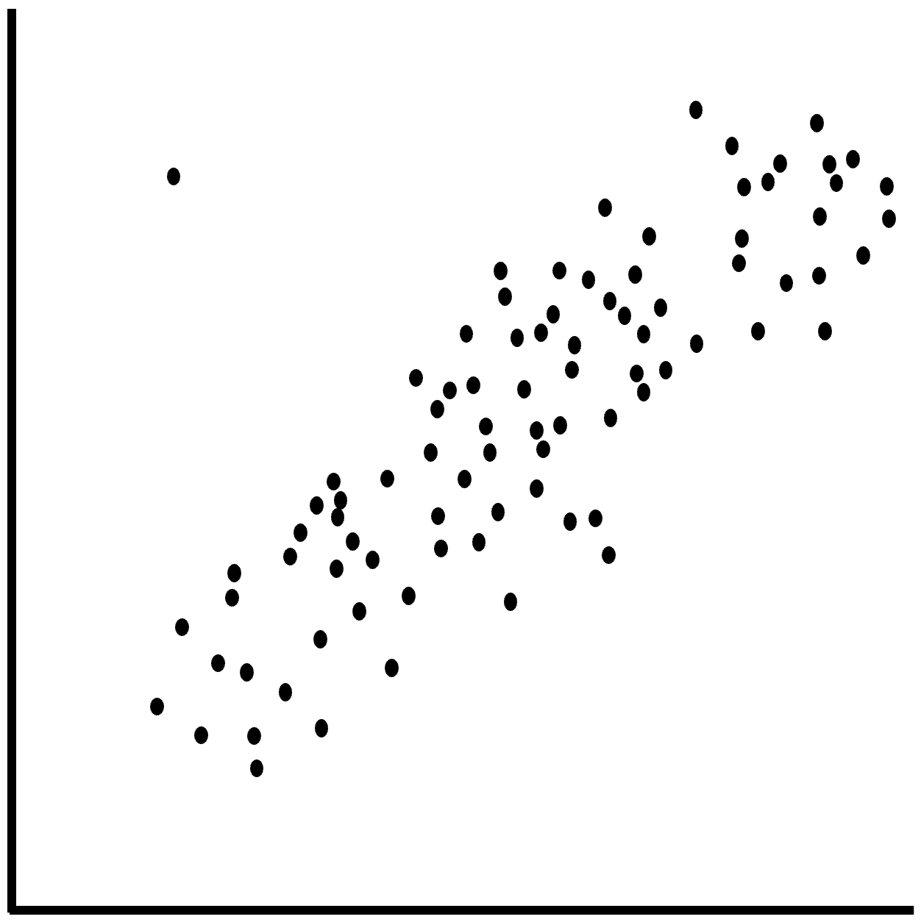
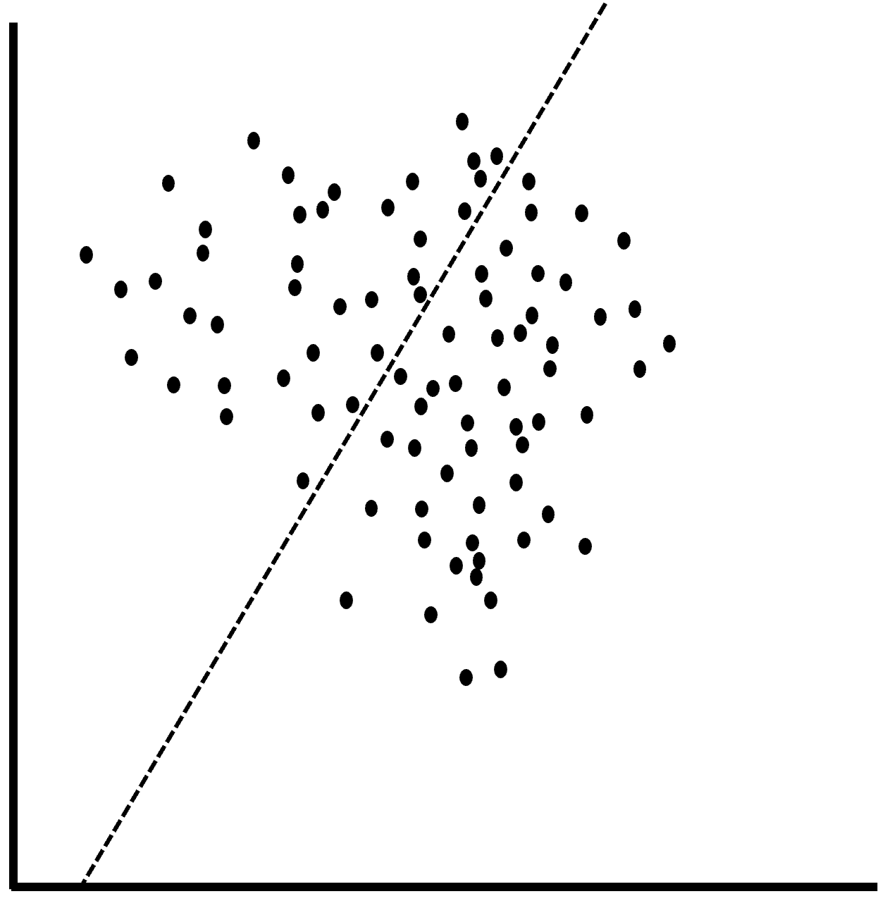
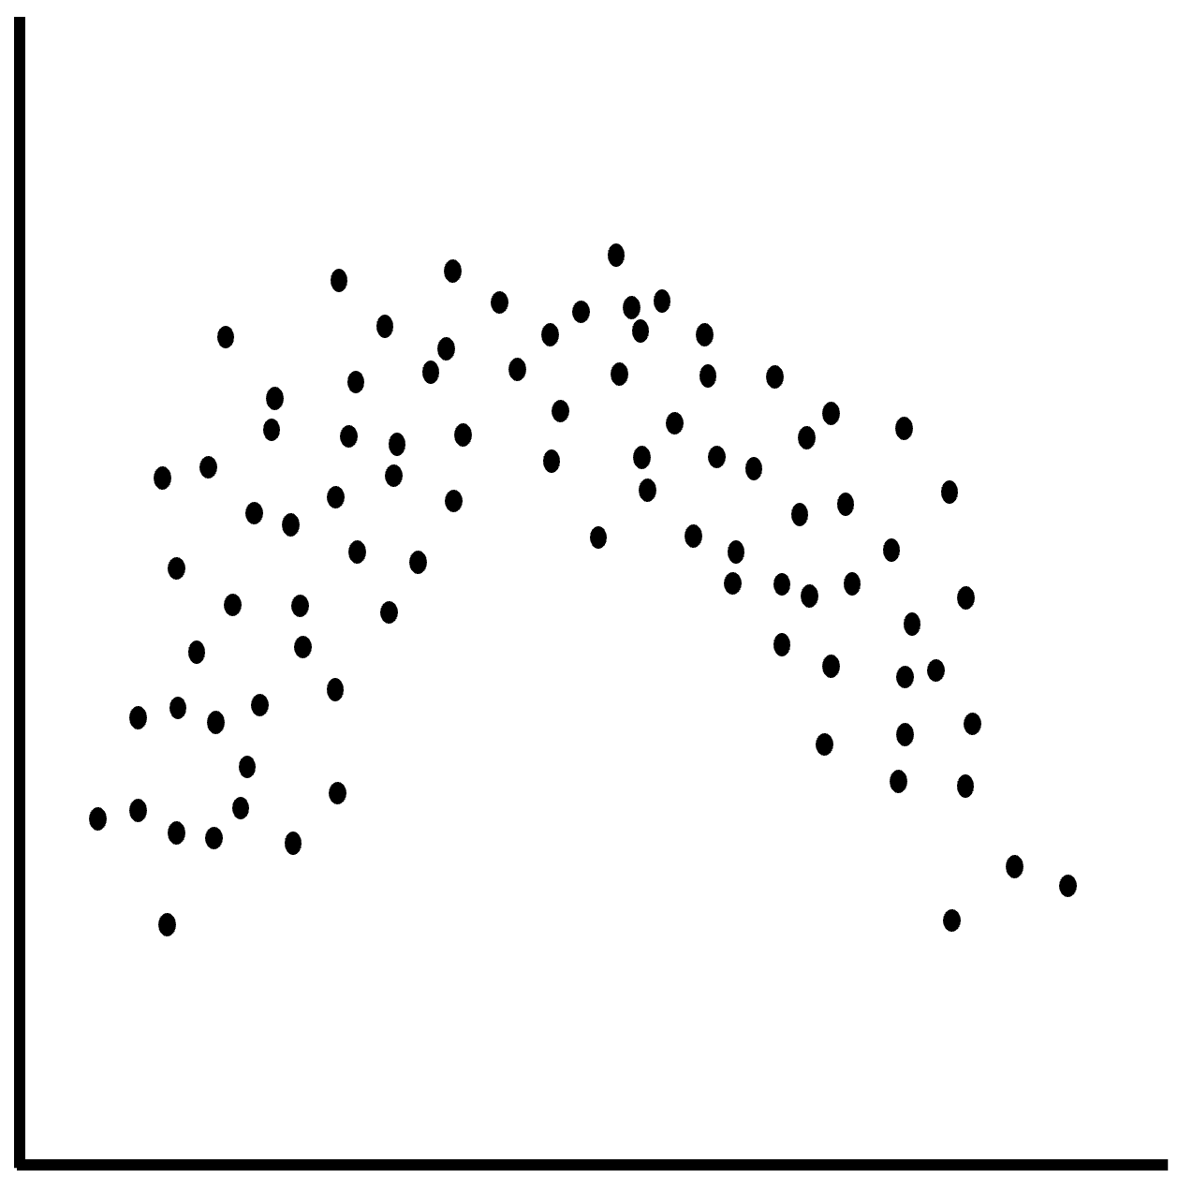
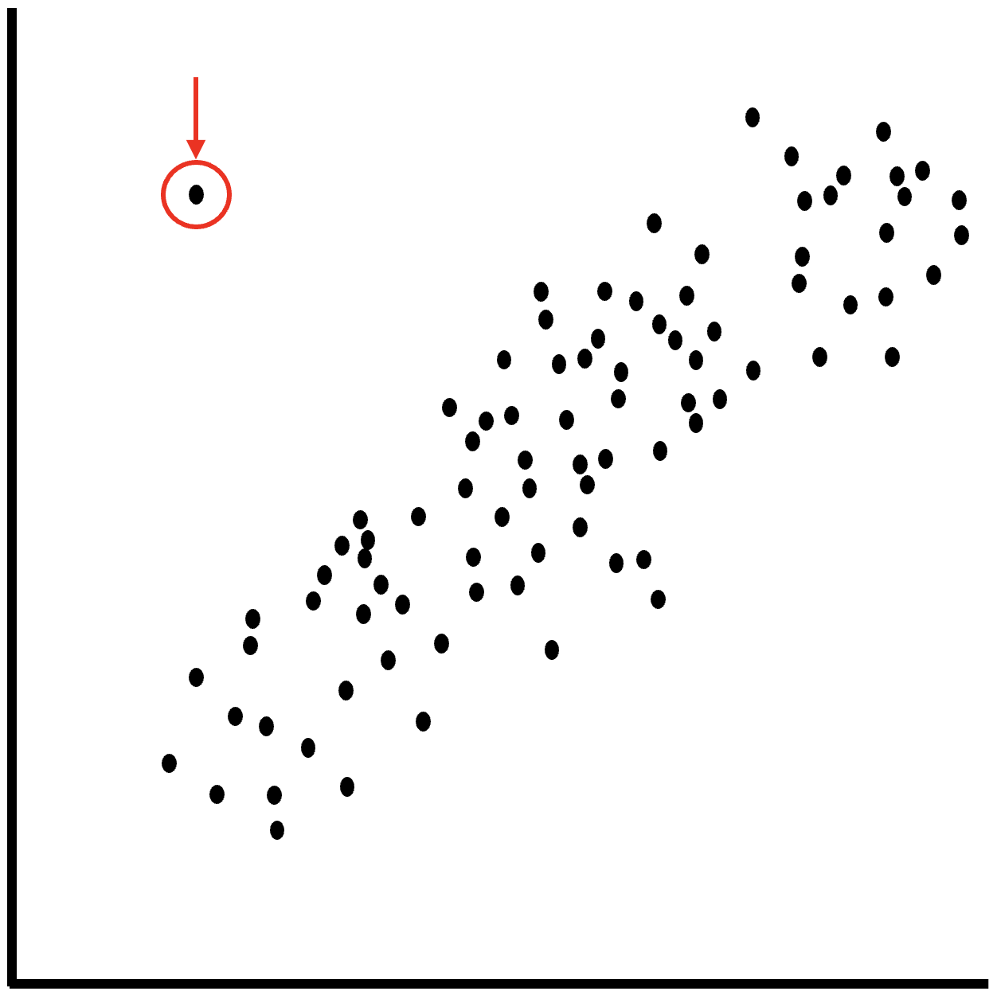
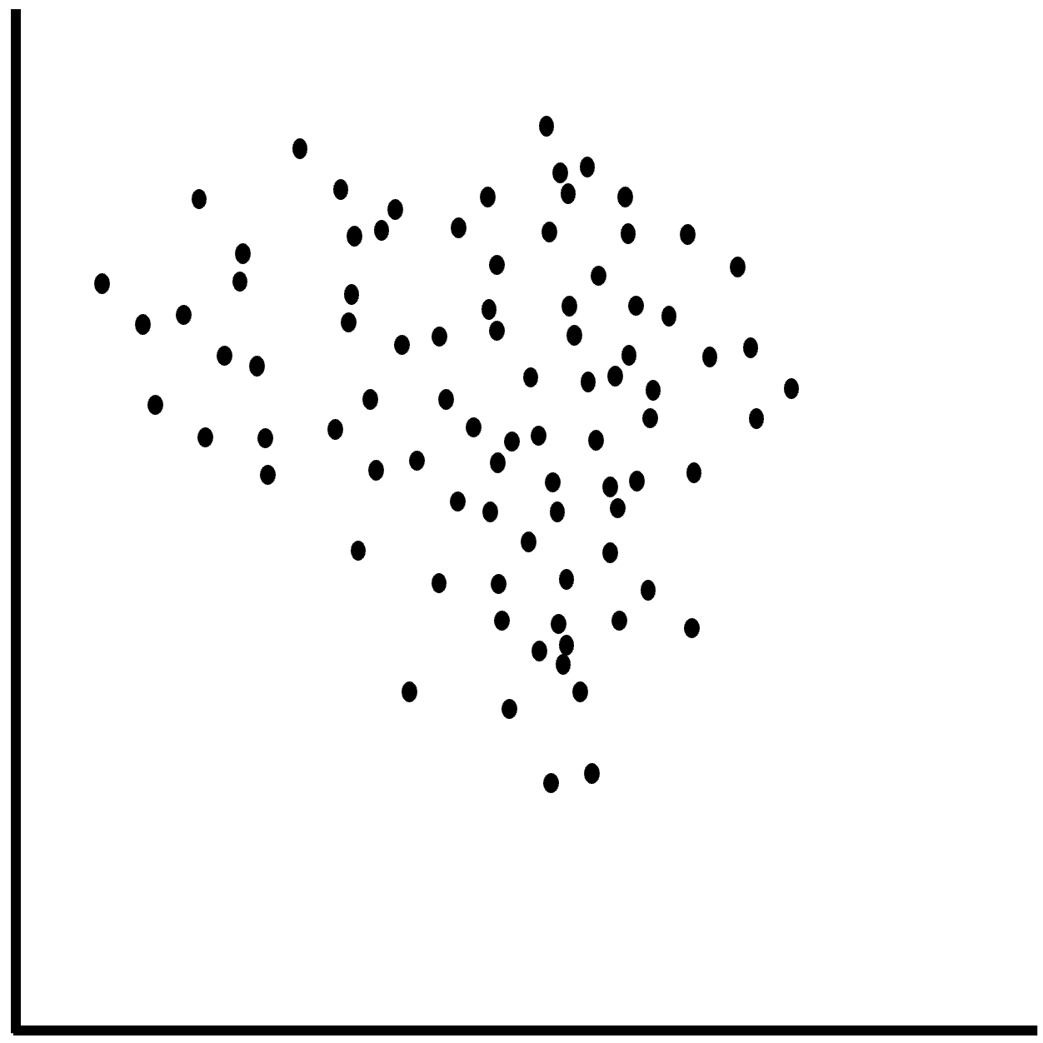
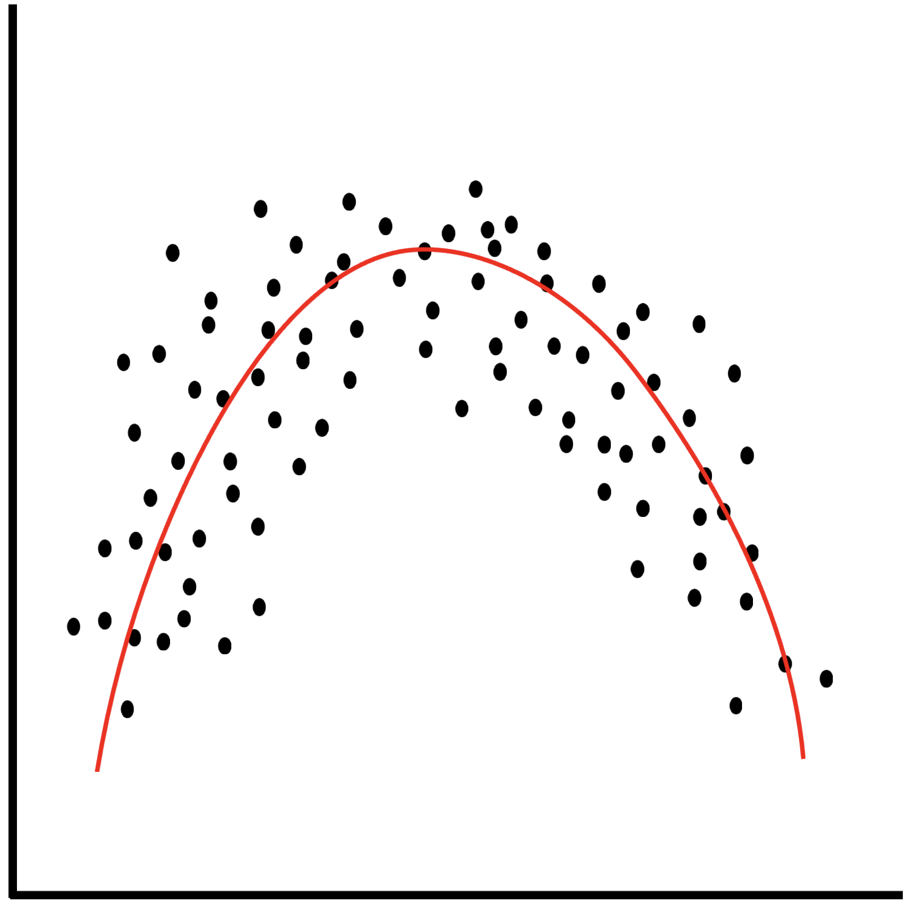
Key ML Tasks
Anomaly
detection
Sequence
modelling
Classification
Regression
Introduction to AI SES
‹#›

Slide 15
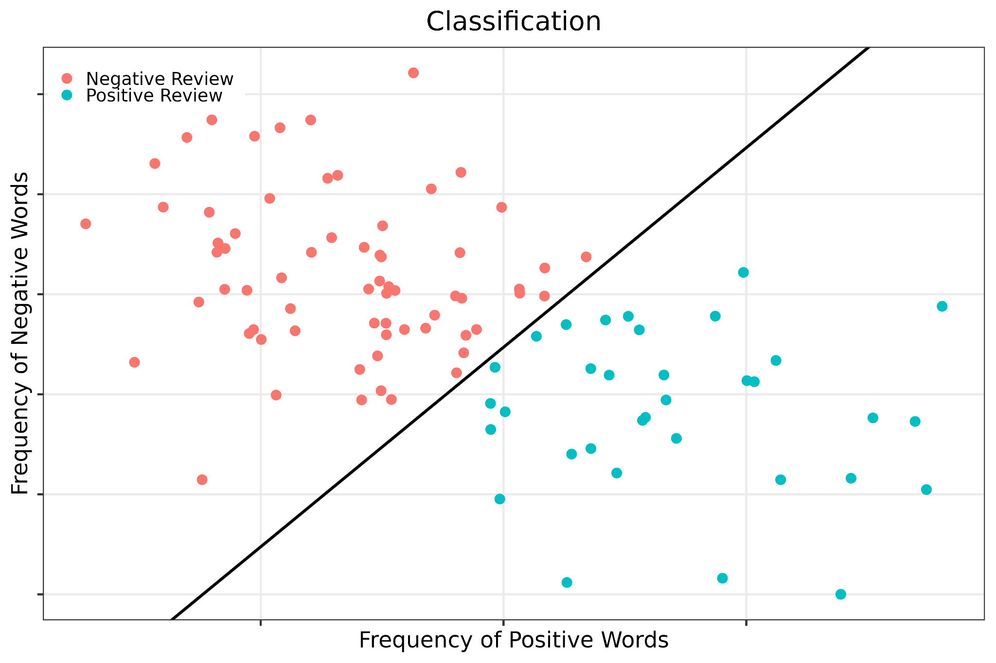
Task 1:
Classification
Classification: predicting categories or “classes” using features of an input data point.
Introduction to AI SES
‹#›

Slide 16
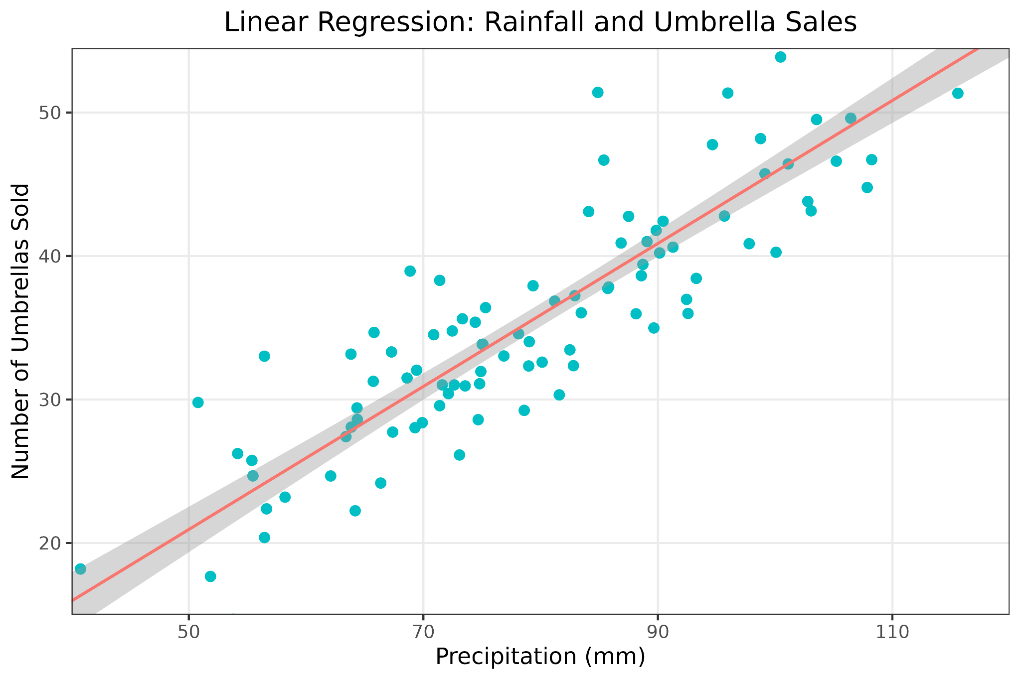
Task 2:
Regression
Regression: predicting numerical outputs using features of input data.
Introduction to AI SES
‹#›

Slide 17
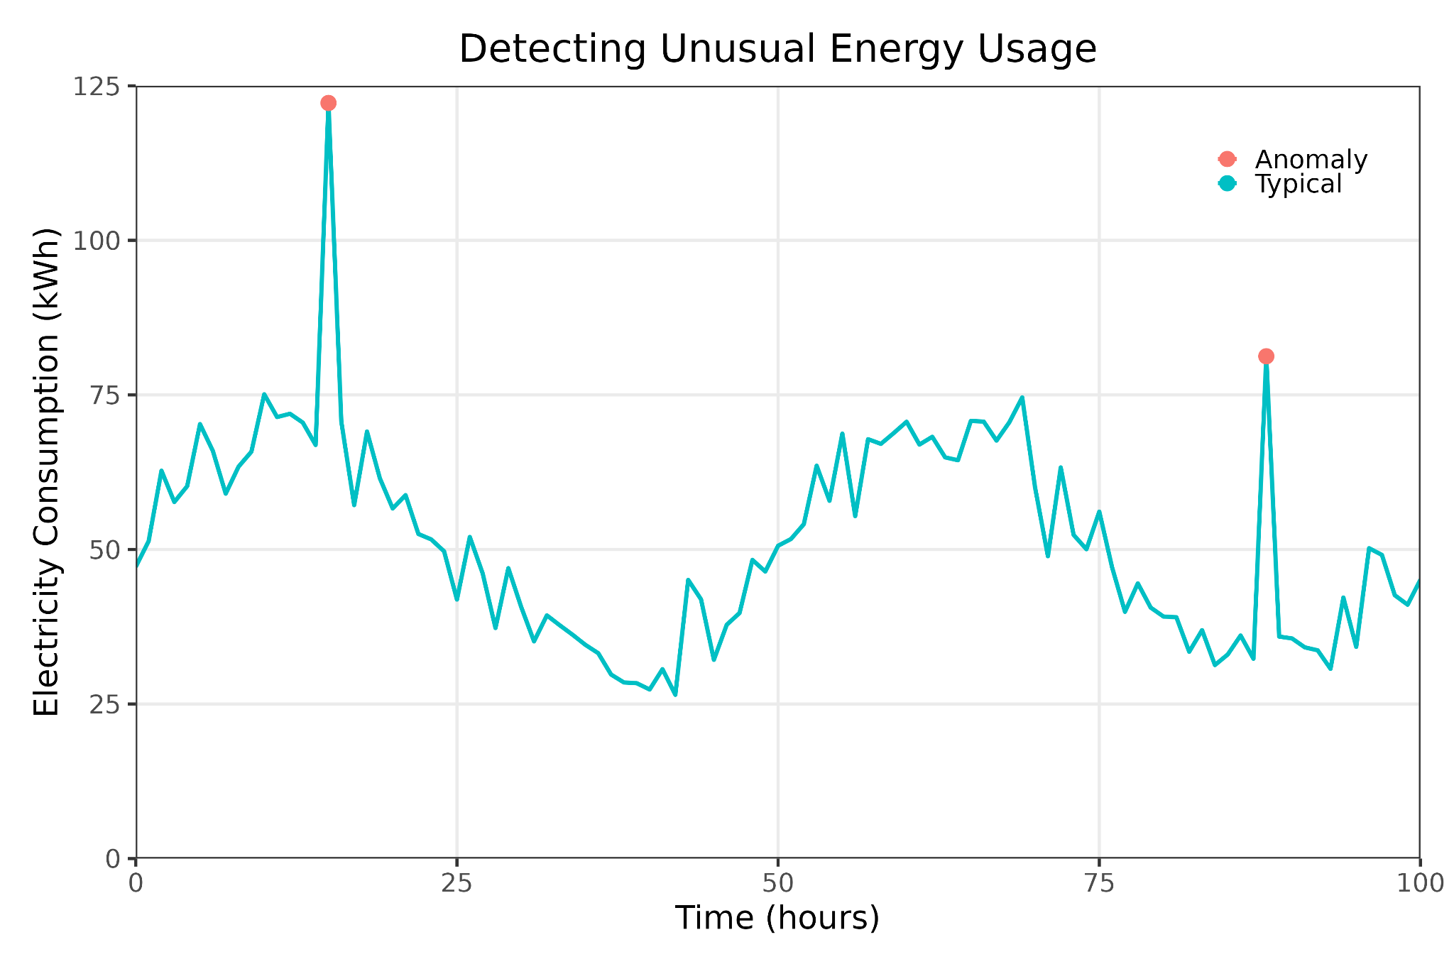
Task 3:
Anomaly Detection
Anomaly detection: identifying outliers or abnormal data points.
Example: black swan detection.
Black swans: events that are rare and unpredictable, yet impactful
Introduction to AI SES
‹#›

Slide 18
Task 4:
Sequence Modeling
Sequence modeling: analyzing and predicting patterns in sequential data.
Generative modeling: creating new data that resembles the input data; ChatGPT is a “generative model”
Introduction to AI SES
‹#›

Slide 19
Components of the ML Pipeline
ML pipeline: a series of interconnected steps in the process of developing a ML model.
Steps:
Data collection
Labeling
Choosing architecture
Training
Evaluation
Deployment
Introduction to AI SES
‹#›

Slide 20
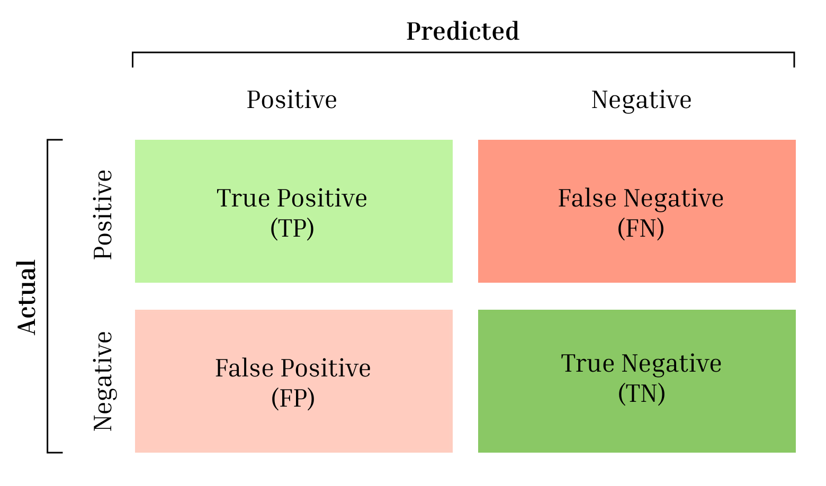
Evaluating ML Models (1/3)
Metrics:
Accuracy: percentage of correct predictions
Precision: the purity of the flagged examples
Recall: proportion of relevant examples that were flagged
Introduction to AI SES
‹#›

Slide 21
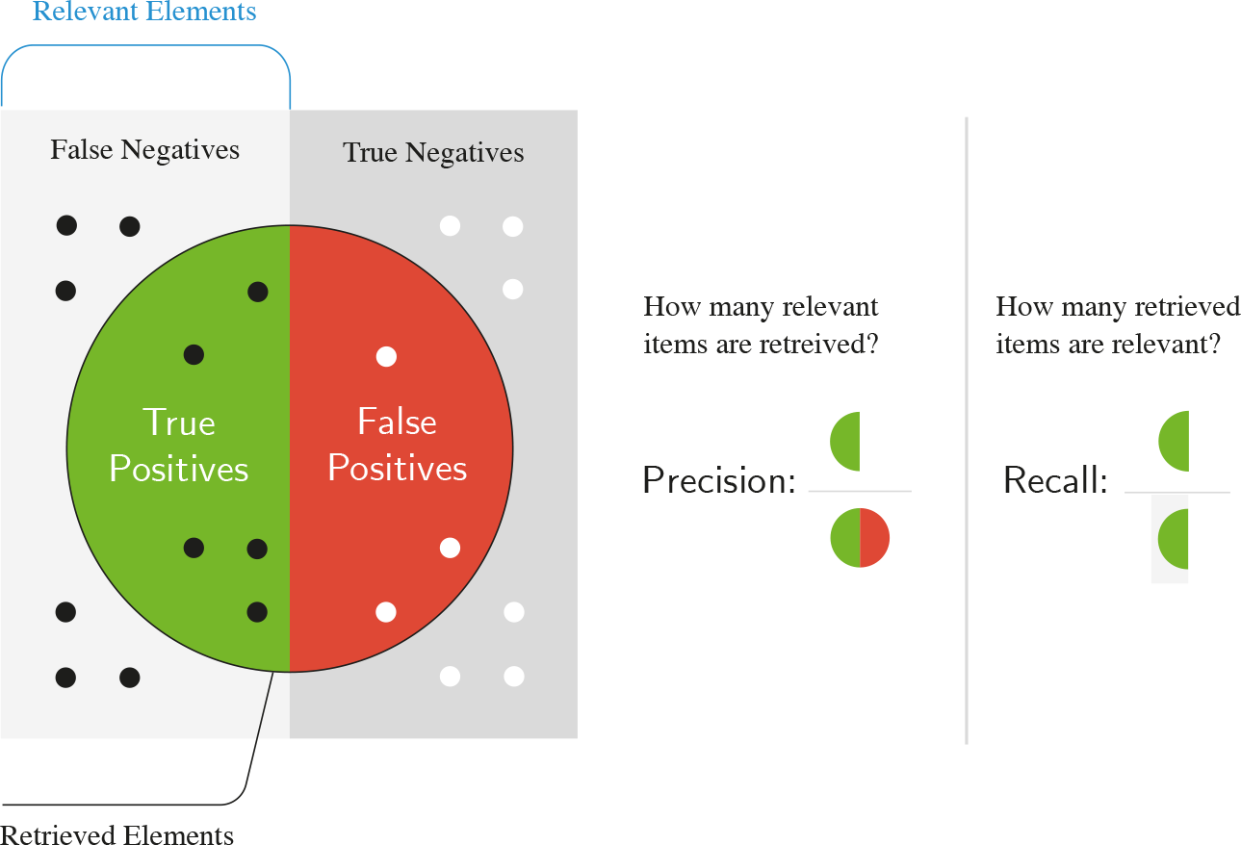
Evaluating ML Models (2/3)
Introduction to AI SES
‹#›

Slide 22
Evaluating ML Models (3/3)
We can have many goals:
Predictive power: the amount of error in predictions
Inference/latency: the speed of result production
Transparency: ability to understand workings producing output
Reliability: performance consistency (over time/in varied conditions)
Scalability: capacity to maintain/improve performance as we scale a key variable:
  Compute
  Parameter count
  Dataset size
Introduction to AI SES
‹#›

Slide 23
Three Types of Machine Learning
Supervised Learning
Unsupervised Learning
Reinforcement Learning
Introduction to AI SES
‹#›

Slide 24


Type 1:
Supervised Learning
Supervised learning: learning from labeled data.
Learning relationships between input data and output labels
Labels are usually generated by humans
Example: Species identification
Advantage: high accuracy and reliability for large and well-labeled dataset.
Disadvantage: worse performance for loosely-defined tasks, like poetry or image generation; may also require manual labeling.
Introduction to AI SES
‹#›

Slide 25

Type 2:
Unsupervised Learning
Unsupervised learning: learning from unlabeled data.
Discovering and identifying patterns within a dataset to learn the relationships between variables
Also known as “self-supervised learning,” because the model may use these patterns to generate supervisory signals for itself
Examples:
Language models
Image inpainting
Introduction to AI SES
‹#›

Slide 26

Type 2:
Unsupervised Learning
Introduction to AI SES
‹#›

Slide 27
Type 3:
Reinforcement Learning
Reinforcement learning (RL): learning from agent-gathered data.
AI agents making decisions and improving their performance based on responses to their environment
Example: robots navigating environments through trial-and-error.
Introduction to AI SES
‹#›

Slide 28
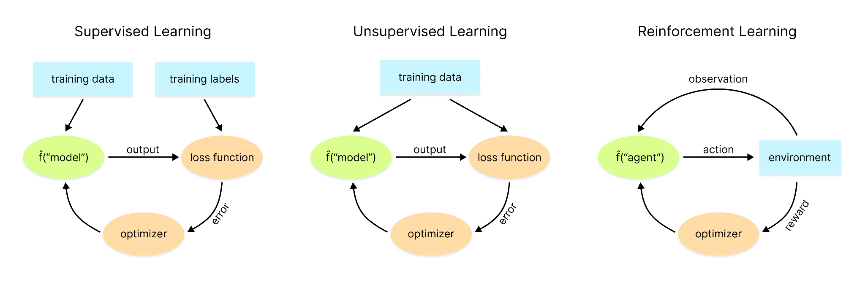
Review of Machine Learning Types
Introduction to AI SES
‹#›

Slide 29
Recap
AIs are computer systems that perform tasks typically associated with intelligence such as problem solving, decision making, forecasting. They can be classified according to their capabilities.
Machine Learning systems can learn directly from data without following explicit pre-set instructions. They are used for tasks like classification, regression, anomaly detection, and sequence modeling.
ML requires data, architecture, training it, evaluating, deploying.
ML can use supervised, unsupervised, and reinforcement learning.
Introduction to AI SES
‹#›

Slide 30
Roadmap
Artificial Intelligence: Definitions, history, and types.
Machine Learning: Models, tasks, data, and learning types.
Deep Learning: The preeminent paradigm.
Scaling Laws: Many AI systems improve predictably with scale.
Introduction to AI SES
‹#›

Slide 31
Deep Learning
The preeminent paradigm
Introduction to AI SES
‹#›

Slide 32
Introduction to Deep Learning
Introduction to AI SES
‹#›

Slide 33
Introduction to Deep Learning
Deep learning (DL):
Uses neural networks: layers of interconnected nodes that transform inputs into outputs, inspired by biological neurons.
Extracts useful patterns from large quantities of data
Useful for learning hierarchical representations of the world
Rule-based systems:
Classic ML:
Deep learning:
Hand-designed features
Hand-designed program
ML Model
Output
Output
Input
DL System
Output
Input
Input
Introduction to AI SES
‹#›

Slide 34
Why Deep Learning Matters
Performance:
Superhuman in some domains (though not reliably so)
Examples: image recognition, chess, and Go
Real-world usefulness:
Wide variety of useful applications
Examples: healthcare, social media, and autonomous vehicles
Scalability:
DL models are highly scalable
Performance tends to improve with more data, rather than tapering off
Introduction to AI SES
‹#›

Slide 35
Three Factors of DL Model
DL model performance is affected by:
Algorithms
Data
Compute
Introduction to AI SES
‹#›

Slide 36
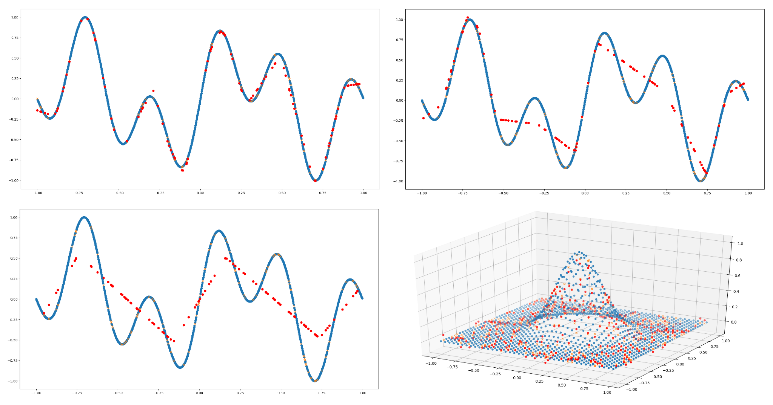
What Deep Learning Models Do
Introduction to AI SES
‹#›

Slide 37
DL Model Building Blocks
Multi-layer perceptrons (MLPs)
Activation functions
Residual connections
Convolution
Self-attention
Introduction to AI SES
‹#›

Slide 38
Building block 1:
Neural Networks
Neural network: a type of ML algorithm composed of layers of interconnected nodes or “neurons.”
Neuron: the basic computational unit of a neural network.
Takes in a weighted sum of its inputs
Applies an activation function to transform it
Generates an output signal that is passed along to other neurons
Introduction to AI SES
‹#›

Slide 39
Building block 1:
Multi-Layer Perceptrons
Multi-layer perceptron (MLP): a foundational neural network architecture.
Multiple layers of neurons: input, hidden, and output.
Feedforward neural network: all the information flows in one direction.
Input
layer
Output
layer
Hidden layers
Introduction to AI SES
‹#›

Slide 40
Building block 2:
Activation Functions
Activation functions: nonlinear functions applied to the weighted input sum of each neuron within a layer of a neural network.
The activation function transforms the weighted input sum into an output signal
1. Receives inputs
2. Multiplies inputs by weights
z=∑_{i} w_{i}x_{i}+b
z=∑_{i} w_{i}x_{i}+b
z=∑_{i} w_{i}x_{i}+b
z=∑_{i} w_{i}x_{i}+b
3. Adds a bias
4. Applies an activation function
5. Produces an output signal
Introduction to AI SES
‹#›

Slide 41
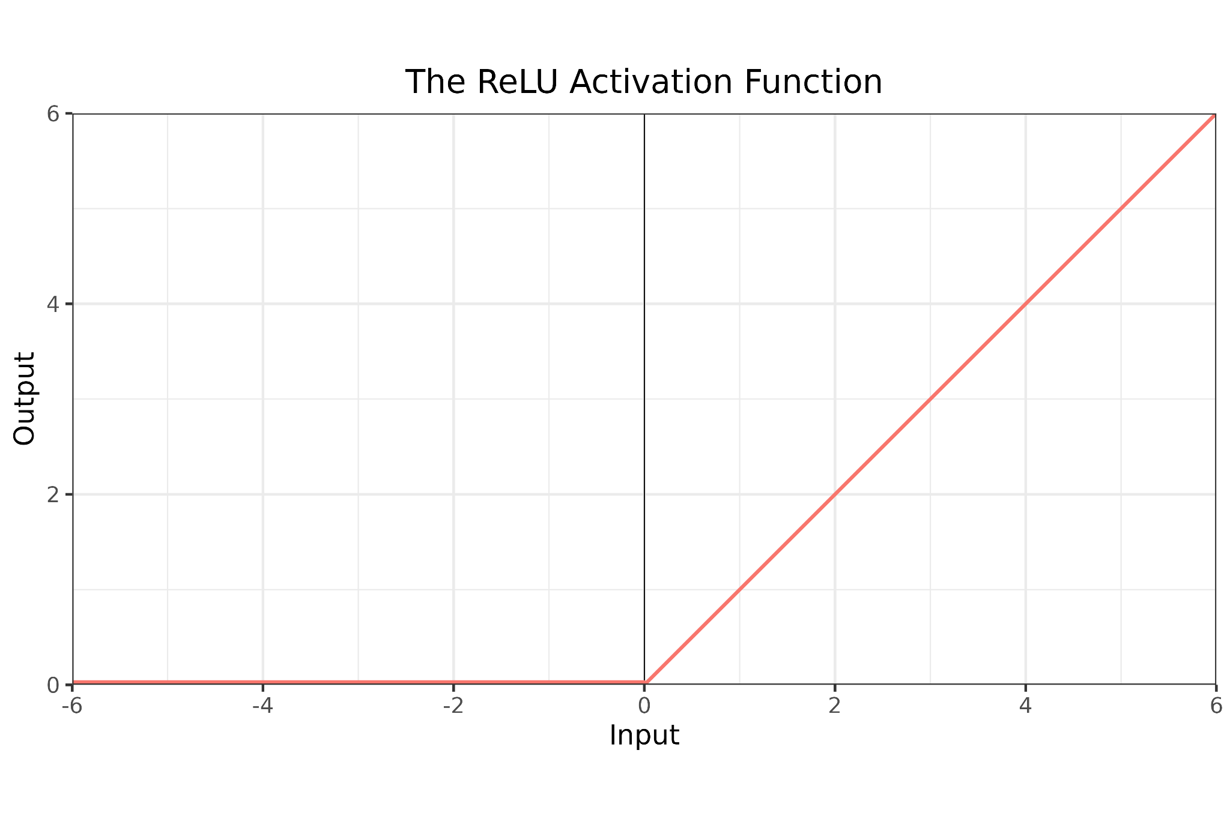
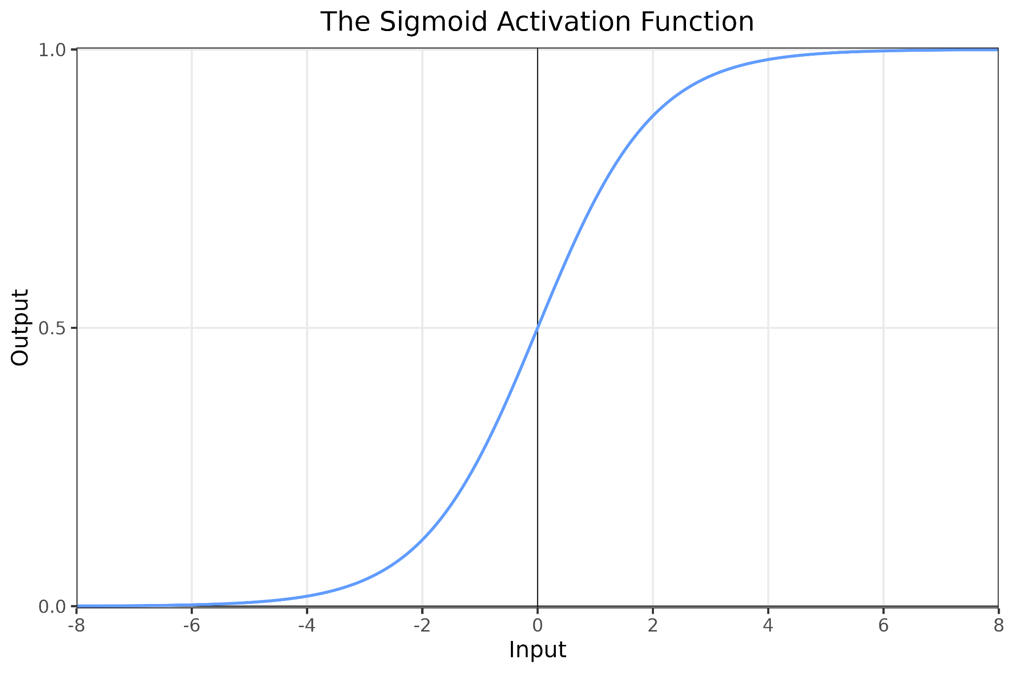
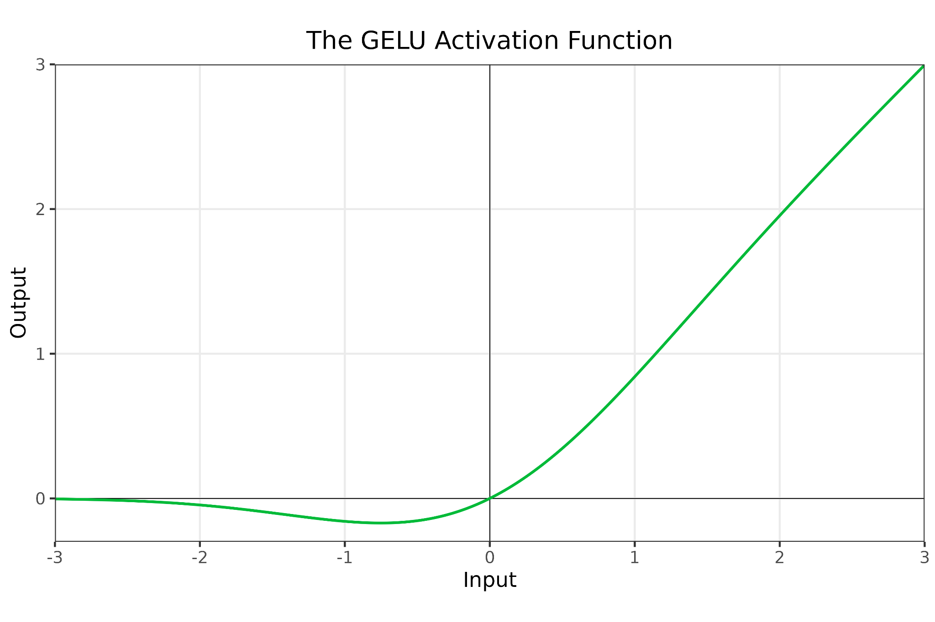
Building block 2:
Activation Functions
Key activation functions:
Rectified Linear Unit (ReLU),
Gaussian Error Linear Unit (GELU), Sigmoid, and Softmax.
Introduction to AI SES
‹#›

Slide 42
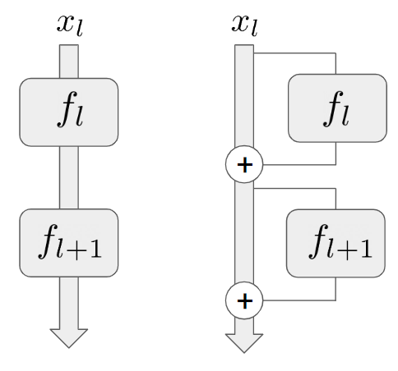
Building block 3:
Residual Connections
Residual connections: pathways for information to bypass network layers.
Data can skip being transformed in each layer, so its original content can be better preserved.
Each layer can access more than just the previous layer’s representations.
Lower-level features from earlier layers contribute directly to higher-level features of deeper layers.
By facilitating information flow, they help models learn iterative and hierarchical feature representations.
Introduction to AI SES
‹#›

Slide 43
Building block 4:
Convolution
Convolution: a process used to detect patterns in input data by applying a small matrix called a “filter” or “kernel” and looking for cross-correlations.
Filter
Data
Activation map
w
x
a
x
aw + bx + dy + ez
bw + cx + ey + fz
b
c
w
w
x
y
z
y
d
w
e
x
f
z
w
x
y
z
dw + ex + gy + hz
ew + fx + hy + iz
g
h
i
y
y
z
z
Introduction to AI SES
‹#›

Slide 44
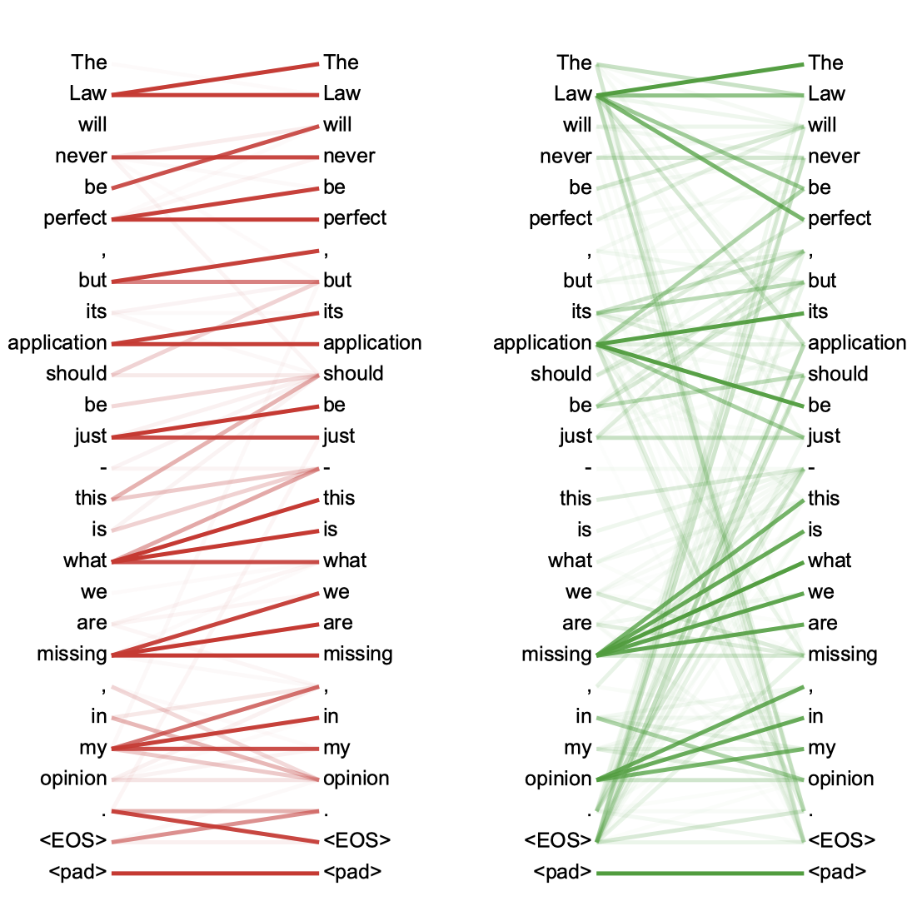
Building block 5:
Self-Attention
Self-attention encodes the relationships between elements in a sequence.
Each element “attends” to every other element by determining its relative importance and focusing on the most relevant connections, capturing relationships within sequences that are separated by long distances.
Example: summarizing a long text.
Introduction to AI SES
‹#›

Slide 45
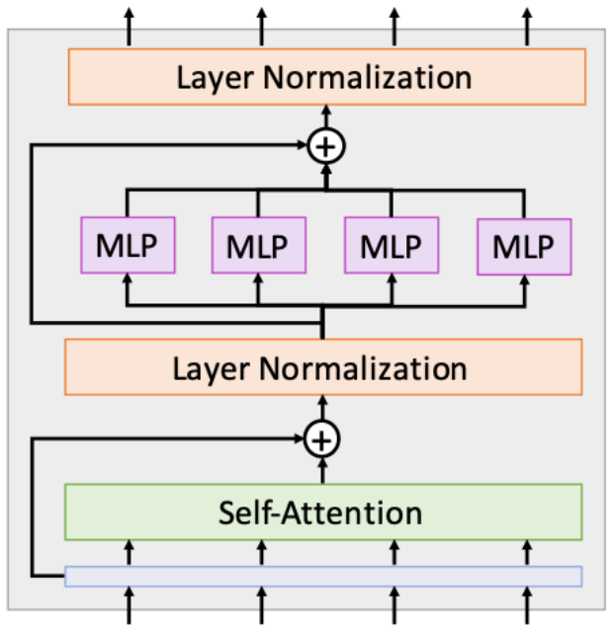
The Transformer
Transformer: a deep learning architecture used in LLMs and other models
The model consists of Transformer blocks, which combine self-attention and MLPs with optimization techniques such as residual connections.
Example: large language models (LLMs):
Very high parameter numbers (billions)
Vast quantities of training data
Most use Transformers to model long-range dependencies effectively.
Introduction to AI SES
‹#›

Slide 46
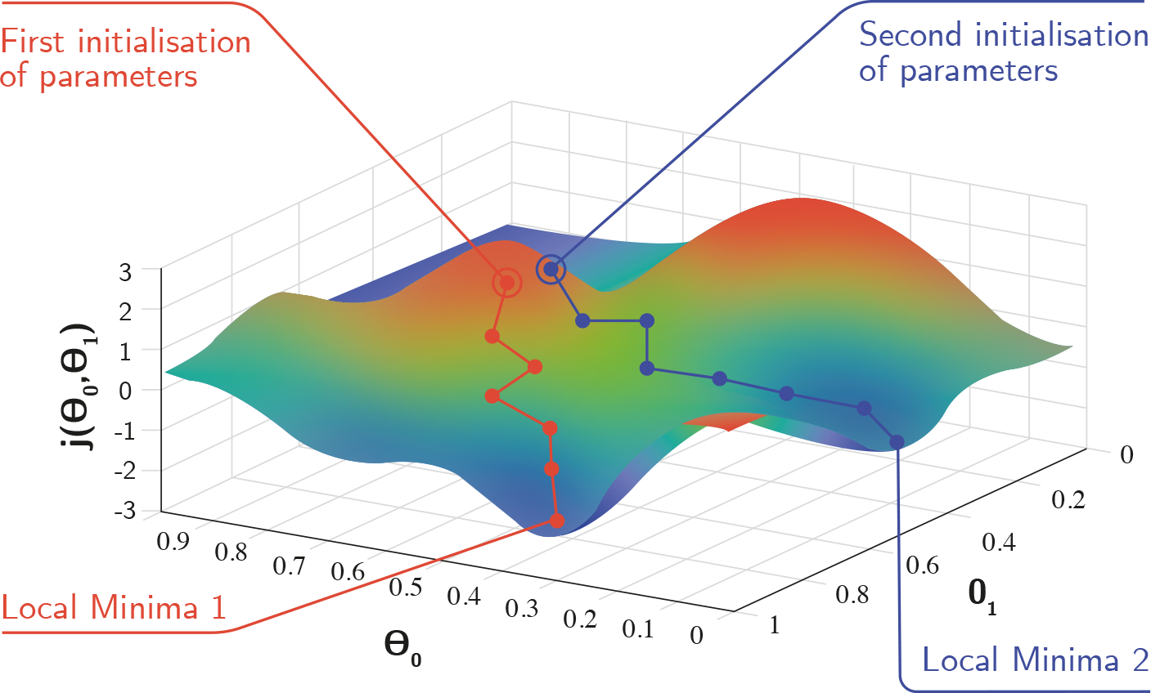
Training Steps
1. Initialization
1. Initialization
A model’s parameters (weights and biases) are set to some initial values, often small random numbers. These values define the starting point for the training of the model and can have a significant influence on its success.
Input data is passed through the model, layer by layer. The neurons in each layer perform their specific operations via weights, biases, and activation functions. Once the final layer is reached, an output is produced. This procedure can be carried out on individual examples or on batches of multiple data points.
The model’s output is compared to the target output using a loss function that quantifies the difference between predicted and actual values. The loss represents the model’s error: how far its output was from what it should have been.
2. Forward propagation
2. Forward propagation
The error is propagated back through the model, starting from the output layer and going backward to the input layer. This process is used to compute gradients that determine how much each parameter contributed to the overall loss.
3. Loss calculation
3. Loss calculation
Based on the gradients, the model’s weights and biases are adjusted using an optimization algorithm. This is typically done using gradient descent or one of its variants.
4. Backpropagation
4. Backpropagation
Training continues until the model reaches a stopping point, such as when the loss stops decreasing, or when the model has gone through the full training dataset a given number of times.
Steps 2–5 are repeated many times, often millions or billions. With each pass, the loss should decrease as the model’s predictions improve.
5. Parameter update
5. Parameter update
6. Iteration
6. Iteration
7. Stopping criterion
7. Stopping criterion
Introduction to AI SES
‹#›

Slide 47
Training Methods (1/2)
Pre-training: training a model on vast quantities of data to give it many generally useful representations.
These representations are encoded via the model’s weights
Example: training a model to write movie scripts by first teaching it more general rules about grammar and language
Introduction to AI SES
‹#›

Slide 48
Training Methods (2/2)
Fine-tuning: adapting a pre-trained model to a new dataset or task.
Use the weights of the pre-trained model as a starting point
Then some (or all) layers are trained on the new task or data, usually backwards from the output layer to the input layer
Few-shot learning: training a model using a small amount of training data.
Most effective after a model has already learned good representations
Introduction to AI SES
‹#›

Slide 49
Scaling Laws
Many AI systems improve predictably with scale.
Introduction to AI SES
‹#›

Slide 50
Scaling laws
Scaling laws predictably model the how AI systems’ performance scales with resources.
Parameter count and dataset size are crucial inputs, both are bottlenecked by compute.
Scaling laws detail the relationship between an AI model's performance and its primary inputs.
Introduction to AI SES
‹#›

Slide 51
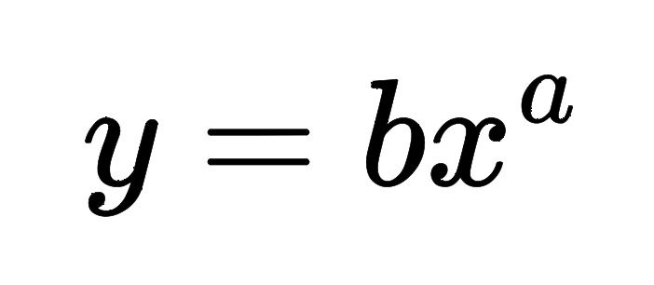
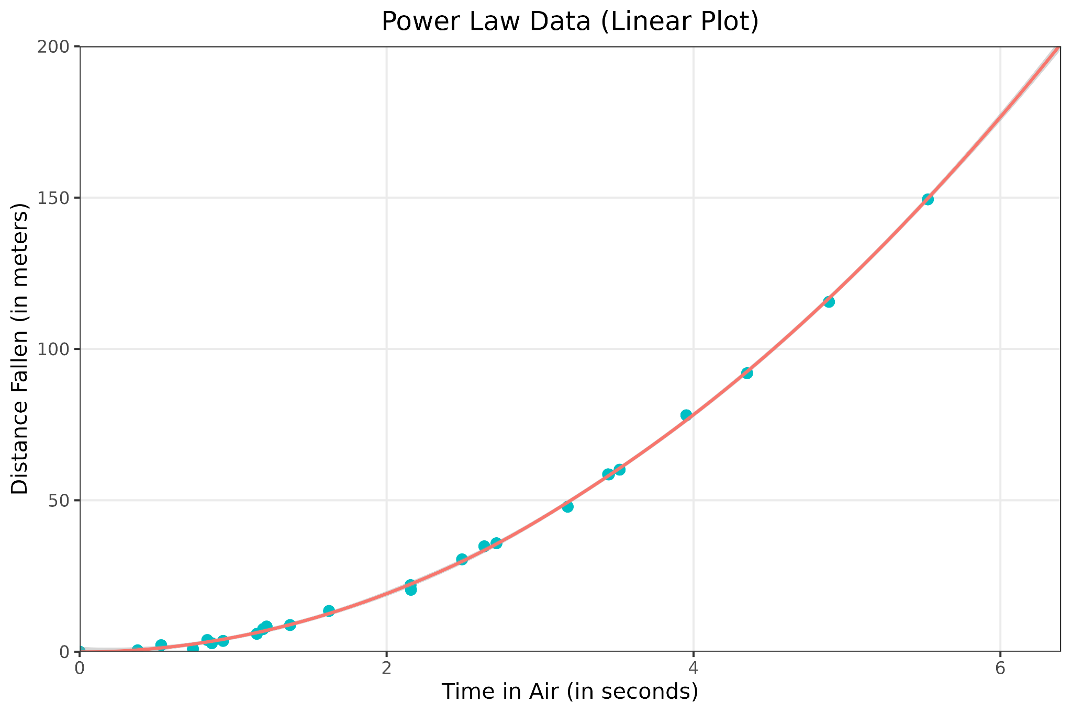
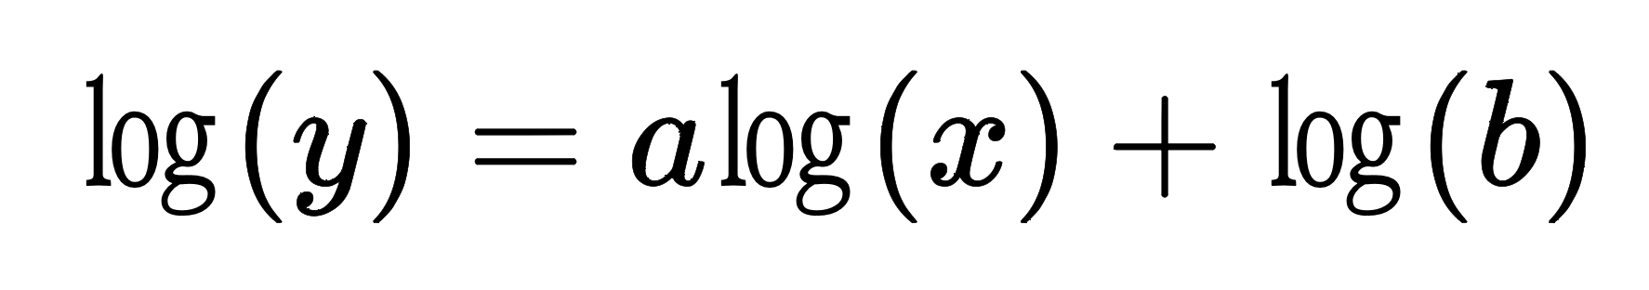
Power Laws
Scaling laws are a type of power law, in which one quantity varies as a power of another.
The change in y is proportional to the change in x raised to a.
A power law relationship is linear in the logarithmic space.
Introduction to AI SES
‹#›

Slide 52
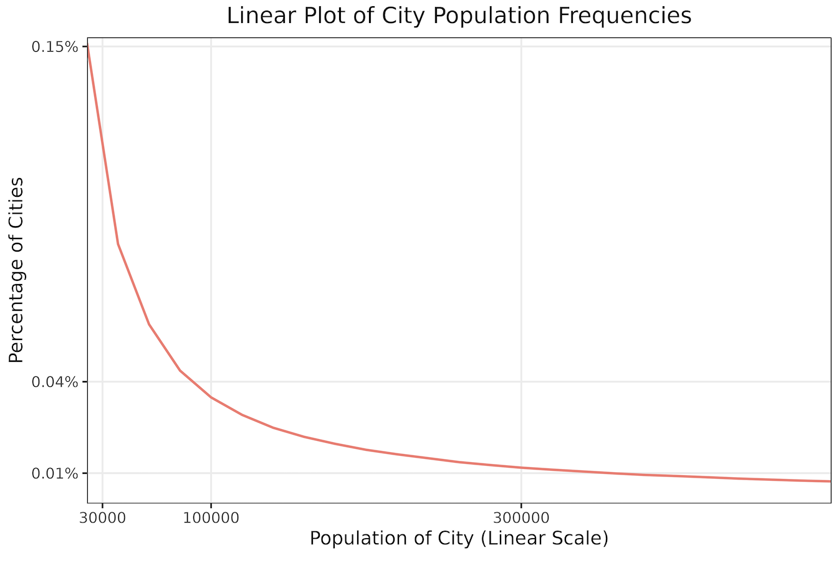
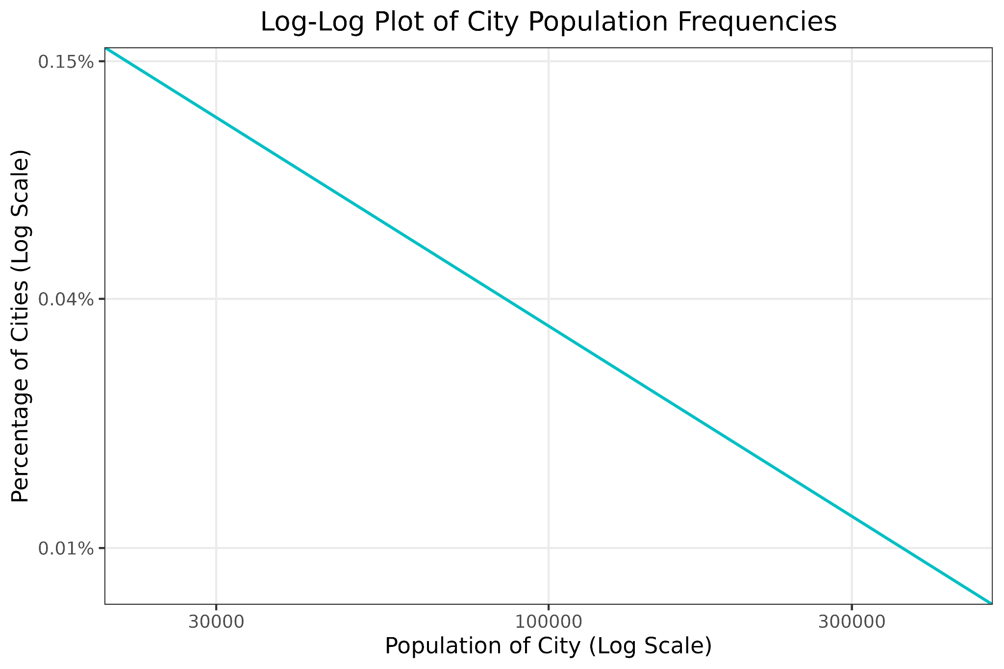
Power Laws
Power laws are very ubiquitous, found throughout nature and society.
Examples include the distributions of earthquake magnitudes, social media content generation, wealth, and city populations.
Introduction to AI SES
‹#›

Slide 53
Scaling Laws in Deep Learning
Scaling laws follow power laws that predict loss based on model size and dataset size.
Model size is measured in parameters, a model’s adjustable weights.
Dataset size is measured in tokens, fundamental units of data that may vary based on the type of data.
Loss falls nonlinearly with increased numbers of parameters or tokens.
Scaling is dependent on computational power (compute), which enables more operations, more parameters, and processing of more data.
Introduction to AI SES
‹#›

Slide 54
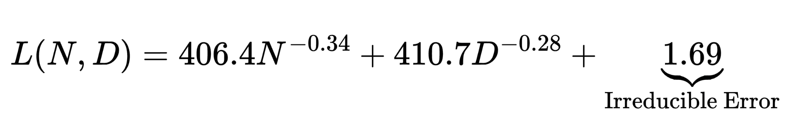
The Chinchilla Scaling Example (1/2)
Chinchilla is a LLM that was outperformed much larger models (in terms of parameters) by training on more data (tokens).
Chinchilla scaling law:
Loss
Tokens
Parameters
Introduction to AI SES
‹#›

Slide 55
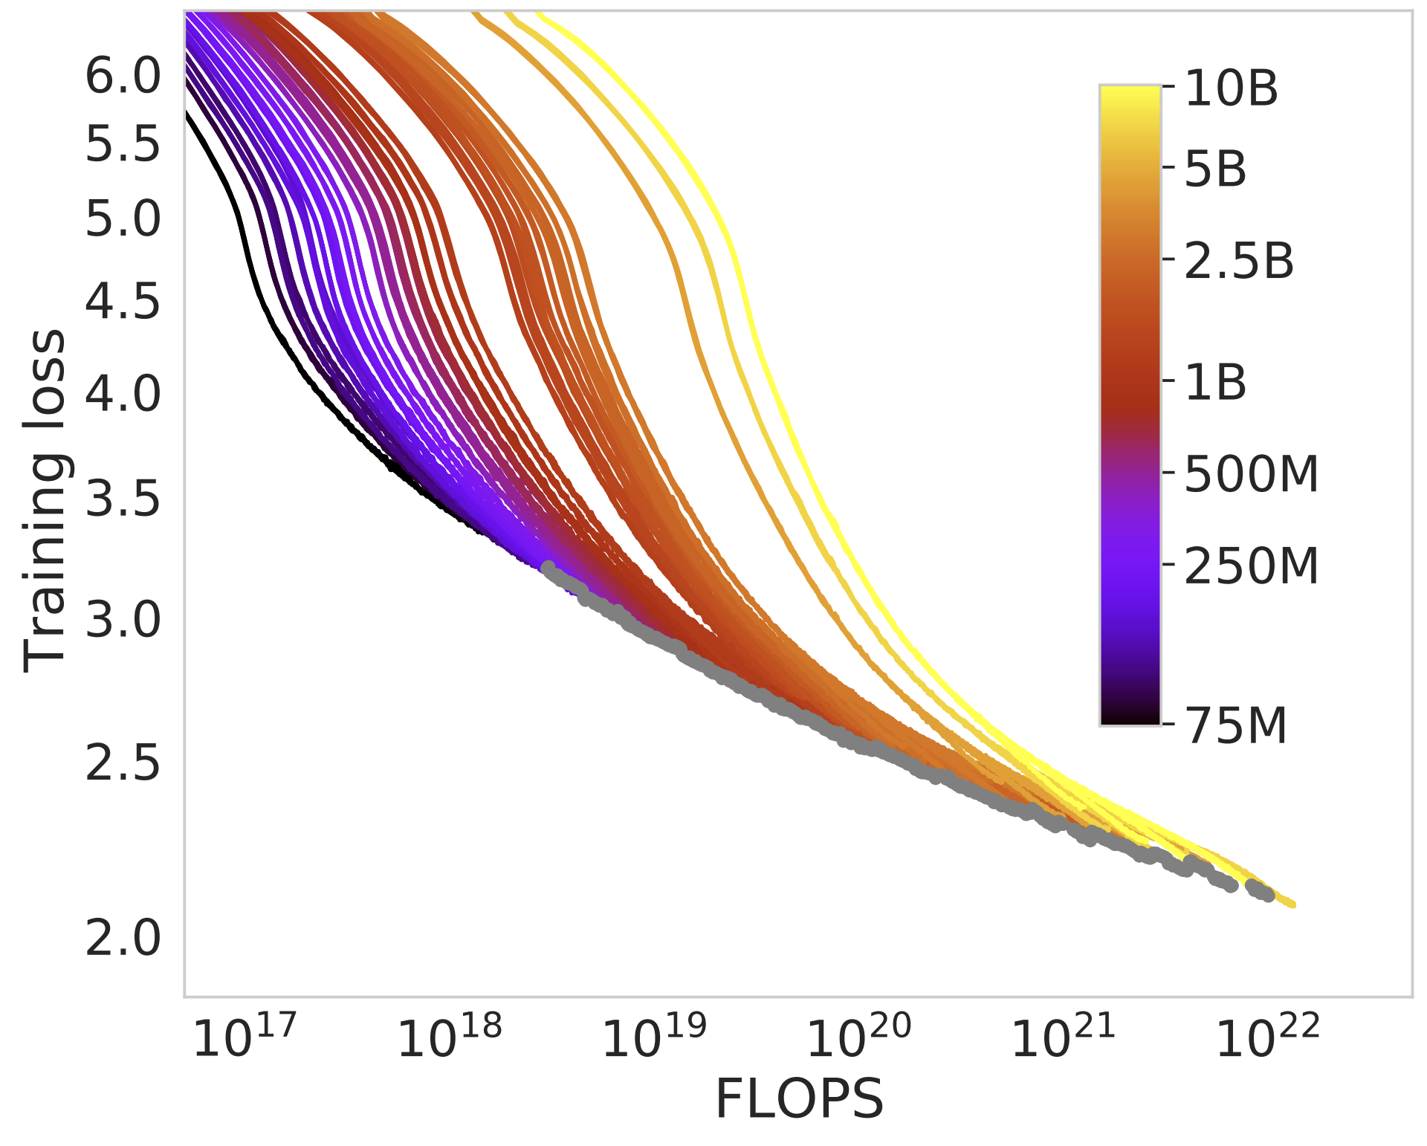
The Chinchilla Scaling Example (2/2)
Introduction to AI SES
‹#›

Slide 56
Discussion of Scaling Laws
Scaling laws hold across modalities and orders of magnitude—factors of ten—applying to both small and larger models.
Scaling laws describe some ML models more closely than others.
Generative models like LLMs following scaling laws closely.
Discriminative models like image classifiers do not.
Better learning algorithms increase the constant term in scaling laws.
Introduction to AI SES
‹#›

Slide 57
The Bitter Lesson
AI researchers have often tried to improve systems using expert knowledge.
This approach only leads to improvements in the short term, and may even hurt long term progress.
Breakthrough progress occurs when developers instead scale computation and data.
Takeaway: The simple method of increasing scale beats complex research approaches.
Introduction to AI SES
‹#›

Slide 58
Introduction to
AI Safety, Ethics, and Society
Artificial Intelligence Fundamentals
Part 3: Reinforcement Learning
Introduction to AI SES
‹#›

Slide 59
Roadmap
Artificial Intelligence: Definitions, history, and types.
Machine Learning: Models, tasks, data, and learning types.
Deep Learning: The preeminent paradigm.
Scaling Laws: Many AI systems improve predictably with scale.
Reinforcement Learning: RL agents learn by interacting with their environments.
Introduction to AI SES
‹#›

Slide 60
Reinforcement Learning
RL agents learn by interacting with their environments.
Introduction to AI SES
‹#›

Slide 61
Introduction (1/2)
Reinforcement learning (RL) is a field of machine learning where agents learn by exploring their environments.
RL agents take different actions and learn from consequences, in order to maximize reward.
In other ML techniques, systems learn from a existing dataset.
Reinforcement learning is inspired by how humans and animals learn.
Introduction to AI SES
‹#›

Slide 62

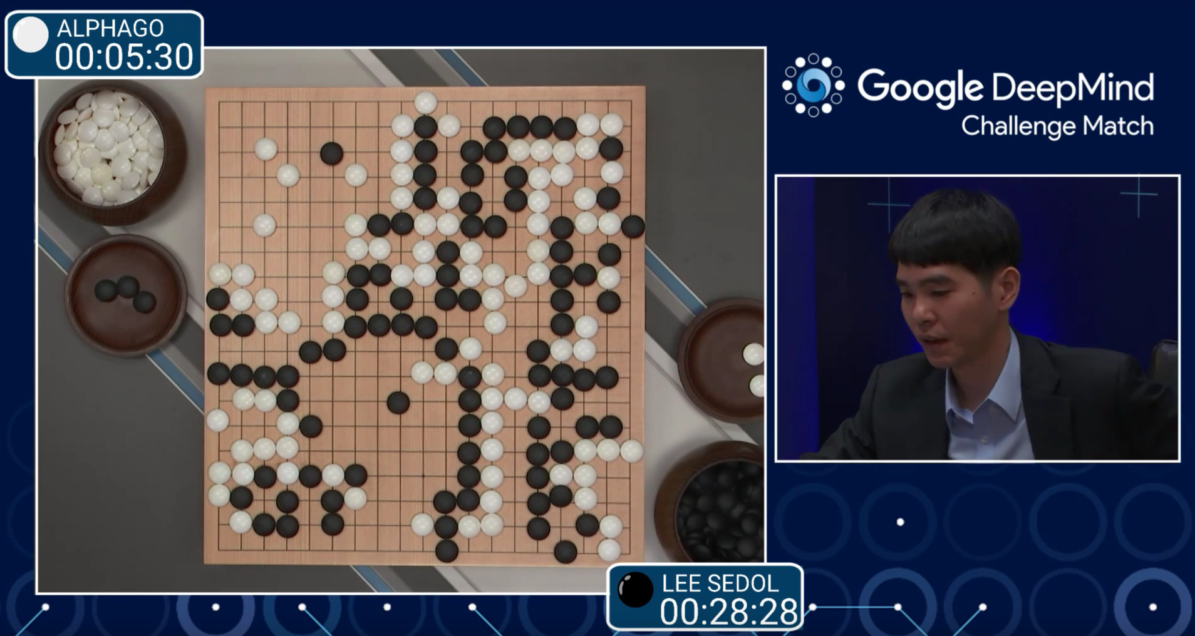
Introduction (2/2)
Human learning
Reinforcement learning
Humans learn from experiences of interacting with the world.
A child learns not to touch hot surfaces after feeling the pain once.
Reinforcement learning mirrors human and animal learning.
DeepMind’s AlphaGo uses RL to learn to beat the top Go players.
Introduction to AI SES
‹#›
Notes:
Image: https://www.popularmechanics.com/technology/a19844/googles-alphago-ai-wins-first-round-against-go-champion/
Image: https://www.pexels.com/photo/photo-of-girl-baking-cookies-4149015/

Slide 63
Reinforcement Learning
Typically, RL agents do not initially have information about their environment.
They use trial and error to gain information and inform decision making.
RL is a form of sequential decision making.
What is the correct order of actions?
What are delayed consequences of actions?
How should changes in the environment impact decision making?
Introduction to AI SES
‹#›

Slide 64
Reinforcement Learning
Sequential decision making is a type of sequence modeling task, which analyzes ordered data and makes predictions.
Data for RL agents is observations of the environment over time.
While supervised and unsupervised learning involve structured datasets, RL agents must interact with the environment to gather data.
Introduction to AI SES
‹#›
Notes:
Image: https://commons.wikimedia.org/wiki/File:Markov_diagram_v2.svg

Slide 65
The Reinforcement Learning Problem
Multi-Armed
Bandits
The Full RL
Problem
Policies in RL
Introduction to AI SES
‹#›

Slide 66
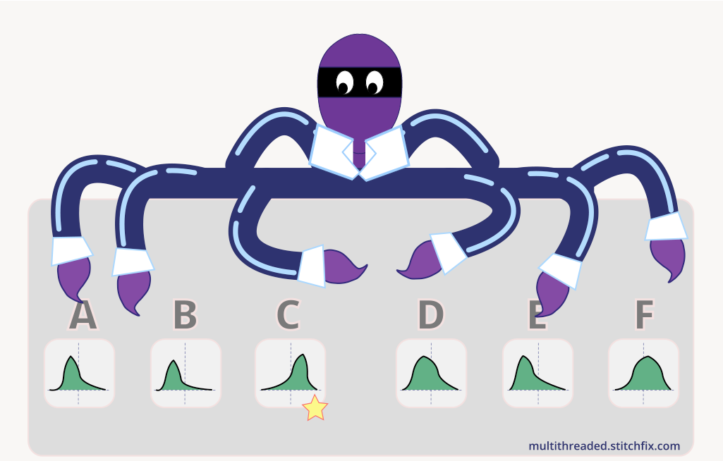
Multi-Armed Bandits (1/2)
Suppose there’s a slot machine with multiple levers which lead to different outcomes. What levers should one pull and in what order?
Introduction to AI SES
‹#›

Slide 67
Multi-Armed Bandits (2/2)
Exploration vs. exploitation.
Try different actions with uncertain rewards.
Take actions with high expected value.
Greedy strategy: Try each lever once and repeatedly pull the most profitable.
May choose a suboptimal lever to pull.
Epsilon-greedy: Greedy strategy but pull randomly 5% of the time, so as to gather more information.
In the long run, pulls the optimal lever 95% of the time.
Introduction to AI SES
‹#›

Slide 68
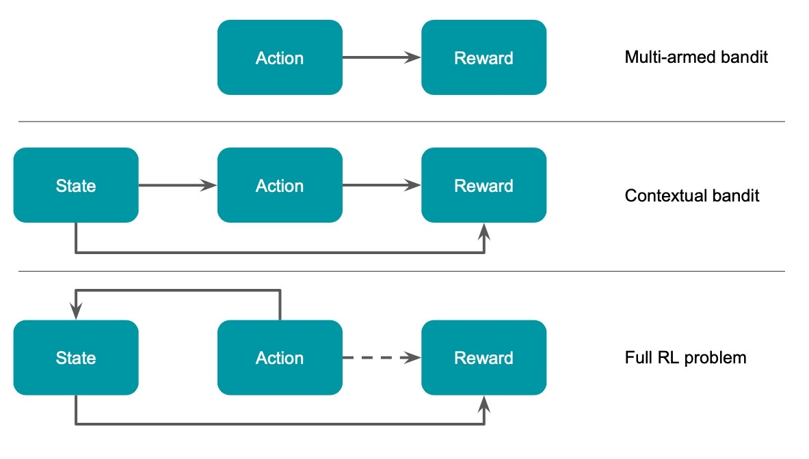
Full RL Problem
Add context: Suppose each lever has a light that varies randomly between green and red. The lever has a different distribution for each color.
Add interaction: Suppose the color of the lever depends on previous actions taken by the agent.
The agent must now consider environmental context and the sequence of decision making: this is a full RL problem.
Introduction to AI SES
‹#›

Slide 69
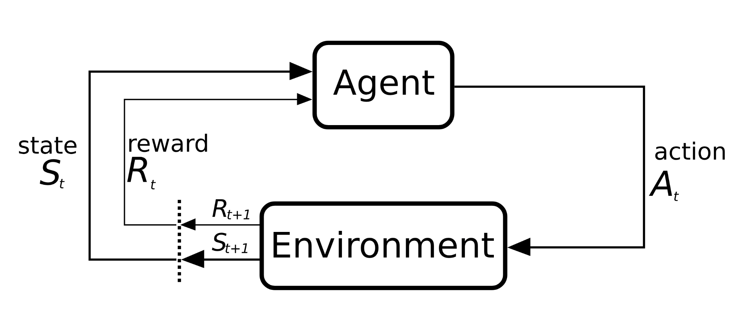
The Agent-Environment Loop
Rewards are feedback received at each time step. Reward shaping is the process of designing suitable rewards for a problem. Future rewards may be discounted.
State is a snapshot of the non-reward information an agent knows about the environment.
Agents take actions from the action space—set of possible actions—to affect the environment.
Introduction to AI SES
‹#›

Slide 70
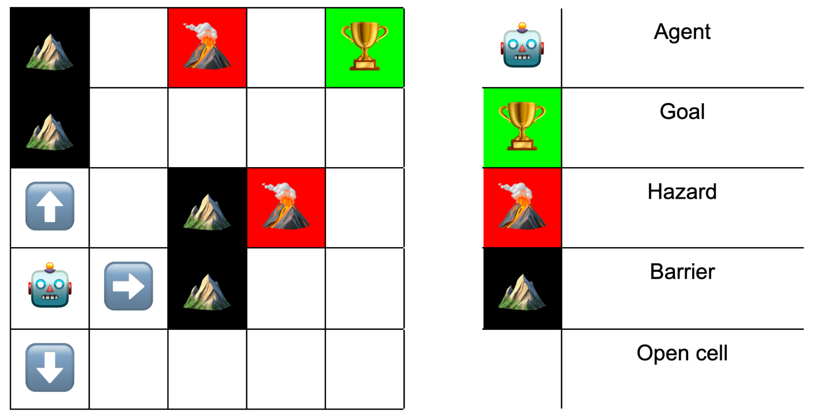
Gridworld
In gridworld, agents move from cell to cell, aiming to find the goal while avoiding hazards.
The environment is fully observable.
The action space is discrete and consists of all possible moves to unoccupied adjacent spaces.
Example rewards: +10 for finding the goal, -10 for encountering a hazard, 0 otherwise.
Introduction to AI SES
‹#›

Slide 71
Policies
A policy specifies an action for each possible state observation.
Deterministic policies takes actions with certainty. Stochastic policies—like greedy-epsilon—have some randomness involved.
An optimal policy maximizes rewards.
In Gridworld, an optimal policy reaches the goal in the fewest possible steps.
In chess, an optimal policy would need to specify an action in 10^45 possible board positions, but RL agents can find powerful approximations.
Introduction to AI SES
‹#›

Slide 72
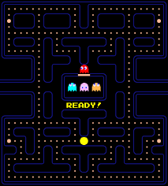
Methods for Solving RL Problems (1/3)
RL algorithms guide the learning process.
In model-based RL, the agent constructs a representation of its environment.
A model-free RL agent playing Pac-Man may learn associations like “eat a power pellet and then chase ghosts to earn high scores.”
In model-free RL, the agent learns helpful associations from experience, rather than construct a full model of the environment.
Introduction to AI SES
‹#›
Notes:
Image: https://commons.wikimedia.org/wiki/File:Pac-man_oyununun_ba%C5%9Flang%C4%B1c%C4%B1.png

Slide 73
Methods for Solving RL Problems (2/3)
RL methods can be policy-based, value-based, or both.
Policy-based: agents focus on learning sets of rules to guide actions in response to different states.
Value-based: agents try to estimate the value of actions and states, and attempt to choose those with the highest expected reward.
An agent’s value functions estimates the expected rewards.
They help estimate a policy’s long run rewards.
State-value functions estimate the total rewards from starting at state s and following policy 𝜋.
Action-value functions estimate the total rewards from taking action a at state s and then following policy 𝜋.
Introduction to AI SES
‹#›

Slide 74
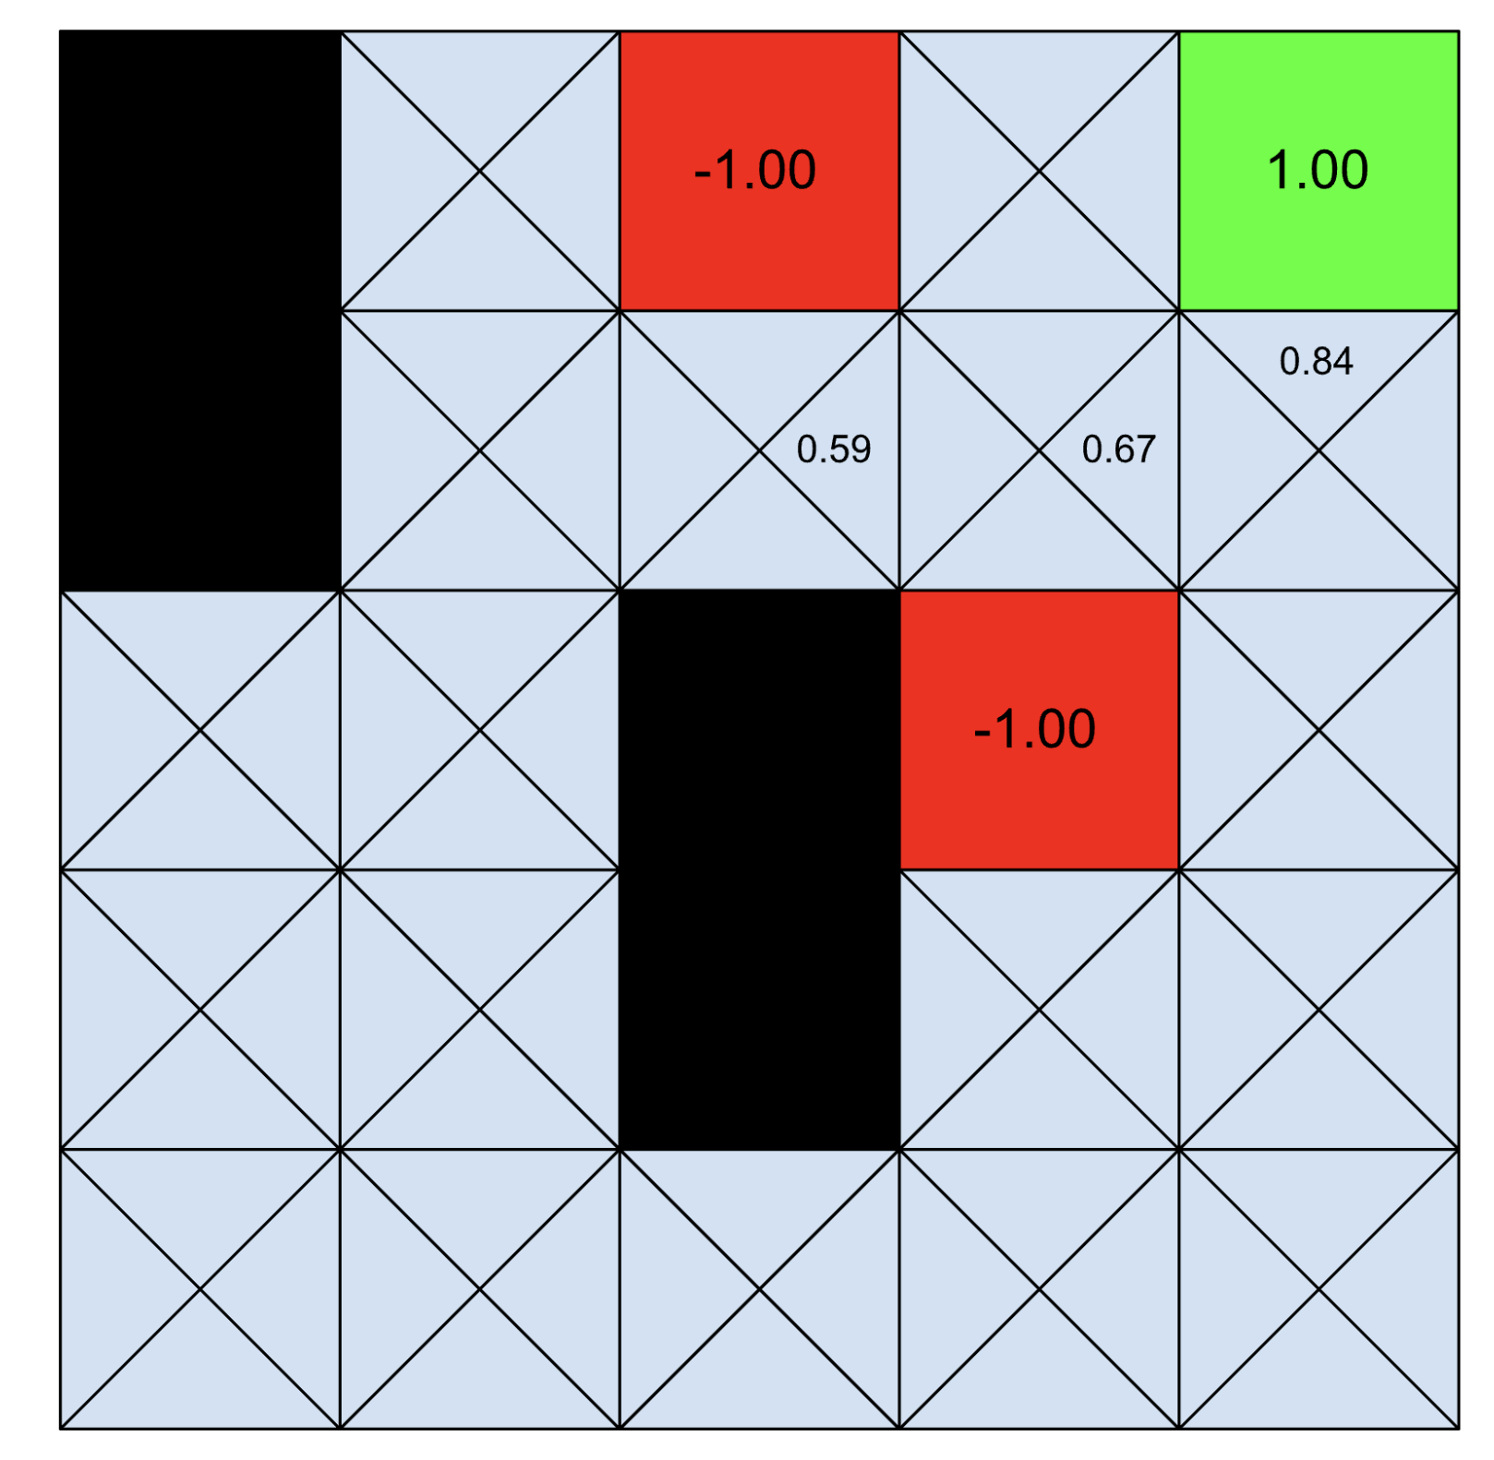
Methods for Solving RL Problems (3/3)
Action-valued functions are also called Q-functions, and their outputs are called Q-values.
Q-learning is a reinforcement learning algorithm where agents learn what actions to take in different states.
The agent attempts to iteratively construct a Q-function that outputs accurate Q-values, based on what it has learned.
It takes the action with the highest Q-value.
Introduction to AI SES
‹#›

Slide 75
Deep Reinforcement Learning
Deep reinforcement-learning (Deep RL) uses deep learning techniques to help solve reinforcement problems.
Deep RL has been a pivotal part of RL in recent years:
Modeling the policy function.
Approximating the value function.
Modeling the environment.
Introduction to AI SES
‹#›

Slide 76
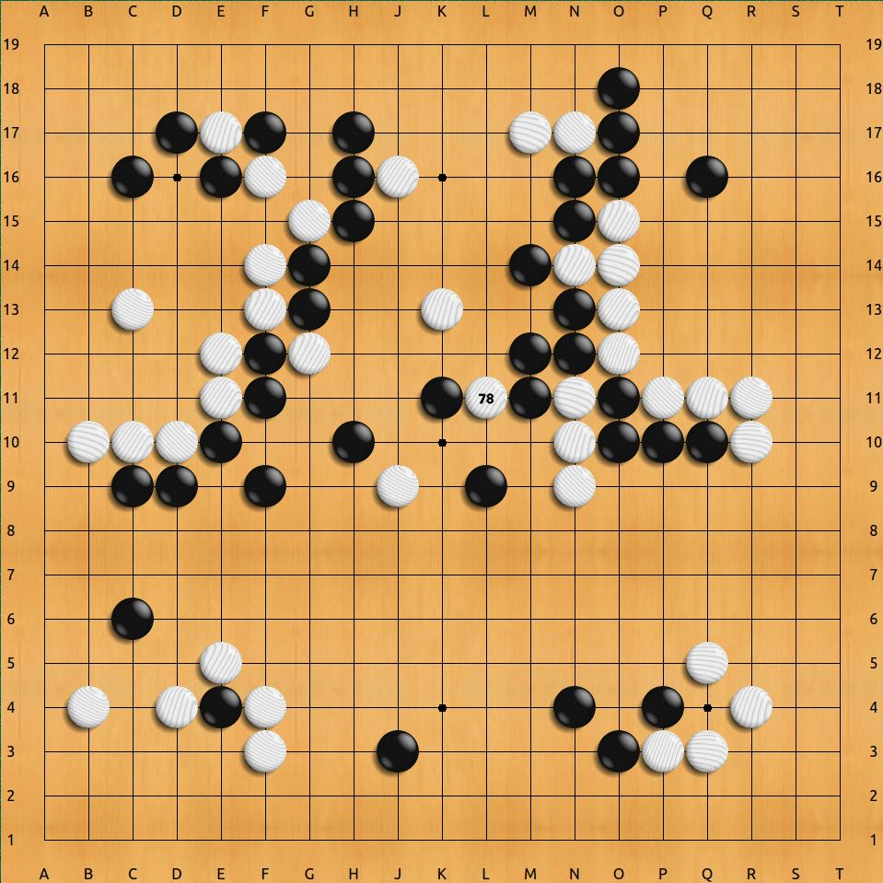
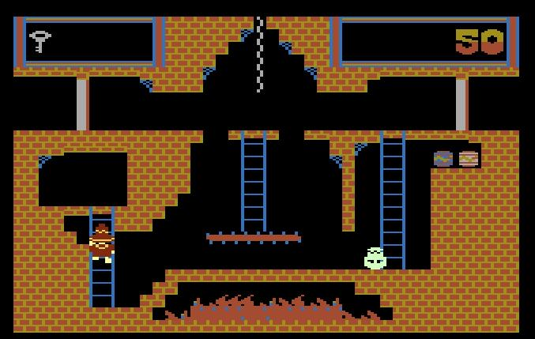
Examples of RL (1/2)
AlphaGo
Atari
Go is a fully-observable board game that is more complex than chess.
RL agents have mastered classic Atari video games like Pacman, Montezuma’s Revenge, and Breakout.
AlphaGo bettered human performance by playing against itself millions of times.
In Montezuma’s Revenge, agents overcame sparse rewards by adopting a preference for novelty.
Introduction to AI SES
‹#›

Slide 77

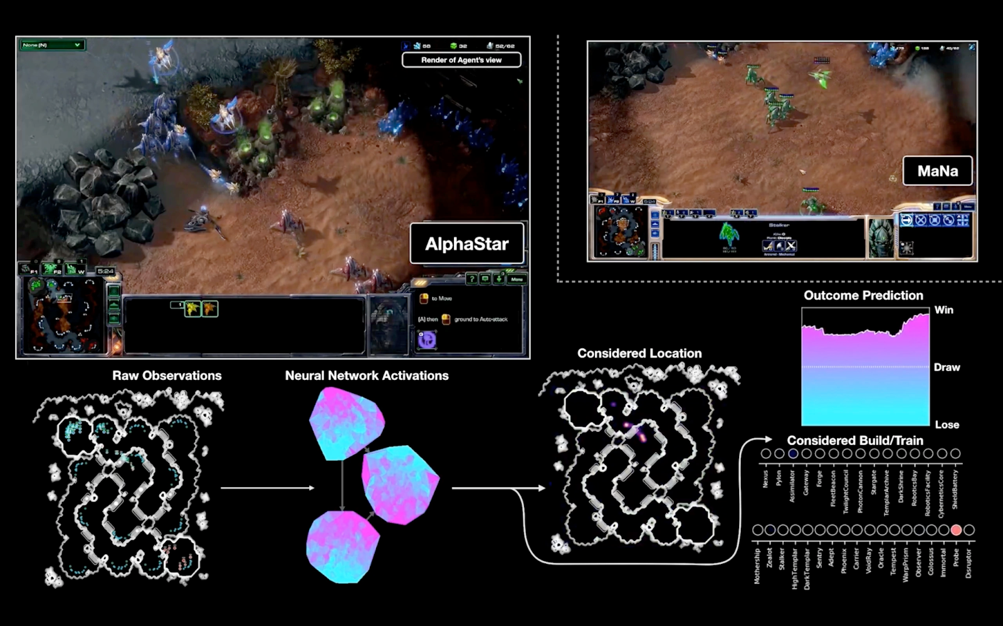
Examples of RL (2/2)
AlphaStar
Diplomacy
DeepMind’s program mastered StarCraft, a two player strategy game with significant uncertainty due to a partially-observable board.
Facebook’s Cicero used natural language to communicate and surpass human performance in Diplomacy.
Cicero demonstrated the ability to deceive human players.
Introduction to AI SES
‹#›

Slide 78
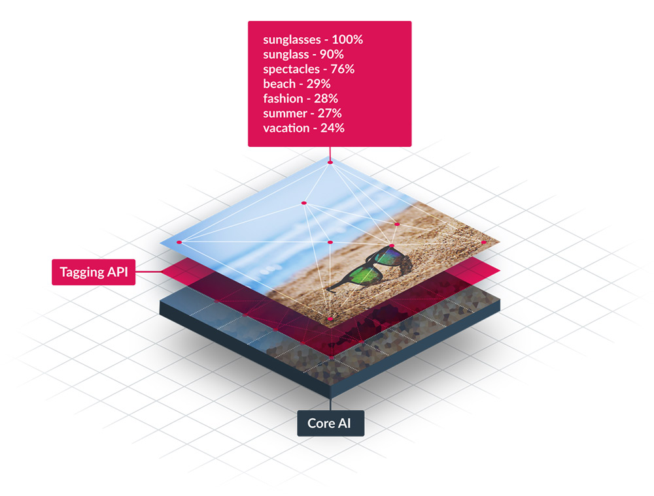

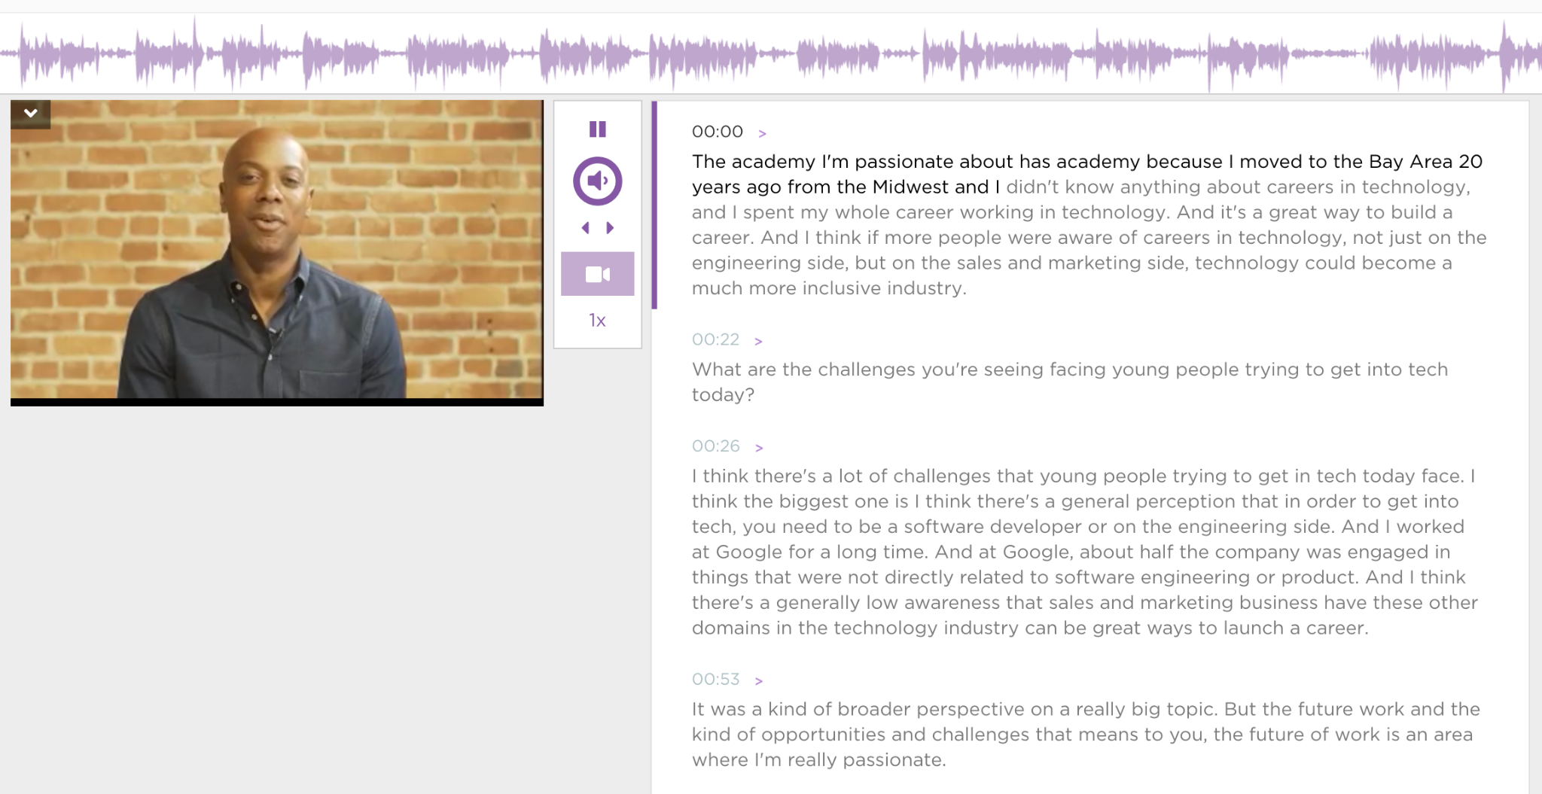





Applications
Communication, entertainment, and productivity:
Streaming services: recommendation systems
Social media: photo auto-tagging and video transcription
Personal assistants: SIRI, Google Assistant, and Alexa
Introduction to AI SES
‹#›

Slide 79
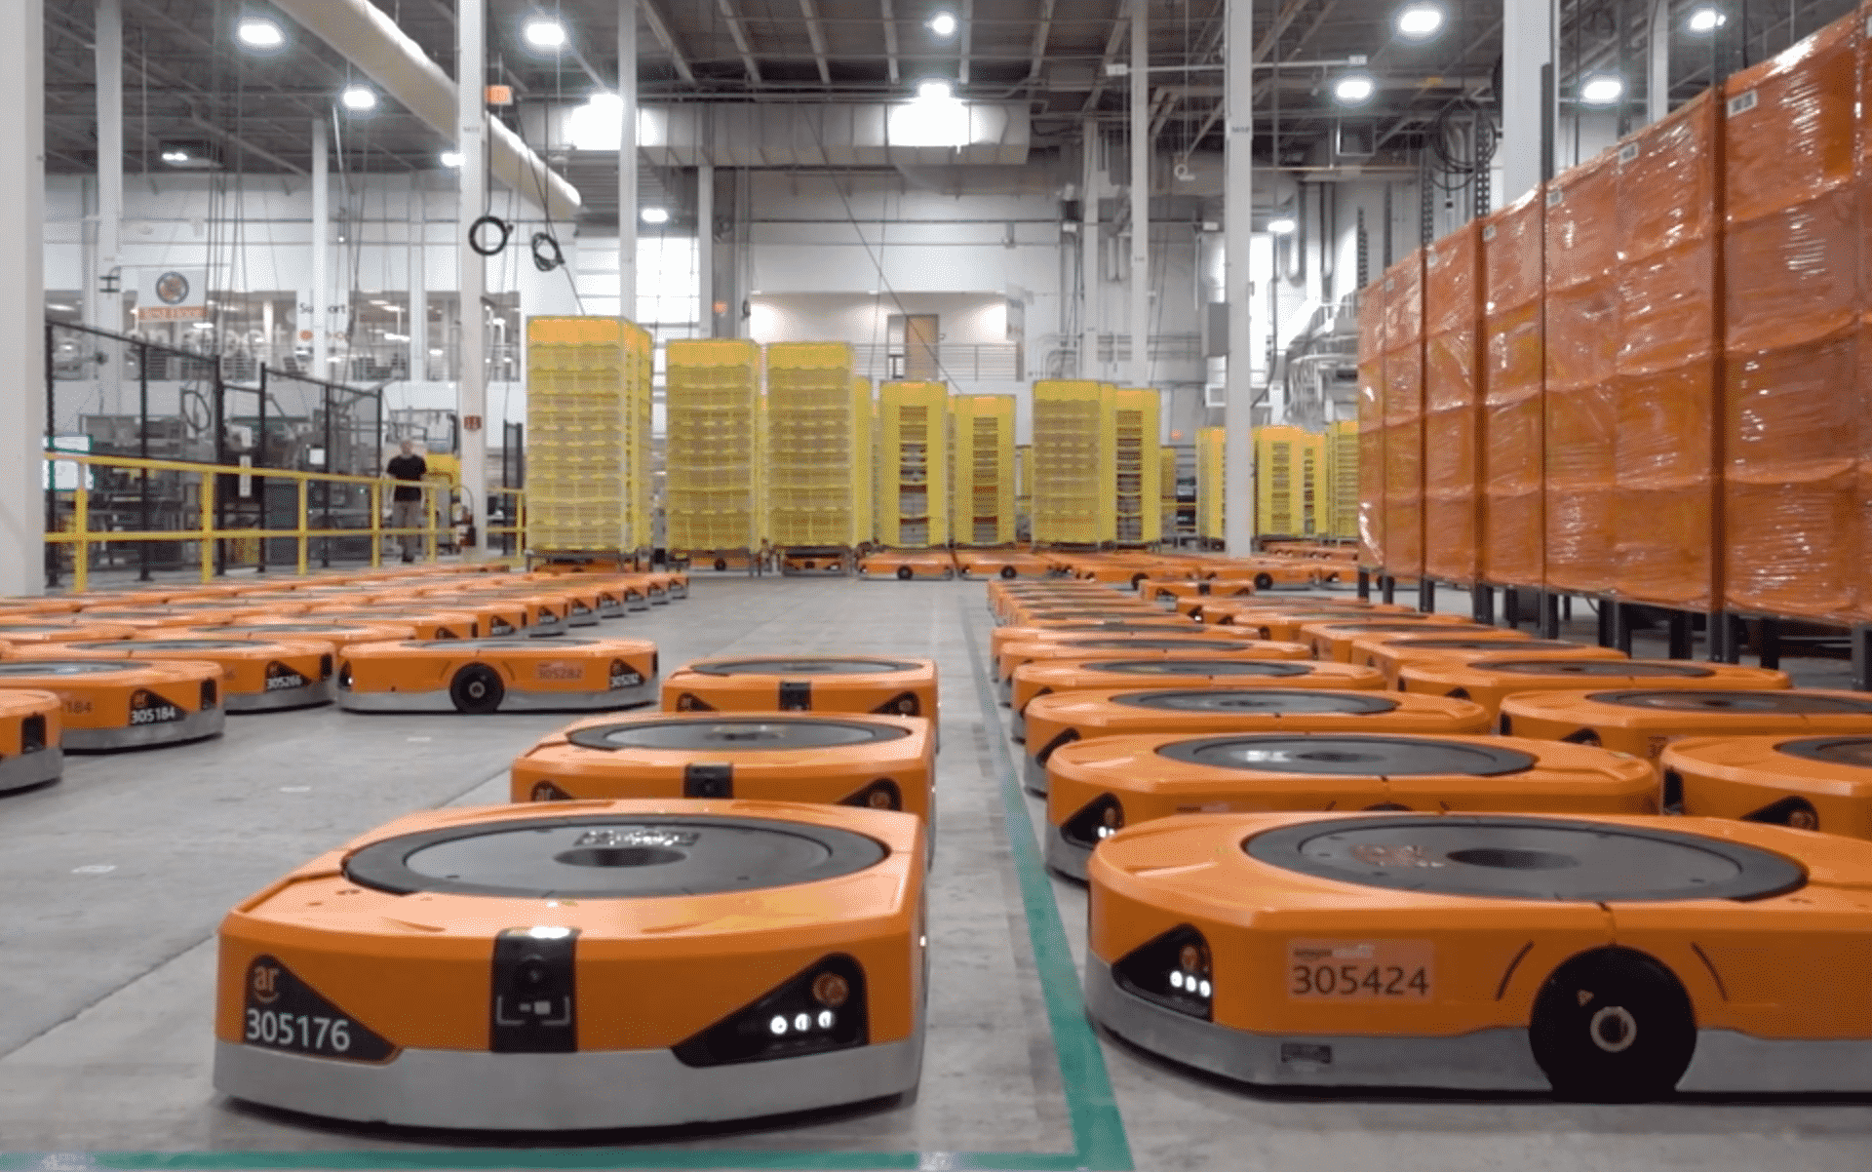

Applications
Transportation:
Autonomous vehicles: object recognition and decision-making
Retail and logistics: inventory management and warehouse robots
Healthcare, cybersecurity, agriculture, finance, business analytics…
Introduction to AI SES
‹#›

Slide 80
Recap
Reinforcement learning agents interact with their environment to learn which actions tend to be good and which tend to be bad.
RL balance exploration with exploitation of its findings.
RL agents develop policies that specify how they act in various contexts.
Different RL approaches differ on the basis of action (value- vs. policy-based) and model (model-based vs model-free).
RL models have been become world-class at games and specific tasks.
Introduction to AI SES
‹#›

Slide 81
Chapter Recap
Artificial Intelligence: Definitions, historical development, and types.
Machine Learning: Models, tasks, data, and learning types.
Deep Learning: Fundamental concepts and applications.
Scaling Laws: Predictable improvement in performance with scale.
Introduction to AI SES
‹#›

