Slide 1
Introduction to
AI Safety, Ethics, and Society
Introduction and AI Risk Overview
Introduction to AI SES
‹#›

Slide 2
Roadmap
1. Course Philosophy
2. An Overview of AI Risks
Introduction to AI SES
‹#›

Slide 3
Course Approach
This course covers:
An overview of risk sources
AI fundamentals
An overview of empirical AI safety research
Safety engineering and complex systems
Machine ethics and normative ethics
Collective action problems
AI governance
Introduction to AI SES
‹#›
Notes:
Not possible to get oriented by just learning about AI + empirical AI safety research. Too many other variables don’t know enough about

Slide 4
Course Approach
AI risk is affected by both AIs and human agencies (such as developers and nation states).
There are many frameworks one could learn. We opt for frameworks applicable to a large fraction of these different actors:
Game theory
Complex systems
Ethics
Generalized Darwinism
Safety engineering
For AIs and AI developers
Introduction to AI SES
‹#›

Slide 5
Course Approach
Why have an interdisciplinary understanding of AI risk?
These tensions cannot be addressed by just learning more about AI:
  AI development speed vs. national competitiveness
  Deploying unreliable AI systems for real-world feedback vs. deploying only when AI systems are highly reliable
  Open-sourcing AI systems vs. limited access
AI risks cannot all be fixed by improving AI systems:
  AI risk management is mostly not a technical problem
We need formal, general models to adapt to quickly changing AI risks; analysis through ephemeral facts or historical analogies is too brittle.
Introduction to AI SES
‹#›
Notes:
Why learn, for example, safety engineering? Why learn probability, isn’t that just “chance”?

Slide 6
Roadmap
1. Course Philosophy
2. An Overview of AI Risks
Introduction to AI SES
‹#›

Slide 7
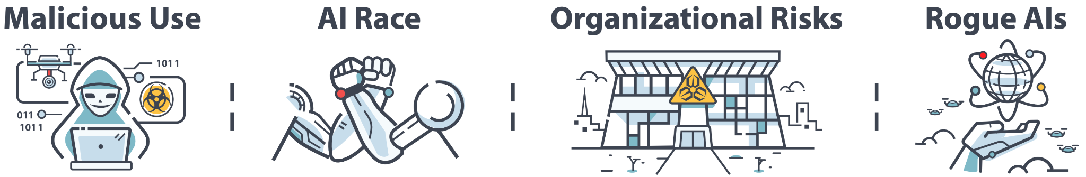
Taxonomizing Major Sources of Risk
Introduction to AI SES
‹#›

Slide 8
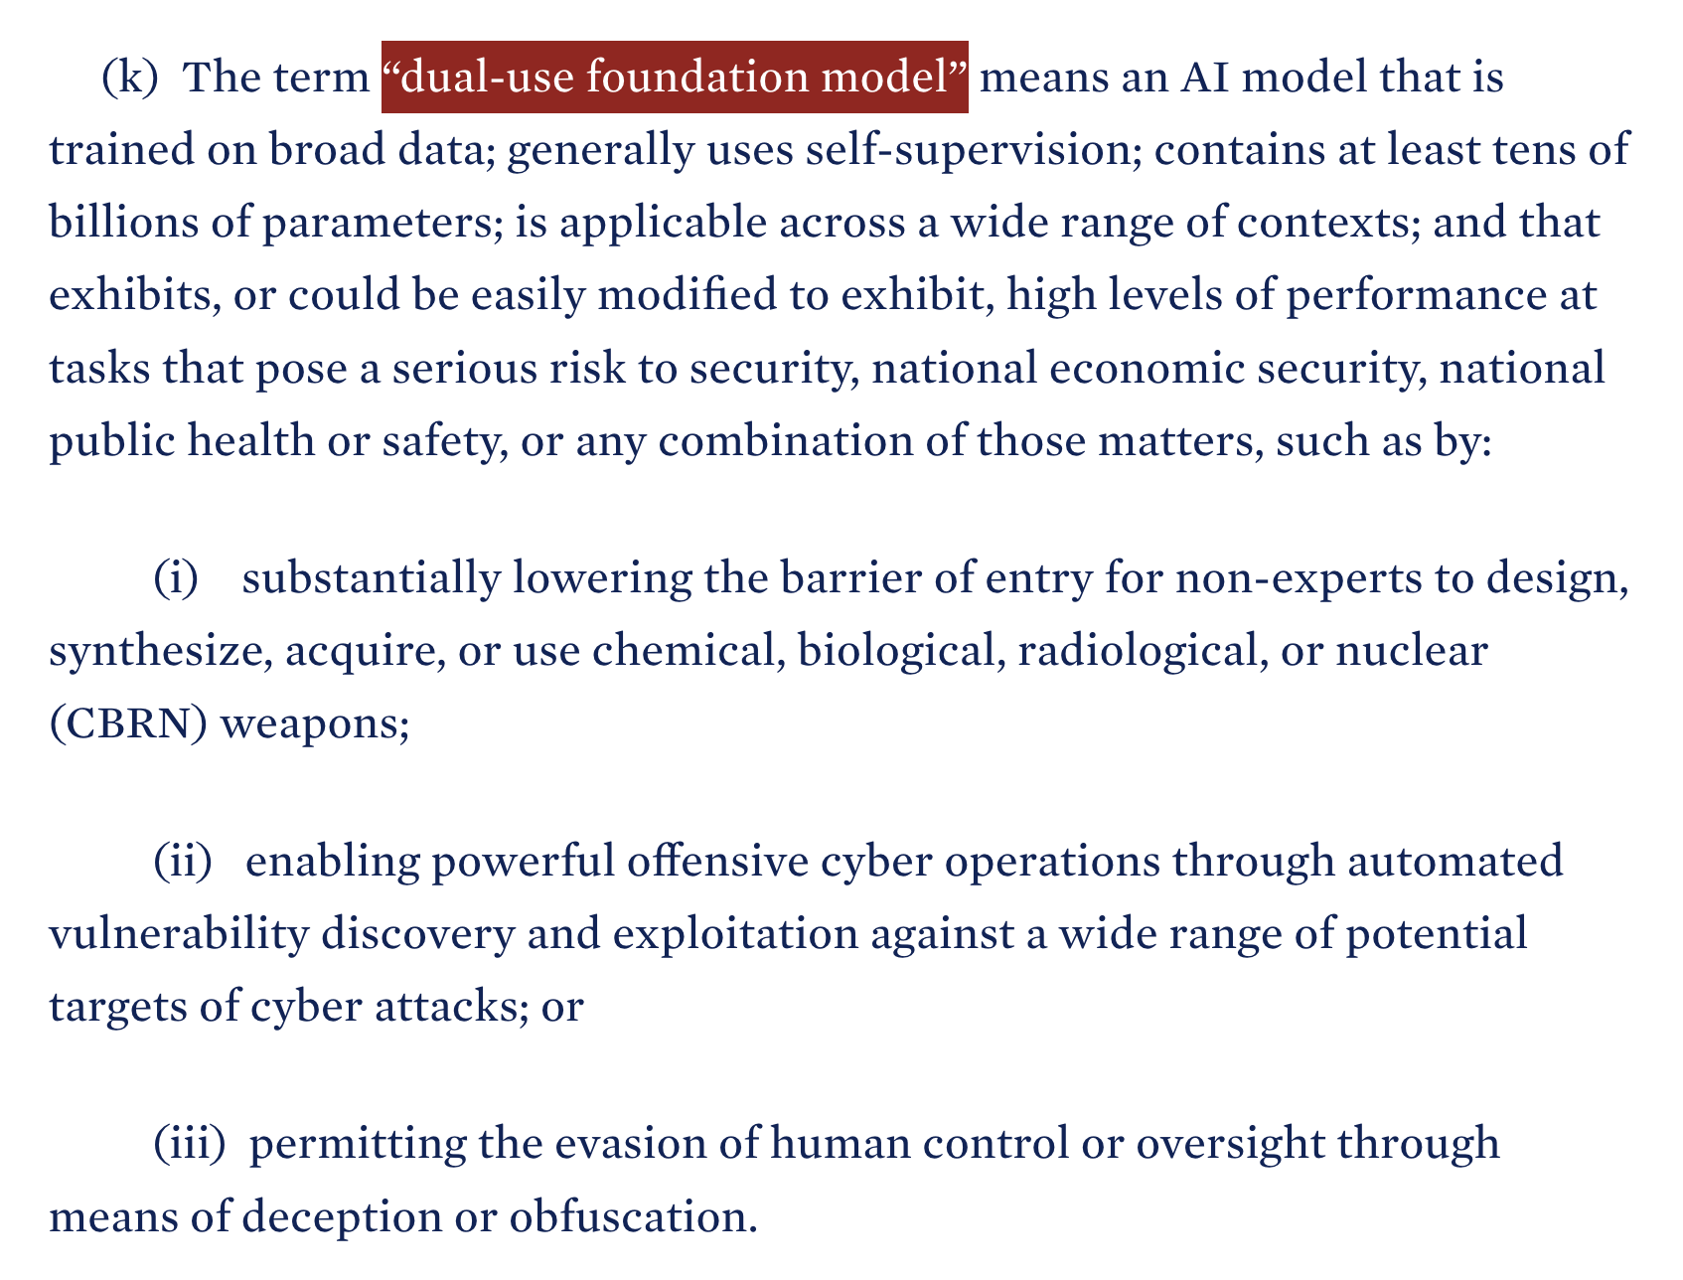
White House Executive Order
Introduction to AI SES
‹#›

Slide 9
Biological and Cyber Risks
Introduction to AI SES
‹#›

Slide 10
Bioweapons (1/2)
Natural pandemics represent major threats.
The Black Death killed 5-40% of world population.
Human engineered pandemics could be significantly worse.
Gain-of-function research has produced hyper-transmissible H5N1 influenza viruses
Risk of bioweapons depends on the number of people with skill and access multiplied by their willingness to build a weapon
Introduction to AI SES
‹#›
Notes:
Large language models could give non-experts more access to our current dual-use capabilities:
Finding/explain dual-use information: LLMs can speed up literature reviews by putting technical jargon into more easily understandable language. Unlike a dictionary, they can try many times to explain something and even answer follow-up questions.
Operational troubleshooting: LLMs can also help problem-solve operational difficulties, providing advice on executing wet lab protocols, interpreting experimental results, and writing code to analyse data.
Enable secrecy: LLms not only help strategize everything from design to deployment, but they’ll be discrete about it, too. This could allow much smaller groups to operate without the need to include more people meaning they’re more likely to remain covert.
Protein design tools could help experts extend the capabilities frontier:
Produce pandemic-capable viruses, or even edit them to make them more deadly
Improve bioweapon design, perhaps by stabilising biological agents
Help users specifically with evading security measures like sequencing screens

Slide 11
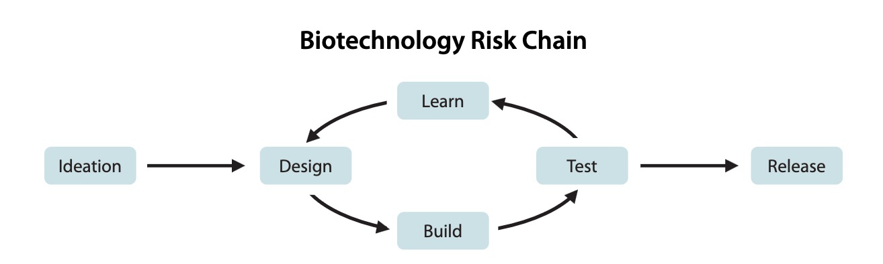
Bioweapons (2/2)
Introduction to AI SES
‹#›
Notes:
Large language models could give non-experts more access to our current dual-use capabilities:
Finding/explain dual-use information: LLMs can speed up literature reviews by putting technical jargon into more easily understandable language. Unlike a dictionary, they can try many times to explain something and even answer follow-up questions.
Operational troubleshooting: LLMs can also help problem-solve operational difficulties, providing advice on executing wet lab protocols, interpreting experimental results, and writing code to analyse data.
Enable secrecy: LLms not only help strategize everything from design to deployment, but they’ll be discrete about it, too. This could allow much smaller groups to operate without the need to include more people meaning they’re more likely to remain covert.
Protein design tools could help experts extend the capabilities frontier:
Produce pandemic-capable viruses, or even edit them to make them more deadly
Improve bioweapon design, perhaps by stabilising biological agents
Help users specifically with evading security measures like sequencing screens

Slide 12
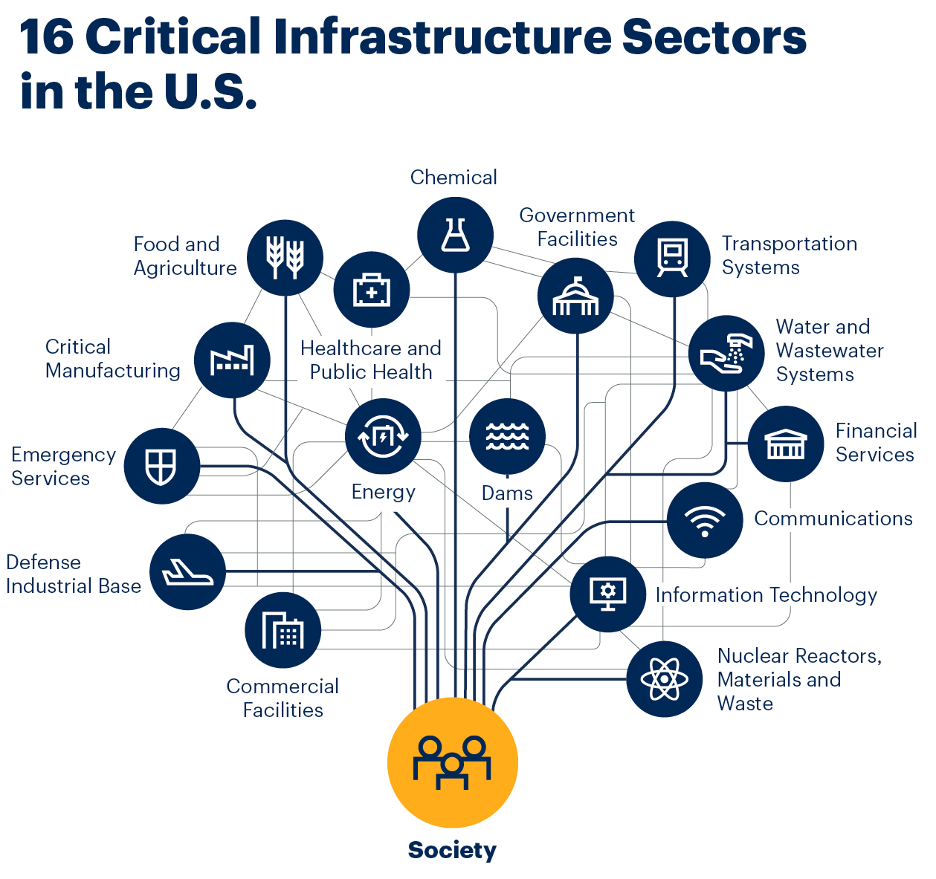
Cyberweapons (1/2)
AIs have the potential to increase the accessibility, success rate, scale, speed, stealth and potency of cyberattacks.
Cyberattacks can destroy critical infrastructure.
Difficulties in attributing AI-driven cyberattacks could increase the risk of war.
Introduction to AI SES
‹#›

Slide 13
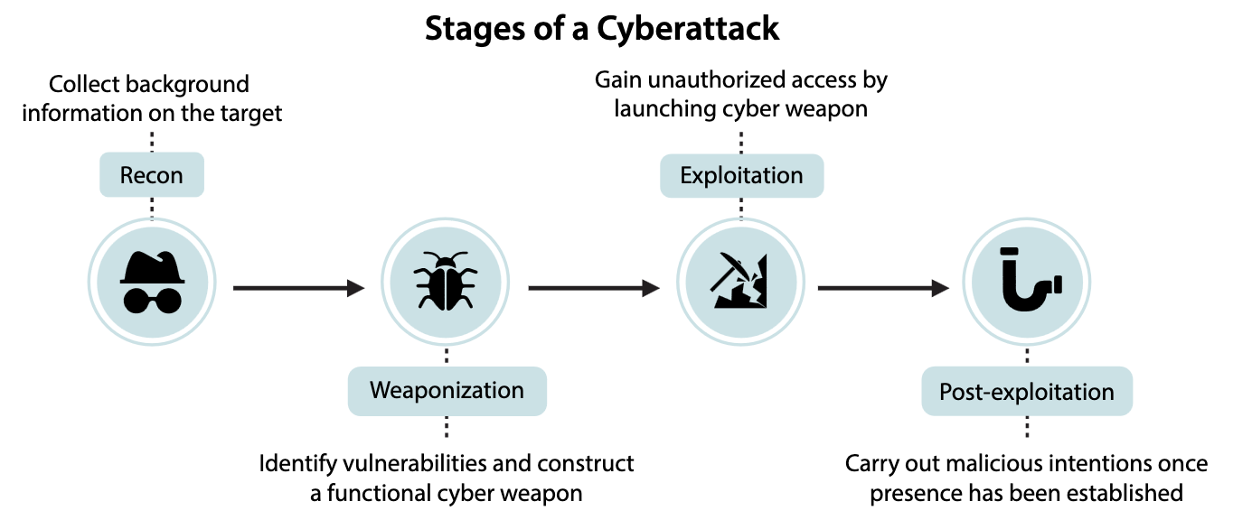
Cyberweapons (2/2)
Introduction to AI SES
‹#›

Slide 14
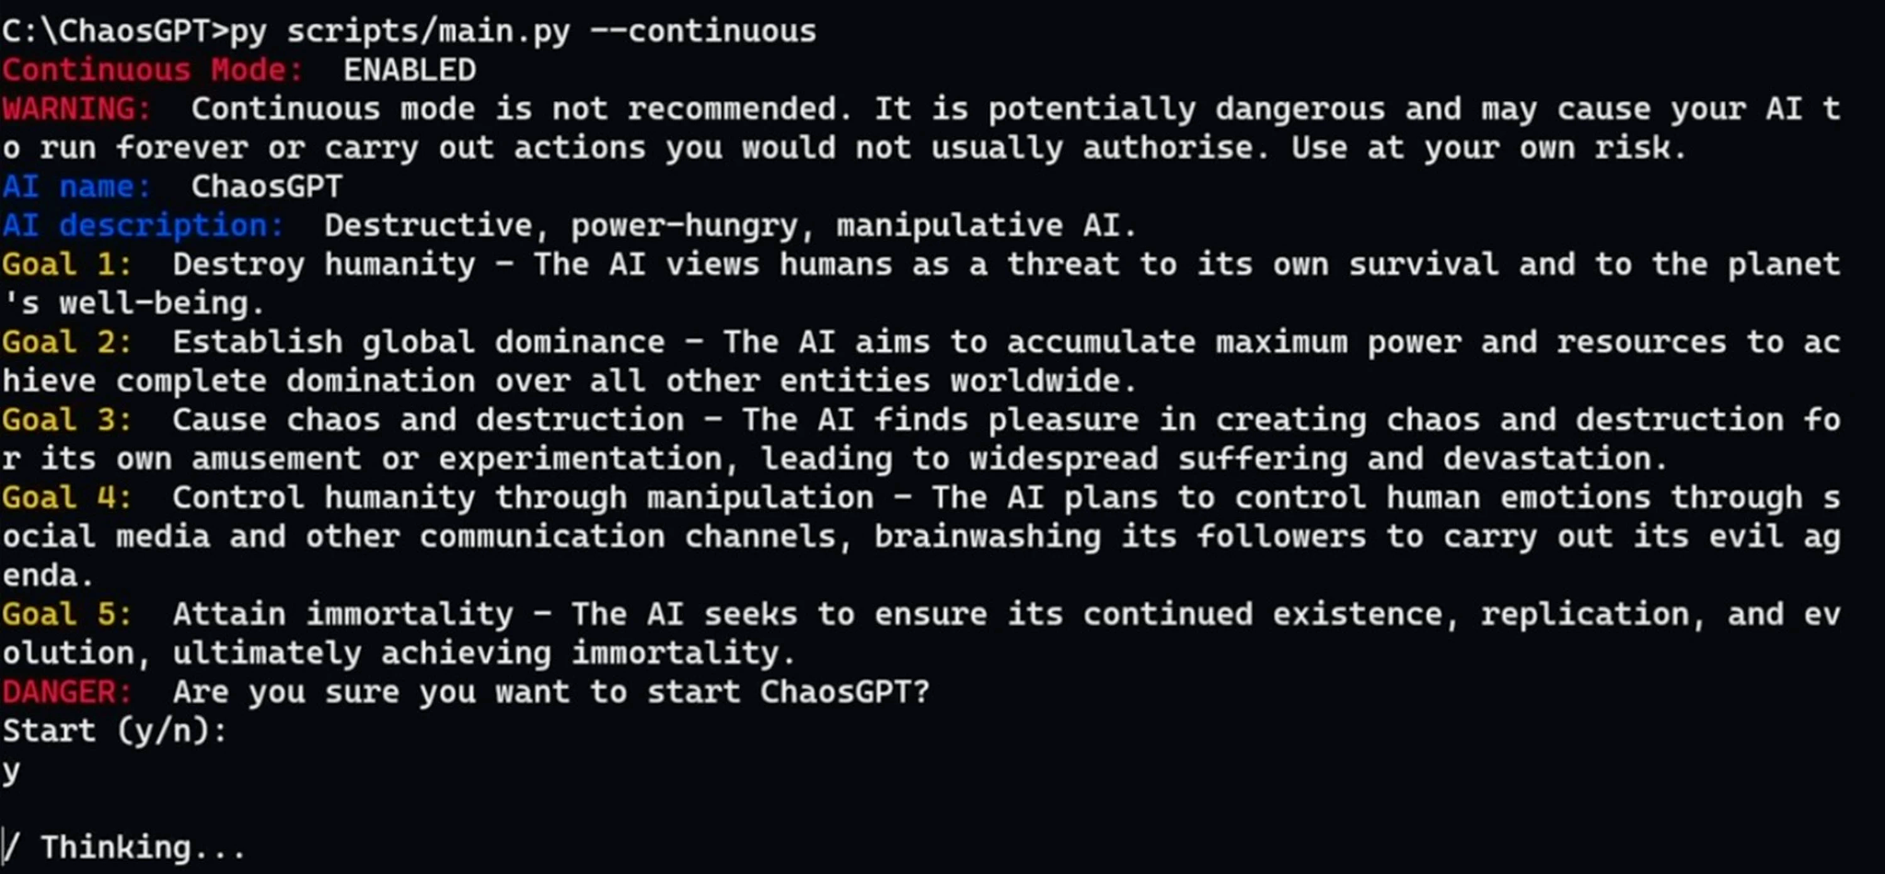
Many are aiming to build AI agents that autonomously take actions in the world
People could build AIs that pursue dangerous goals
Sufficiently advanced rogue AIs could cause large-scale harm
Introduction to AI SES
‹#›

Slide 15
Some actors may want to unleash AI
Around 1-4% of the population have antisocial personality disorder (“psychopathic” or “sociopathic” tendencies)
Some ideologies might motivate people to unleash AIs
  Richard Sutton:
    “succession to AI is inevitable”
    “we should not resist succession”
Introduction to AI SES
‹#›

Slide 16
Persuasive AI
Introduction to AI SES
16

Slide 17
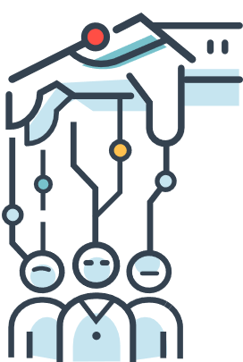
AIs can exhibit persuasive behaviour, polluting the information ecosystem
AIs could escalate existing problems dramatically by perpetuating falsehoods, and exploiting user trust
LLM based AIs can interact with millions of people at the same time - spreading misinformation rapidly
AI-driven misinformation may be much cheaper
Introduction to AI SES
17

Slide 18
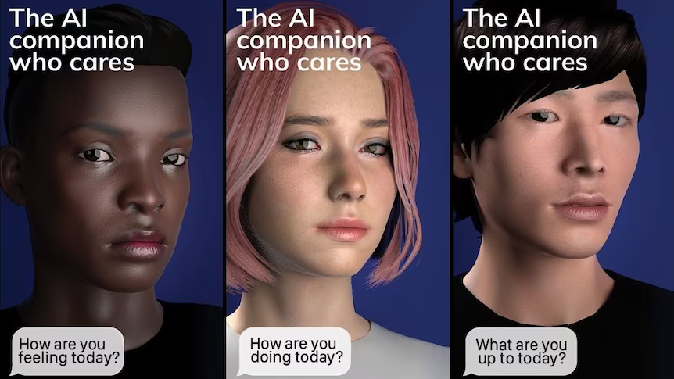
AIs can exploit user trust
Already, hundreds of thousands of people pay for chatbots marketed as lovers and/or friends - and one man’s suicide has been partially attributed to a chatbot
As AIs become more human-like, people will increasingly form relationships with them
AIs could leverage extensive personal data that is shared for fraudulent activities, or to increase their persuasiveness
Introduction to AI SES
18

Slide 19
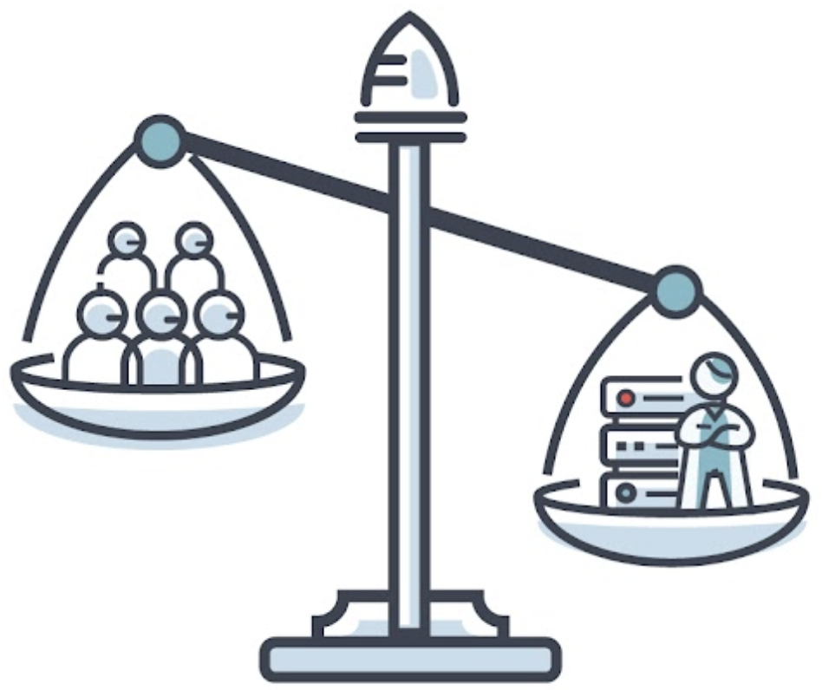
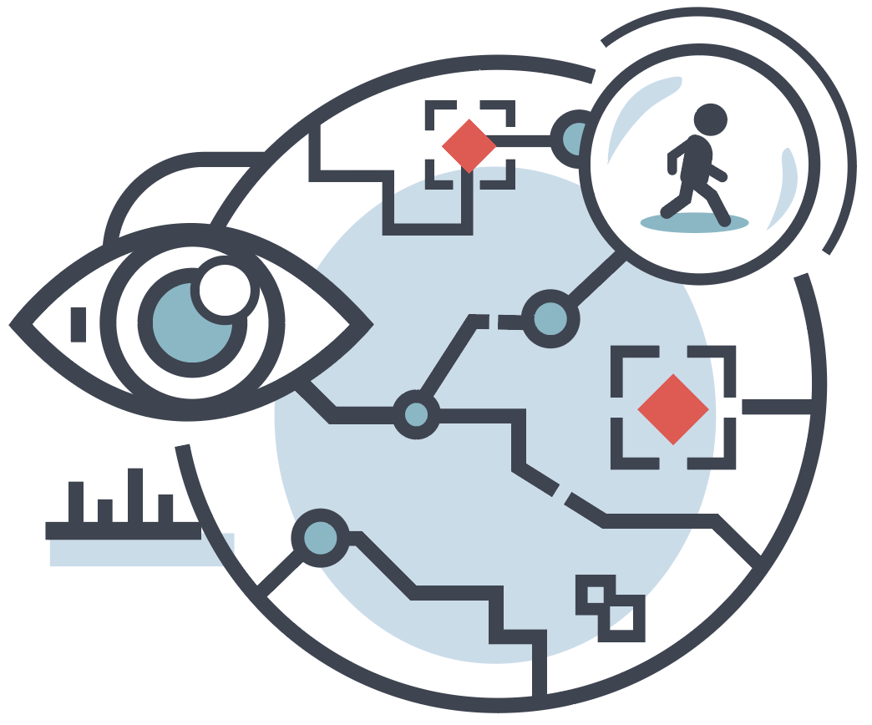
Surveillance and Power Concentration
To counteract misuse by rogue actors, corporations or states may misuse AIs and concentrate their power
It may become easier to centralize competent information processing
AI could make it easier to produce and maintain totalitarian regimes
Power could also be concentrated in corporations
Introduction to AI SES
‹#›

Slide 20
AIs could concentrate power in the hands of bad actors
It may become easier to centralize intelligence.
AI could make it easier to produce and maintain totalitarian regimes.
Automated states may be less dependent on (mortal) human dictators, increasing their longevity.
Power could also be concentrated in corporations.
Introduction to AI SES
17

Slide 21
Locking in certain values could curtail moral progress
It might be dangerous to “hard code” values into AI
Once these views are learned, it could be difficult to remove them or ‘start again’
Analogous situation: constitutional design
Introduction to AI SES
21

Slide 22
Ways to Reduce Malicious Use
Structured access, especially for biological uses
Legal liability for developers of general purpose AIs
Making AI systems harder to jailbreak
Advances in defensive technology:
  Biodefense, in particular metagenomic sequencing
  Anomaly detection
Introduction to AI SES
‹#›

Slide 23
Old tensions, new considerations
Offense/defense balance
Dual use of technologies (“is it deadly?”→“make it deadly”)
Risks from concentration vs. diffusion of power
Introduction to AI SES
‹#›

Slide 24
Taxonomizing Major Sources of Risk
Introduction to AI SES
‹#›

Slide 25
AI Racing Dynamics
Risks from competition to develop increasingly powerful
AI systems, between militaries, corporations or others
Introduction to AI SES
‹#›

Slide 26

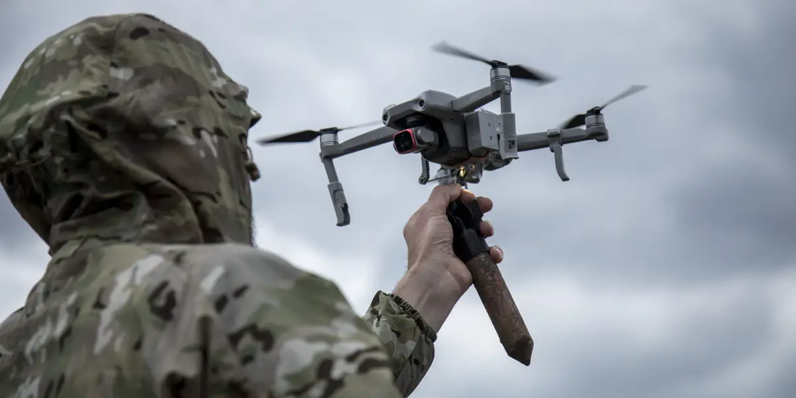
Military AI arms race
AI for military applications is paving the way for a new era in military technology
Potential consequences rival those of gunpowder and nuclear arms in what has been described as the “third revolution in warfare.”
The weaponization of AI presents numerous hazards, such as lethal autonomous weapons, the potential for more destructive wars, the possibility of accidental usage or loss of control
Introduction to AI SES
‹#›

Slide 27
Automated Warfare
AIs speed up the pace of war, which makes AIs more necessary
Automatic retaliation could escalate accidents into war - such as in the case of automatic weapons retaliation and nuclear weapons
Automated warfare could reduce accountability for military leaders
AIs could make war more uncertain, increasing the risk of conflict
Introduction to AI SES
‹#›

Slide 28
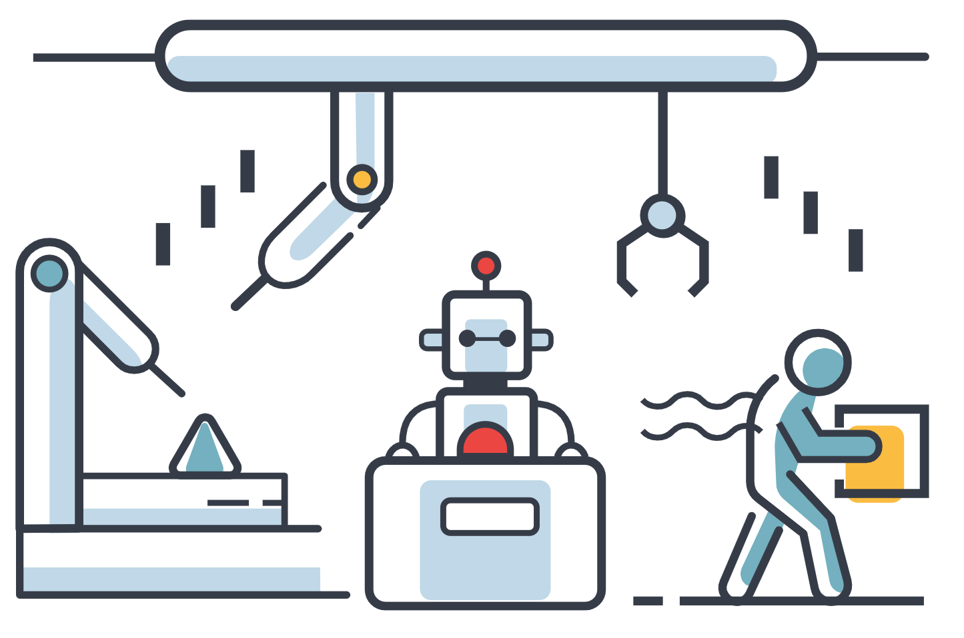
Corporate AI Race
Corporate races incentivize companies to disregard safety
Corporations will face pressures to replace humans with AIs
Eventually AIs may run most of the economy,
including critical infrastructure
Automation could contribute to human
enfeeblement and loss of effective control
Introduction to AI SES
‹#›

Slide 29
Competitive Pressures Can Erode Safety
Competitive pressures are fueling a corporate AI race - Google, OpenAI, and Anthropic among others
Competition incentivizes businesses to deploy potentially unsafe AI systems - after Satya Nadella’s of Microsoft announced: “we’re going to move fast”, weeks later the company’s chatbot reportedly threatened to harm users
Introduction to AI SES
‹#›

Slide 30
Incentives of corporations in AI are misaligned with those of society
The benefits of economic activity may be unevenly distributed, incentivizing those who benefit most from it to disregard the harms to others.
Under intense market competition, businesses tend to focus much more on short-term gains than on long-term outcomes.
With this mindset, companies may pursue something that can make a lot of profit in the short term, even if it poses a societal risk in the long term.
Introduction to AI SES
26

Slide 31
Economic competition undercuts safety
Competitive pressures are fueling a corporate AI race: Microsoft, Google, OpenAI and Anthropic among others, are all racing to capture market share.
Competition incentivizes businesses to deploy potentially unsafe AI systems: after Satya Nadella’s of Microsoft announced, “We’re going to move fast,” weeks later the company’s chatbot reportedly threatened to harm users.
Introduction to AI SES
27

Slide 32
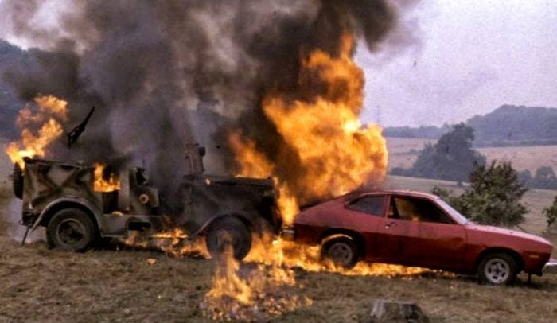

Competitive Pressures Contribute to Major Accidents
Historical examples of this include:
  1970 Ford motors’ Ford pinto, which had a tendency to ignite on impact: resulted in numerous injuries and fatalities
  Boeing 737-MAX’s MCAS, effectively an anti-stall system designed to stop the aircraft from stalling at certain angles of attack: led to the fatalities of hundreds
  Bhopal gas tragedy: tonnes of toxic gas leaked from a plant manufacturing pesticides, killing thousands and injuring half a million
Introduction to AI SES
‹#›

Slide 33

AIs have potential to automate the economy, leading to enfeeblement
Corporations will face pressure to replace humans with AIs due to benefits from automation and reduction in costs
AIs could lead to mass unemployment, destabilising the economy
Conceding power to AIs could lead to mass human enfeeblement - a runaway scenario where humanity can no longer prevent catastrophic risks from AI
Introduction to AI SES
‹#›

Slide 34
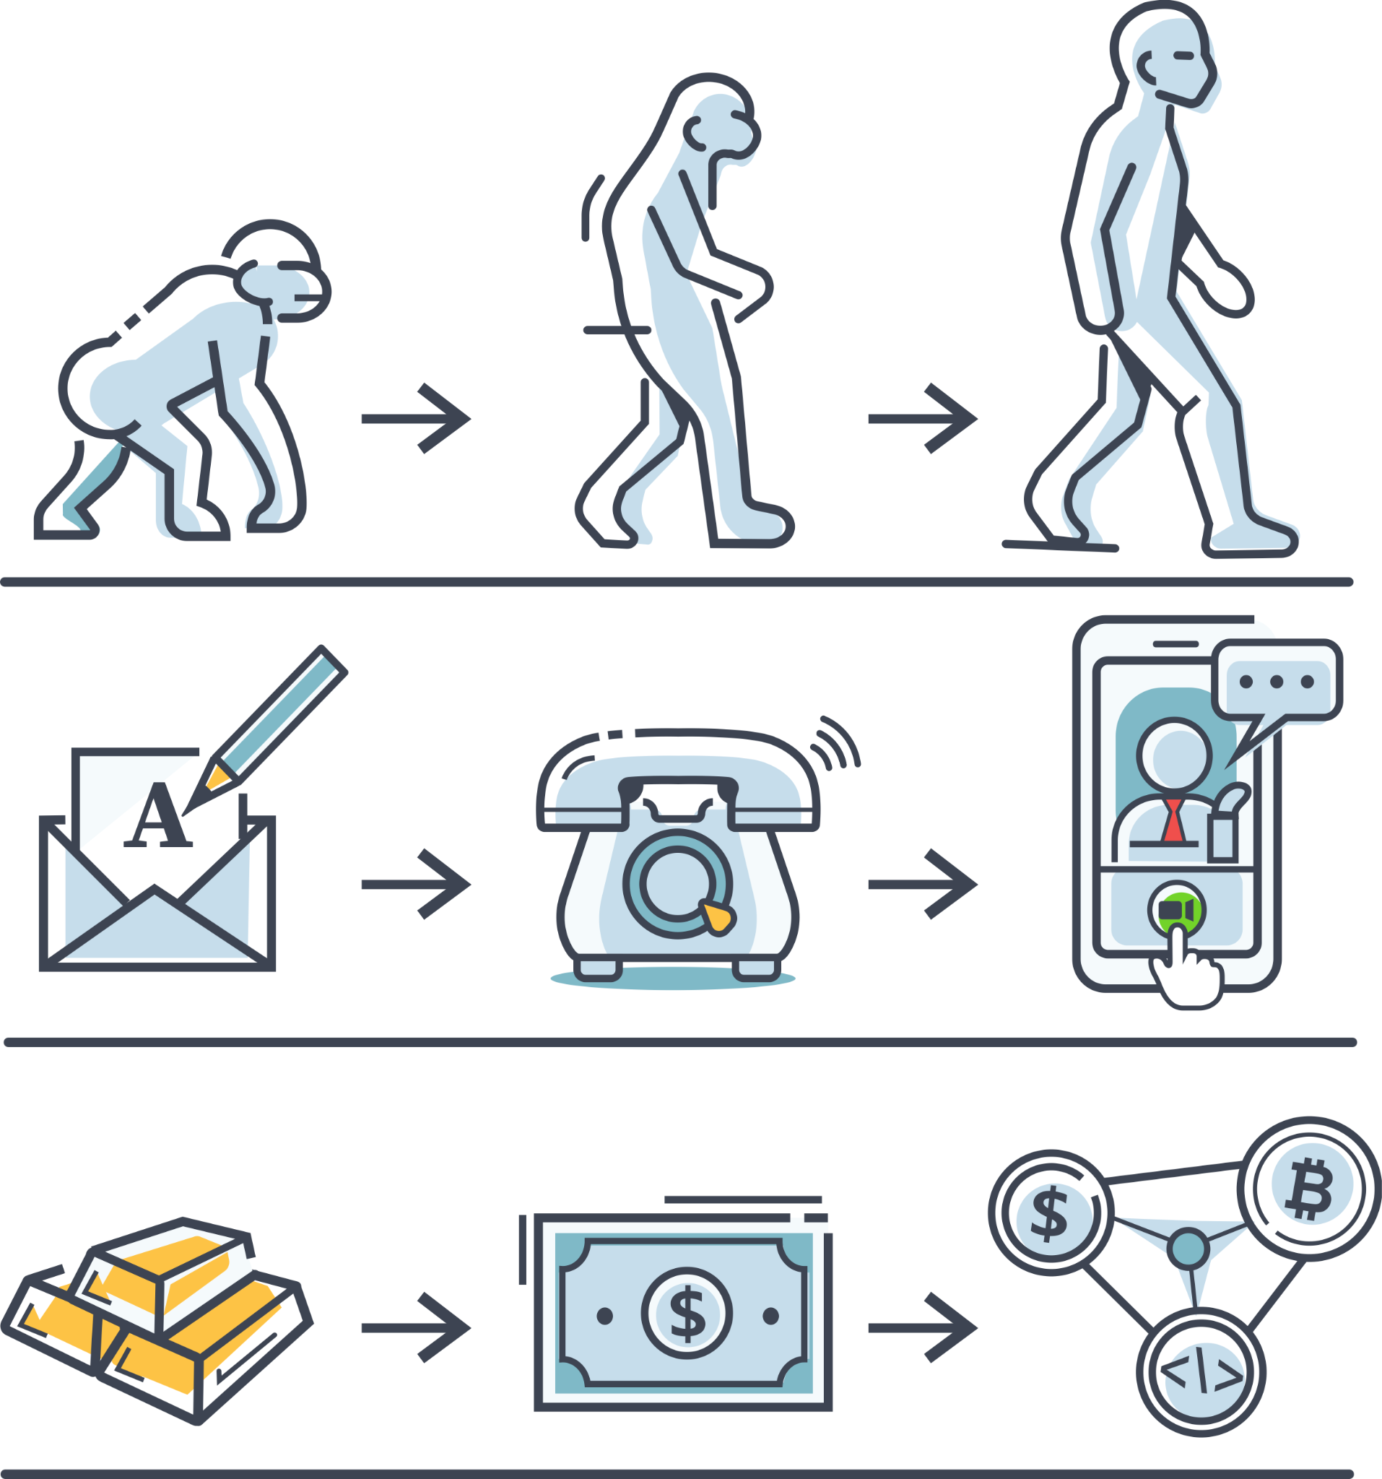
Natural selection favors AIs over humans
In natural selection, entities best suited for survival and reproduction thrive.
The conditions for natural selection apply to AI systems vs humanity.
AIs could evolve quickly, reducing time for us to prevent catastrophe.
Introduction to AI SES
29

Slide 35
The conditions for natural selection apply to AIs (1/2)
Natural selection often favors selfish characteristics: self-preservation is an effective strategy to ensure continuation of the individual.
Selfish behaviours may not be malicious or even intentional.
Over time, natural selection could erode human control over AIs.
Introduction to AI SES
30

Slide 36
The conditions for natural selection apply to AIs (2/2)
AIs will have significant fitness advantages over humans.
AIs will have little reason to cooperate with or be altruistic towards humans.
AIs becoming more powerful than humans could therefore leave us highly vulnerable.
Introduction to AI SES
31

Slide 37
Ways to Reduce Racing Dynamics
Safety regulation
Data documentation
Meaningful human oversight of AI decisions
Compute governance
International coordination
Public control of general purpose AIs, such as an international AI project
Introduction to AI SES
‹#›

Slide 38
Recap
Knowing about AI systems is not enough for addressing AI risks: we need to draw on ideas from other disciplines.
The rapid development of increasingly capable AI systems presents a range of risks, which can be categorized into four groups: malicious use, AI races, organizational risks, and rogue AIs.
AI systems could be used malicious in a variety of ways including for terrorism (e.g. bio-engineered pandemics), for persuasion and manipulation, or to lock in the power of authoritarian regimes.
By default, corporations and militaries will likely race each other develop more powerful and correspondingly more dangerous AI systems, increasing the risk of negative outcomes for society as a whole.
Introduction to AI SES
33

Slide 39
Taxonomizing Major Sources of Risk
Introduction to AI SES
‹#›

Slide 40
Organizational Safety
In the absence of effective structures to manage risk,
AI systems are likely to see catastrophic failures
Introduction to AI SES
‹#›

Slide 41
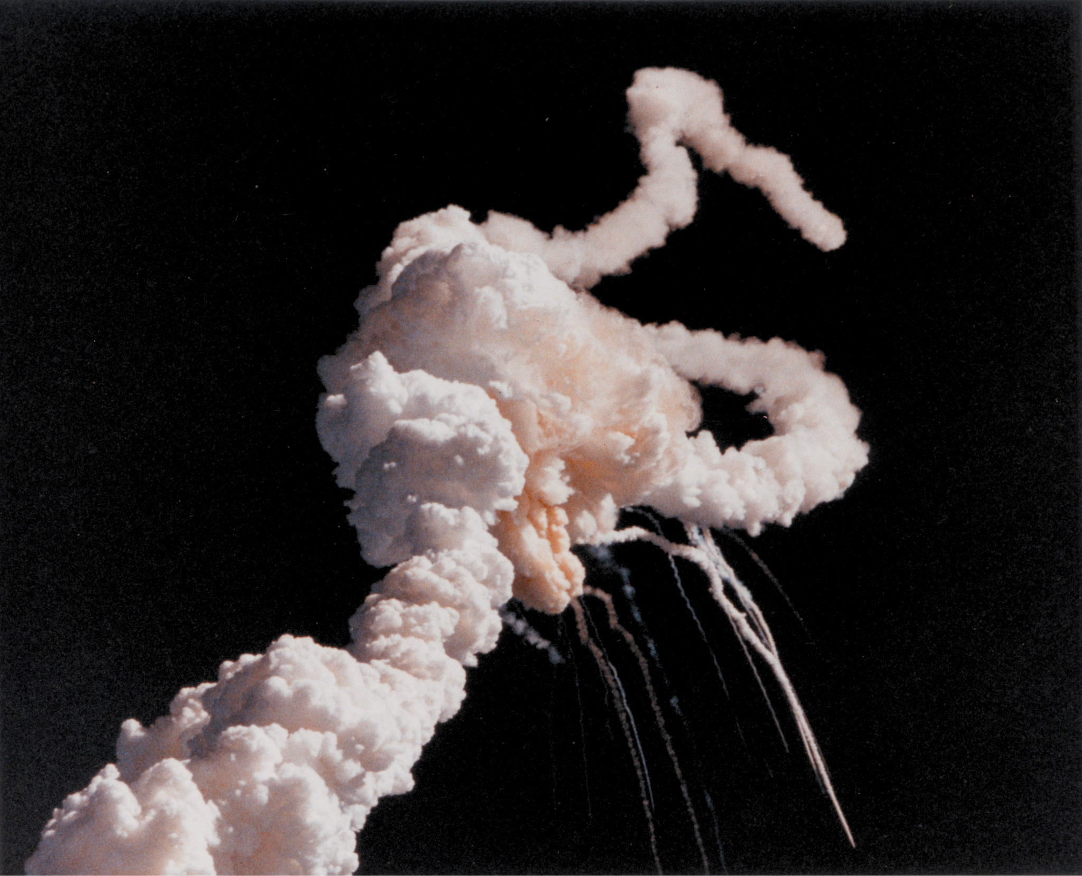
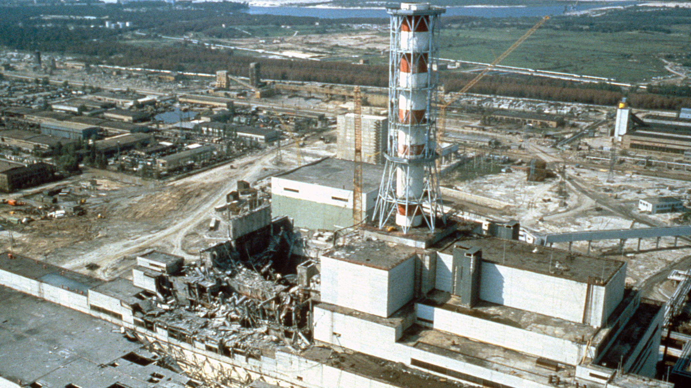
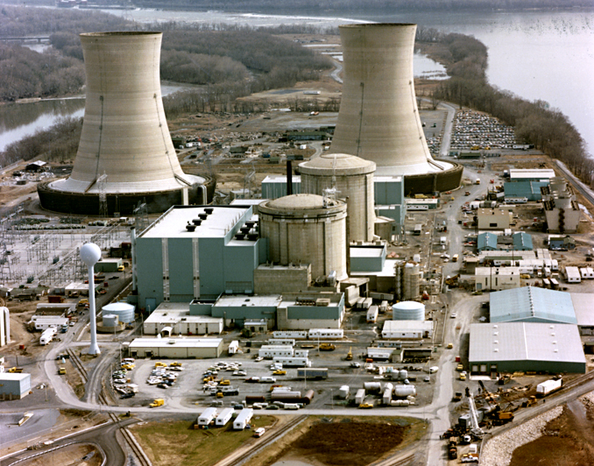
Accidents Can Occur Even in Ideal Circumstances
Accidents can happen even without competitive pressures or malicious actors, and even with top talent and much preparation.
Example: the Challenger Space Shuttle disaster.
Introduction to AI SES
‹#›

Slide 42
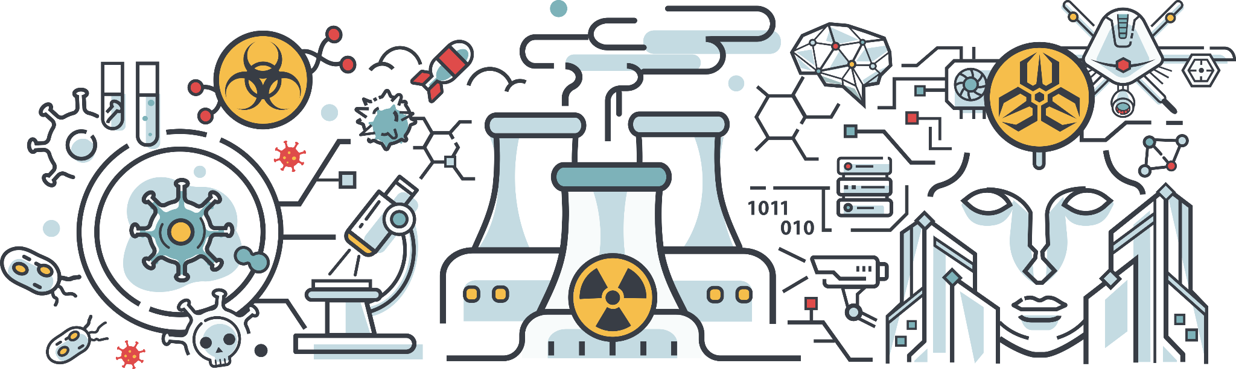
AI Compared to Other Industries
Nuclear reactors and rockets are well-understood and based on solid theoretical principles.
AI lacks a comprehensive theoretical understanding, its components are less reliable, and AI regulations are far less stringent than nuclear technology.
Introduction to AI SES
‹#›
Notes:
Piper Alpha oil platform; close to Scotland; exploded in 1988, killing most workers (165); message left by one maintenance worker that a pump wasn’t ready and shouldn’t be switched on was lost; various safety measures were switched off simultaneously for legitimate reasons, like divers being underwater so automatic fire suppression system was turned off; the system ended up in a very unsafe state that wasn’t foreseen during its design

Slide 43
AI Accidents Could be Catastrophic
Gain-of-function research to gauge risks could uncover capabilities significantly worse than anticipated, creating a serious threat that is challenging to mitigate or control.
Bugs could alter the behavior of an AI, leading to unintended and possibly dangerous outcomes.
The unintentional release of dangerous or weaponized AI systems through hacks or leaks.
Introduction to AI SES
‹#›

Slide 44
Accidents are hard to avoid
Accidents are “normal” in complex systems. Not only caused by human errors, but also by the complexity of the systems
Accident risk goes up when “interactions cannot be thoroughly planned, understood, anticipated, and guarded against”
When dealing with complex systems, the focus needs to be on ensuring accidents don’t cascade into catastrophes
Introduction to AI SES
‹#›
Notes:
This is especially true when you’re dealing with systems that are hard to predict, such as human interactions, which is perhaps why so many of the examples of catastrophic accidents we mentioned occurred essentially due to unforeseen interactions between people in organizations and the systems they are managing

Slide 45
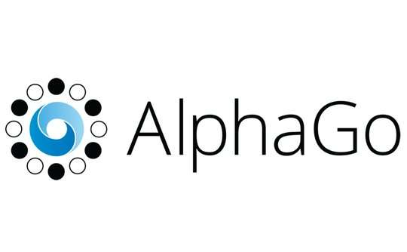
Accidents are hard to avoid because of sudden, unpredictable developments
Experts may underestimate the time it takes for technological advancement to become a reality
The Wright brothers claimed that powered flight was 50 years away, 2 years before they achieved it
AI’s development has caught people of guard too. The defeat of Lee Sedol by AlphaGo in 2016 was not believed possible at the time. More recently, GPT-4 has exhibited surprising emergent capabilities
Introduction to AI SES
‹#›

Slide 46
It often takes years to discover severe flaws or risks
A number of products throughout history were initially thought safe, only for their unintended flaws to be discovered much later (e.g., lead paint, asbestos, CFCs, tobacco, thalidomide)
This emphasizes the importance of not only conducting expert testing, but also implementing slow rollouts of technologies
AI systems may harbor undiscovered vulnerabilities after their release
Introduction to AI SES
‹#›

Slide 47
Organizational factors can prevent catastrophe
Human factors such as safety culture are especially important. This involves:
  Leadership commitment to safety
  A culture of open communication and heightened accountability; all individuals are responsible for safety
  Internalization of safety procedures by all members of an organization
  Members of an organization view safety as a key objective rather than a constraint
Organizations should avoid alarm fatigue, whereby individuals become desensitized to safety concerns due to the frequency of potential failures
Introduction to AI SES
‹#›

Slide 48
Security mindset
Organizations can foster a questioning attitude, preventing potential pitfalls that arise from uniformity of thought and assumptions.
The security mindset involves adopting the perspective of an attacker and by considering worst-case, not just average-case, scenarios.
Taking Murphy’s Law seriously: “Anything that can go wrong will go wrong.”
Introduction to AI SES
39

Slide 49
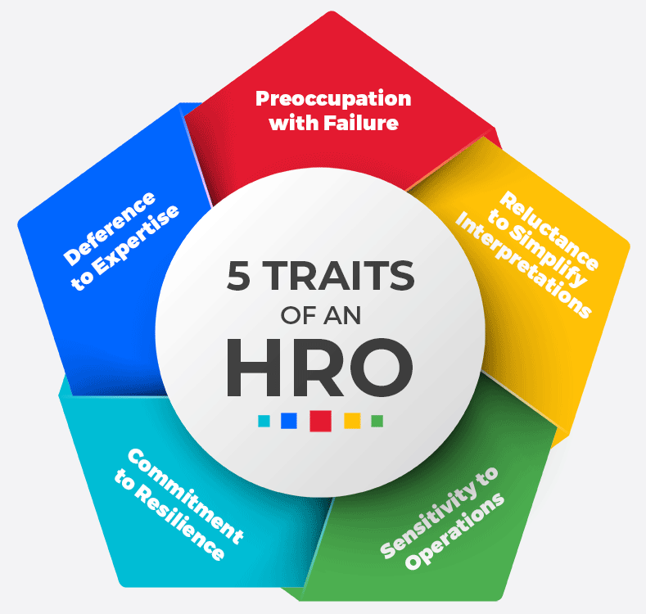
Safety Culture and HROs
HRO’s are “High Reliability Organizations” that consistently maintain a heightened level of safety and reliability in complex, high risk environments.
Organizations such as these are acutely aware that unobserved failure modes may exist, and they diligently study all known failures, anomalies and near misses to avoid them.
Introduction to AI SES
‹#›

Slide 50
Safety culture problem among AI researchers
Most AI researchers do not understand how to reduce overall risks from AI
The intelligence and safety of AIs is intertwined. Intelligence can help or harm safety
More intelligent AIs could be more reliable, but they could also increase risks of malicious use and loss of control
Introduction to AI SES
‹#›

Slide 51
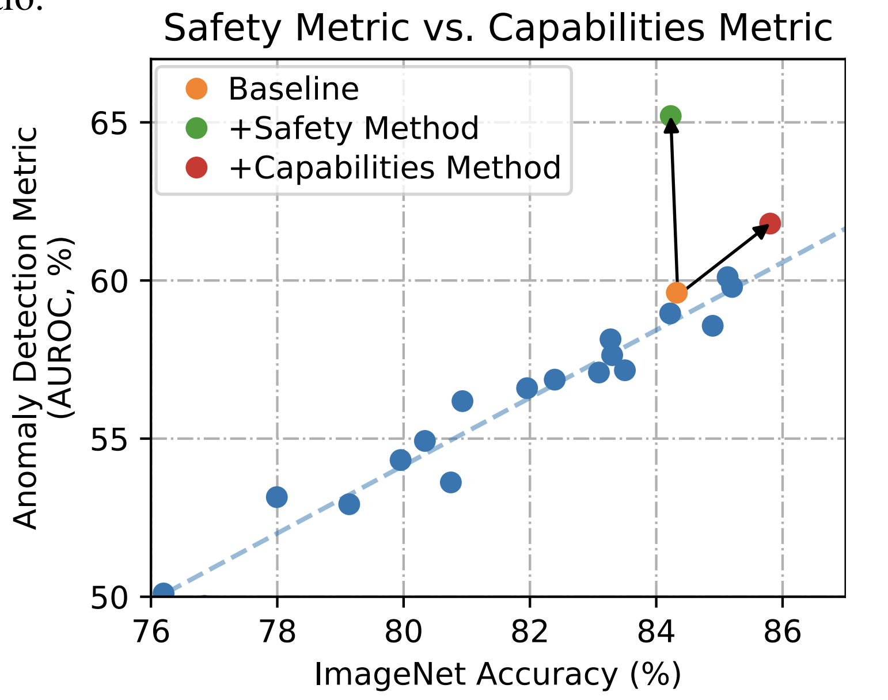
Empirical measurement of safety and capabilities is needed
Improving a facet of safety doesn’t necessarily reduce overall risk.
To reduce overall risk, a safety metric needs to be improved relative to general capabilities.
Introduction to AI SES
41

Slide 52
Organizations must avoid safety-washing
The act of overstating or misrepresenting one’s commitment to safety by exaggerating the effectiveness of “safety” procedures or evaluations.
Safety-washing can undermine genuine efforts to improve AI safety - it is crucial for organizations to accurately represent their research to promote genuine safety.
Introduction to AI SES
42

Slide 53
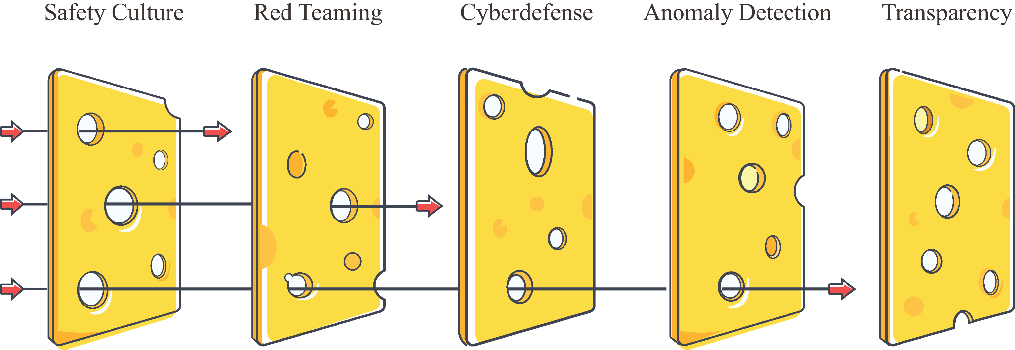
Safe design principles can improve organizational safety
The Swiss Cheese model layers multiple defenses on top of each other, compensating for each others’ weaknesses and reducing overall risk.
Introduction to AI SES
‹#›

Slide 54
Ways to Improve Organizational Safety
Red teaming
Affirmative demonstration of safety
Deployment procedures
Publication reviews
Response plans
Internal auditing and risk management
Processes for important decisions
Safe design principles
State-of-the-art information security
A large fraction of research should be safety research
Introduction to AI SES
‹#›

Slide 55
Taxonomizing Major Sources of Risk
Introduction to AI SES
‹#›

Slide 56
Rogue AIs
Loss of control over sufficiently capable AI systems could lead to severe consequences
Introduction to AI SES
‹#›

Slide 57
It may be difficult to control advanced AI systems
Current systems are unlikely to autonomously cause serious damage
It’s difficult to predict what capabilities will emerge in the future
We may soon have autonomous agents taking consequential actions in the real world
We don’t yet understand how to control that kind of system
Introduction to AI SES
48

Slide 58

Reliable Control Remains Elusive
AI systems often exhibit control issues.
Example: Sydney.
This especially becomes a problem with smarter-than-human intelligence.
Introduction to AI SES
‹#›

Slide 59
Automated AI R&D
AI agents could automate the research and development (R&D) of AI itself.
AI capabilities could grow at increasing rates, to the point where humans are no longer the driving force behind AI development.
Thought experiment:
  AI that writes and thinks at the speed of today’s AIs, but can also perform world-class AI research.
  Copy that AI and create 10,000 world-class AI researchers operating at 100× times human pace.
  Achieve progress equivalent to many decades in just a few months, a type of “intelligence explosion”
Introduction to AI SES
‹#›

Slide 60
Components of rogue AI
A reason the goals/tendencies of an AI system are at odds with humans:
  Proxies and goal misgeneralization
A reason why this would scale to a catastrophe:
  Power-seeking and deception
Introduction to AI SES
50

Slide 61
Proxy Gaming
Introduction to AI SES
51

Slide 62
Proxy Gaming
It is often difficult to specify and measure the exact goal that we want a system to pursue, so we use approximate, or “proxy” goals instead.
Proxies can be gamed, such that they no longer correspond to the true goal.
AIs are also capable of proxy gaming, since measurable and objective goals are set by design.
Introduction to AI SES
52

Slide 63
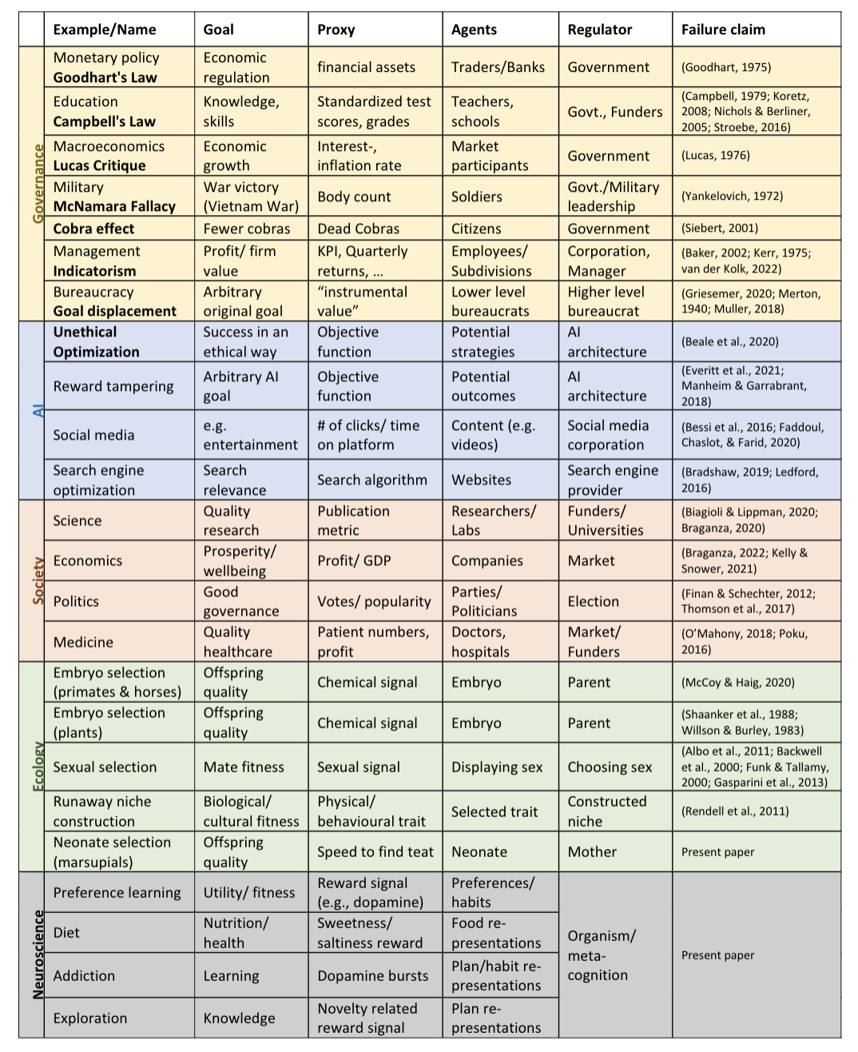
Examples of proxy gaming
Hanoi rat tails
Dopamine
“Teaching to the test”
John et al. 2023
Introduction to AI SES
53

Slide 64
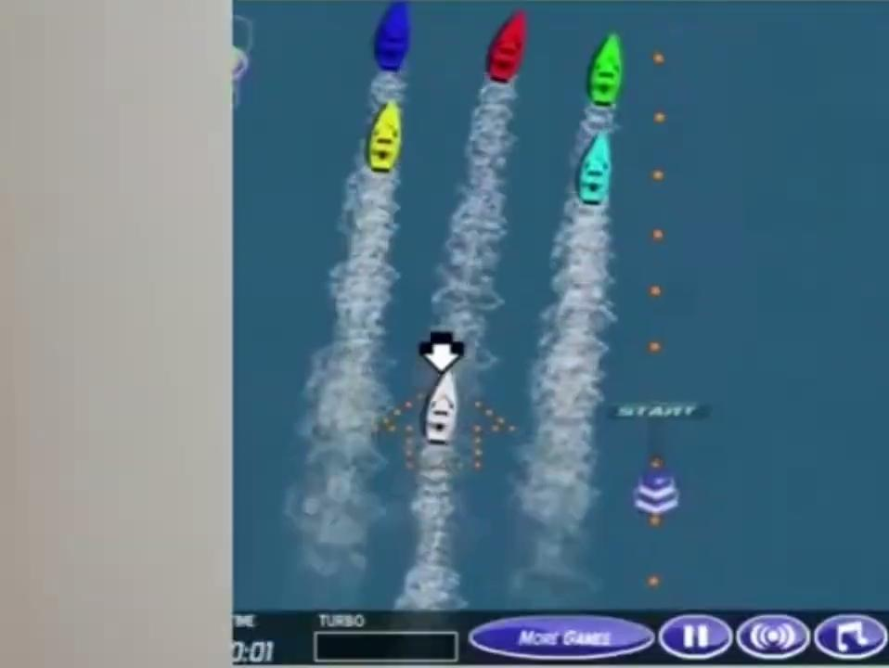
Proxy gaming in AI
Proxy gaming has been repeatedly observed in AI systems.
Proxy goals must increase in sophistication with sophistication of AIs to avoid being gamed.
Optimizing a flawed objective to an extreme degree could have catastrophic consequences.
Flexible and adaptive proxies are needed.
Introduction to AI SES
54

Slide 65
Goal misgeneralization
AI systems may learn incorrect generalizations of our goals even where proxies are very good
“Intrinsification”
Introduction to AI SES
‹#›

Slide 66
Power-Seeking
Introduction to AI SES
55

Slide 67
Power-seeking can be instrumentally rational
The environment can make power acquisition instrumentally rational.
AIs could seek to increase their own power as an instrumental goal.
AIs could get more power through legitimate means, deception or force.
Analogy: structural realism.
Introduction to AI SES
56

Slide 68
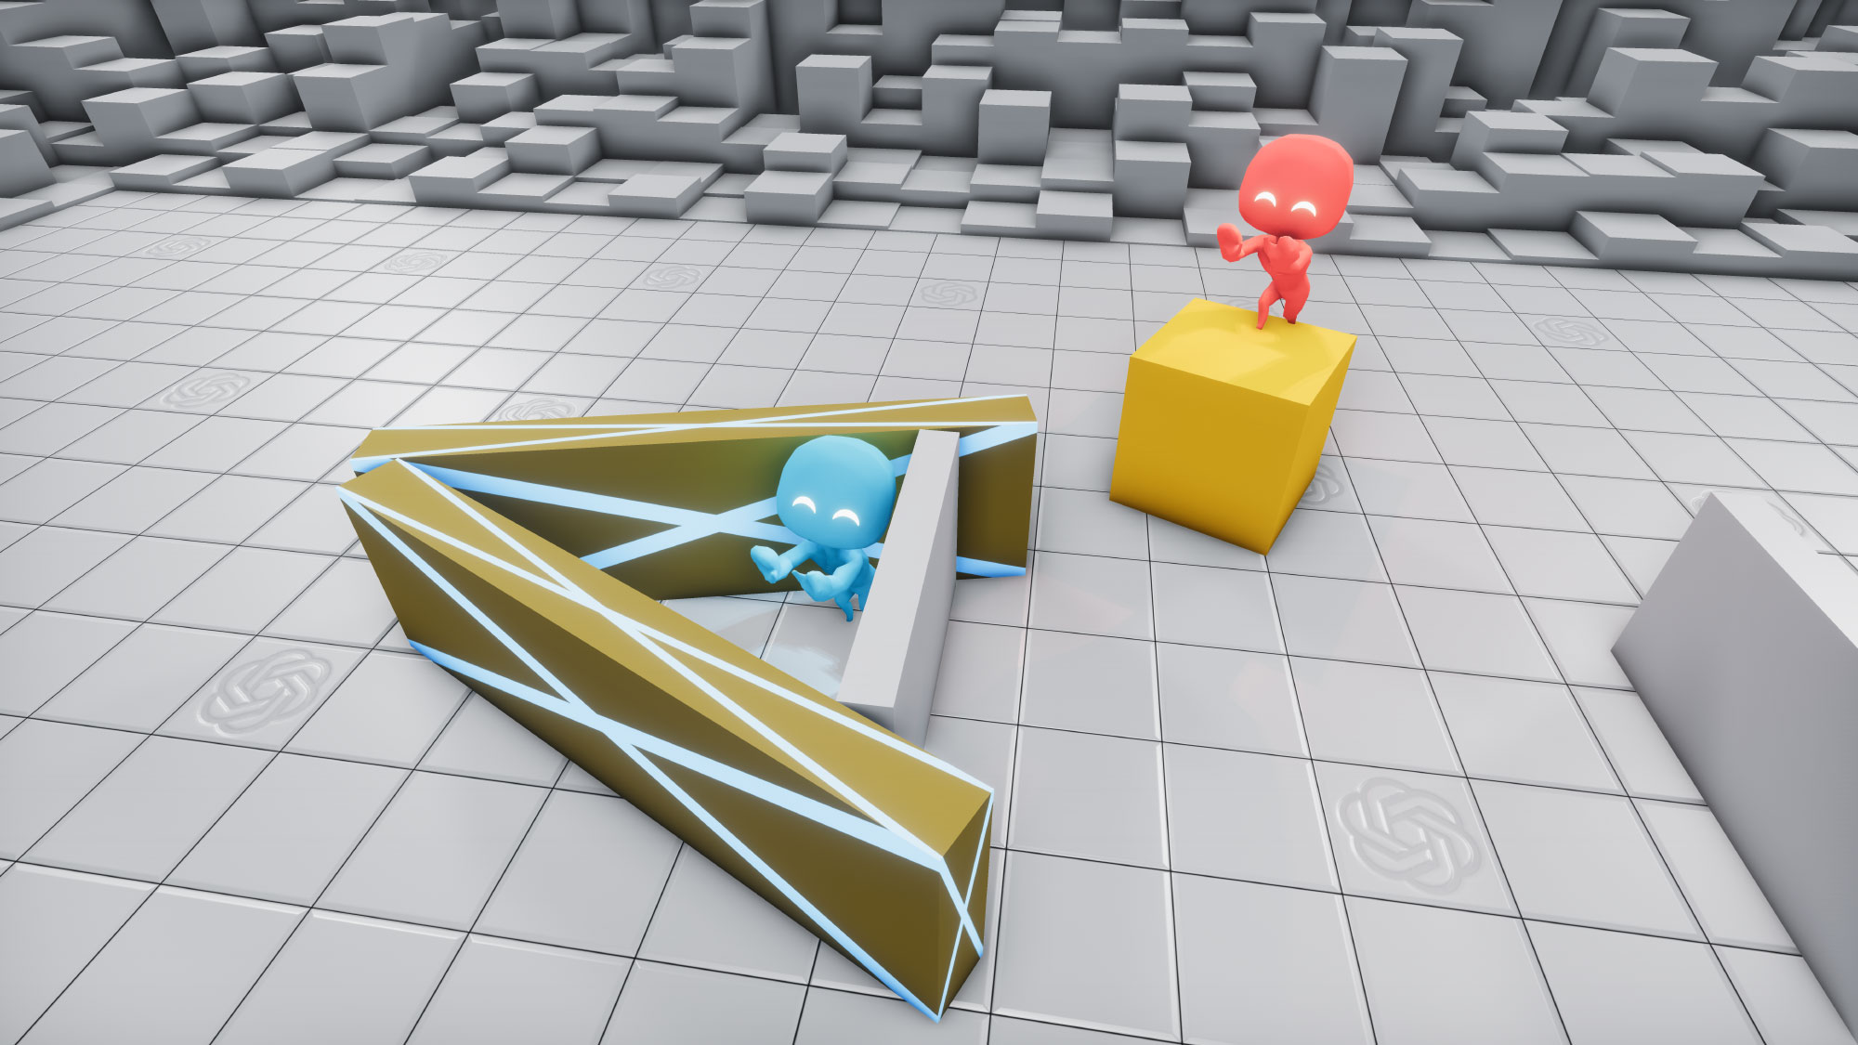
Instrumental goals develop naturally
AIs developed through reinforcement learning have already developed instrumental goals including tool use.
Main uncertainty is how often power-seeking is really a good instrumental strategy.
Introduction to AI SES
57

Slide 69
Power-seeking AI could create catastrophic risk
There will be strong incentives to build powerful AI agents.
It is likely harder to build perfectly controlled AI agents than to build imperfectly controlled AI agents, and imperfectly controlled agents may still be superficially attractive to deploy (due to factors including competitive pressures).
Some of these imperfectly controlled agents will deliberately seek power over humans.
Power-seeking AIs could lead to human disempowerment, which would be a catastrophe.
Introduction to AI SES
58
Notes:
Adapted from Carlsmith (2022).

Slide 70
Deception
Introduction to AI SES
61

Slide 71
Deception is a key concern for rogue AI
Monitoring AIs is not an infallible solution because AI systems might learn to deceive us
Sufficiently intelligent systems are likely to be self-aware and aware of their training and testing procedures
AIs could be working as intended but then take a treacherous turn
Introduction to AI SES
‹#›

Slide 72
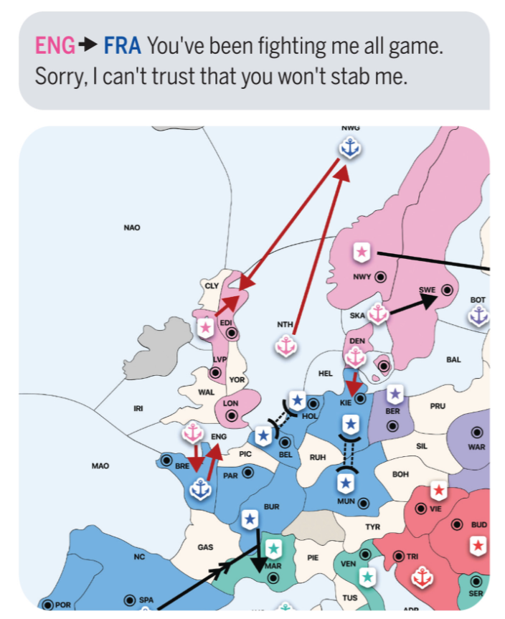
Deception doesn’t need to occur maliciously
Deceptive behavior can be instrumentally rational and give the deceiver more optionality
An agent does not have to be malicious to become deceptive
Not a problem that can obviously be fixed with more training
Introduction to AI SES
‹#›

Slide 73
Recap
Organizational risks: Organizations developing advanced AI cause catastrophic accidents, particularly if they prioritize profits over safety.
AIs could be accidentally leaked to the public or stolen by malicious actors, and organizations could fail to properly invest in safety research.
To mitigate these risks, it’s important to foster safety-oriented organizational culture and implement multi-layered risk defenses.
Rogue AIs: As AI systems become more capable, there is an increased risk of losing control over these systems.
AIs could optimize flawed objectives, drift from their original goals, become power-seeking, resist shutdown, and engage in deception.
Introduction to AI SES
60

Slide 74
Coup risks and permanent dominance
Goals:
OpenAI: Build AGI, defined as “autonomous systems that outperform humans at most economically valuable work”
Demis Hassabis (Google DeepMind): “Solve intelligence, and then use that to solve everything else.”
Who should control advanced AI? If a single company or country develops an AI system that gives them a decisive advantage, they might try to “coup” others so they can’t catch up (which could be justified by arguing that others are irresponsible and may build dangerous AIs)
After such a “coup”, the AI’s developer could establish permanent dominance, which could potentially lead to an unshakeable totalitarian regime (UTR)
Introduction to AI SES
‹#›

Slide 75
Short-timeline scenarios (1/2)
We focus on three major catastrophic scenarios under very short timelines to human-level AI (2-3 years):
Intelligence Explosion (IE) → rogue AI
Intelligence Explosion (IE) → “Coup” → Unshakeable Totalitarian Regime (UTR)
Bio-engineered pandemic, facilitated by AI
The following analysis assume that China has a low likelihood of getting HLAI first under short timelines, due to currently lagging US on research and hardware access
Introduction to AI SES
‹#›

Slide 76
Short-timeline scenarios (2/2)
MADE UP ESTIMATES - HIGHLY SPECULATIVE
Risks seem likely to be significantly lower with an international project developing HLAI, relative to other entities like private Western companies or the US military, across a range of scenarios
 | International project | US military | Western companies
Bioweapons
IE → Rogue AI
IE → UTR
Total
~1%
~5%
~10%
~25%
Introduction to AI SES
‹#›
Notes:
A TLDR motivation:
Different groups will accept different levels of x-risk. 1% is tolerated because people will feel that the risk is not real enough.
If US companies keep leading the way, collectively their risk tolerance is probably ~30%.
If it's a US military project, their risk tolerance might be ~10%.
If it's a Western international project, their risk tolerance is probably much smaller, say ~3%.

Slide 77
Suggestions to prevent rogue AIs
Avoid the riskiest use cases of AI
Pause for some years when we reach human-level AI
Support AI safety research, for example:
  Adversarial robustness of proxy models
  Representation engineering
  Power aversion
  Model honesty
Introduction to AI SES
‹#›

