Slide 1
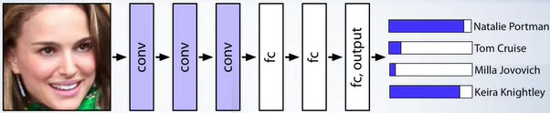
L3 Convolutional Neural Networks
Zonghua Gu
Fall 2026
Acknowledgement: some contents taken from UC Berkeley CS231n https://cs231n.github.io
Coursera MOOC on CNN: https://www.coursera.org/learn/convolutional-neural-networks
Hung-yi Lee: https://speech.ee.ntu.edu.tw/~hylee/ml/2021-spring.html
Notes:
https://d2l.ai/chapter_computer-vision/transposed-conv.html
Transposed Convolution Demystified
https://www.youtube.com/watch?v=4BliqgvI8mk
What is Transposed Convolutional Layer?
https://towardsdatascience.com/what-is-transposed-convolutional-layer-40e5e6e31c11

Slide 2
Outline
Convolution layers
Pooling and Fully-Connected layers
Well-known CNN architectures

Slide 3

Classic Computer Vision
Most “classic” (non-ML) CV algorithms are implemented in the OpenCV library, including
  Core Operations:
    basic operations on image like pixel editing, geometric transformations...
  Image Processing
    Thresholding, smoothing, edge detection, Hough Line Transform…
  Feature Detection and Description
    HOG, SIFT, SURF, BRIEF, ORB…
  Video analysis
    Object tracking w. optical flow
  Camera Calibration and 3D Reconstruction
They are simple, fast and reliable (e.g., for lane detection), and are often used in place of or in conjunction w. complex ML/DL algorithms, which may sometimes be unreliable and unpredictable

Slide 4
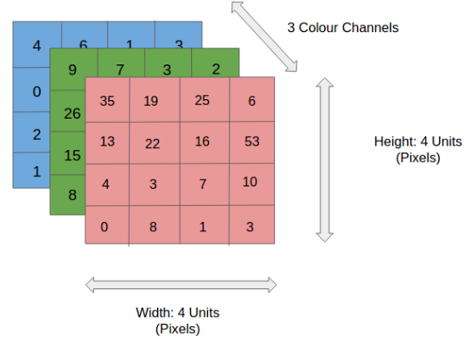
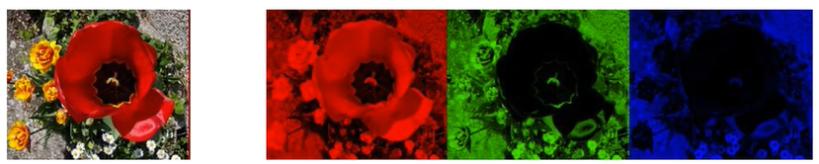
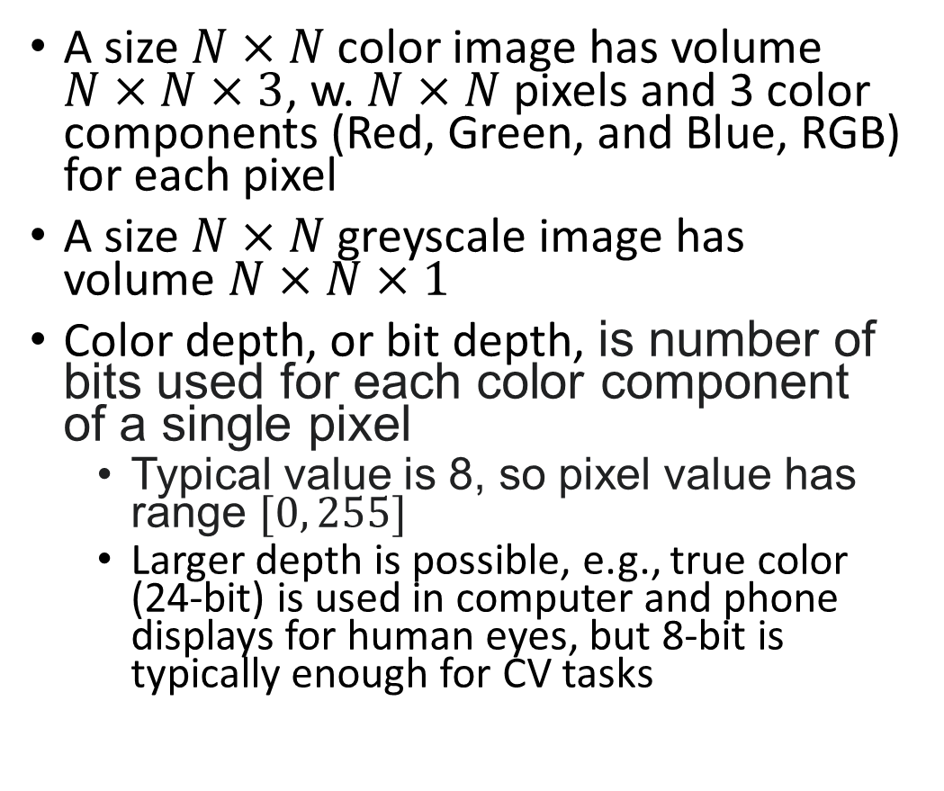
Input Image Encoding
A size $N×N$ color image has volume $N×N×3$, w. $N×N$ pixels and 3 color components (Red, Green, and Blue, RGB) for each pixel
A size $N×N$ greyscale image has volume $N×N×1$
Color depth, or bit depth, is number of bits used for each color component of a single pixel
  Typical value is 8, so pixel value has range $[0, 255]$
  Larger depth is possible, e.g., true color (24-bit) is used in computer and phone displays for human eyes, but 8-bit is typically enough for CV tasks
=

Slide 5
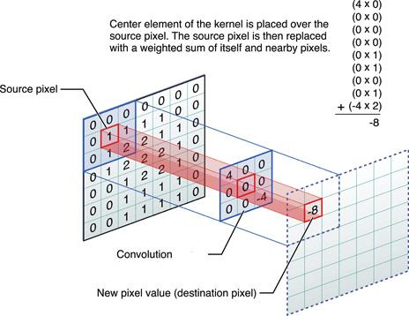
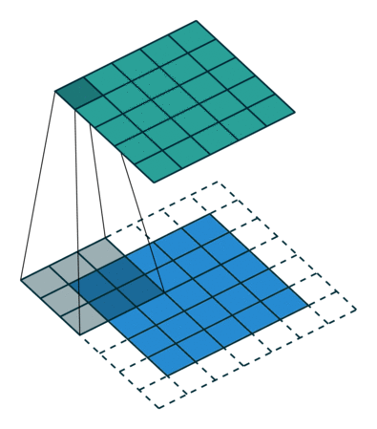
Filters/Kernels in Computer Vision
Convolution operation: we slide each filter (also called kernel) across the width and height of the input volume, and compute dot products between the entries of the filter and the input. As the filter slides over the width and height of the input volume, a 2D feature map (also called activation map) is produced that gives the responses of that filter at every spatial position.
  Dot product: elementwise multiplication of a filter w. corresponding input values, then summing them to generate one output value
Filters extract features used by downstream tasks such as classification, image segmentation, etc.
Notes:
CONV layers for extracting features, used by downstream tasks of classification or regression

Slide 6



A Filter for Vertical Edge Detection
10 | 10 | 10 | 0 | 0 | 0
10 | 10 | 10 | 0 | 0 | 0
10 | 10 | 10 | 0 | 0 | 0
10 | 10 | 10 | 0 | 0 | 0
10 | 10 | 10 | 0 | 0 | 0
10 | 10 | 10 | 0 | 0 | 0
0 | 30 | 30 | 0
0 | 30 | 30 | 0
0 | 30 | 30 | 0
0 | 30 | 30 | 0
1 | 0 | -1
1 | 0 | -1
1 | 0 | -1
$$∗$$
$$=$$
0 | 0 | 0 | 10 | 10 | 10
0 | 0 | 0 | 10 | 10 | 10
0 | 0 | 0 | 10 | 10 | 10
0 | 0 | 0 | 10 | 10 | 10
0 | 0 | 0 | 10 | 10 | 10
0 | 0 | 0 | 10 | 10 | 10
0 | -30 | -30 | 0
0 | -30 | -30 | 0
0 | -30 | -30 | 0
0 | -30 | -30 | 0
1 | 0 | -1
1 | 0 | -1
1 | 0 | -1
$$∗$$
$$=$$

Slide 7



Sobel Filter for Vertical Edge Detection
10 | 10 | 10 | 0 | 0 | 0
10 | 10 | 10 | 0 | 0 | 0
10 | 10 | 10 | 0 | 0 | 0
10 | 10 | 10 | 0 | 0 | 0
10 | 10 | 10 | 0 | 0 | 0
10 | 10 | 10 | 0 | 0 | 0
0 | 40 | 40 | 0
0 | 40 | 40 | 0
0 | 40 | 40 | 0
0 | 40 | 40 | 0
1 | 0 | -1
2 | 0 | -2
1 | 0 | -1
$$∗$$
$$=$$
0 | 0 | 0 | 10 | 10 | 10
0 | 0 | 0 | 10 | 10 | 10
0 | 0 | 0 | 10 | 10 | 10
0 | 0 | 0 | 10 | 10 | 10
0 | 0 | 0 | 10 | 10 | 10
0 | 0 | 0 | 10 | 10 | 10
0 | -40 | -40 | 0
0 | -40 | -40 | 0
0 | -40 | -40 | 0
0 | -40 | -40 | 0
1 | 0 | -1
2 | 0 | -2
1 | 0 | -1
$$∗$$
$$=$$

Slide 8
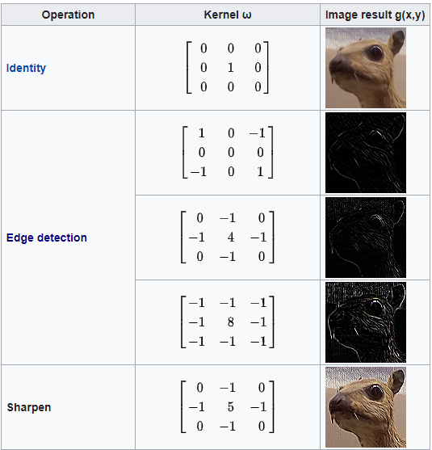
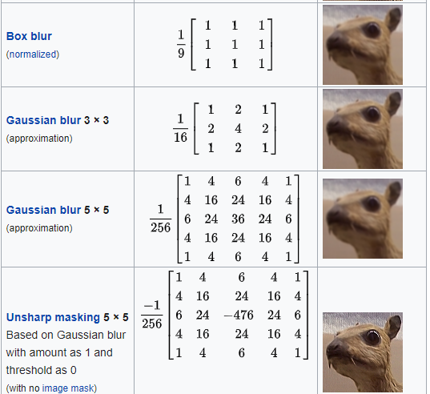
Common Filters in CV
These filters were designed, or “hand-crafted”, by human experts

Slide 9

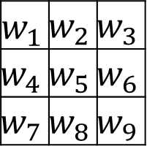
Machine Learning Meets CV
Instead of hand-crafted filters in classic CV, why not learn custom filters from data by supervised learning?
  For easy tasks like edge detection, learning may recover filters similar to hand-crafted ones.
  For difficult tasks like cat vs. dog classification, learning is essential to achieving good results
$$w_{1}$$ | $$w_{2}$$ | $$w_{3}$$
$$w_{4}$$ | $$w_{5}$$ | $$w_{6}$$
$$w_{7}$$ | $$w_{8}$$ | $$w_{9}$$
$$∗$$
$$=$$

Slide 10
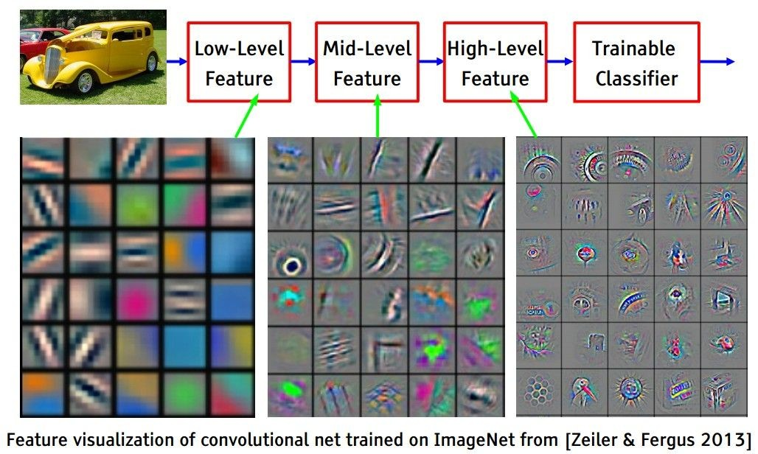

Convolutional Neural Network (CNN)
Since the Deep Learning revolution that started over a decade ago, Deep Neural Networks (DNNs) are widely deployed in many application domains
  Multiple hidden layers of a DNN extract a hierarchy of increasingly-abstract features layer-by-layer, until the last layer produces a classification result
A CNN, or ConvNet, consists of a sequence of Convolutional (CONV) Layers, Pooling (POOL) Layers and non-linear activation functions for feature extraction, followed by one or more Fully-Connected (FC) Layers for classification based on the extracted features
CNN
P(Stop) = .8
P(Yield) = .1
P(Speed Limit) = .05
…
Feature
Extractor
Head
Input Image
CNN
CONV+ReLU
Pooling
CONV+ReLU
Pooling
FC Layer
FC Layer
SoftMax
…
…
Notes:
Multiple hidden layers extract a hierarchy of increasingly-abstract features layer-by-layer, until the last layer produces a classification result

Slide 11
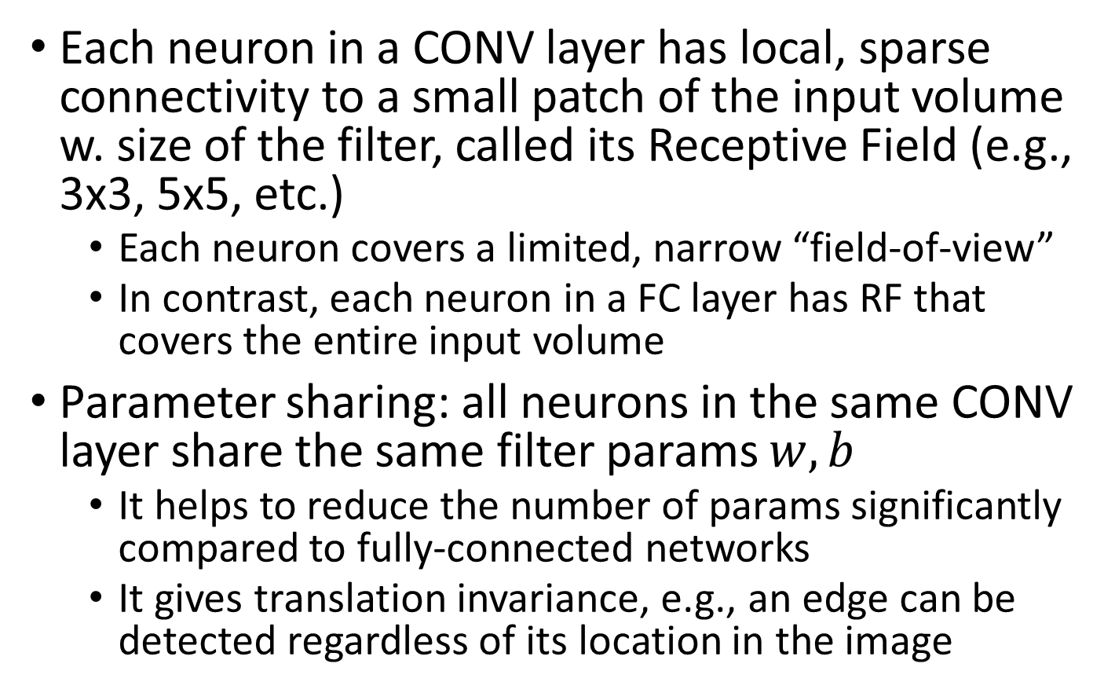
Receptive Field and Parameter Sharing
Each neuron in a CONV layer has local, sparse connectivity to a small patch of the input volume w. size of the filter, called its Receptive Field (e.g., 3x3, 5x5, etc.)
  Each neuron covers a limited, narrow “field-of-view”
  In contrast, each neuron in a FC layer has RF that covers the entire input volume
Parameter sharing: all neurons in the same CONV layer share the same filter params $w,b$
  It helps to reduce the number of params significantly compared to fully-connected networks
  It gives translation invariance, e.g., an edge can be detected regardless of its location in the image
A filter sliding across different parts of the image

Slide 12
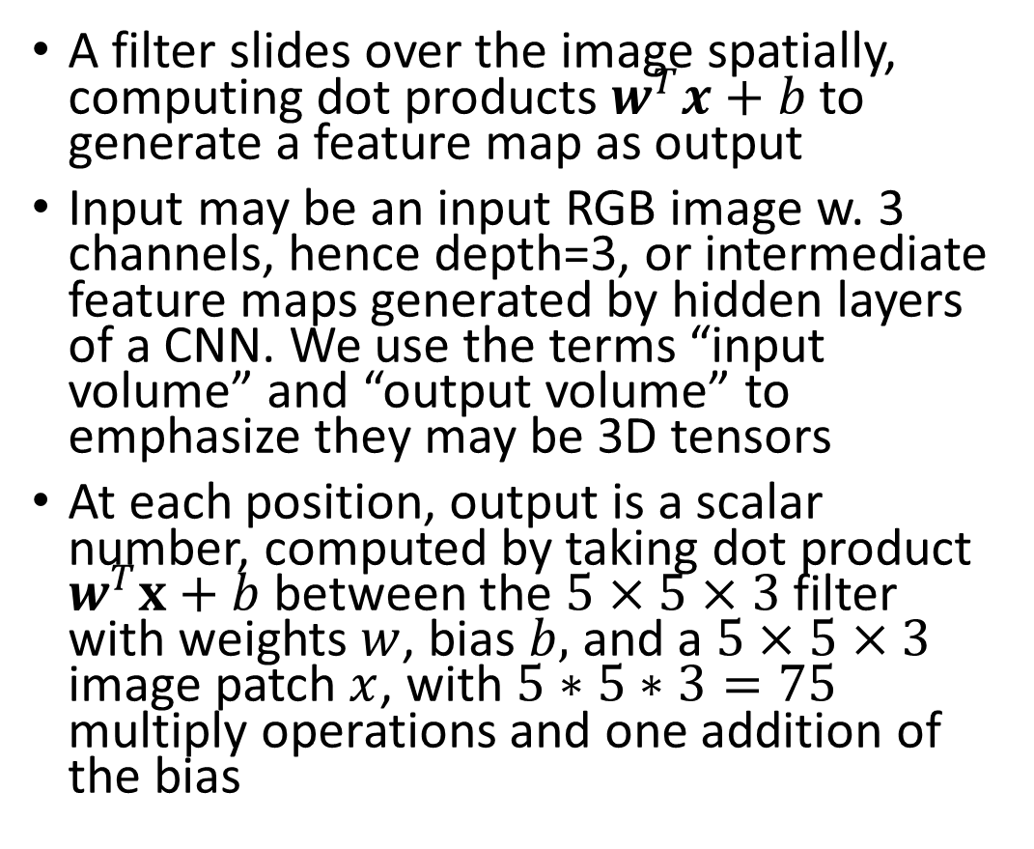
Convolution Operation
A filter slides over the image spatially, computing dot products $w^{T}x+b$ to generate a feature map as output
Input may be an input RGB image w. 3 channels, hence depth=3, or intermediate feature maps generated by hidden layers of a CNN. We use the terms “input volume” and “output volume” to emphasize they may be 3D tensors
At each position, output is a scalar number, computed by taking dot product $w^{T}x+b$between the $5×5×3$filter with weights $w$, bias $b,$ and a $5×5×3$ image patch $x$, with $5∗5∗3=75$ multiply operations and one addition of the bias
32x32x3 input 5x5x3 filter
32
Output: a scalar number
32
3

Slide 13
Convolution Operation
32x32x3 input
5x5x3 filter
32
One (blue) filter generates one 2D feature map as output
28
convolve (slide) over all spatial locations
32
28
32x32x3 input 5x5x3 filter
Two filters (blue and green) generate two 2D feature maps (blue and green), stacked along the depth dimension to produce a 3D output volume
3
1
32
28
convolve (slide) over all spatial locations
32
28
3
1

Slide 14
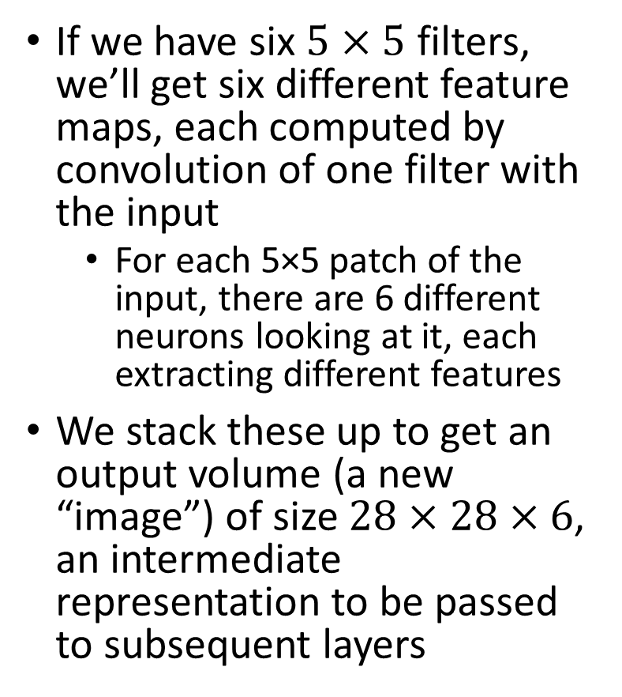
Stacked feature maps
If we have six $5×5$ filters, we’ll get six different feature maps, each computed by convolution of one filter with the input
  For each 5×5 patch of the input, there are 6 different neurons looking at it, each extracting different features
We stack these up to get an output volume (a new “image”) of size $28×28×6$, an intermediate representation to be passed to subsequent layers
feature maps
32
28
Convolution Layer w.
six 5x5 filters
32
28
3
6

Slide 15
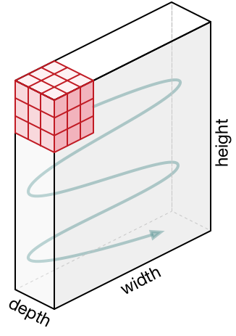


Convolution of a Filter on an RGB Image w. 3 Channels
6x6 input feature map w. 3 channels; one 3x3 filter with depth 3; 4x4 output feature map w. one channel
# channels of input feature map == # depth of each filter (3)
# channels of output feature map == # filters (1)
(Even though the fig shows sequential computation, convolution operations are inherently parallel, hence suitable for implementation on parallel hardware like GPUs)
$$∗$$
$$=$$
3 x 3 x 3
4 x 4 x 1
6 x 6 x 3

Slide 16



Convolution of 2 Filters on an RGB Image w. 3 Channels
Important
6x6 input feature map w. 3 channels; two 3x3 filters with depth 3; 4x4 output feature map w. two channels
# channels of input feature map == # depth of each filter (3)
# channels of output feature map == # filters (2)
$$∗$$
3 x 3 x 3
$$=$$
$$∗$$
6 x 6 x 3
3 x 3 x 3
4 x 4 x 2

Slide 17
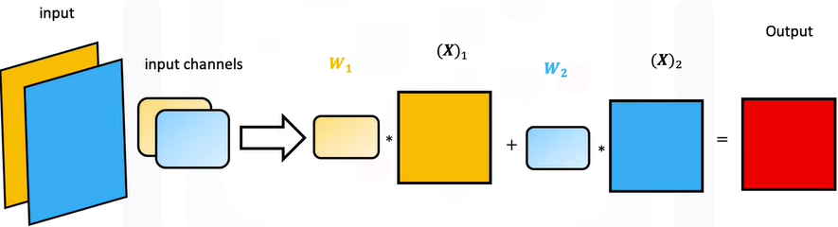
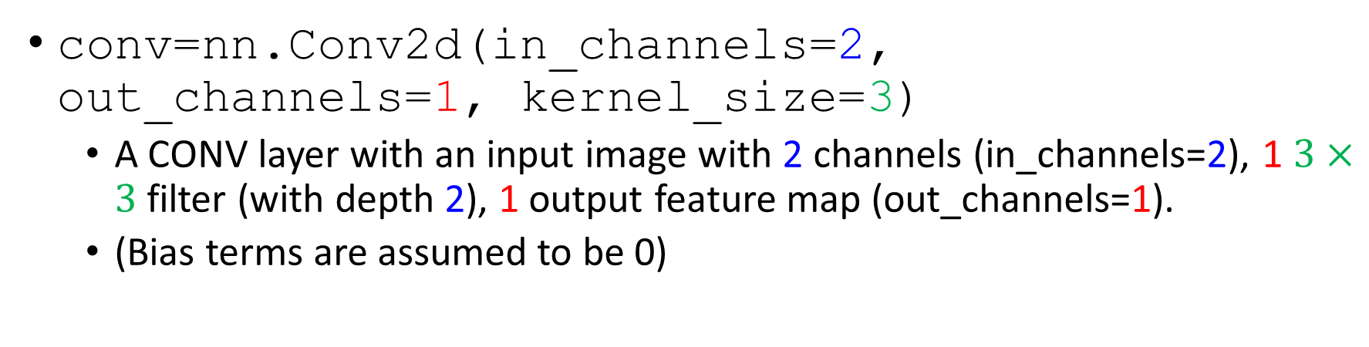
Convolution in PyTorch
conv=nn.Conv2d(in_channels=2, out_channels=1, kernel_size=3)
  A CONV layer with an input image with 2 channels (in_channels=2), 1 $3×3$ filter (with depth 2), 1 output feature map (out_channels=1).
  (Bias terms are assumed to be 0)
input
1 filter/kernel
output

Slide 18
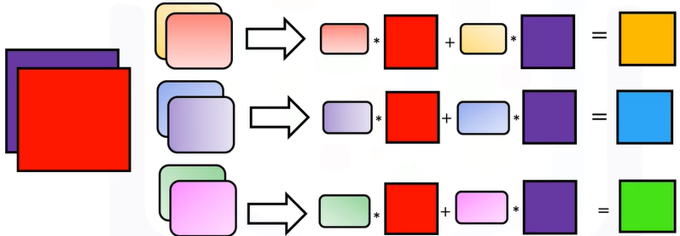
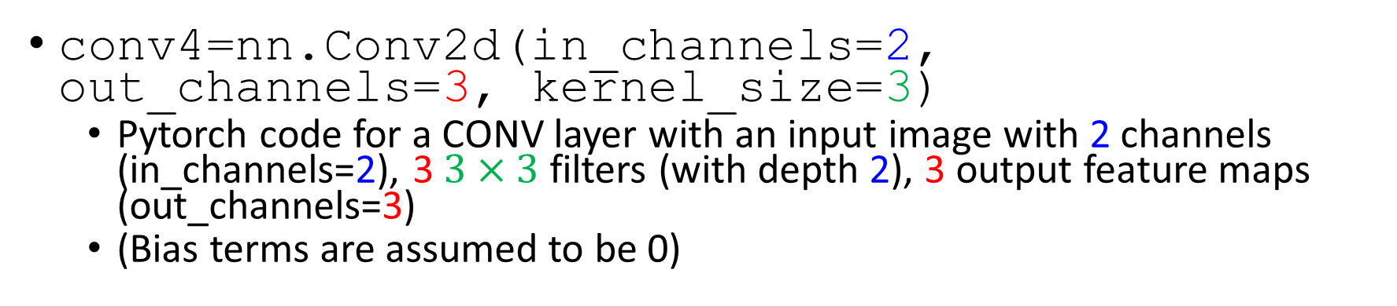
Convolution in PyTorch Cont’
conv4=nn.Conv2d(in_channels=2, out_channels=3, kernel_size=3)
  PyTorch code for a CONV layer with an input image with 2 channels (in_channels=2), 3 $3×3$ filters (with depth 2), 3 output feature maps (out_channels=3)
  (Bias terms are assumed to be 0)
input
3 filters/kernels
output

Slide 19
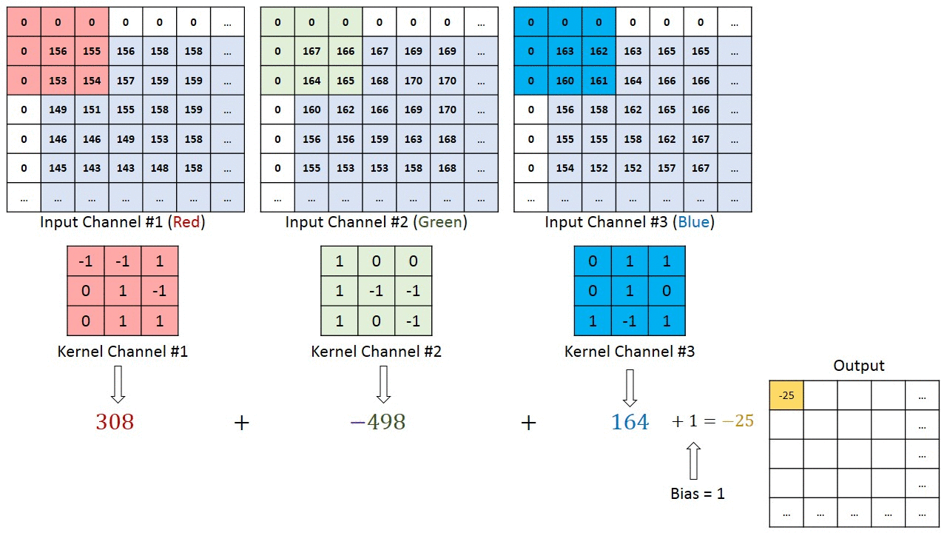
Convolution Example 1: Computing a Single Output Element
https://towardsdatascience.com/a-comprehensive-guide-to-convolutional-neural-networks-the-eli5-way-3bd2b1164a53
Notes:
CONV Example 4: Input Depth $D_{1}=3$
Input volume$:$ $M×N×3$
A $3×3×3$ filter ($K=1,F=3$) w. stride $S=1$, padding$P=1$
Output volume: $M×N×1$ (since $\frac{1}{1}\left(M+2∗1−3\right)+1=M, \frac{1}{1}\left(N+2∗1−3\right)+1=N$)

Slide 20
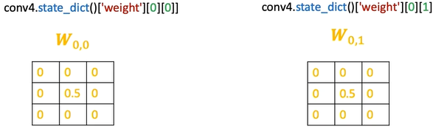
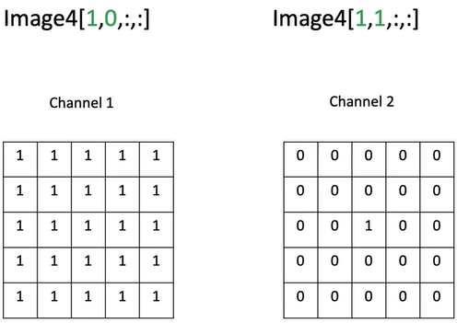
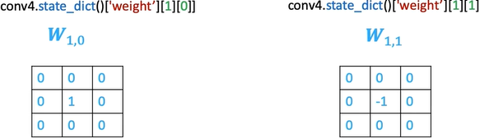
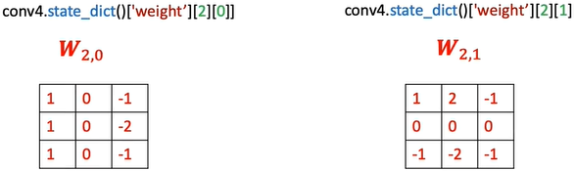

Convolution Example 2
Input image with 2 channels
Three $3×3$ filters
Notes:
Conv4.state_dict()weight 0 0

Slide 21
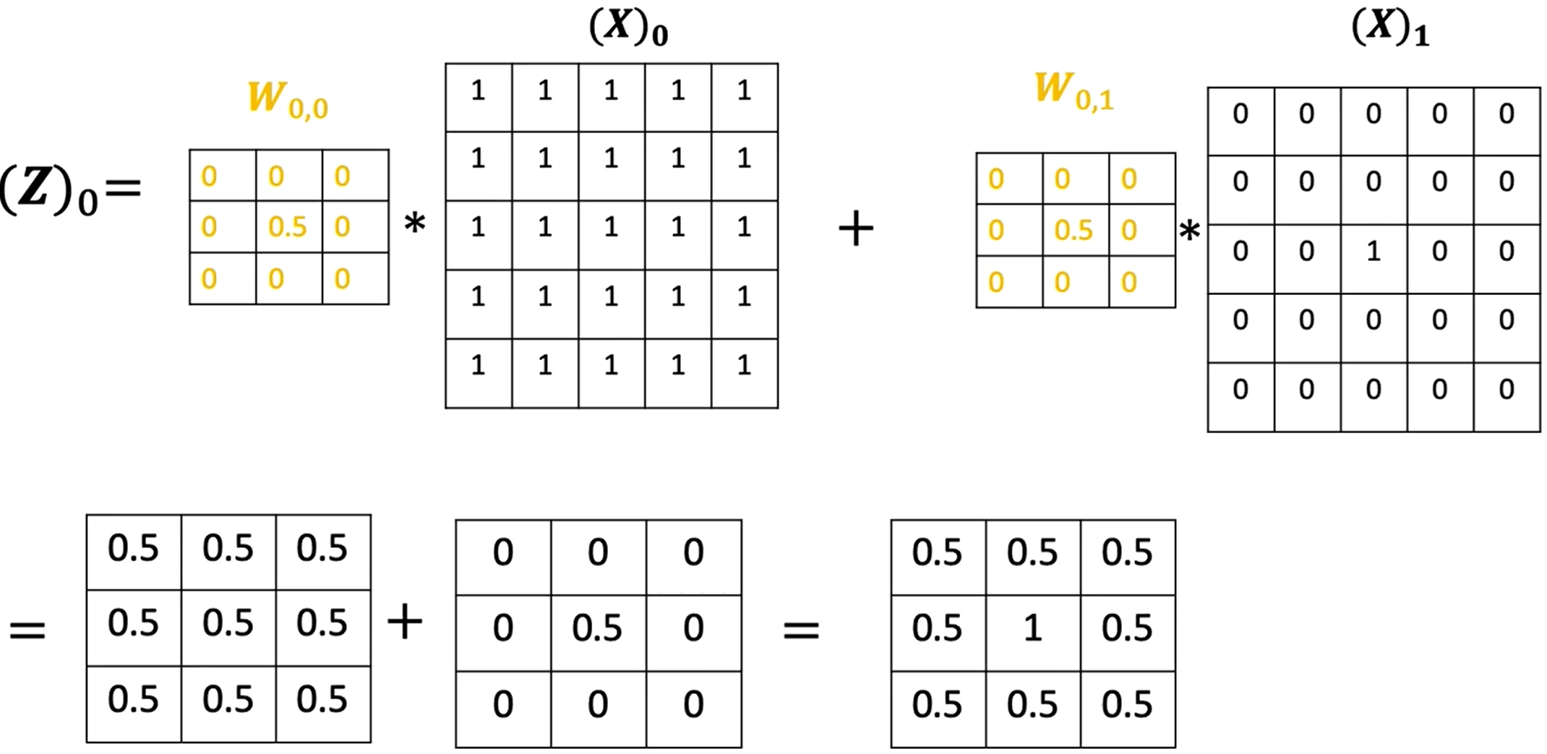
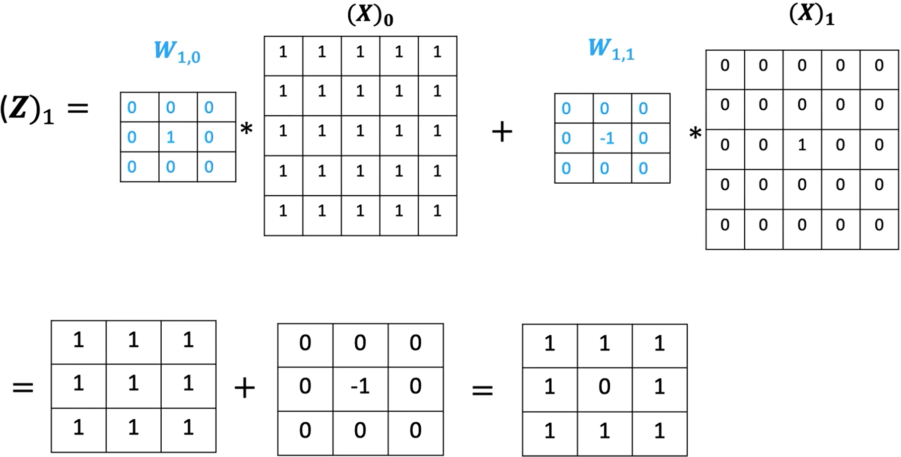
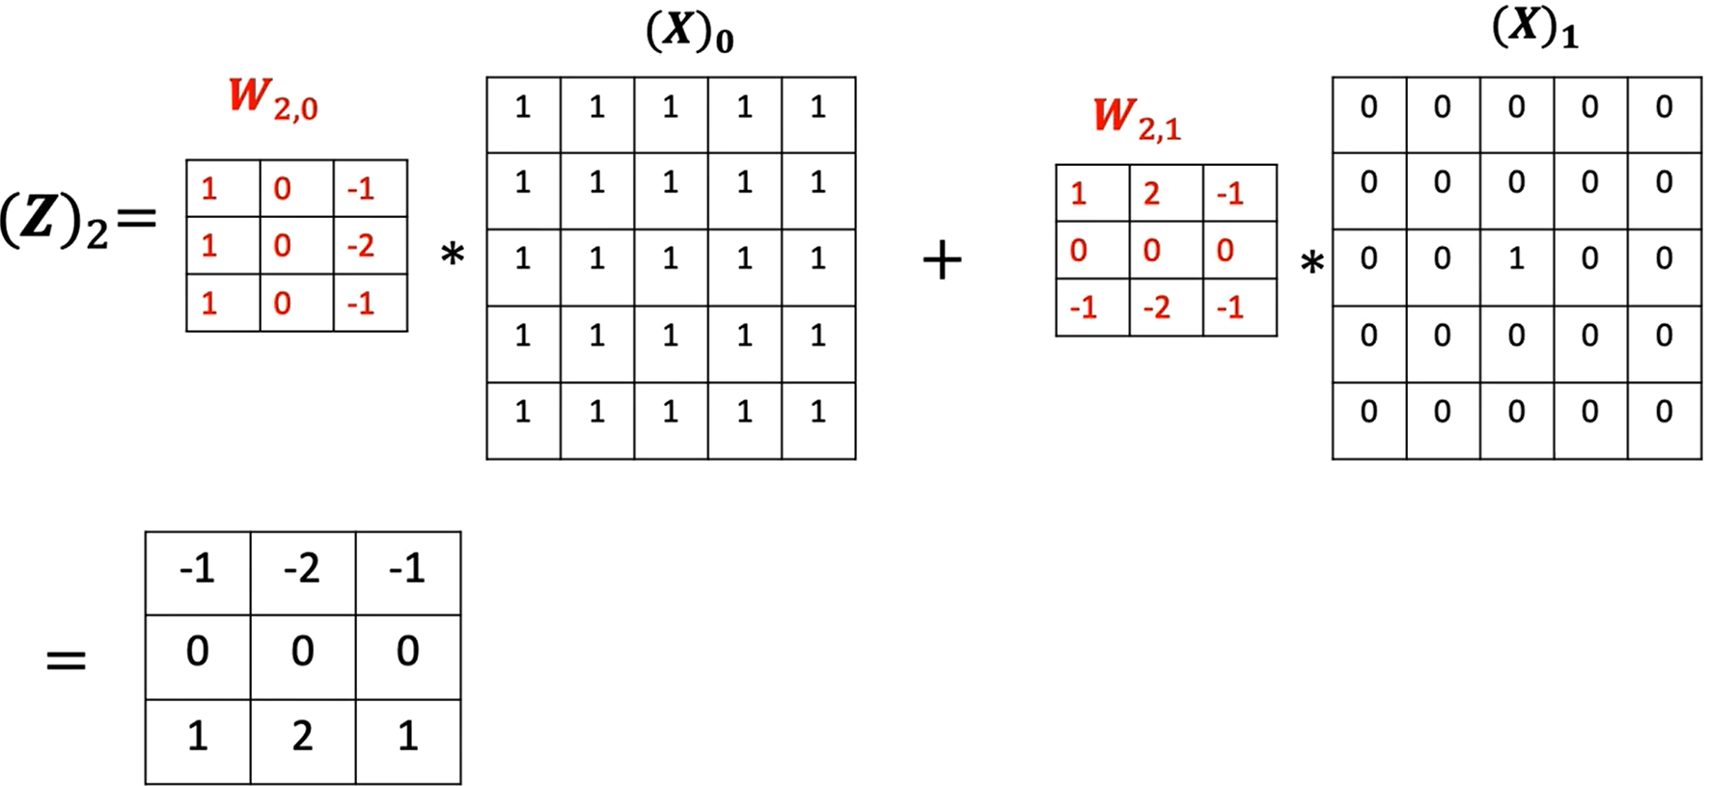
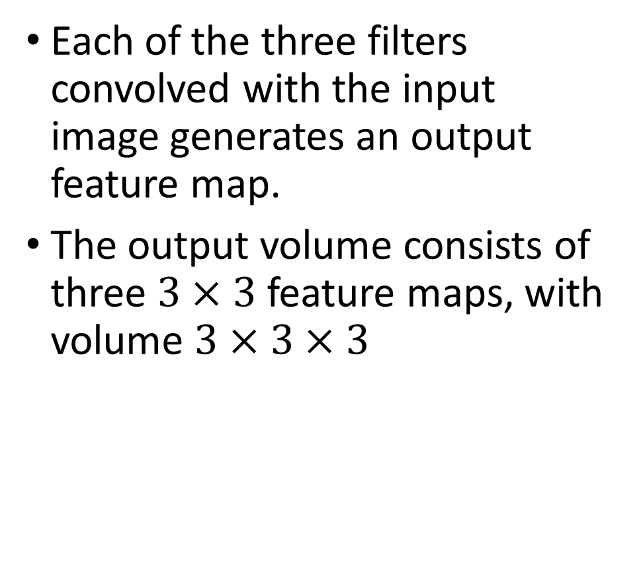
Convolution Example 2 Cont’
Each of the three filters convolved with the input image generates an output feature map.
The output volume consists of three $3×3$ feature maps, with volume $3×3×3$

Slide 22
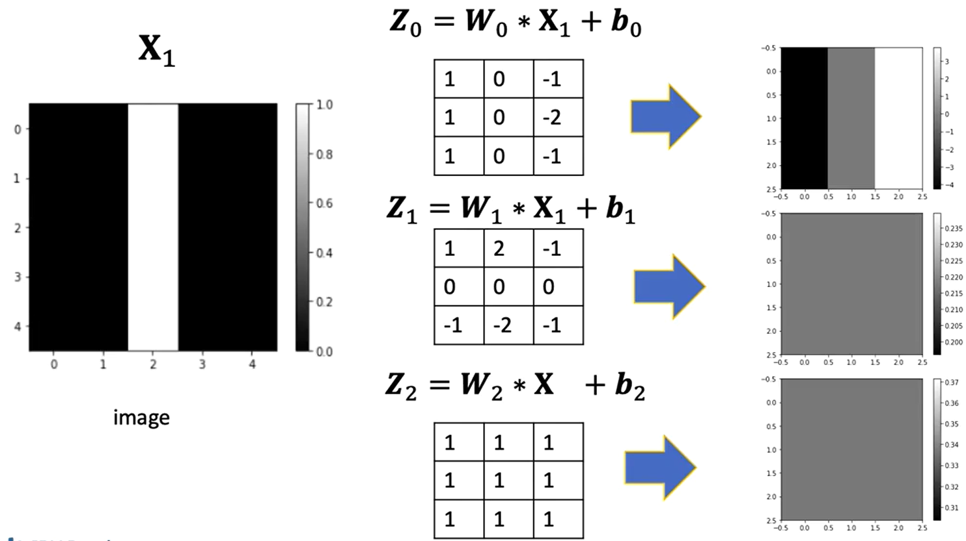
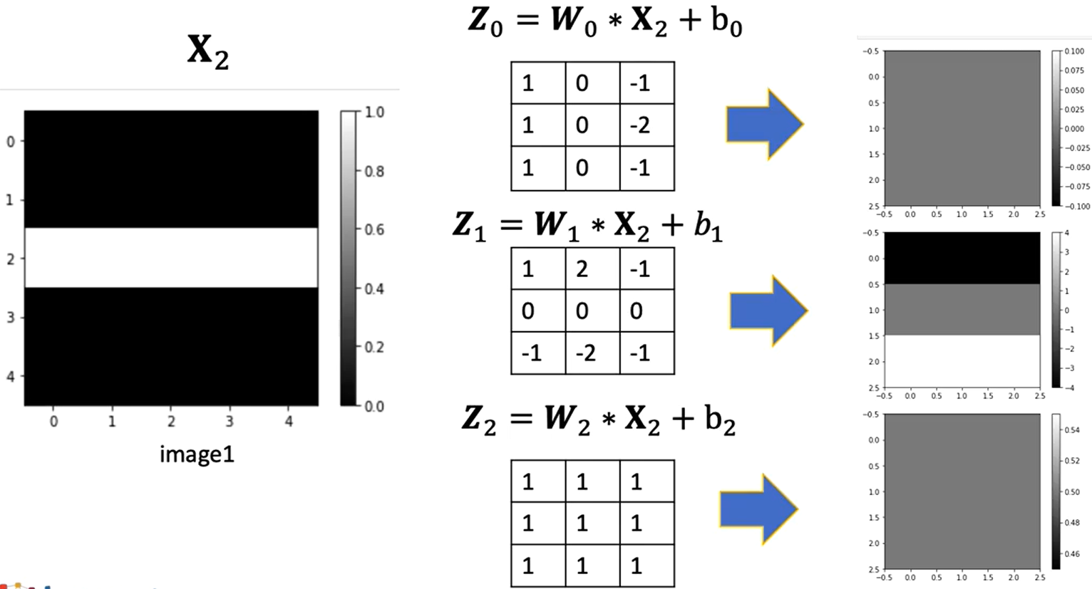
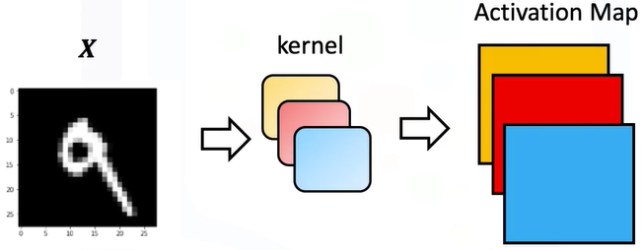
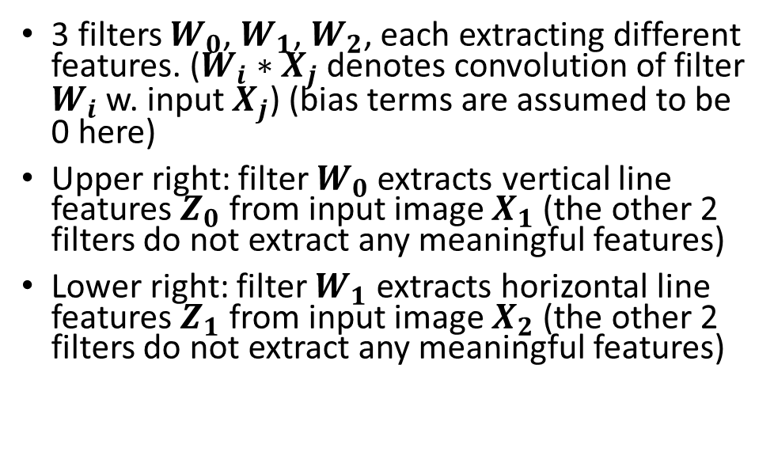
Convolution Example 3
3 filters $W_{0}$, $W_{1}$, $W_{2}$, each extracting different features. ($W_{i}∗X_{j}$ denotes convolution of filter $W_{i}$ w. input $X_{j}$) (bias terms are assumed to be 0 here)
Upper right: filter $W_{0}$ extracts vertical line features $Z_{0}$ from input image $X_{1}$ (the other 2 filters do not extract any meaningful features)
Lower right: filter $W_{1}$ extracts horizontal line features $Z_{1}$ from input image $X_{2}$ (the other 2 filters do not extract any meaningful features)
3 filters/kernels, 3 output feature/activation map
22

Slide 23
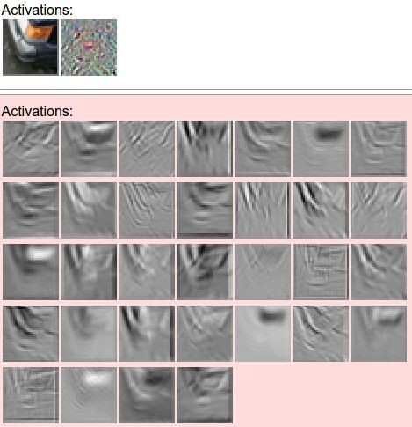
Filters and feature maps Example
filters
one filter =>
one feature map
32 5x5 filters

Slide 24
7x7 input, 3x3 filter, stride=1 ⇒ output: 5x5

Slide 25
7x7 input, 3x3 filter, stride=2 ⇒ output: 3x3

Slide 26
7x7 input, 3x3 filter, stride=3 ⇒ output: ???
The rightmost column and bottom row are not processed!

Slide 27
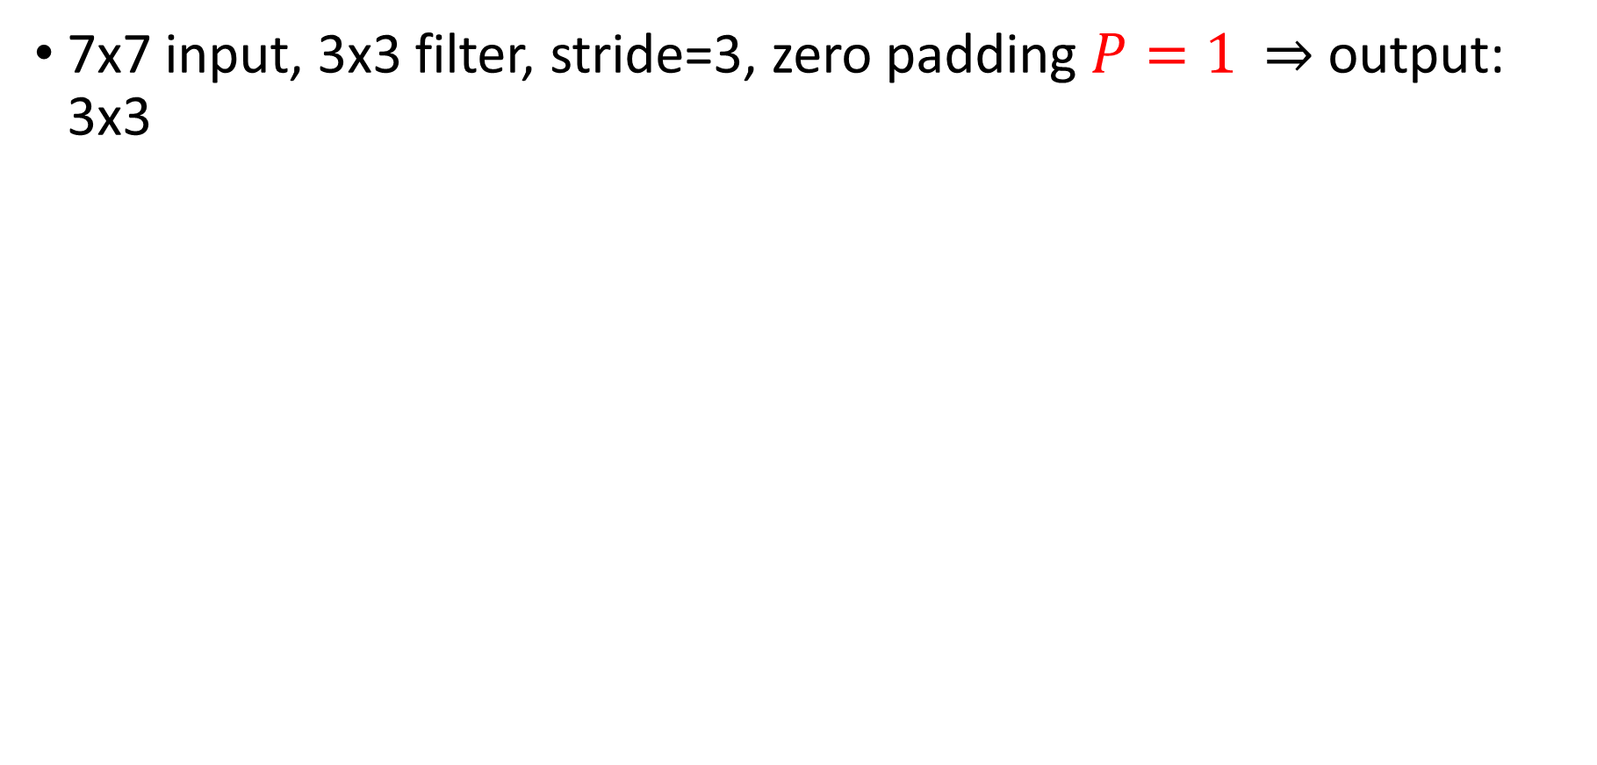
Solution: Add padding
7x7 input, 3x3 filter, stride=3, zero padding $P=1$ $⇒$ output: 3x3
0 | 0 | 0 | 0 | 0 | 0 | 0 | 0 | 0
0
0
0
0
0 | 0 | 0 | 0 | 0 | 0 | 0 | 0 | 0
0
0
0
0
0 | 0 | 0 | 0 | 0 | 0 | 0 | 0 | 0
0
0
0
0

Slide 28
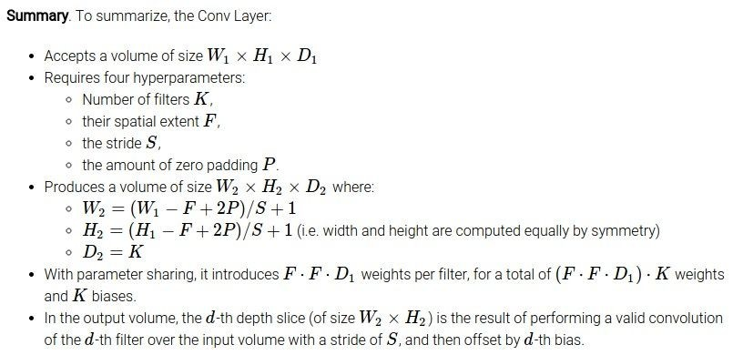
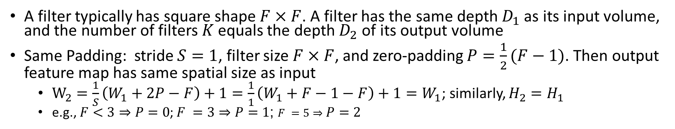
Computation of CONV Layer Sizes
Important
Common settings:
K = (powers of 2, e.g. 32, 64, 128, 512)
- F = 3, S = 1, P = 1
- F = 5, S = 1, P = 2
- F = 1, S = 1, P = 0
A filter typically has square shape $F×F$. A filter has the same depth $D_{1}$ as its input volume, and the number of filters $K$ equals the depth $D_{2}$ of its output volume
Same Padding: stride $S=1$, filter size $F×F$, and zero-padding $P=\frac{1}{2}(F−1)$. Then output feature map has same spatial size as input
  $W_{2}=\frac{1}{S}\left(W_{1}+2P−F\right)+1=\frac{1}{1}\left(W_{1}+F−1−F\right)+1=W_{1}$; similarly, $H_{2}=H_{1}$
  e.g., $F=1⇒P=0$; $F =3⇒P=1$; $F =5⇒P=2$
Notes:
If input has square shape, then we denote $N_{1}=W_{1}=H_{1}$; Filters typically have square shape

Slide 29
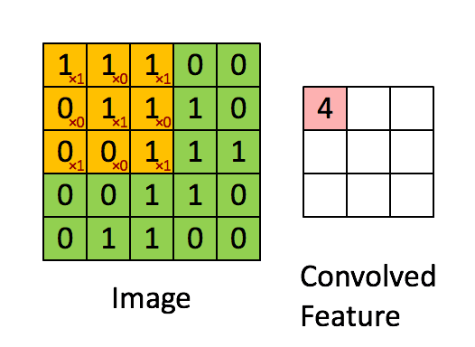
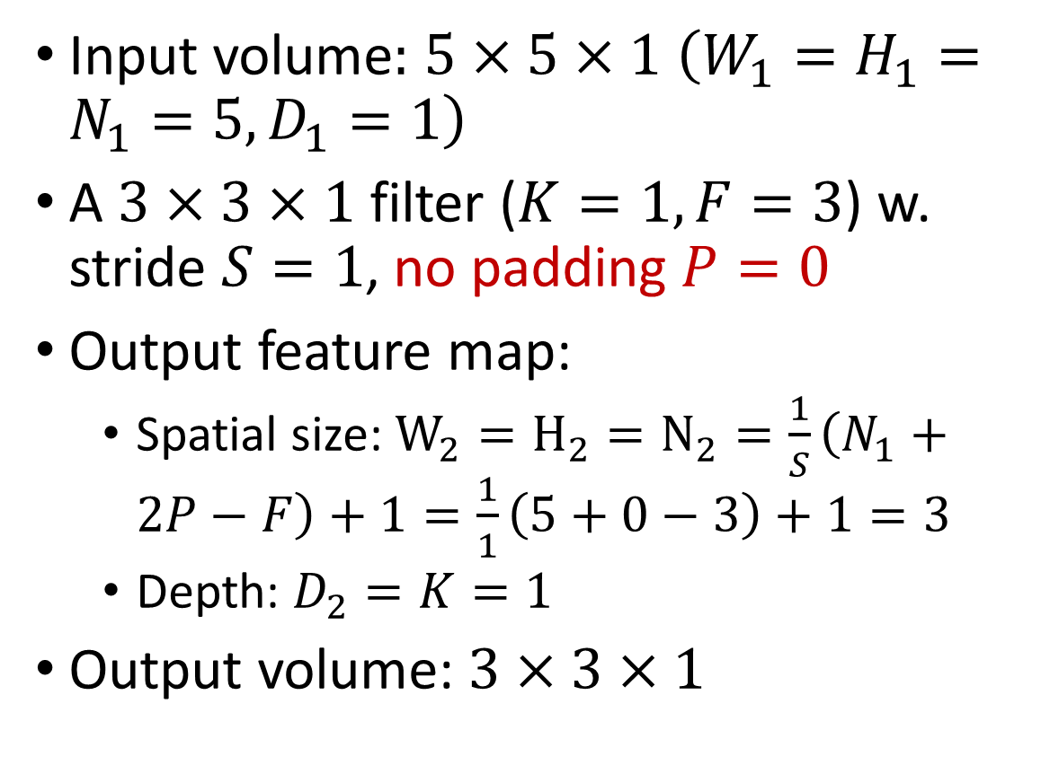
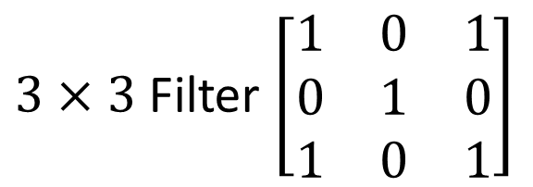
CONV Example 1: No Padding
Input volume$:$ $5×5×1$ $\left(W_{1}=H_{1}=N_{1}=5,D_{1}=1\right)$
A $3×3×1$ filter ($K=1,F=3$) w. stride $S=1$, no padding $P=0$
Output feature map:
  Spatial size: $W_{2}=H_{2}=N_{2}=\frac{1}{S}\left(N_{1}+2P−F\right)+1=\frac{1}{1}\left(5+0−3\right)+1=3$
  Depth: $D_{2}=K=1$
Output volume: $3×3×1$
Map
$3×3$ Filter $\left[\begin{matrix}1 & 0 & 1 \\ 0 & 1 & 0 \\ 1 & 0 & 1\end{matrix}\right]$

Slide 30

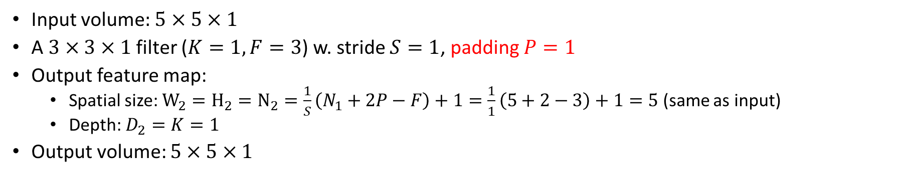
CONV Example 2: Same Padding
Input volume$:$ $5×5×1$
A $3×3×1$ filter ($K=1,F=3$) w. stride $S=1$, padding $P=1$
Output feature map:
  Spatial size: $W_{2}=H_{2}=N_{2}=\frac{1}{S}\left(N_{1}+2P−F\right)+1=\frac{1}{1}\left(5+2−3\right)+1=5$ (same as input)
  Depth: $D_{2}=K=1$
Output volume: $5×5×1$

Slide 31
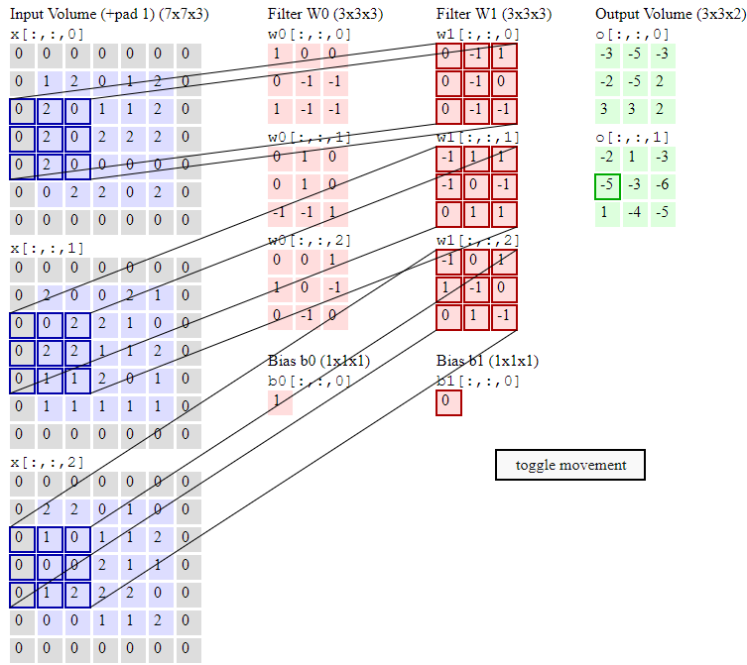
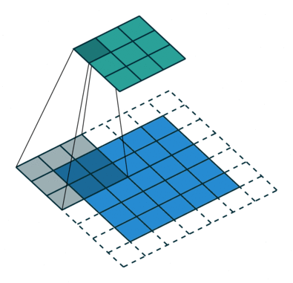

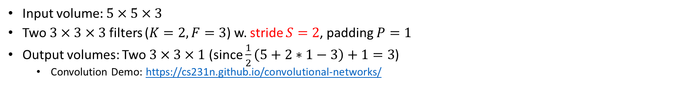
CONV Example 3: Stride $S=2$
Input volume$:$ $5×5×3$
Two $3×3×3$ filters ($K=2,F=3$) w. stride $S=2$, padding $P=1$
Output volumes: Two $3×3×1$ (since $\frac{1}{2}\left(5+2∗1−3\right)+1=3$)
  Convolution Demo: https://cs231n.github.io/convolutional-networks/

Slide 32
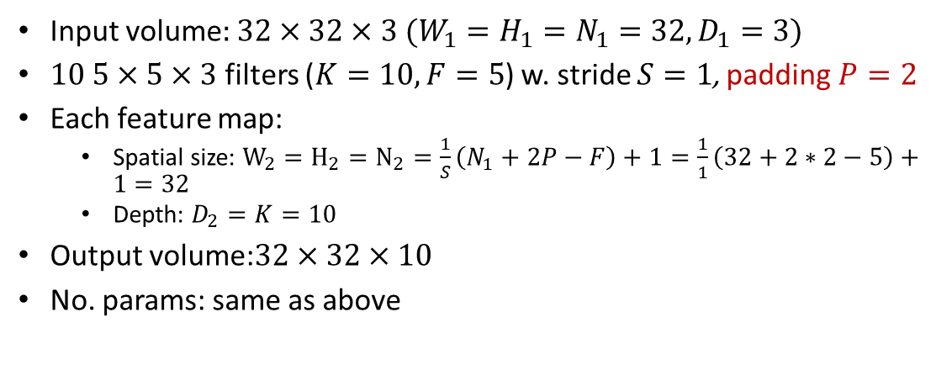
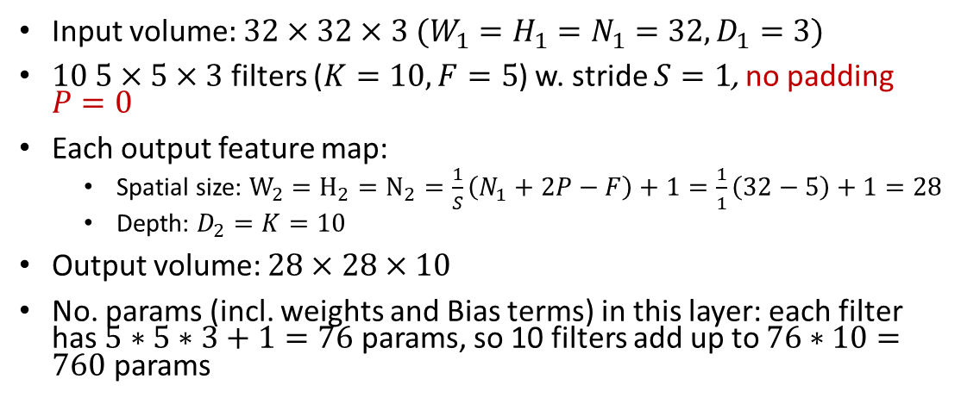
CONV Example 4: No Padding vs. Same Padding
Input volume$:$ $32×32×3$ $(W_{1}=H_{1}=N_{1}=32,D_{1}=3)$
$10 5×5×3$ filters ($K=10,F=5$) w. stride $S=1$, no padding $P=0$
Each output feature map:
  Spatial size: $W_{2}=H_{2}=N_{2}=\frac{1}{S}\left(N_{1}+2P−F\right)+1=\frac{1}{1}\left(32−5\right)+1=28$
  Depth: $D_{2}=K=10$
Output volume: $28×28×10$
No. params (incl. weights and Bias terms) in this layer: each filter has $5∗5∗3+1=76$ params, so 10 filters add up to $76∗10=760$ params
32
28
5x5 Conv
w. 10 filters
32
28
3
10
Input volume$:$ $32×32×3$ $(W_{1}=H_{1}=N_{1}=32,D_{1}=3)$
$10 5×5×3$ filters ($K=10,F=5$) w. stride $S=1$, padding$P=2$
Each feature map:
  Spatial size: $W_{2}=H_{2}=N_{2}=\frac{1}{S}\left(N_{1}+2P−F\right)+1=\frac{1}{1}\left(32+2∗2−5\right)+1=32$
  Depth: $D_{2}=K=10$
Output volume:$32×32×10$
No. params: same as above
32
32
5x5 Conv
w. 10 filters
32
32
3
10
Input volume
Output volume

Slide 33

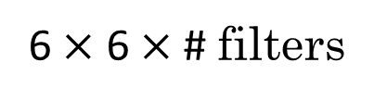
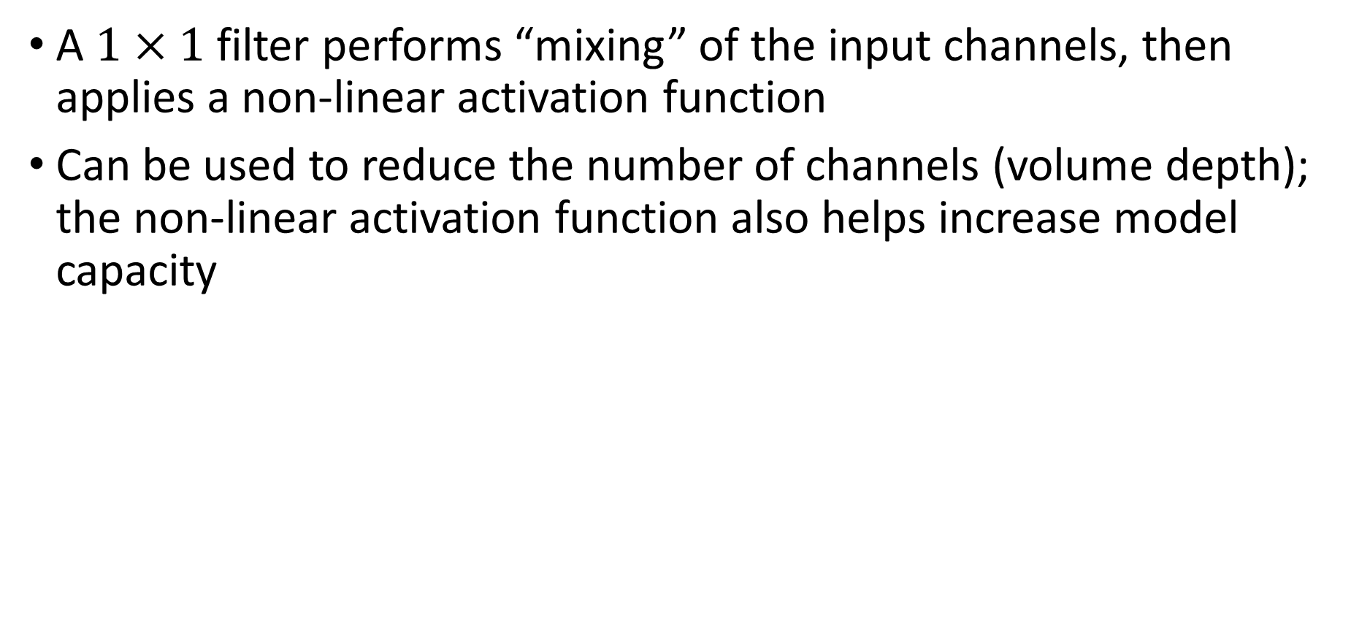
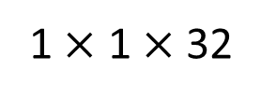
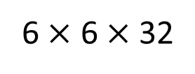

Pointwise Convolution with 1×1 Filter
A $1×1$ filter performs “mixing” of the input channels, then applies a non-linear activation function
Can be used to reduce the number of channels (volume depth); the non-linear activation function also helps increase model capacity
$$∗$$
$$=$$
6 $×$ 6 $×$ 32
1 $×$ 1 $×$ 32
6 $×$ 6 $×$ # filters

Slide 34
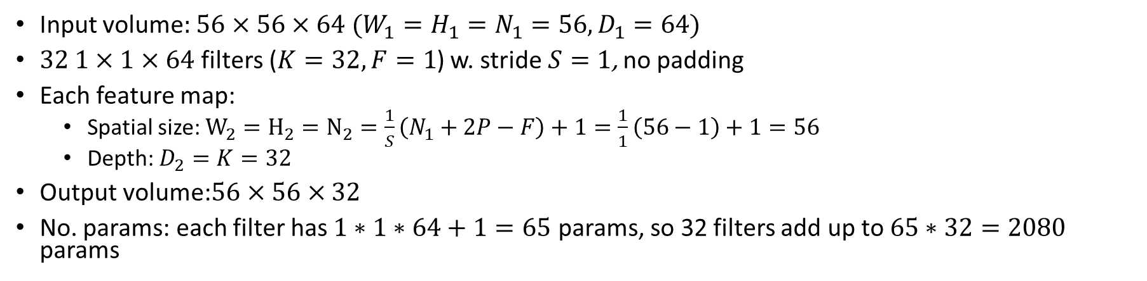
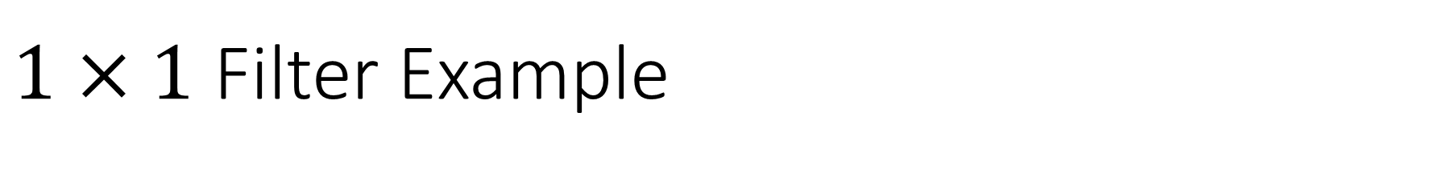
$1×1$ Filter Example
Input volume$:$ $56×56×64$ $(W_{1}=H_{1}=N_{1}=56, D_{1}=64)$
$32 1×1×64$ filters ($K=32,F=1$) w. stride $S=1$, no padding
Each feature map:
  Spatial size: $W_{2}=H_{2}=N_{2}=\frac{1}{S}\left(N_{1}+2P−F\right)+1=\frac{1}{1}\left(56−1\right)+1=56$
  Depth: $D_{2}=K=32$
Output volume:$56×56×32$
No. params: each filter has $1∗1∗64+1=65$ params, so 32 filters add up to $65∗32=2080$ params
1x1 Conv
w. 32 filters
56
56
(Each filter has size 1x1x64, and performs a 64-dimensional dot product)
56
56
64
32

Slide 35


Dilated Convolution
Increase receptive field size without increasing # params
Regular convolution
(1-dilated)
2-dilated
convolution

Slide 36

3D Convolution
3D filter slides along all 3 axes (width, height, depth). Very computation intensive
Useful for 3D images such as medical CT/MRI images, or Point Clouds from Lidar

Slide 37










Converting Convolution to Matrix Multiplication: 1D CONV Example
Since parallel hardware (GPU, FPGA…) can handle matrix multiplication efficiently, this conversion increases computation efficiency at the expense of increased memory size for storing the weights (bias terms are not shown in fig)
Input
Kernel
$$x_{0}$$
$$x_{1}$$
$$x_{2}$$
$$x_{3}$$
$$x_{4}$$
Output
$$w_{0}$$
$$w_{1}$$
$$w_{2}$$
$$y_{1}$$
$$y_{2}$$
$$y_{3}$$
$$∗$$
$$=$$
$$x_{0}$$
$$x_{1}$$
$$x_{2}$$
$$x_{3}$$
$$x_{4}$$
$$w_{0}$$ | $$w_{1}$$ | $$w_{2}$$ | $$0$$ | $$0$$
$$0$$ | $$w_{0}$$ | $$w_{1}$$ | $$w_{2}$$ | $$0$$
$$0$$ | $$0$$ | $$w_{0}$$ | $$w_{1}$$ | $$w_{2}$$
$$y_{1}$$
$$y_{2}$$
$$y_{3}$$
$$×$$
$$=$$

Slide 38

Converting Convolution to Matrix Multiplication: 2D CONV Example
An Illustrated Explanation of Performing 2D Convolutions Using Matrix Multiplications https://medium.com/@_init_/an-illustrated-explanation-of-performing-2d-convolutions-using-matrix-multiplications-1e8de8cd2544
Notes:
Two different ways

Slide 39
Outline
Convolution layers
Pooling and Fully-Connected layers
Well-known CNN architectures
Notes:
Safety plan
The safety plan gives an overview of how you are going to achieve a safe system. A few of the major elements include:
what system is under consideration
the goal of the project
what steps will be taken to ensure safety
the roles and personnel involved in the project
the project timeline

Slide 40

Typical CNN Architecture
Multiple layers, each consisting of CONV, POOL and non-linear activation functions (e.g., ReLU), are stacked into a deep network
  Many variants possible, e.g., multiple CONV layers can be stacked without POOL and activation functions in-between
32
28
24
….
CONV,
POOL, ReLU
e.g. 6 5x5x3 filters
CONV,
POOL, ReLU
e.g. 10 5x5x6 filters
CONV,
POOL, ReLU
32
28
24
3
6
10
ReLU Activation Function

Slide 41


Pooling (Sub-Sampling) Layer
Important
A pooling filter has depth 1, and operates over each feature map independently, hence the input volume and output volume have the same depth $D_{1}=D_{2}$
  In contrast, a CONV filter has the same depth $D_{1}$ as its input volume, and the number of filters $K$ equals the depth $D_{2}$ of its output volume
  Common settings: $F=2, S=2$, or $F=3, S=2$
Example: pooling w. a $2×2$ filter w. stride $S=2$, no padding. Output volume: $\frac{W_{1}}{2}×\frac{H_{1}}{2}×D_{1}$(since $\frac{1}{2}\left(W_{1}−2\right)+1=\frac{W_{1}}{2},\frac{1}{2}\left(H_{1}−2\right)+1=\frac{H_{1}}{2}$)

Slide 42


Max Pooling w. Examples
Max pooling: take the max element among the $F∗F$ elements in each $F×F$ patch of each input feature map to reduce its dimension ($F=2,S=2$)
Alternative: average pooling is less commonly used
Pooling is also called subsampling or downsampling
  Max pooling selects the brighter pixels from the image. It is useful when the background of the image is dark and we are interested in only the lighter pixels of the image.
  Average pooling method smooths out the image and hence the sharp features may not be identified when this pooling method is used
6 | 8
3 | 4
1 | 1 | 2 | 4
5 | 6 | 7 | 8
3 | 2 | 1 | 0
1 | 2 | 3 | 4
max pooling
3.3 | 5.3
2 | 2
avg pooling

Slide 43

Overlapping Pooling
Input volume: $N×N×D_{1}$
A $3×3$ pooling filter w. stride $S=1$, no padding
Output volume: $(N−2)×(N−2)×D_{1}$(since $\frac{1}{1}\left(N−3\right)+1=N−2$)
  In practice, it is more common to have $F=3, S=2$ for overlapping pooling
1 | 3 | 2 | 1 | 3
2 | 9 | 1 | 1 | 5
1 | 3 | 2 | 3 | 2
8 | 3 | 5 | 1 | 0
5 | 6 | 1 | 2 | 9
9 | 9 | 5
9 | 9 | 5
8 | 6 | 9
max pool w. 3x3
filter and stride 1

Slide 44


Fully-Connected (FC) Layer
Each neuron connects to the entire input volume w. no weight sharing
  No. params for FC layer of size $N_{out}$ connected to input layer of size $N_{in}$ is $(N_{in}+1)∗N_{out}$ ($=\left(20+1\right)∗5=105$ for the example)
bias

Slide 45

Fully-Connected (FC) Layer

Slide 46



A Complete CNN Example
A CNN with a CONV layer, a FC layer and a SoftMax layer
-2
.993
.007
  Logits: $\left[\begin{matrix}4 \\ −1\end{matrix}\right]$
Step 6 (SoftMax)
  SoftMax Scores: $\frac{1}{e^{4}+e^{−1}}\left[\begin{matrix}e^{4} \\ e^{−1}\end{matrix}\right]=\left[\begin{matrix}.993 \\ .007\end{matrix}\right]$
Huang C, Fan J, Chen X, et al. Divide and slide: Layer-wise refinement for output range analysis of deep neural networks[J]. IEEE Transactions on Computer-Aided Design of Integrated Circuits and Systems, 2020, 39(11): 3323-3335.
Notes:
Step 6 (SoftMax):
Logits: $[4, −1]$
SoftMax scores $[\frac{2^{4}}{2^{4}+2^{−1}},\frac{2^{−1}}{2^{4}+2^{−1}}]=[.97, .03]$

Slide 47





Summary of 3 Types of CNN Layers
Important
 | CONV | POOL | FC
Input volume | $$W_{1}×H_{1}×D_{1}$$ | $$W_{1}×H_{1}×D_{1}$$ | $$N_{in}$$
Output volume | $$W_{2}×H_{2}×K$$ | $$W_{2}×H_{2}×D_{1}$$ | $$N_{out}$$
No. params | $$\left(F∗F∗D_{1}+1\right)∗K$$ | $$0$$ | $$\left(N_{in}+1\right){∗N}_{out}$$
No. MULs | $$\left(F∗F∗D_{1}+1\right)∗K∗W_{2}∗H_{2}$$ | $$0$$ | $$\left(N_{in}+1\right){∗N}_{out}$$
(1) No. MULs for CONV layer: $\left(F∗F∗D_{1}+1\right)$ MULs to compute each output element; $K∗W_{2}∗H_{2}$output elements
(2) Bias term of $+1$ is often omitted
https://stanford.edu/~shervine/teaching/cs-230/cheatsheet-convolutional-neural-networks

Slide 48


MLP vs. CNN
In a Multi-Layer Perceptron (MLP), all layers are FC layers
Cannot alter input image size
No translation invariance
No. params can grow very large, prone to overfitting
In a CNN, only the last few (typically <=3) layer(s) are FC
CONV layers can handle images of arbitrary size
Translation invariance
Fewer params than MLP

Slide 49
Outline
Convolution layers
Pooling and Fully-Connected layers
Well-known CNN architectures
Notes:
Safety plan
The safety plan gives an overview of how you are going to achieve a safe system. A few of the major elements include:
what system is under consideration
the goal of the project
what steps will be taken to ensure safety
the roles and personnel involved in the project
the project timeline

Slide 50


LeNet-5 (LeCun et al. 1998)
Layer | Input $$W_{1}×H_{1}×D_{1}$$ | No. Filters | Filter $$K×K×D/S$$ | Output $$W_{2}×H_{2}×D_{2}$$ | No. params
C1:CONV | $$32×32×1$$ | $$6$$ | $$5×5×1$$ | $$28×28×6$$ | $$156$$
S2:POOL | $$28×28×6$$ | $$6$$ | $$2×2×1/2$$ | $$14×14×6$$ | $$0$$
C3:CONV | $$14×14×6$$ | $$16$$ | $$5×5×6$$ | $$10×10×16$$ | $$2416$$
S4:POOL | $$10×10×16$$ | $$16$$ | $$2×2×1/2$$ | $$5×5×16$$ | $$0$$
C5:CONV | $$5×5×16$$ | $$120$$ | $$5×5×16$$ | $$1×1×120$$ | $$48120$$
F6 | FC | - | $$−$$ | $$84$$ | $$10164$$
Output | FC |  |  | $$10$$ | $$850$$

Slide 51

LeNet-5 Details
Input image: $32×32×1$(grey-scale images of hand-written digits w. size $32×32$ pixels)
Conv filters $5×5×1$ w. stride 1; Pooling filters $2×2$ w. stride $2$
Conv layer C1 maps from input volume $32×32×1$ to 6 feature maps w. volume $28×28×6$ (since $\frac{1}{1}(32−5)+1=28$). No params: $\left(5∗5∗1+1\right)∗6=156$
Pooling layer S2 maps from input volume $28×28×6$ to 6 feature maps w. volume $14×14×6$ (since $\frac{1}{2}(28−2)+1=14$).
Conv layer C3 maps from input volume $14×14×6$ to 16 feature maps w. volume $10×10×16$ (since $\frac{1}{1}(14−5)+1=10$). No params: $\left(5∗5∗6+1\right)∗16=2416$
Pooling layer S4 maps from input volume $10×10×16$ to 16 feature maps w. volume $5×5×16$ (since $\frac{1}{2}(10−2)+1=5$)
Conv layer C5 maps from input volume $5×5×16$ to 120 feature maps w. volume $1×1×120$ (since $\frac{1}{1}(5−5)+1=1$). No params: $\left(5∗5∗16+1\right)∗120=48120$
  You can also view it as an equivalent Fully-Connected layer that maps from the flattened input of size $400×1$ ($5∗5∗16=400$) to output of size $120×1$. For details, refer to L4.2 “Turning FC layer into CONV Layers”
FC layer F6 maps from input of size $120×1$ to output of size $84×1$. No params: $(120+1)∗84=10164$
Output layer (SoftMax) maps from input of size $84×1$ to output of size $10$. No params: $(84+1)∗10=850$
Refs: p. 28 “Computation of CONV Layer Sizes”; p. 41 “Pooling (Sub-Sampling) Layer”; p. 47 “Summary of 3 Types of CNN Layers”
https://www.analyticsvidhya.com/blog/2021/03/the-architecture-of-lenet-5/
https://towardsdatascience.com/understanding-lenet-a-detailed-walkthrough-17833d4bd155

Slide 52


ImageNet Large Scale Visual Recognition Challenge
1,000 object classes, 1.2 M labeled training images

Slide 53


AlexNet [Krizhevsky et al. 2012]
Input image: $227×227×3$
1st layer (CONV1): $96 11×11$ filters w. stride $S=4$, w. ReLU activation function
Output volume: $55×55×96$ (since $\frac{1}{4}\left(227−11\right)+1=55$).
2nd layer (POOL1): $3×3$ filters w. stride $S=2$ (overlapping)
Output volume: $27×27×96$ (since $\frac{1}{2}\left(55−3\right)+1=27$)
…
Total # params: 60M
Introduced ReLU activation function

Slide 54


VGGNet [Simonyan 2014] (the best performing variant VGG-16)
Same padding used for all CONV layers

Slide 55

VGG-16 Details
VGG-16 has 16 weight layers, not including POOL layers w. 0 weight
Input image: $224×224×3$
1st and 2nd CONV layers: $64 3×3$ filters w. stride $S=1$, padding $P=1$
  Output volume: $224×224×64$ (since $\frac{1}{1}\left(224+2∗1−3\right)+1=224$)
3rd POOL layer: $2×2$ filters w. stride $S=2$
  Output volume: $112×112×64$ (since $\frac{1}{2}\left(224−2\right)+1=112$)
4th and 5th CONV layers: $128 3×3$ filters w. stride $S=1$, padding $P=1$
  Output volume: $112×112×128$ (since $\frac{1}{1}\left(112+2∗1−3\right)+1=112$)
6th POOL layer: $2×2$ filters w. stride $S=2$
  Output volume: $56×56×128$ (since $\frac{1}{2}\left(112−2\right)+1=56$)
Total # params: 138M
ImageNet top 5 error: 7.3%

Slide 56




Stacked $3×3$ CONV Layers
2 stacked $3×3$ CONV layers w. padding $P=1$ have the same effective receptive field as a $5×5$ CONV layer; 3 stacked $3×3$ CONV layers w. padding $P=1$ have RF of $7×7$; $L$ stacked $3×3$ CONV layers w. padding $P=1$ have RF of $1+2L$. Benefits:
  Fewer params. Suppose all volumes have the same depth $D$, then a $7×7$ CONV layer has $\left(7∗7∗D+1\right)∗D≈49D^{2}$ params, while three stacked 3x3 CONV layers have only $\left(3∗3∗D+1\right)∗D∗3)≈27D^{2}$ params
  Multiple layers of non-linear activation functions increases CNN depth, hence larger model capacity
https://zhuanlan.zhihu.com/p/79258431

Slide 57

VGGNet Variants
Best performing variant
VGG-16

Slide 58

GoogLeNet [Szegedy et al., 2014]
Additional classification heads
for regularization
Inception Module

Slide 59


Inception Module
Can’t make up your mind about filter size? Have them all in the Inception Module!
  But this increases computation load
Additional $1×1$ CONV layers serve as bottleneck to reduce number of parameters and computation load

Slide 60










CONV
32,
5 $×$ 5 $×$ 192
Same padding ($P=2$)
28 $×$ 28 $×$ 192
28 $×$ 28 $×$ 32
Without the bottleneck layer: No. params: $5∗5∗192∗32=153600$; No. MULs: $(5∗5∗192)∗(32∗28∗28)=120$M
CONV
32,
5 $×$ 5 $×$ 16
Same padding ($P=2$)
CONV
16,
1 $×$ 1 $×$ 192
28 $×$ 28 $×$ 192
28 $×$ 28 $×$ 16
28 $×$ 28 $×$ 32
With the bottleneck layer: No. params: $1∗1∗192∗16+5∗5∗16∗32=15872$; No. MULs: $(1∗1∗192)∗(16∗28∗28)+(5∗5∗16)∗(32∗28∗28)=12.4$M
60

Slide 61

GoogLeNet Size
Compared to AlexNet:
  12x less params (only 5M, due to no FC layers), 2x more compute (due to more CONV layers)

Slide 62



Xception [Chollet 2017] MobileNets [Howard et al. 2017] : Depthwise Separable Convolution
Each filter is convolved with one input channel
Each filter is convolved with all input channels
Regular Convolution
Intermediate feature maps serve as bottleneck to reduce number of parameters and computation load. Refs:
  A Basic Introduction to Separable Convolutions https://towardsdatascience.com/a-basic-introduction-to-separable-convolutions-b99ec3102728
  Depthwise Separable Convolution - A FASTER CONVOLUTION! https://www.youtube.com/watch?v=T7o3xvJLuHk
  Groups, Depthwise, and Depthwise-Separable Convolution (Neural Networks) https://www.youtube.com/watch?v=vVaRhZXovbw
Followed by pointwise convolution
Depthwise Separable Convolution

Slide 63

Example: Regular Convolution
Input feature map
No. params: $3∗3∗2∗4=72$ (Four $3×3×2$ filters) (not counting Bias terms)
No. MULs: $(3∗3∗2)∗(4∗4∗4)=1152$ ($3∗3∗2$ MULs to compute each output element; $4∗4∗4$ output elements)
2 channels

Slide 64


Example: Depthwise Separable Convolution
1. Depthwise Convolution
No. params: $3∗3∗2+2∗4=26$ (Two $3×3×1$ filters and four $1×1×2$ filters) (not counting Bias terms)
No. MULs: $(3∗3∗1)∗(2∗4∗4)+(1∗1∗2)∗(4∗4∗4)=416$ (Depthwise Conv: $3∗3∗1$ MULs to compute each output element; $2∗4∗4$ output elements; Pointwise Conv: $1∗1∗2$ MULs to compute each output element; $4∗4∗4$ output elements)
2. Pointwise Convolution
$1×1$
filters

Slide 65



Residual Networks (ResNet) [He et al. 2015]
In a standard NN, output from a given layer is $F\left(x\right)$
In ResNet w. skip connection, output from a given layer is $H\left(x\right)=F\left(x\right)+x$
Benefits:
  Residual connections help in handling the vanishing gradient problem in very deep NNs
  If identity mapping is close to optimal, then weights can be small to capture minor differences only, in other words, “unnecessary layers” can learn to be identity mapping. This allows stacking many layers (e.g., 152) without overfitting
Notes:
Based on VGG-19, adding more layers and skip connections

Slide 66

Deeper Nets have Better Performance

Slide 67

CNN Layer Patterns
A typical CNN architecture looks like: INPUT->[[CONV->RELU]*N->POOL?]*M->[FC->RELU]*K->FC
  where * indicates repetition, and POOL? indicates an optional pooling layer. $N≥0$ (usually $N≤3$), $M≥0$, $K≥0$ (and usually $K<3$)
Some common architectures:
  INPUT->FC, implements a linear classifier. Here N = M = K = 0.
  INPUT->CONV->RELU->FC
  INPUT->[CONV->RELU->POOL]*2->FC->RELU->FC (fig below). There is a single CONV layer between every POOL layer.
  INPUT->[CONV->RELU->CONV->RELU->POOL]*3->[FC->RELU]*2->FC There are two CONV layers stacked before every POOL layer, e.g., two stacked $3×3$ CONV Layers. This is generally a good idea for larger and deeper networks, because multiple stacked CONV layers can develop more complex features of the input volume before the destructive pooling operation

Slide 68
Transfer Learning
Instead of training your CNN from scratch, start from a pre-trained CNN (e.g., ResNet) and fine-tune it for your task
First, replace SoftMax layer (classification head) with your own
Next, train the CNN while keeping parameters frozen for
  all CONV layers and only train the FC layer
  or part of the earlier CONV layers close to the input layer (since earlier layers extract lower-level features that are more likely to be common among different tasks)
  or none of the layers
  The decision depends on how much training data you have, and how similar your task is to that of the pre-trained CNN
Keep frozen earlier layers
Retrain one or more later layers
Replace SoftMax layer

