Slide 1
Introduction to Neural Networks, Backpropagation, and Gradient Descent
Zonghua Gu
Hofstra University

Slide 2
Overview
Goals of this lecture:
- Explain what a neural network is and how it works
- Why you should use them, and why not
- Which neural networks are used today
- Where neural networks are headed next
Outline:
- Building a Neural Network from Scratch
- Gradient Descent
- Types of Neural Networks
- Training tips
Notes:
[Slide 2] Overview — goals of this lecture
Let me lay out the plan. There are four goals for today: to explain what a neural network is and how it works; to discuss honestly why you should use them and why you sometimes should not; to survey which kinds of neural networks are used today; and to look at where the field is heading.
The lecture follows those goals. We will first build a neural network from scratch, then study gradient descent and backpropagation — the learning algorithm at the heart of it all — then tour different architectures and their capabilities and limits, and we will close with practical training tips. Let me start at the foundation: the supervised learning problem.

Slide 3
ML Training paradigms
Supervised (focus of this lecture)
  Train a model with explicit input-output pairs
Unsupervised
  Learns “patterns” from unlabelled data
Semi-supervised learning
  Learn a few things with input-output pairs, relate them to patterns learnt unsupervised
Reinforcement Learning
  Learn an optimal “policy” that gives you the best action to take at any given state space by taking random actions and learning through positive or negative reinforcement.
Notes:
[Slide 3] Machine-learning training paradigms
Before neural networks specifically, let me place them in context. Most of what we do today is supervised learning, which is the focus of this lecture: we train a model using explicit input-output pairs — each input comes with its correct answer. But it is worth knowing the alternatives. Unsupervised learning finds structure in unlabelled data. Semi-supervised learning combines a little labelled data with a lot of unlabelled data. There is also reinforcement learning and others. The important point is that the same network architectures and the same backpropagation machinery underpin most of these paradigms — what changes is the nature of the training signal.

Slide 4



Supervised Learning
Given: Input-output examples of the form:
Assumption: Data is generated by a “true” function, with some added noise:
Goal: Learn an approximation of the generator function to use on new data:
Loss function: A distance between and such that we can say is “good” if L is low across many given instances of S.
Notes:
[Slide 4] The supervised learning setup
Let me define supervised learning carefully. We are given input-output examples — pairs of an input and its correct output. We then make one key assumption: that the data is generated by some true underlying function, with a bit of random noise added on top. We never observe that true function directly; we only see noisy samples from it.
Our goal is to learn an approximation of that generating function — a model we can apply to new, unseen inputs and still get good answers. Everything that follows is machinery for achieving exactly that.

Slide 5
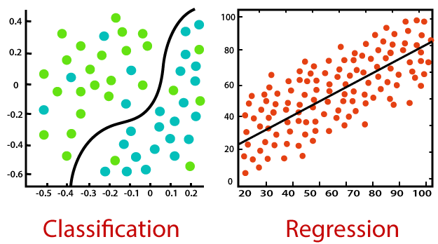
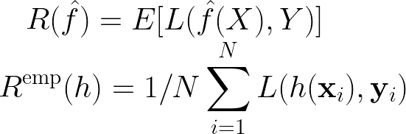
Aim: Learn a function with low “risk”
Risk or Loss: What we want to minimize
Empirical Risk: What we can actually calculate (loss for a candidate model h, averaged over N training examples)
In classification (left), the goal is to learn a decision boundary that separates different classes.
In regression (right), the goal is to predict a continuous numerical value by fitting a function that captures the relationship between input and output.
Notes:
[Slide 5] Risk and empirical risk
Let me make the objective precise, because this distinction matters for the whole lecture. What we truly want is a function with low risk — the expected loss over the entire data distribution, including all the data we will ever encounter in the future. That is the quantity we genuinely care about.
The catch is that we cannot compute the true risk, because we do not have all possible data. What we can compute is the empirical risk: the loss averaged over the N training examples we actually have. So in practice we minimize the empirical risk and hope it generalizes to the true risk. That gap between the two — between training performance and real-world performance — is the central tension in all of machine learning, and it returns later when we discuss overfitting.

Slide 6
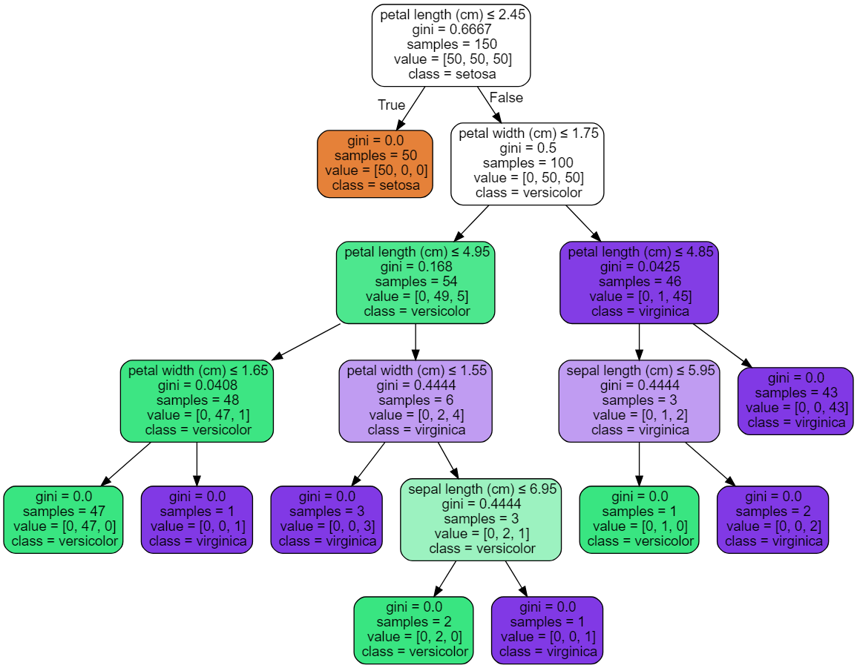
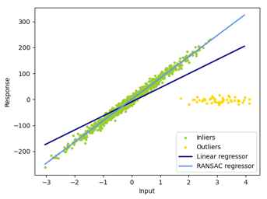
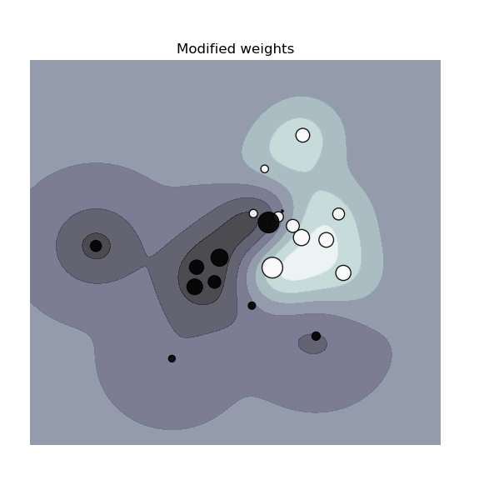

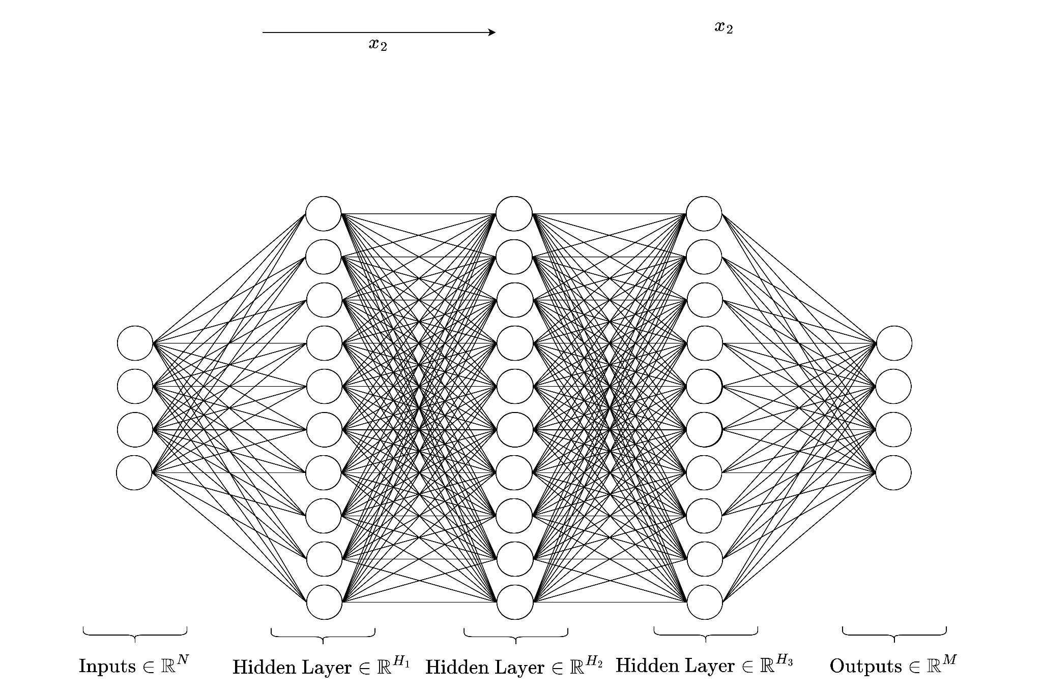
Common Approaches
Linear/Polynomial/Logistic Regression
(Boosted) Decision trees
Support Vector Machines
Naive Bayes
Neural Networks
…
Images of regressions, decision tree, and SVM from scikit-learn.org
Notes:
[Slide 6] Common approaches
Neural networks are not the only way to solve this problem. There is a whole family of supervised methods: linear, polynomial, and logistic regression; decision trees and their boosted variants; support vector machines; naive Bayes; nearest-neighbour methods, and more. Neural networks are simply one member of this family. I mention this deliberately, because part of being a good practitioner — and a good teacher — is knowing that a neural network is not always the right tool. Sometimes a simple regression or a decision tree is faster, more interpretable, and entirely sufficient.

Slide 7
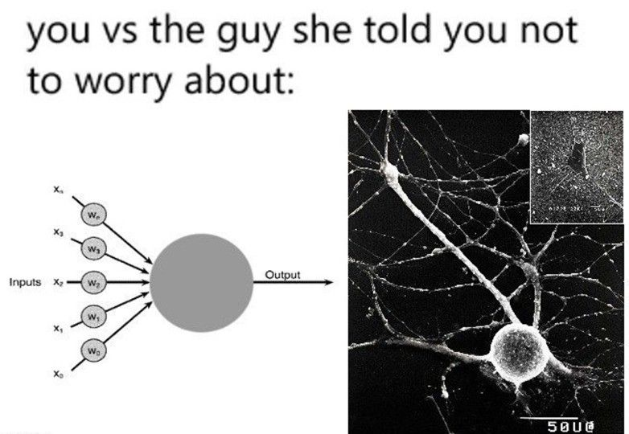
Artificial vs Biological NNs
ANNs initially inspired by the brain:
Alexander Bain (1873), William James (1890)
Electrical connections/flow of neurons result in thought
and movement
McCulloch & Pitts (1943)
Modern mathematical “artificial” NN models
Rosenblatt (1958)
Description of the perceptron
Rumelhart, Hinton & Williams (1986)
Multi-layer perceptrons and error backpropagation (learning principle)
Modern:
- ANNs used everywhere for everything!
- Simplified, abstracted version of biological neurons
- Biologically implausible
- Yann LeCun calls them “units” instead of “neurons”
linkedin.com/company/deeplearningai
Notes:
[Slide 7] Artificial vs. biological neural networks
The name neural network comes from an analogy to the brain, and the analogy has real historical roots. Alexander Bain in eighteen-seventy-three and William James in eighteen-ninety speculated that the electrical connections and flow among neurons give rise to thought and action. Those ideas eventually inspired the first mathematical models of an artificial neuron.
But I want to set expectations honestly from the start: modern artificial neural networks are only loosely inspired by biology. A real neuron is vastly more complex than the simple mathematical unit we will use. So treat the brain analogy as inspiration and vocabulary, not as a claim about how the brain actually works.

Slide 8
Building a Neural Network
From Scratch
Notes:
[Slide 8] Section — building a neural network from scratch
With that context set, let us roll up our sleeves and build a neural network from scratch. I will start with a picture rather than a formula, because the geometric intuition is what makes the algebra stick later.

Slide 9
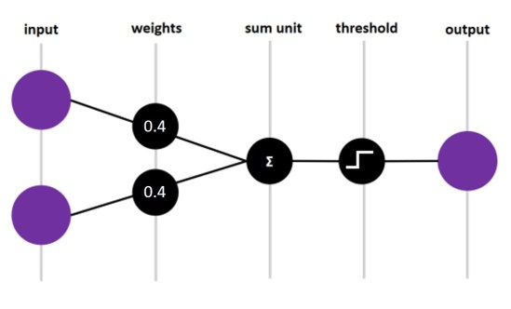
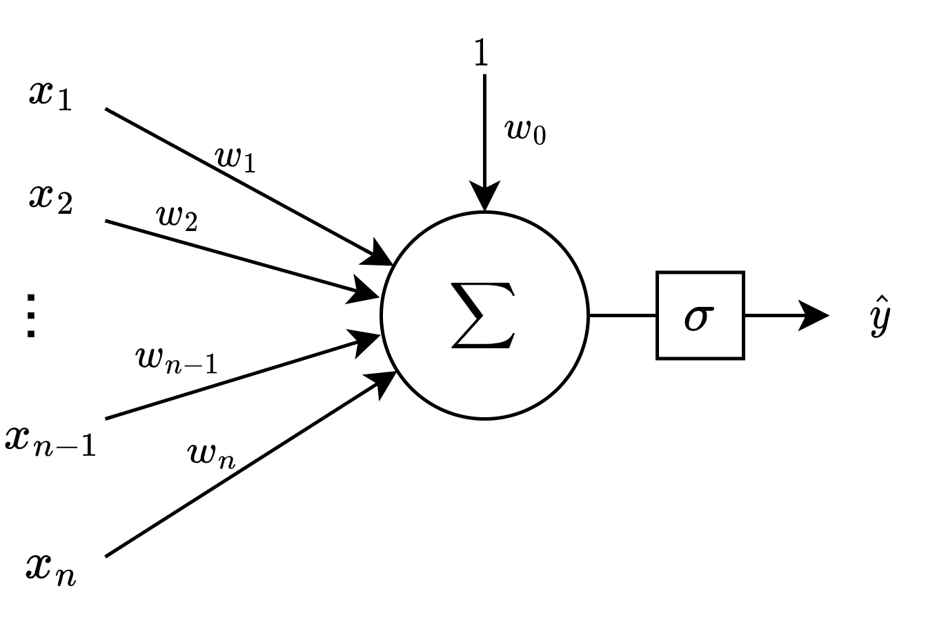
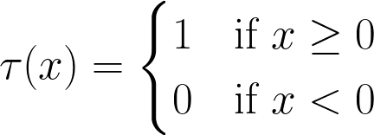

Perceptron
$$σ$$
Activation function
An example of perceptron w/ 2 inputs and binary threshold activation function.
A single “neuron”
Only works on linearly separable classes
Notes:
[Slide 9] The perceptron
We begin with the perceptron, the modern notion of a single neuron. A perceptron takes the inputs, forms a weighted sum, and passes the result through an activation function to produce an output. It is the basic building block for everything else.
But it has a fundamental limitation, and it is important: a single perceptron only works when the classes are linearly separable. It can only ever draw a single straight line to separate the data. So the obvious question becomes — what do we do when a straight line is not enough?

Slide 10
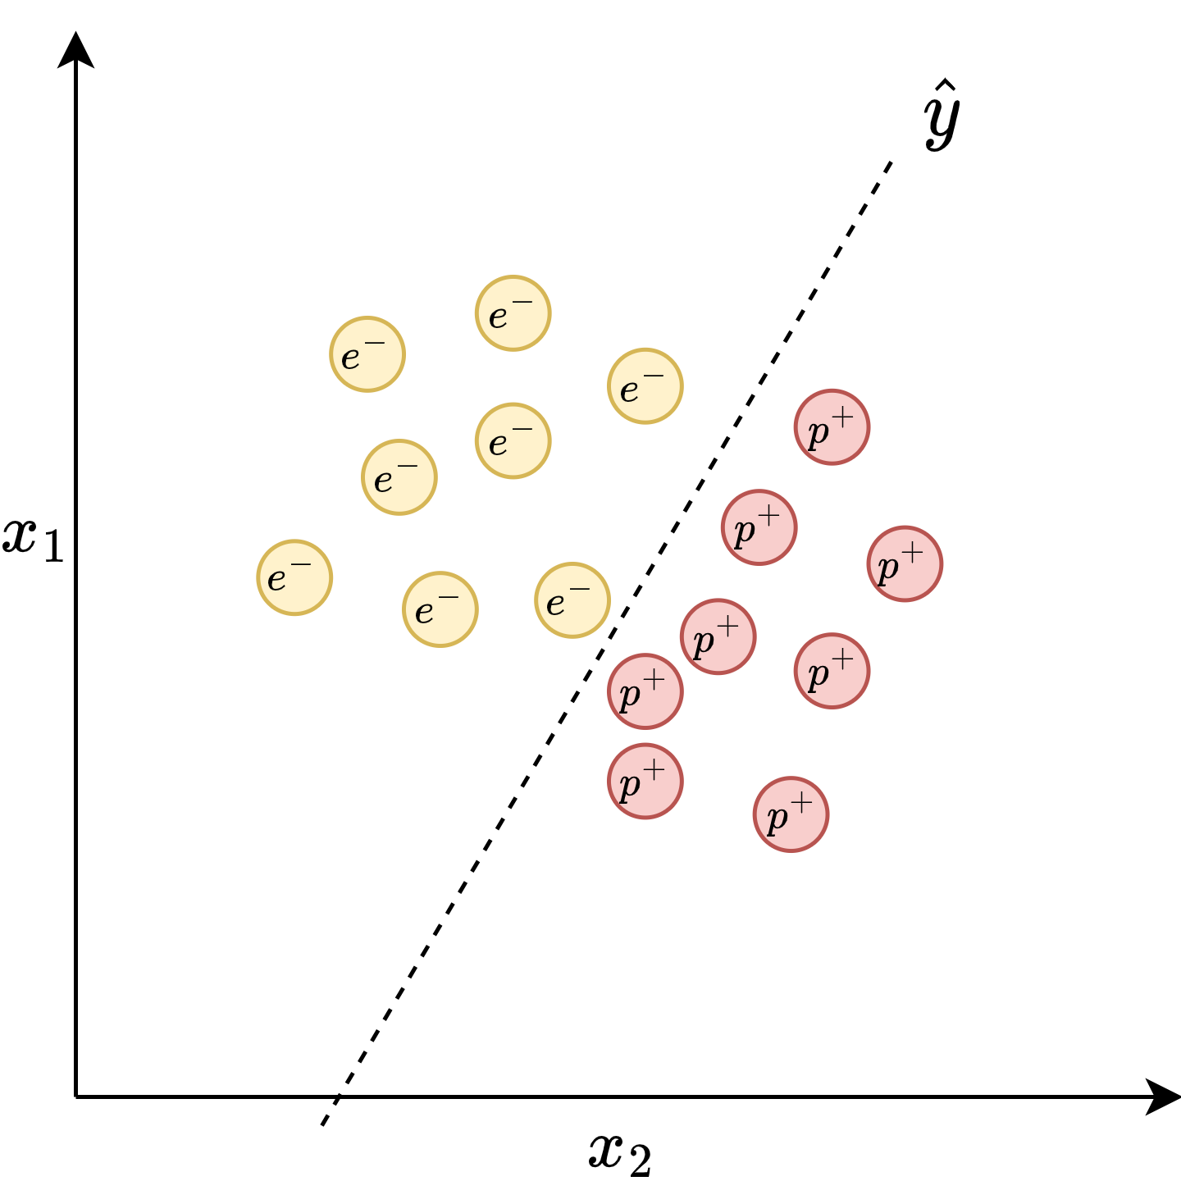
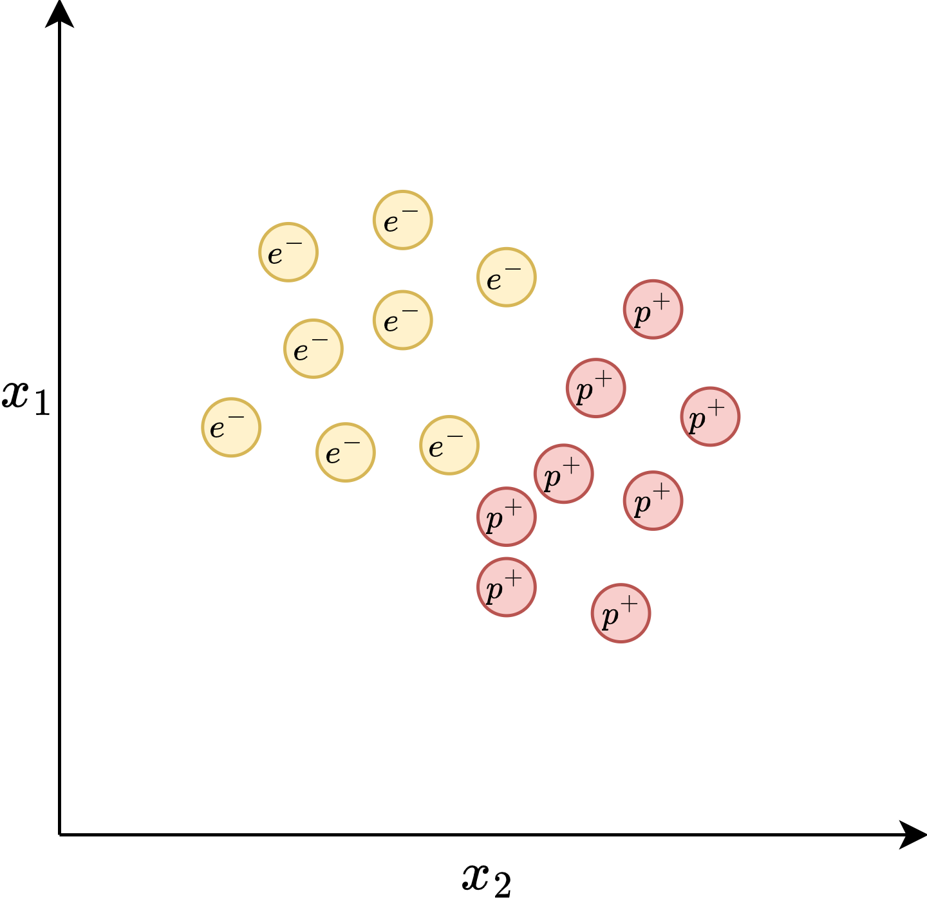
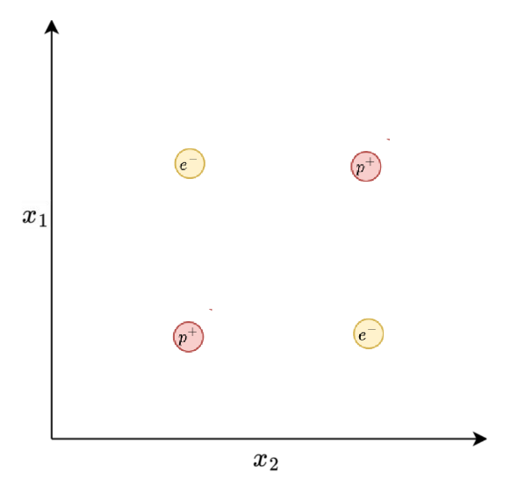
Two classes are linearly separable
Two classes are not linearly separable: no single straight line can separate them
Notes:
[Slides 10–11] Linearly separable vs. not
Here is the heart of that limitation, shown geometrically. On the first case, two classes are linearly separable: we can draw a single straight line that puts one class on each side. A single perceptron handles this perfectly — the position and angle of that line are exactly what the neuron's weights control.
But on these next cases, the two classes are not linearly separable: no single straight line can separate them, no matter how we rotate or shift it. Some points always end up on the wrong side. A single perceptron is helpless here. Hold on to this picture, because resolving it is precisely what motivates stacking neurons into a network.

Slide 11
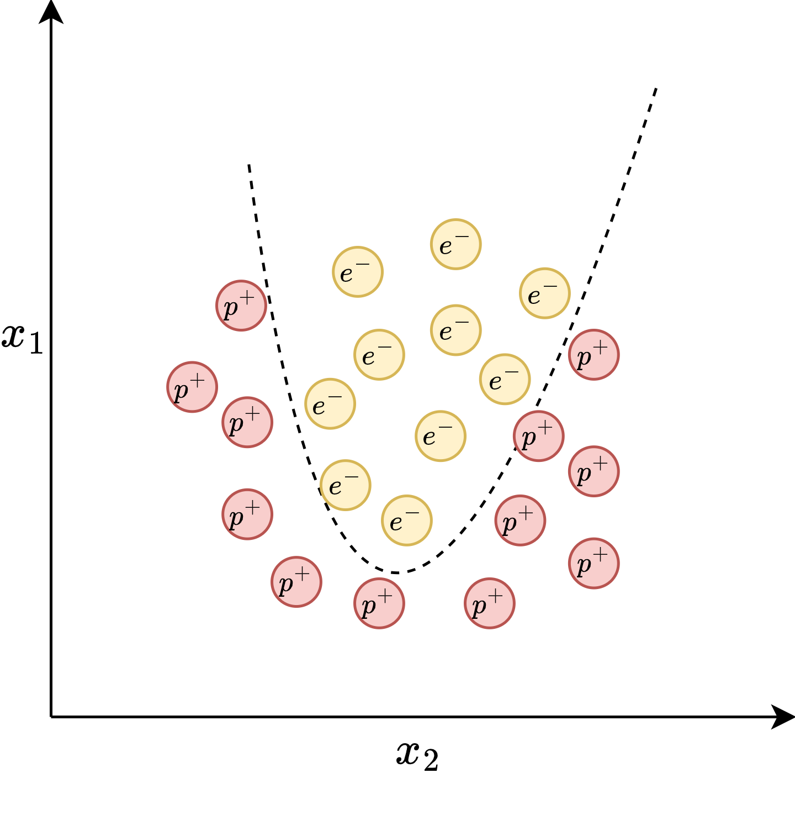
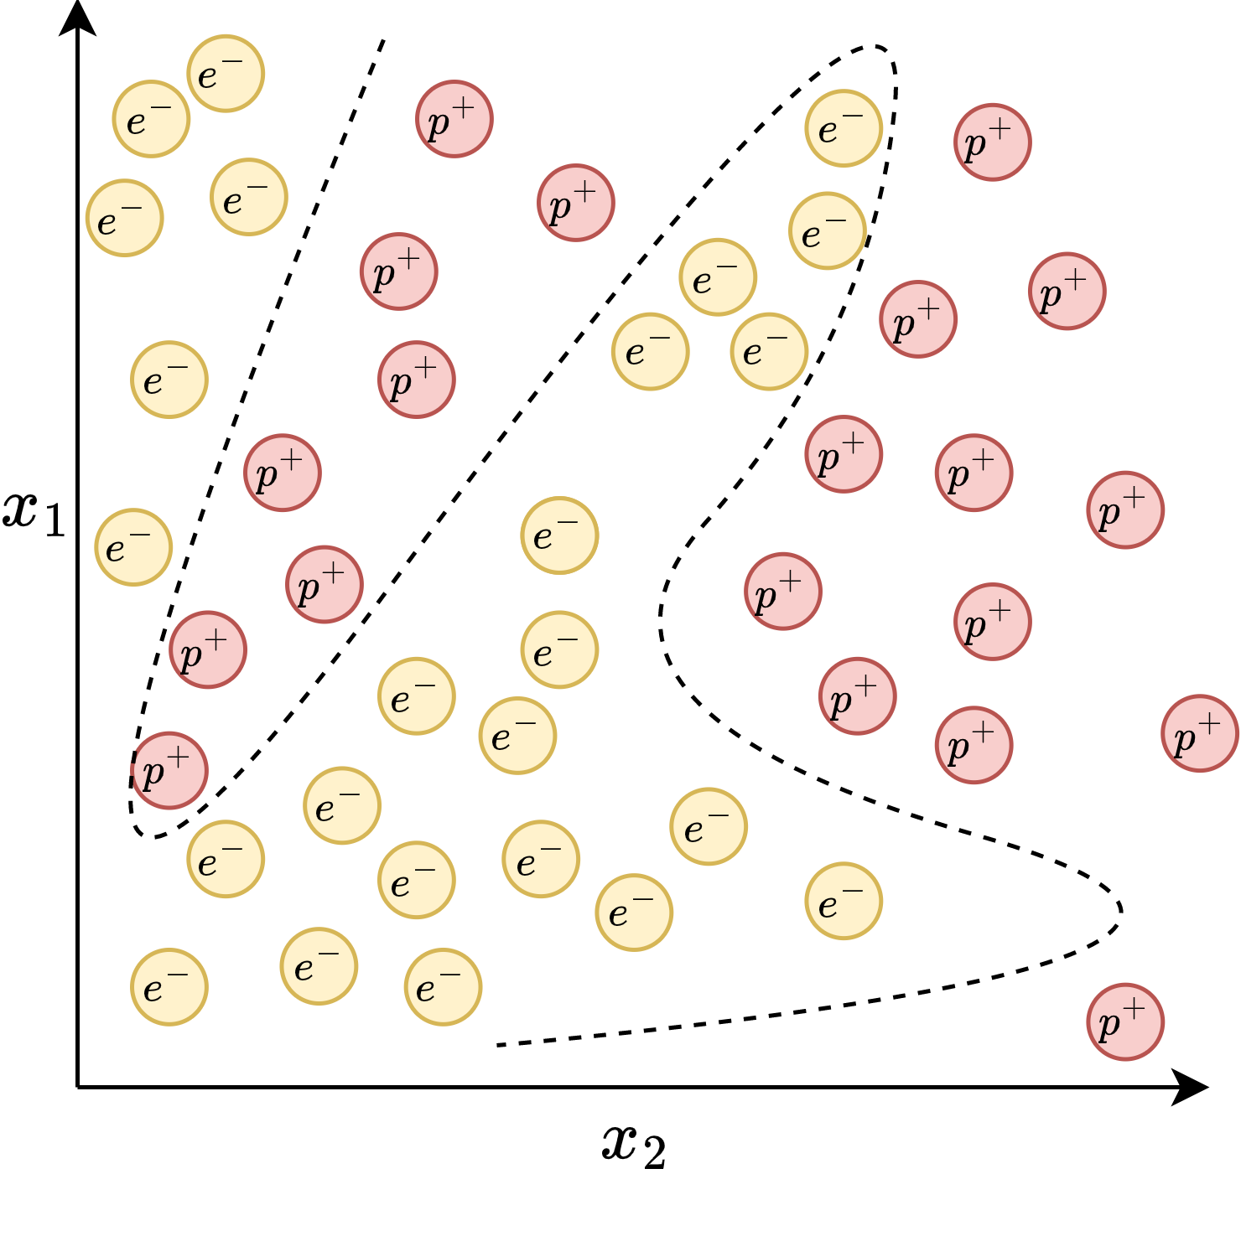
More cases of non-linearly-separable datasets
Notes:
[Slides 10–11] Linearly separable vs. not
Here is the heart of that limitation, shown geometrically. On the first case, two classes are linearly separable: we can draw a single straight line that puts one class on each side. A single perceptron handles this perfectly — the position and angle of that line are exactly what the neuron's weights control.
But on these next cases, the two classes are not linearly separable: no single straight line can separate them, no matter how we rotate or shift it. Some points always end up on the wrong side. A single perceptron is helpless here. Hold on to this picture, because resolving it is precisely what motivates stacking neurons into a network.

Slide 12
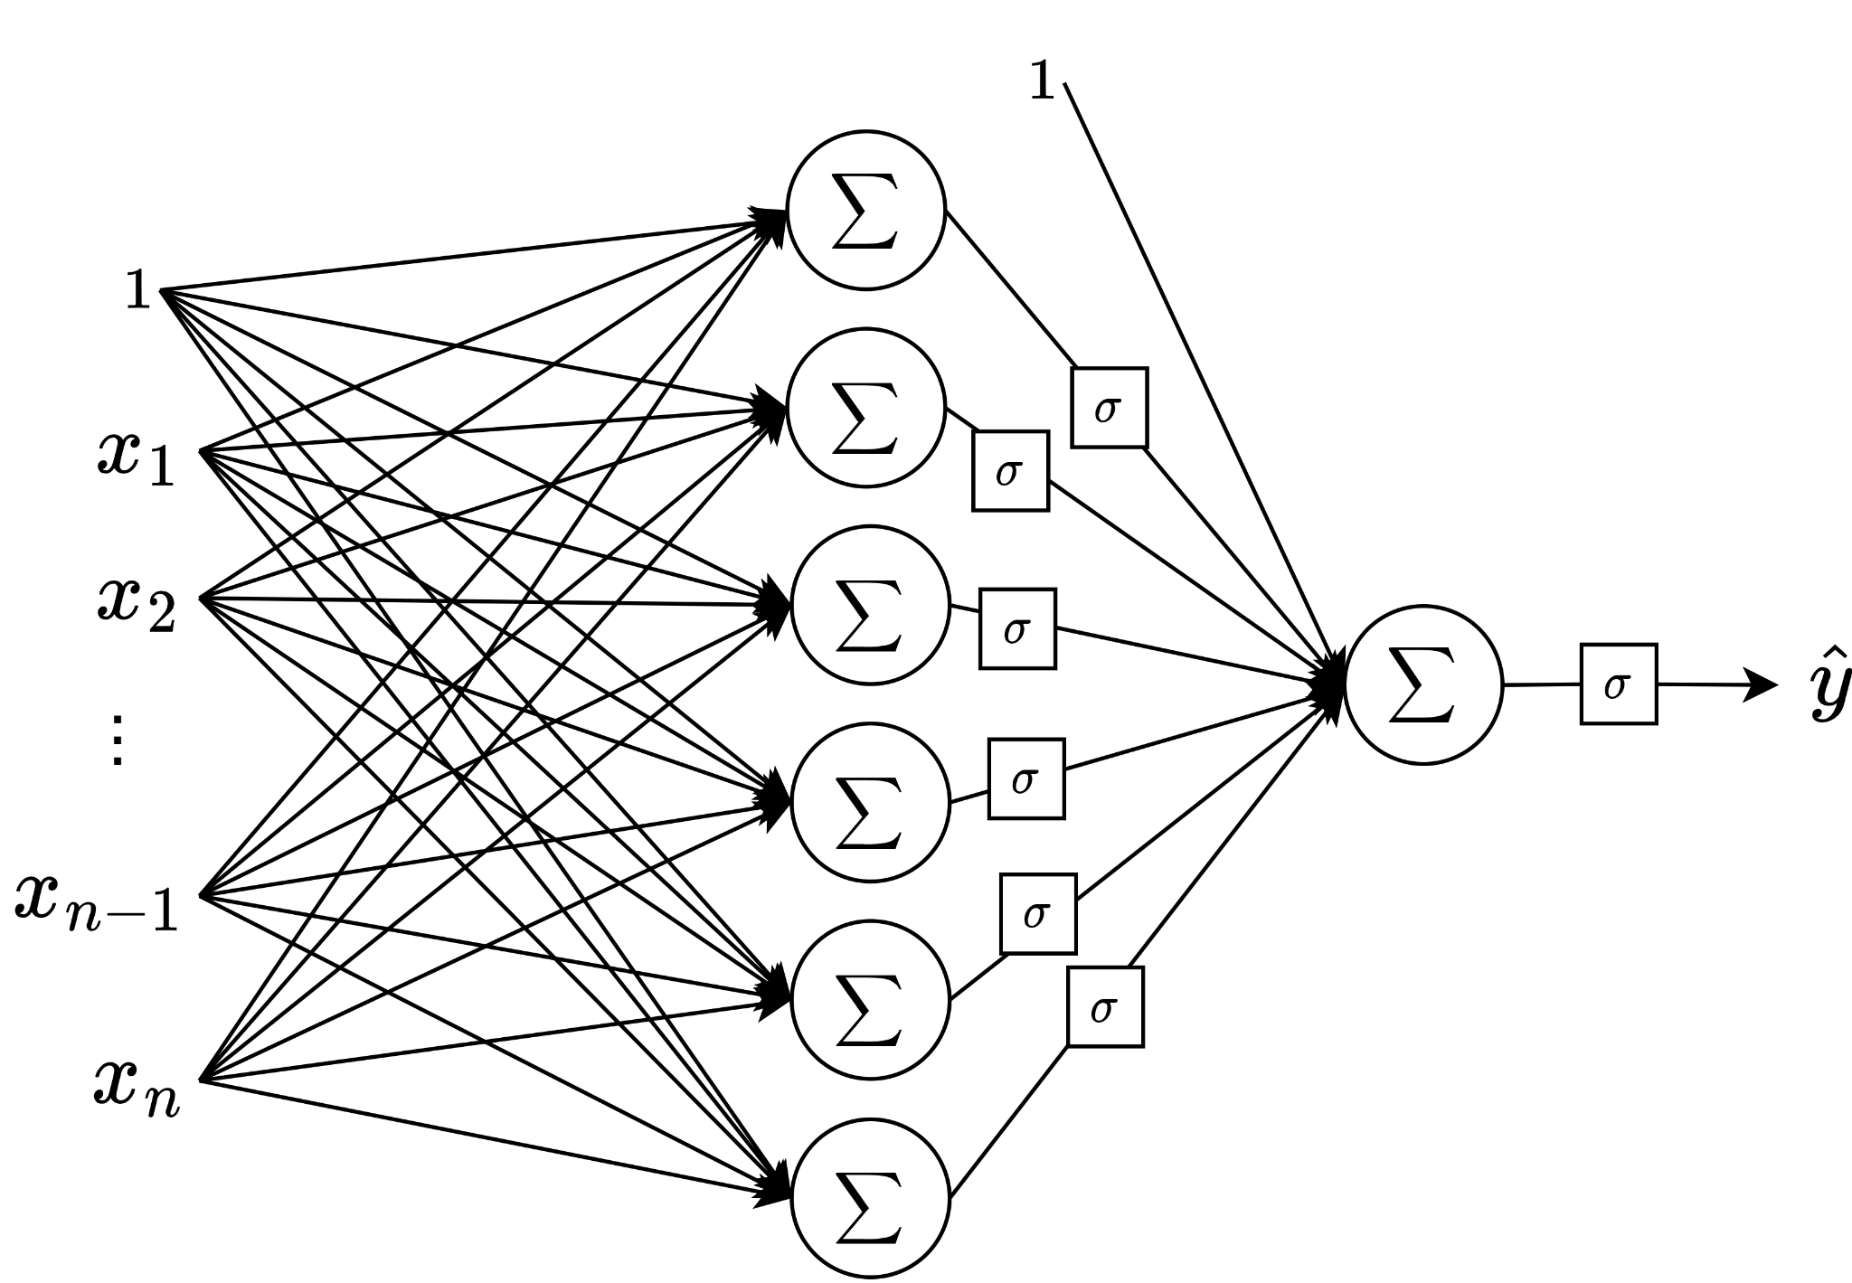
Multi-layer Perceptron (MLP)
…
If we put multiple perceptrons together, with one or more hidden layers, then we can approximate a complex function as a piecewise linear function, making it work for non-linearly-separable datasets.
Notes:
[Slide 12] Multi-layer perceptron (MLP)
Here is the resolution. If we put multiple perceptrons together — organized into one or more hidden layers — we can approximate a complex, curved decision boundary as a piecewise-linear function: many small straight pieces stitched together. Each perceptron contributes one linear piece, and together they carve out regions that a single line never could. This is the multi-layer perceptron, or MLP, and it is the canonical feed-forward neural network we will develop in detail.

Slide 13
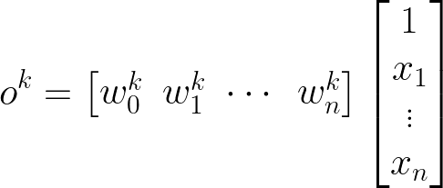
Activation/
output
of neuron k
“Weight vector”
“Feature vector”
K "hidden” neurons
in layer L
Notes:
[Slide 13] Anatomy of a neuron — the vocabulary
Let me attach precise vocabulary, because we will use these terms constantly. Each neuron has a weight vector — the strengths of its connections. It receives a feature vector — the inputs. It applies an activation function to produce its activation, or output. A layer simply contains many such neurons — here, K hidden neurons in layer L — each with its own weights, all operating on the same input.

Slide 14
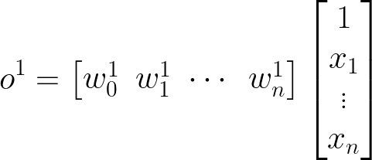
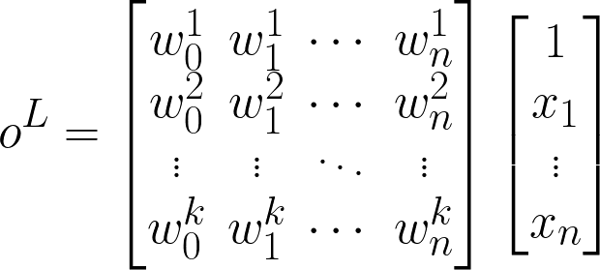
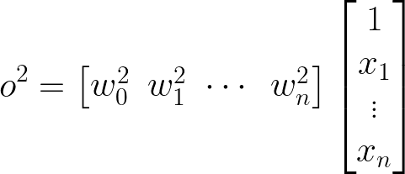
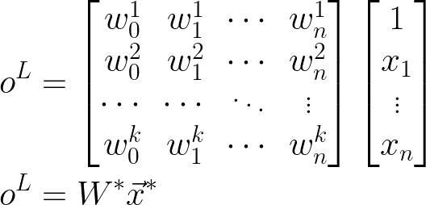
Notes:
[Slides 14–15] From neuron to layer — the matrix form
Now I want to walk from the single-neuron equation to the compact matrix form that everyone actually uses, because this is where it becomes both elegant and efficient. If we write each neuron's weights as a row and stack those rows, we get a weight matrix. Then — here is the key observation — computing the weighted sums of all the neurons at once is precisely a single matrix-vector multiplication: the layer's weight matrix times the input vector.
We then add the bias vector, and finally apply the activation function element-wise. So the output of an entire layer is wonderfully concise: the product of its weight matrix and the input vector, plus its bias, all wrapped in a non-linear activation function. This is not just mathematical tidiness — matrix multiplication is exactly the operation modern GPUs are built to do at scale, which is why neural networks run fast enough to be useful at all.

Slide 15
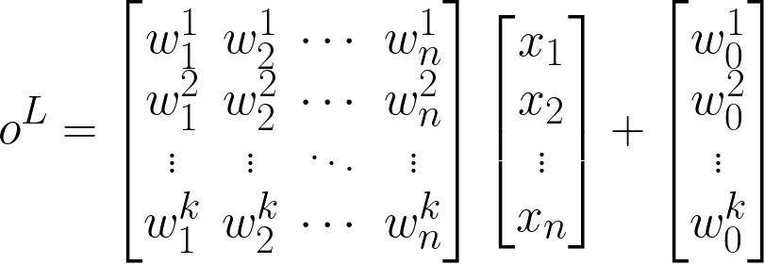
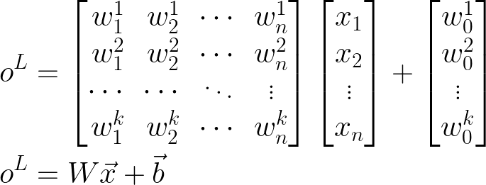

Output of each layer is the product of its weight matrix and the input vector plus its bias vector, followed by a non-linear activation function.
$$\hat{y}=σ(o^{L})$$
“Activation”
“Bias”
“Activation function”
Notes:
[Slides 14–15] From neuron to layer — the matrix form
Now I want to walk from the single-neuron equation to the compact matrix form that everyone actually uses, because this is where it becomes both elegant and efficient. If we write each neuron's weights as a row and stack those rows, we get a weight matrix. Then — here is the key observation — computing the weighted sums of all the neurons at once is precisely a single matrix-vector multiplication: the layer's weight matrix times the input vector.
We then add the bias vector, and finally apply the activation function element-wise. So the output of an entire layer is wonderfully concise: the product of its weight matrix and the input vector, plus its bias, all wrapped in a non-linear activation function. This is not just mathematical tidiness — matrix multiplication is exactly the operation modern GPUs are built to do at scale, which is why neural networks run fast enough to be useful at all.

Slide 16
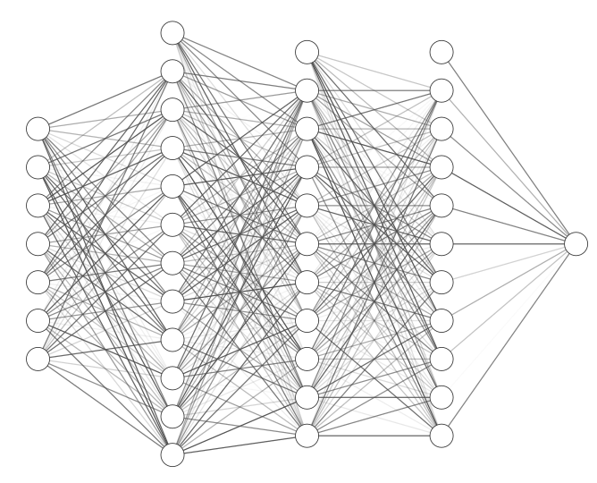


A multi-layer perceptron is a series of affine transformations of an input vector, each of which is wrapped in a non-linear activation function.
Without a non-linear activation function, a series of linear transformations would result in just a linear transformation of the input to the output.
Notes:
[Slide 16] The MLP as composed transformations
Putting it together, the full network is just composition: the output of one layer becomes the input to the next, repeating the same operation layer after layer. So here is the one-sentence definition I would like you to remember: a multi-layer perceptron is a series of affine transformations of an input vector, each of which is wrapped in a non-linear activation function. The affine transformation is the matrix-multiply-plus-bias; the non-linearity is what sits between them. That is the entire model.

Slide 17
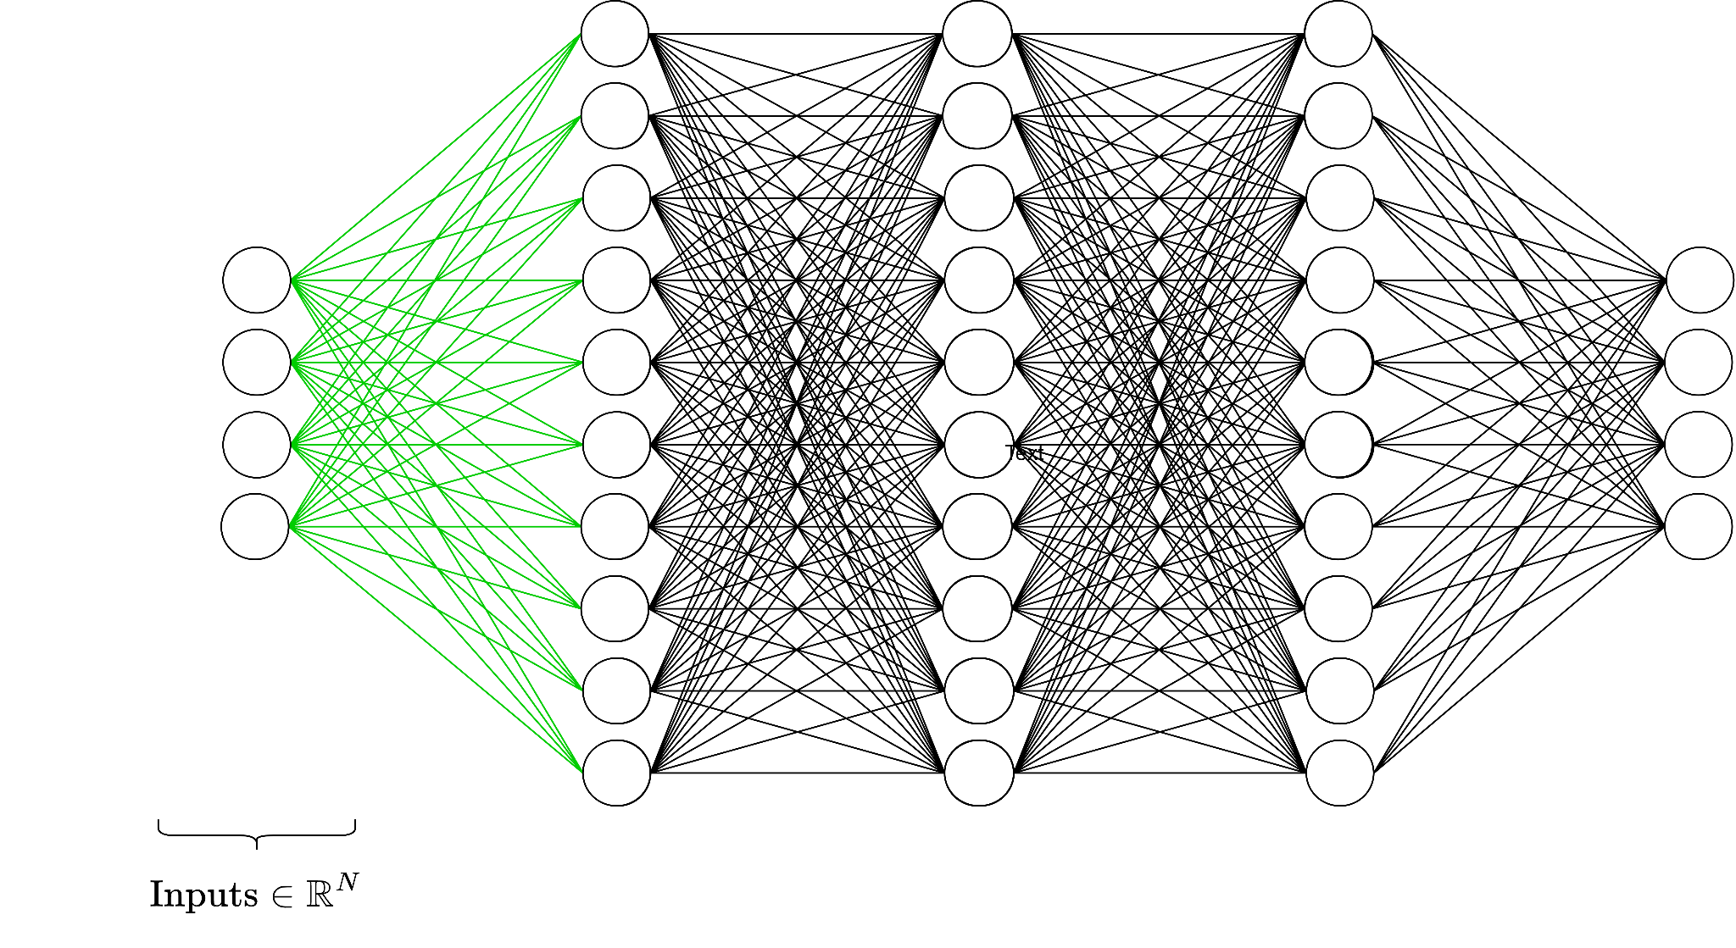
Notes:
[Slides 17–21] Why the non-linearity is essential
I want to dwell on why that non-linear activation function is absolutely essential, because it is the single most common point of confusion and it is the crux of the whole design. These slides build the argument visually.
Suppose, as a thought experiment, we removed all the non-linearities and just stacked linear transformations — matrix multiply, then another, then another. The result collapses: a composition of linear maps is mathematically just one linear map. You could multiply all those weight matrices together into a single matrix in advance. So a deep network with no non-linearities is exactly equivalent to a one-layer network — and we would be right back in the land of linear separability, unable to draw anything but a straight boundary.
So the non-linearity between the layers is precisely what gives the network its power. It lets each successive layer bend and fold the input space, so that classes which were hopelessly tangled become separable. Without it, depth buys you nothing. This is why the choice of activation function is not a minor detail — it is what makes a deep network deep in any meaningful sense.

Slide 18
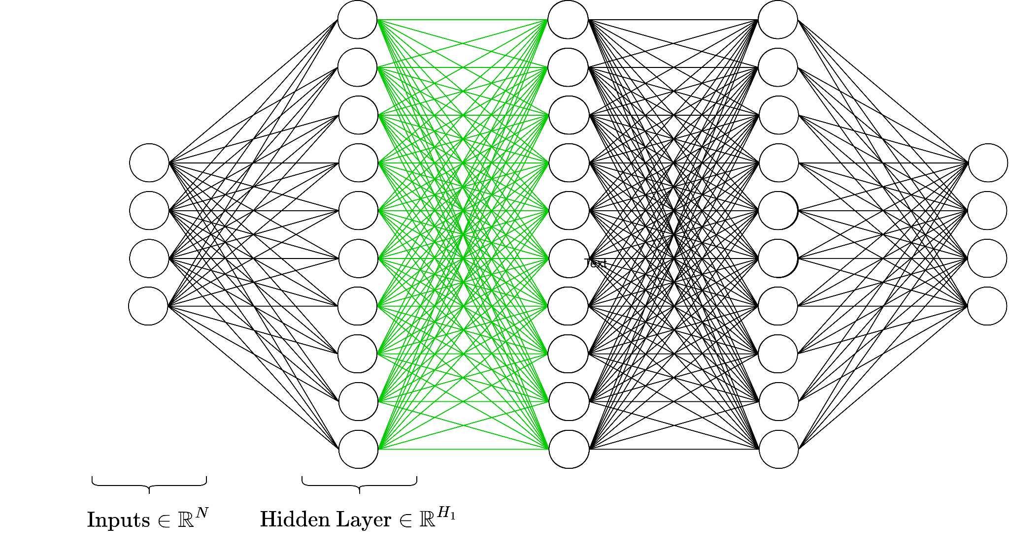
Notes:
[Slides 17–21] Why the non-linearity is essential
I want to dwell on why that non-linear activation function is absolutely essential, because it is the single most common point of confusion and it is the crux of the whole design. These slides build the argument visually.
Suppose, as a thought experiment, we removed all the non-linearities and just stacked linear transformations — matrix multiply, then another, then another. The result collapses: a composition of linear maps is mathematically just one linear map. You could multiply all those weight matrices together into a single matrix in advance. So a deep network with no non-linearities is exactly equivalent to a one-layer network — and we would be right back in the land of linear separability, unable to draw anything but a straight boundary.
So the non-linearity between the layers is precisely what gives the network its power. It lets each successive layer bend and fold the input space, so that classes which were hopelessly tangled become separable. Without it, depth buys you nothing. This is why the choice of activation function is not a minor detail — it is what makes a deep network deep in any meaningful sense.

Slide 19
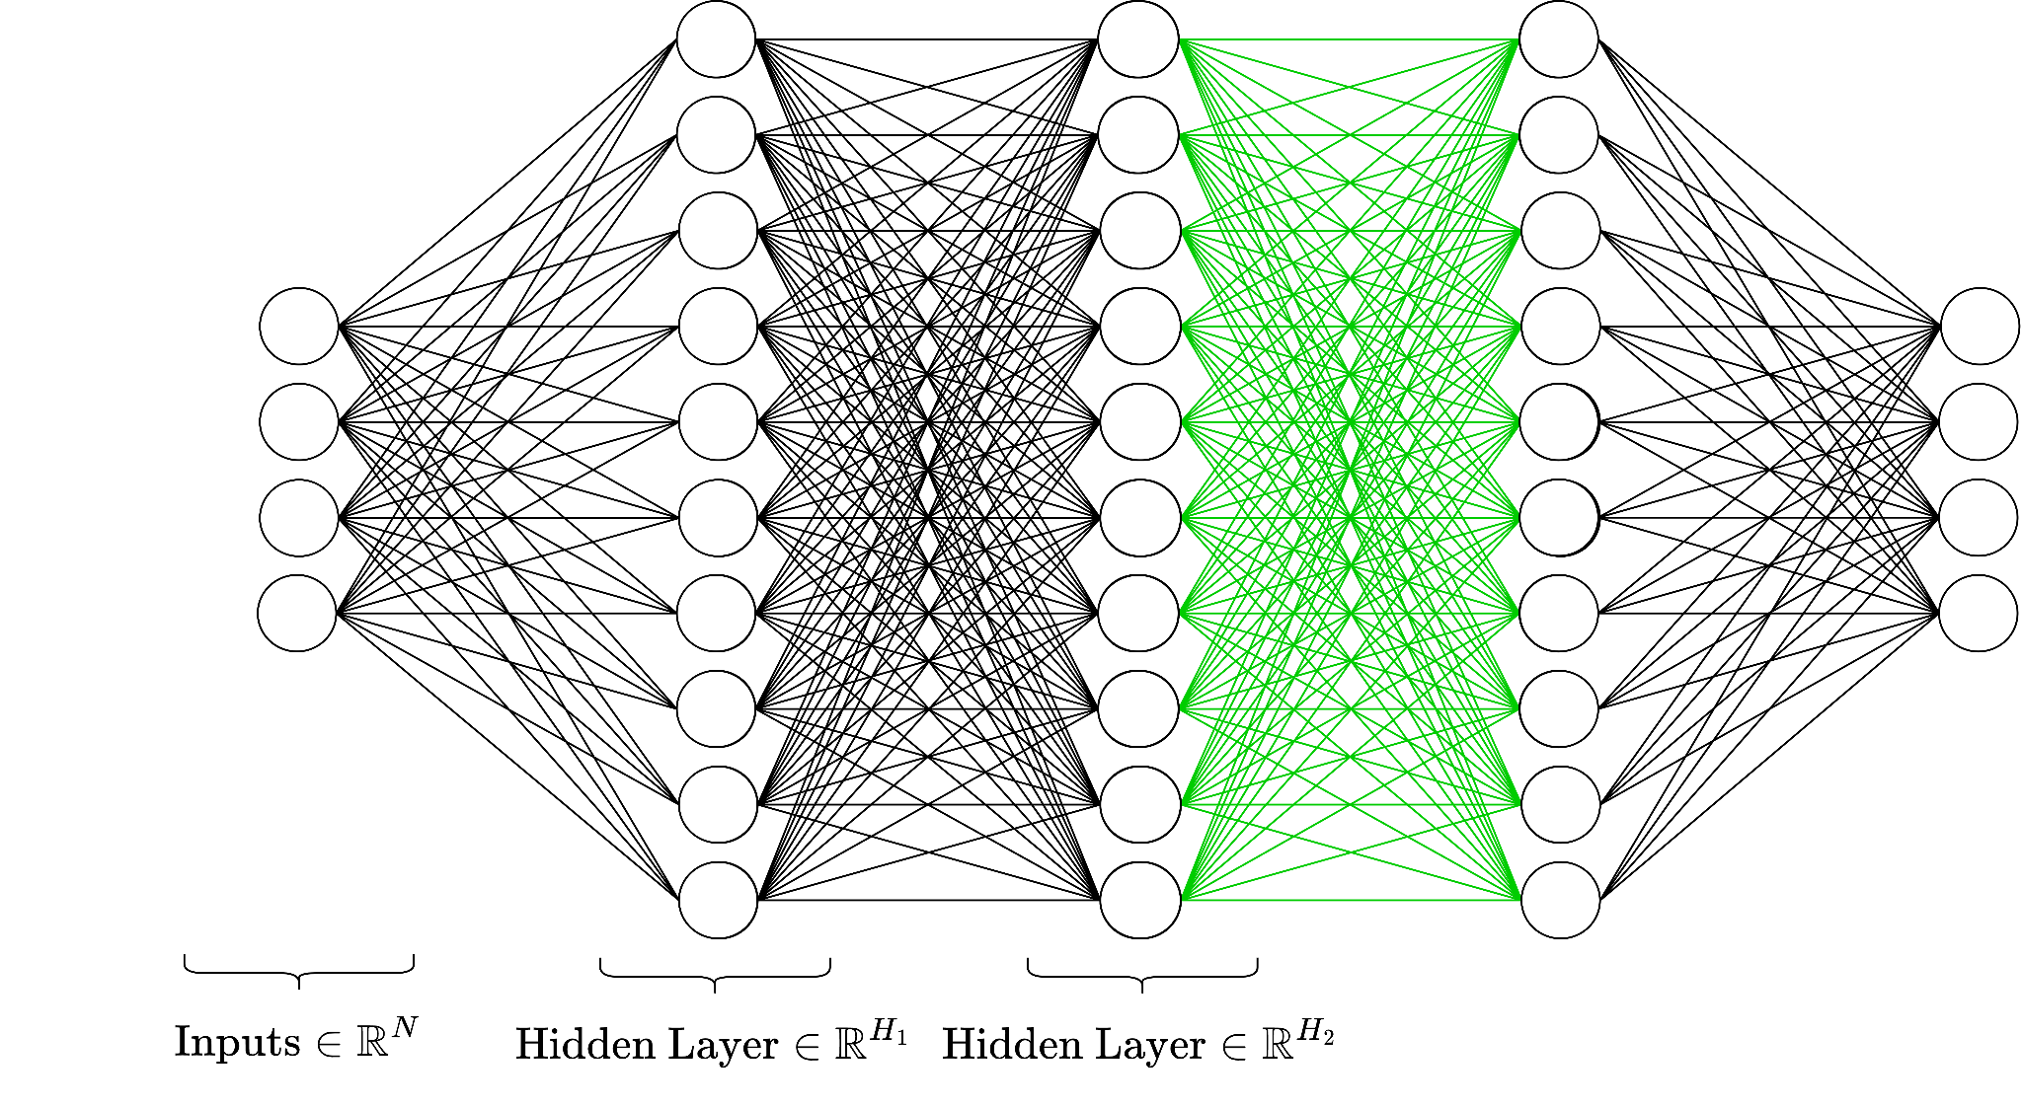
Notes:
[Slides 17–21] Why the non-linearity is essential
I want to dwell on why that non-linear activation function is absolutely essential, because it is the single most common point of confusion and it is the crux of the whole design. These slides build the argument visually.
Suppose, as a thought experiment, we removed all the non-linearities and just stacked linear transformations — matrix multiply, then another, then another. The result collapses: a composition of linear maps is mathematically just one linear map. You could multiply all those weight matrices together into a single matrix in advance. So a deep network with no non-linearities is exactly equivalent to a one-layer network — and we would be right back in the land of linear separability, unable to draw anything but a straight boundary.
So the non-linearity between the layers is precisely what gives the network its power. It lets each successive layer bend and fold the input space, so that classes which were hopelessly tangled become separable. Without it, depth buys you nothing. This is why the choice of activation function is not a minor detail — it is what makes a deep network deep in any meaningful sense.

Slide 20
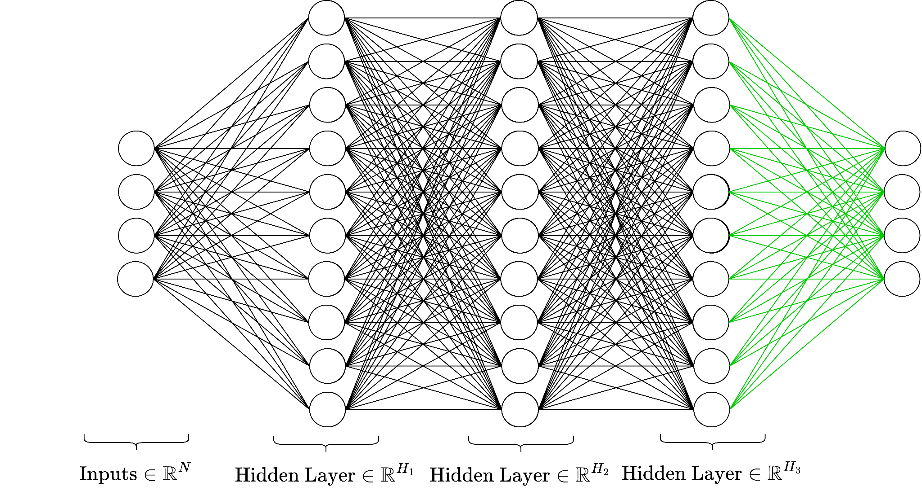
Notes:
[Slides 17–21] Why the non-linearity is essential
I want to dwell on why that non-linear activation function is absolutely essential, because it is the single most common point of confusion and it is the crux of the whole design. These slides build the argument visually.
Suppose, as a thought experiment, we removed all the non-linearities and just stacked linear transformations — matrix multiply, then another, then another. The result collapses: a composition of linear maps is mathematically just one linear map. You could multiply all those weight matrices together into a single matrix in advance. So a deep network with no non-linearities is exactly equivalent to a one-layer network — and we would be right back in the land of linear separability, unable to draw anything but a straight boundary.
So the non-linearity between the layers is precisely what gives the network its power. It lets each successive layer bend and fold the input space, so that classes which were hopelessly tangled become separable. Without it, depth buys you nothing. This is why the choice of activation function is not a minor detail — it is what makes a deep network deep in any meaningful sense.

Slide 21
Notes:
[Slides 17–21] Why the non-linearity is essential
I want to dwell on why that non-linear activation function is absolutely essential, because it is the single most common point of confusion and it is the crux of the whole design. These slides build the argument visually.
Suppose, as a thought experiment, we removed all the non-linearities and just stacked linear transformations — matrix multiply, then another, then another. The result collapses: a composition of linear maps is mathematically just one linear map. You could multiply all those weight matrices together into a single matrix in advance. So a deep network with no non-linearities is exactly equivalent to a one-layer network — and we would be right back in the land of linear separability, unable to draw anything but a straight boundary.
So the non-linearity between the layers is precisely what gives the network its power. It lets each successive layer bend and fold the input space, so that classes which were hopelessly tangled become separable. Without it, depth buys you nothing. This is why the choice of activation function is not a minor detail — it is what makes a deep network deep in any meaningful sense.

Slide 22
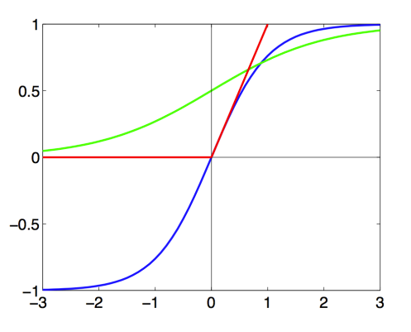


Common nonlinear functions
Notes:
[Slide 22] Common non-linear functions
Here are the common activation functions you will encounter: the sigmoid, the hyperbolic tangent, the ReLU — which is the max of zero and x — leaky ReLU, and ELU, among others. Each has a different shape and different training behavior. The one to remember as your default is the ReLU: it is simple, cheap to compute, does not saturate in the positive region, and in practice trains faster than sigmoid or tanh.

Slide 23
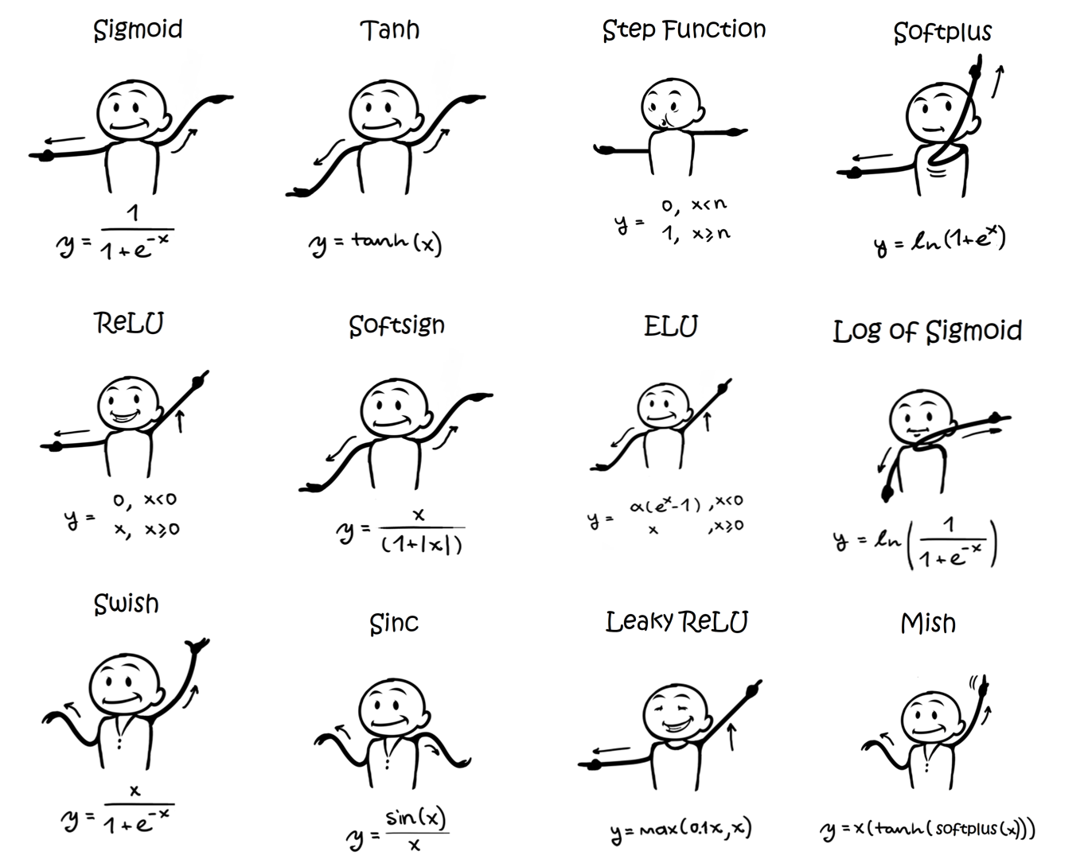
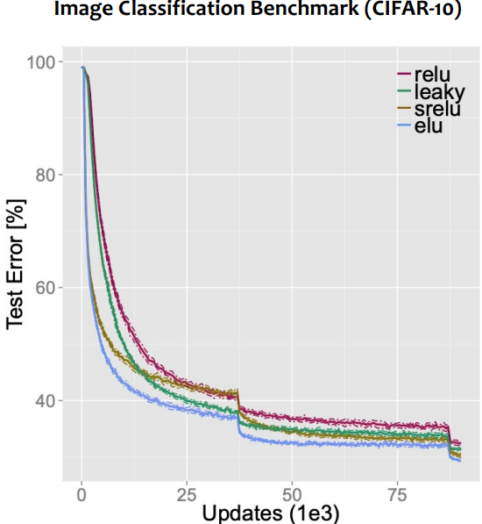
Clevert et al. (2016): Training loss converges fastest with ELU; ELU yields lower test error than ReLU on CIFAR-10
https://sefiks.com/2020/02/02/dance-moves-of-deep-learning-activation-functions/
Notes:
[Slide 23] Activation functions — empirical evidence
This is not just folklore; there is empirical evidence. Clevert and colleagues, in twenty-sixteen, showed that training loss converges fastest with the ELU activation, and that ELU yields lower test error than ReLU on CIFAR-ten. The broader point for students is that activation functions are an active, empirical design choice — the history of activation functions is really a history of fixing the problems of the previous one, validated on real benchmarks.

Slide 24
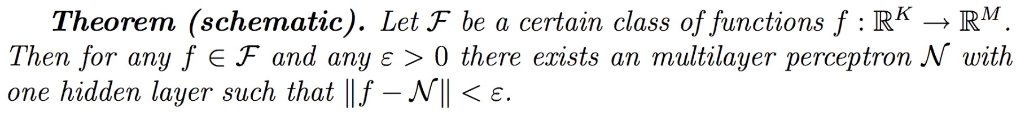
Universal Approximation Theorem
⇒ We can approximate any function we want with a one-hidden-layer MLP!
More effective with more layers than just one (“deeper” networks)
Notes:
[Slide 24] The Universal Approximation Theorem
Here is a remarkable theoretical result: the Universal Approximation Theorem. It says that, in principle, we can approximate any function we want with even a single-hidden-layer MLP, given enough neurons — and that deeper networks achieve this far more efficiently than one very wide layer, which is a major reason we favour depth. But I want to stress the phrase in principle: the theorem guarantees that a good approximation exists; it says nothing about whether our training procedure will actually find it. In practice, that is much easier said than done — which is the perfect motivation for the next section.

Slide 25
Gradient Descent
Notes:
[Slide 25] Section — Gradient Descent
We have now fully defined the model. But a model with random weights is useless — it has to learn. So we turn to the learning algorithm itself: gradient descent. This is the engine that takes a network full of random numbers and gradually tunes it into something that solves the task.

Slide 26
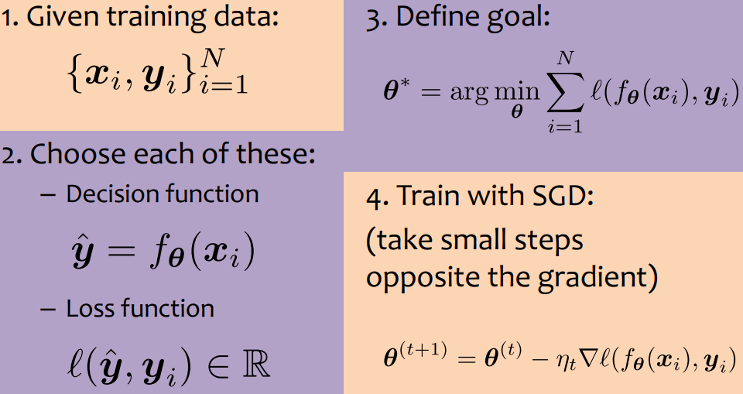
General ML Recipe
https://www.cs.cmu.edu/~mgormley/courses/10601-s23/slides/lecture12-backprop.pdf
Notes:
[Slide 26] The general ML recipe
Let me frame learning as a general recipe, which the slide lays out. We have a model, defined by its parameters; we have a loss or objective function that scores how badly the current parameters perform; and we have an optimization method — gradient descent — that adjusts the parameters to reduce that loss. Almost all of supervised machine learning fits this same three-part template: model, objective, optimizer. Everything we do next is filling in those three boxes for neural networks.

Slide 27
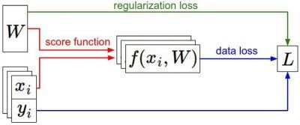
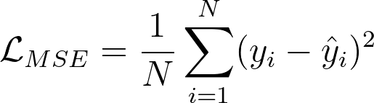
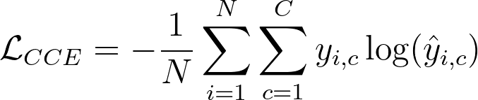
Loss functions
Depends on the task
Mean Squared Error (MSE)
Used for regression
Cross Entropy
Used for classification
Many others
Note: Must be differentiable for gradient descent based optimization
Regularization loss: constrain weights to be sparse or small
Notes:
[Slide 27] Loss functions
First the objective — the loss. The right choice depends on the task. For regression, where we predict continuous values, mean squared error is standard. For classification, cross-entropy is the usual choice. You can even define your own loss for a specialized problem. There is one firm requirement: the loss must be differentiable, because our entire learning method depends on taking its gradient.

Slide 28
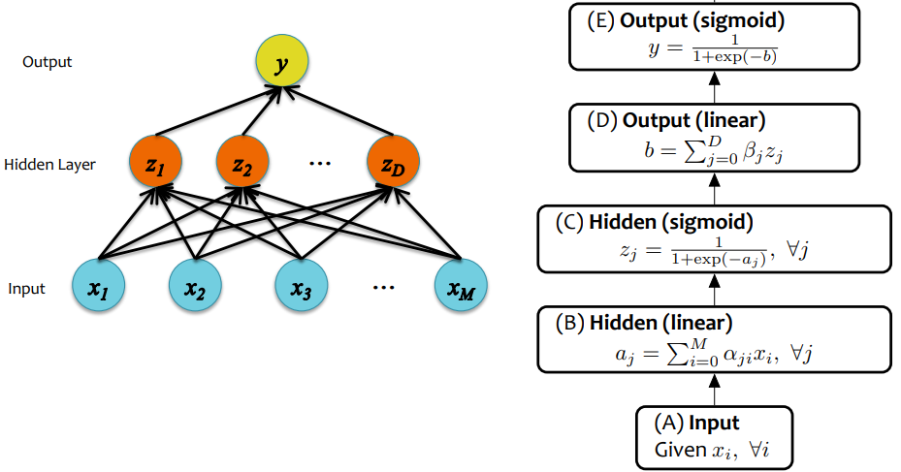
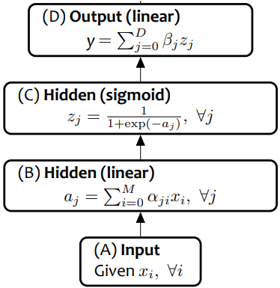
Binary Cross Entropy loss
MSE loss
NN for Binary Classification
NN for Regression
Notes:
[Slide 28] Loss by task — regression vs. binary classification
Let me make that concrete. For a neural network doing regression, we attach an MSE loss to the continuous output. For binary classification, we use a binary cross-entropy loss on the network's probability output. So the same network body can serve very different tasks simply by changing the head and the loss function attached to it.

Slide 29
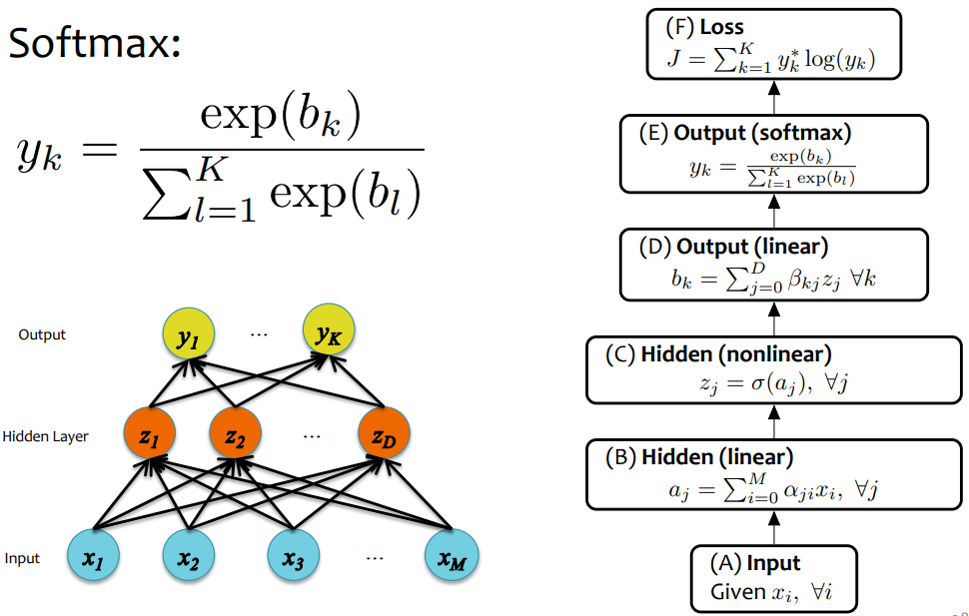
Cross Entropy loss
NN for Multi-Class Classification
Notes:
[Slide 29] Multi-class classification
For multi-class classification — say, ten classes — we use the cross-entropy loss together with a softmax output layer that turns the raw scores into a probability distribution over the classes. This is the setup behind most image classifiers, so let me unpack the cross-entropy loss carefully on the next slide.

Slide 30
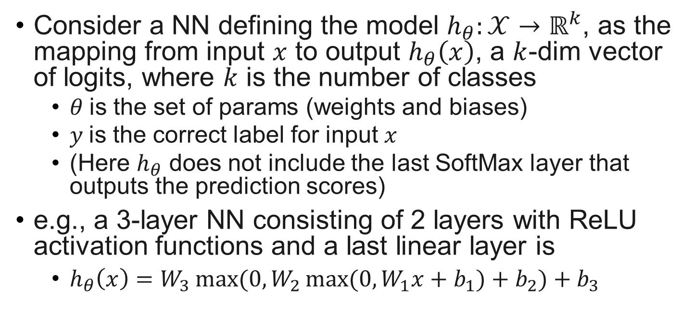
NN for Multi-Class Classification
Consider a NN defining the model $h_{θ}:𝒳→ℝ^{k}$, as the mapping from input $x$ to output $h_{θ}\left(x\right)$, a $k$-dim vector of logits, where $k$ is the number of classes
  $θ$ is the set of params (weights and biases)
  $y$is the correct label for input $x$
  (Here $h_{θ}$ does not include the last SoftMax layer that outputs the prediction scores)
e.g., a 3-layer NN consisting of 2 layers with ReLU activation functions and a last linear layer is
  $h_{θ}\left(x\right)=W_{3}\max{(0,W_{2}\max{(0,W_{1}x+b_{1})}+b_{2})}+b_{3}$
Notes:
[Slides 30–31] Cross-entropy — worked example
Here is the full pipeline on one example. The last linear layer produces raw scores; the softmax layer converts those scores into a probability distribution; we read off the probability assigned to the correct label; and the cross-entropy loss is computed from that. Walking the numbers through this chain once makes the whole classification head concrete, and it is exactly the computation we will soon differentiate with backpropagation.

Slide 31
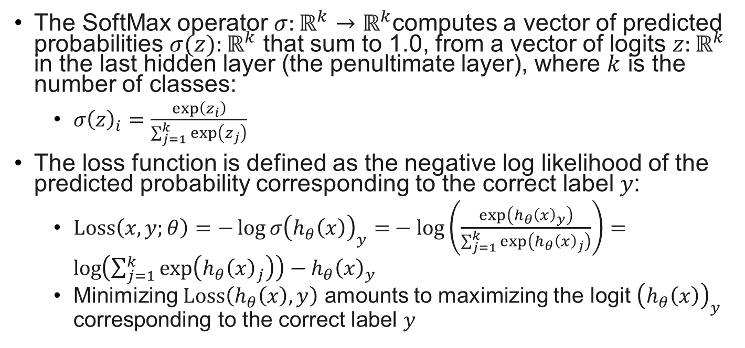
Cross-Entropy Loss for Multi-Class Classification
The SoftMax operator $σ:ℝ^{k}→ℝ^{k}$computes a vector of predicted probabilities $σ(z):ℝ^{k}$ that sum to 1.0, from a vector of logits $z:ℝ^{k}$ in the last hidden layer (the penultimate layer), where $k$ is the number of classes:
  $σ{\left(z\right)}_{i}=\frac{\exp\left(z_{i}\right)}{\sum_{j=1}^{k}{\exp\left(z_{j}\right)}}$
The loss function is defined as the negative log likelihood of the predicted probability corresponding to the correct label $y$:
  $Loss\left(x,y;θ\right)=−\log{σ{\left(h_{θ}\left(x\right)\right)}_{y}=}−\log\left(\frac{\exp\left(h_{θ}{\left(x\right)}_{y}\right)}{\sum_{j=1}^{k}{\exp\left(h_{θ}{\left(x\right)}_{j}\right)}}\right)=\log\left(\sum_{j=1}^{k}{\exp\left(h_{θ}{\left(x\right)}_{j}\right)}\right)−h_{θ}{\left(x\right)}_{y}$
  Minimizing $Loss\left(h_{θ}\left(x\right),y\right)$ amounts to maximizing the logit ${\left(h_{θ}\left(x\right)\right)}_{y}$ corresponding to the correct label $y$
Notes:
[Slides 30–31] Cross-entropy — worked example
Here is the full pipeline on one example. The last linear layer produces raw scores; the softmax layer converts those scores into a probability distribution; we read off the probability assigned to the correct label; and the cross-entropy loss is computed from that. Walking the numbers through this chain once makes the whole classification head concrete, and it is exactly the computation we will soon differentiate with backpropagation.

Slide 32
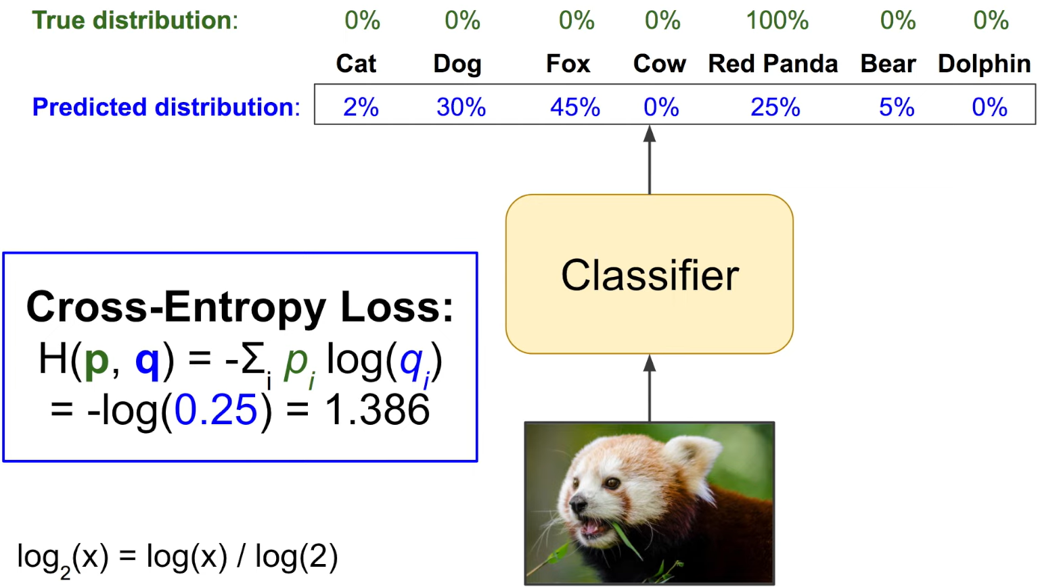
Cross-Entropy Loss for Multi-Class Classification
For a given training sample, CE loss measures how much the predicted distribution diverges from the true distribution, which is a one-hot vector: the entry corresponding to true label being 1 and all others 0.
A Short Introduction to Entropy, Cross-Entropy and KL-Divergence
Notes:
[Slide 32] Cross-entropy loss
For a given training sample, the cross-entropy loss measures how much the predicted probability distribution diverges from the true distribution — which, for a labelled example, is simply all the probability mass on the correct class. Intuitively, if the model assigns high probability to the correct class, the loss is small; if it confidently assigns probability to the wrong class, the loss is large. It is the natural, well-behaved objective for classification.

Slide 33
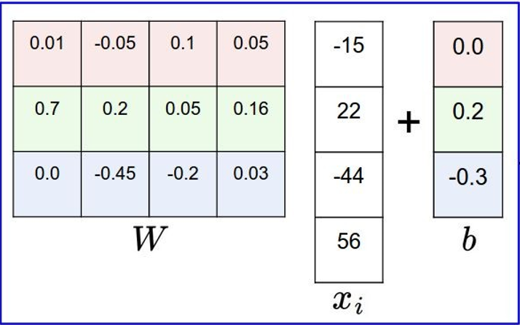
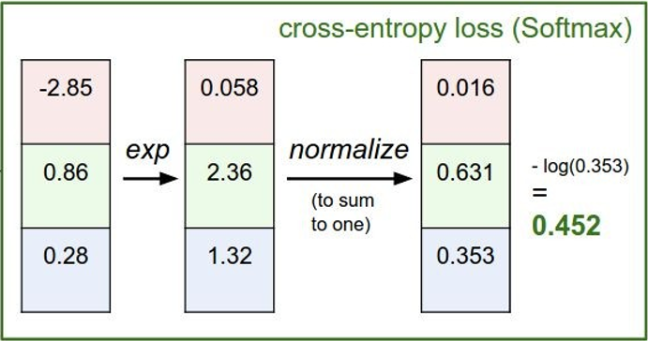
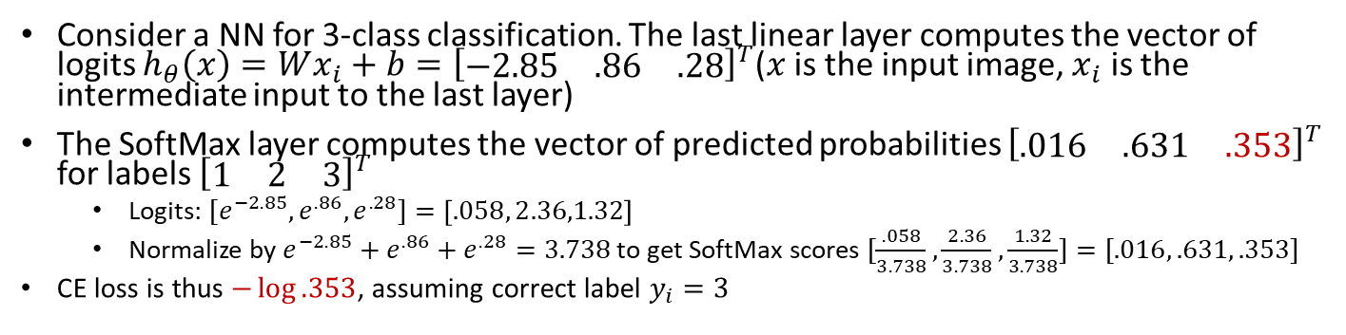
Cross Entropy Loss Example
Consider a NN for 3-class classification. The last linear layer computes the vector of logits $h_{θ}\left(x\right)=Wx_{i}+b={\left[\begin{matrix}−2.85 & .86 & .28\end{matrix}\right]}^{T}$($x$ is the input image, $x_{i}$ is the intermediate input to the last layer)
The SoftMax layer computes the vector of predicted probabilities ${\left[\begin{matrix}.016 & .631 & .353\end{matrix}\right]}^{T}$ for labels ${\left[\begin{matrix}1 & 2 & 3\end{matrix}\right]}^{T}$
  Logits: ${[e}^{−2.85}, e^{.86},e^{.28}]=\left[.058, 2.36,1.32\right]$
  Normalize by $e^{−2.85}+e^{.86}+e^{.28}=3.738$ to get SoftMax scores $[\frac{.058}{3.738},\frac{2.36}{3.738},\frac{1.32}{3.738}]=[.016, .631, .353]$
CE loss is thus $−\log{.353}$, assuming correct label $y_{i}=3$
correct
label
SoftMax Layer
Last Linear Layer
Notes:
[Slide 33] Cross-entropy — worked example
Here is the full pipeline on one example. The last linear layer produces raw scores; the softmax layer converts those scores into a probability distribution; we read off the probability assigned to the correct label; and the cross-entropy loss is computed from that. Walking the numbers through this chain once makes the whole classification head concrete, and it is exactly the computation we will soon differentiate with backpropagation.

Slide 34

Implementing learning: Gradient Descent
Given:
Family of parameters (e.g. possible weights of a NN)
Differentiable risk function (loss function computed over a set of samples)
Goal:
Notes:
[Slide 34] Implementing learning: gradient descent
Now the optimizer. Let me state the learning problem precisely. We are given a family of parameters — for a neural network, all the possible settings of the weights and biases — and a differentiable risk function that scores how bad each setting is. Our goal is to find the parameters that make that risk as small as possible. Conceptually, we are searching an enormous, high-dimensional space for its lowest point.

Slide 35
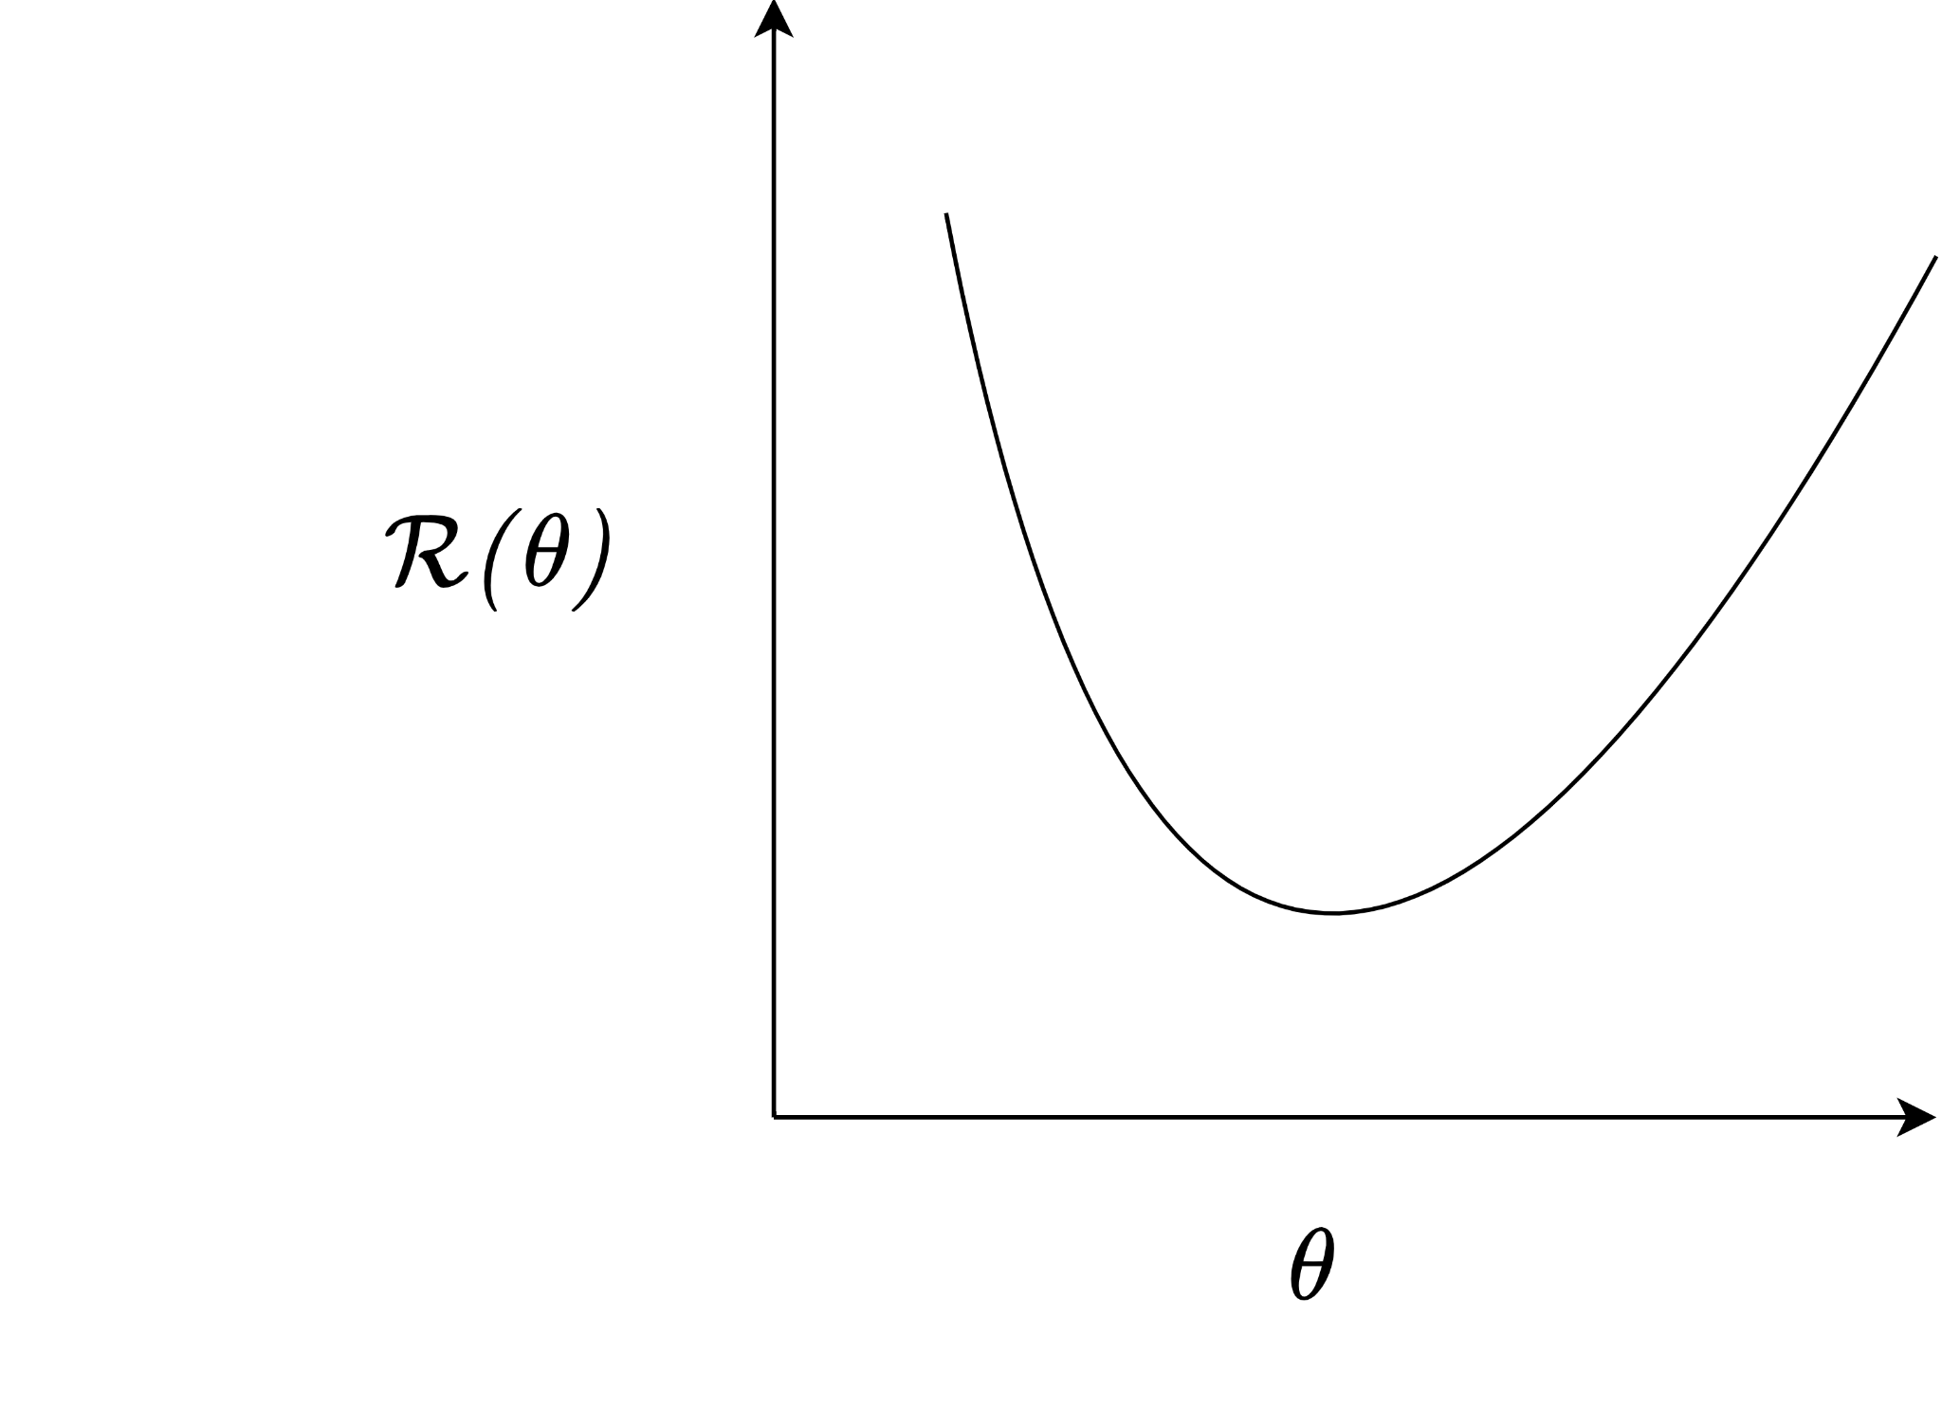
Gradient descent
Notes:
[Slides 35–38] Gradient descent — the loop and the learning rate
Gradient descent solves this with a beautifully simple loop, and the right mental image is hill-climbing in fog. Picture standing somewhere on a foggy mountain, able to see only the ground at your feet, and wanting to reach the valley. The sensible strategy is to feel which way is downhill and step that way.
That is exactly gradient descent. We start with a guess for the weights. We compute the gradient of the loss, which points in the direction of steepest increase, and we take a small step in the opposite direction — downhill. The size of that step is set by the learning rate. Then we repeat: evaluate, step downhill, evaluate, step downhill, again and again.
I want to underline the learning rate, because it is the hyperparameter students most often get wrong. Too large, and we take giant strides that overshoot the valley and may even diverge. Too small, and training crawls. Choosing it well is part science, part experience — and later, the training curves will tell us when we have it wrong.

Slide 36
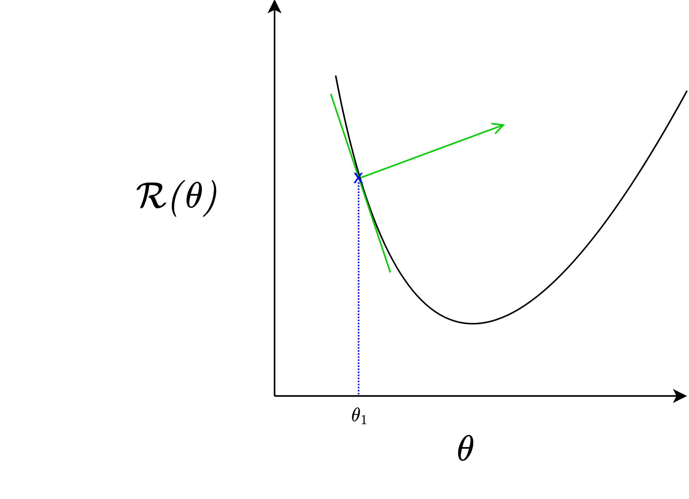

“Learning rate”
“Guess”
Notes:
[Slides 35–38] Gradient descent — the loop and the learning rate
Gradient descent solves this with a beautifully simple loop, and the right mental image is hill-climbing in fog. Picture standing somewhere on a foggy mountain, able to see only the ground at your feet, and wanting to reach the valley. The sensible strategy is to feel which way is downhill and step that way.
That is exactly gradient descent. We start with a guess for the weights. We compute the gradient of the loss, which points in the direction of steepest increase, and we take a small step in the opposite direction — downhill. The size of that step is set by the learning rate. Then we repeat: evaluate, step downhill, evaluate, step downhill, again and again.
I want to underline the learning rate, because it is the hyperparameter students most often get wrong. Too large, and we take giant strides that overshoot the valley and may even diverge. Too small, and training crawls. Choosing it well is part science, part experience — and later, the training curves will tell us when we have it wrong.

Slide 37
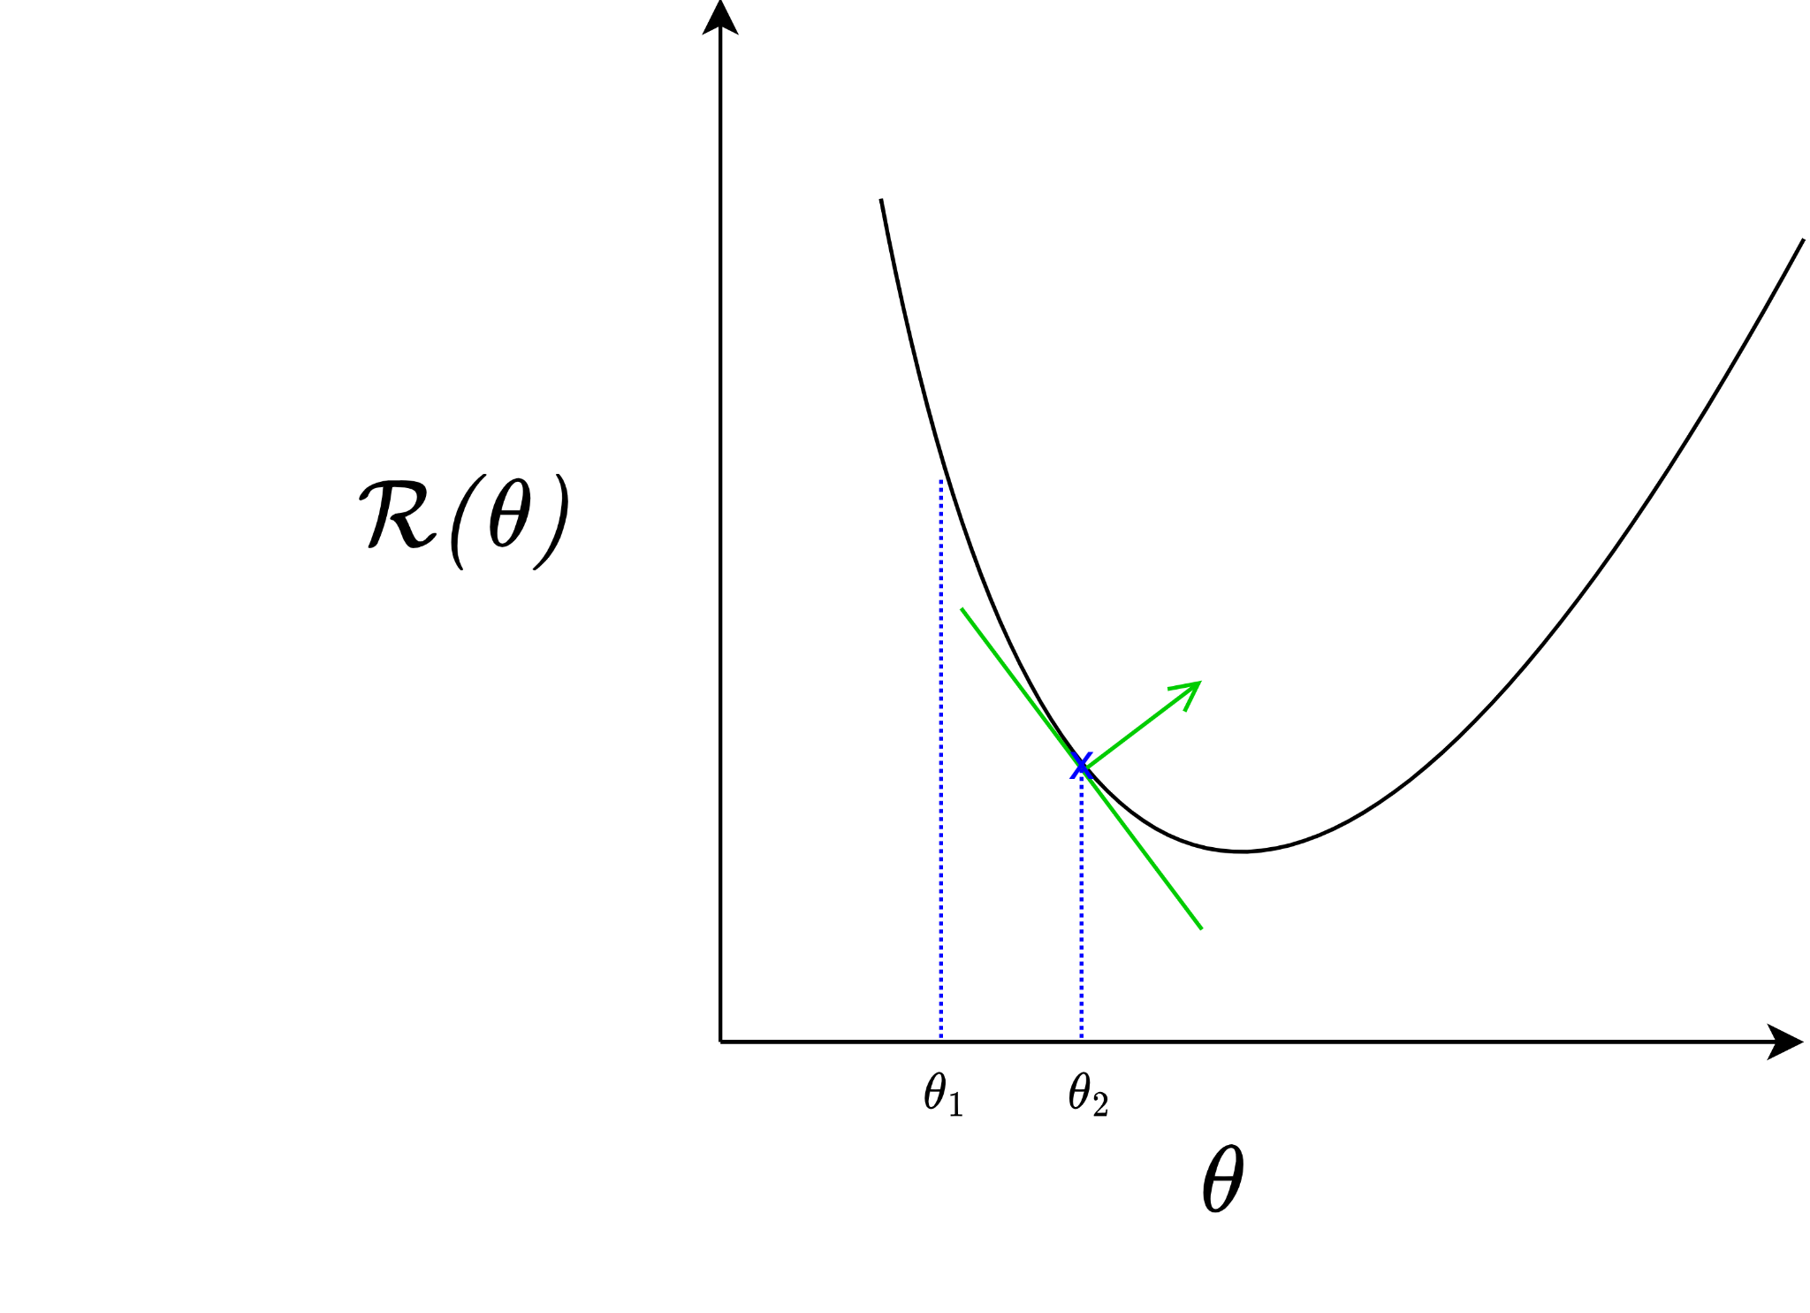
Notes:
[Slides 35–38] Gradient descent — the loop and the learning rate
Gradient descent solves this with a beautifully simple loop, and the right mental image is hill-climbing in fog. Picture standing somewhere on a foggy mountain, able to see only the ground at your feet, and wanting to reach the valley. The sensible strategy is to feel which way is downhill and step that way.
That is exactly gradient descent. We start with a guess for the weights. We compute the gradient of the loss, which points in the direction of steepest increase, and we take a small step in the opposite direction — downhill. The size of that step is set by the learning rate. Then we repeat: evaluate, step downhill, evaluate, step downhill, again and again.
I want to underline the learning rate, because it is the hyperparameter students most often get wrong. Too large, and we take giant strides that overshoot the valley and may even diverge. Too small, and training crawls. Choosing it well is part science, part experience — and later, the training curves will tell us when we have it wrong.

Slide 38
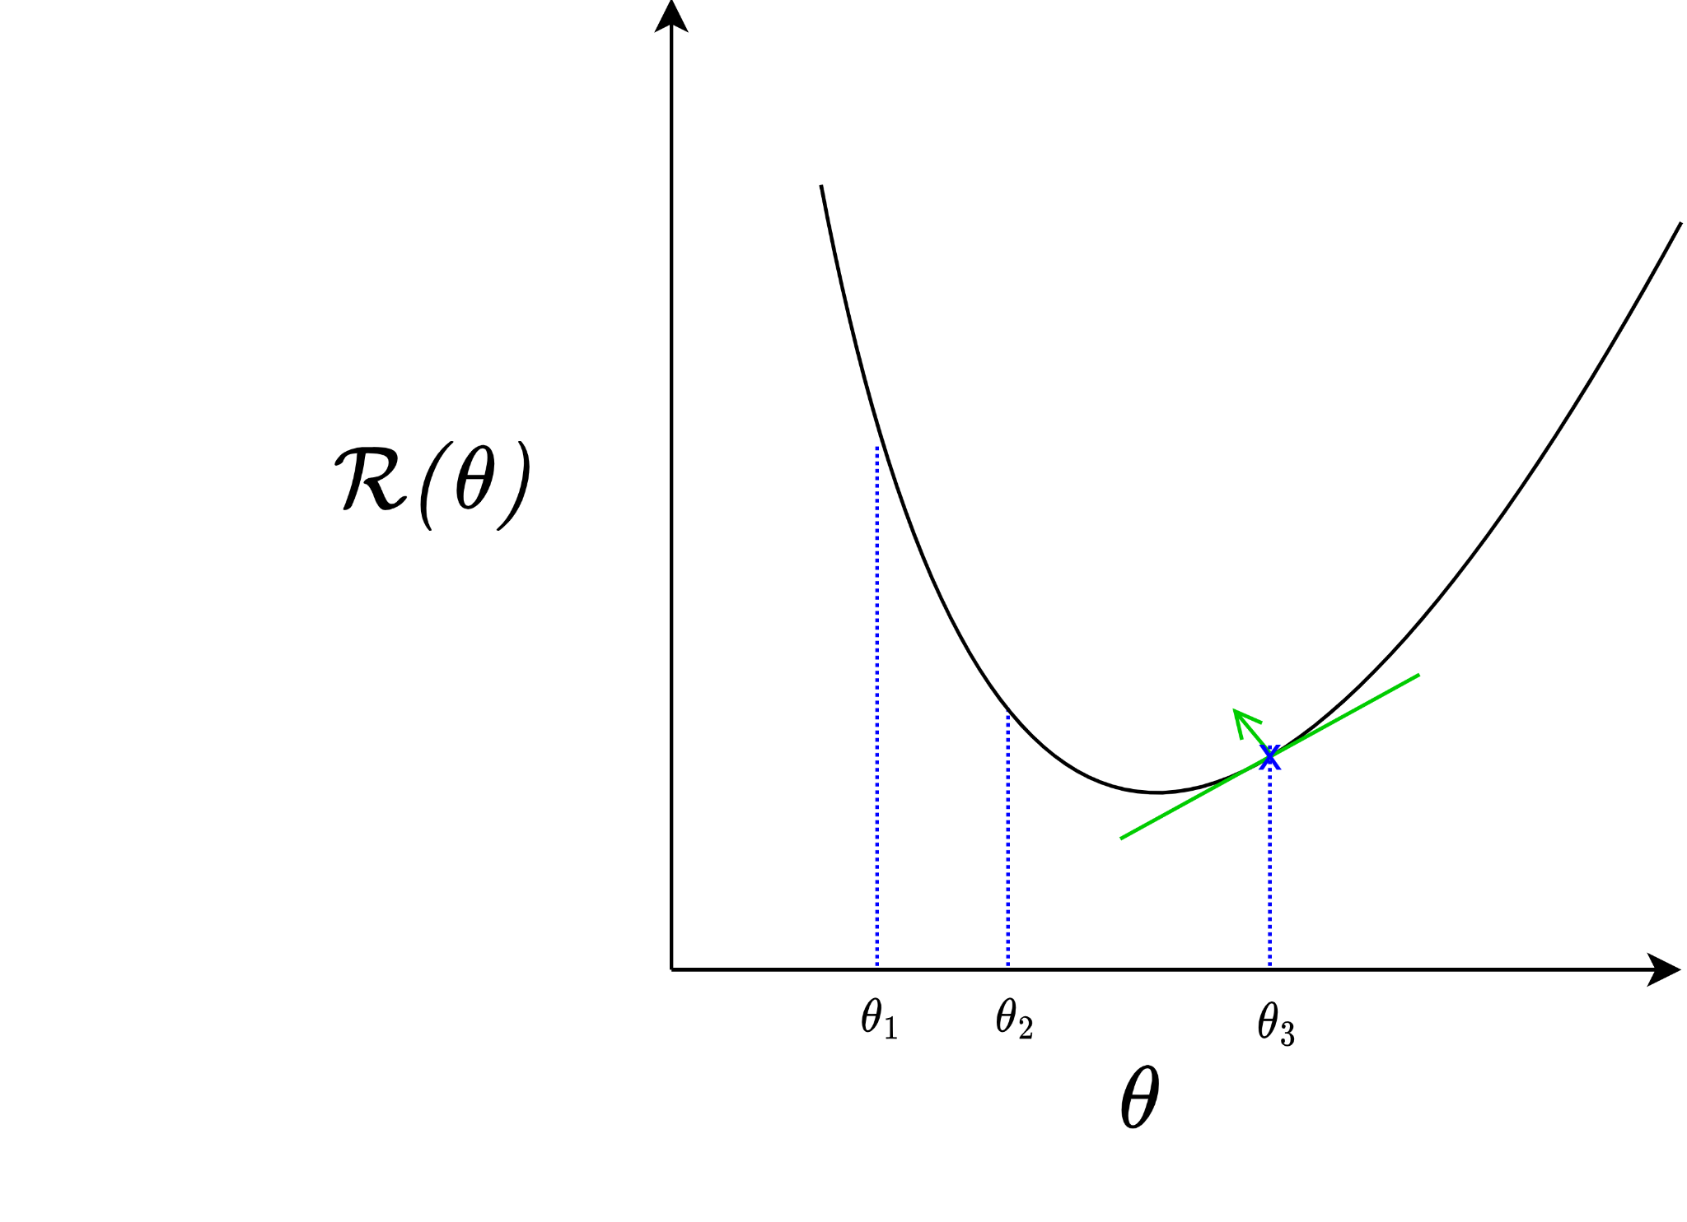
Notes:
[Slides 35–38] Gradient descent — the loop and the learning rate
Gradient descent solves this with a beautifully simple loop, and the right mental image is hill-climbing in fog. Picture standing somewhere on a foggy mountain, able to see only the ground at your feet, and wanting to reach the valley. The sensible strategy is to feel which way is downhill and step that way.
That is exactly gradient descent. We start with a guess for the weights. We compute the gradient of the loss, which points in the direction of steepest increase, and we take a small step in the opposite direction — downhill. The size of that step is set by the learning rate. Then we repeat: evaluate, step downhill, evaluate, step downhill, again and again.
I want to underline the learning rate, because it is the hyperparameter students most often get wrong. Too large, and we take giant strides that overshoot the valley and may even diverge. Too small, and training crawls. Choosing it well is part science, part experience — and later, the training curves will tell us when we have it wrong.

Slide 39
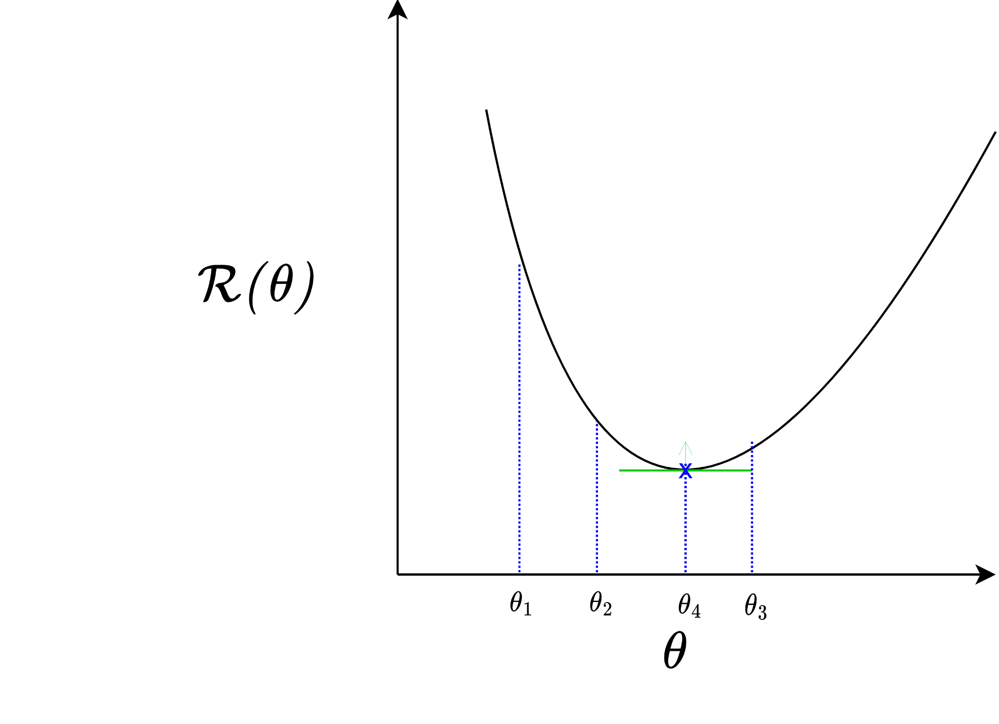
Converges to local minima
Notes:
[Slide 39] Convergence to local minima
If we keep stepping downhill, where do we end up? At a local minimum of the loss — a point where every direction is uphill, so we stop. It is worth being honest: this is a local minimum, not necessarily the global best. Gradient descent finds a good valley, not a guaranteed deepest valley.

Slide 40

A “real” loss landscape:
Many (many many) local minima
Saddle points
http://www.telesens.co/2019/01/16/neural-network-loss-visualization/
Notes:
[Slide 40] A real loss landscape
And to appreciate why that matters, look at this visualization of a real neural-network loss landscape. It is not a smooth bowl with one bottom — it is rugged terrain with many, many local minima and saddle points, those flat regions that are uphill in one direction and downhill in another. This is the genuinely difficult landscape our simple downhill walk must navigate. Remarkably, in the very high-dimensional spaces of real networks, this tends to work far better than this intimidating picture suggests — which is part of what makes neural networks so interesting.

Slide 41






Backprop: Efficient NN GD
Apologies for different notation
Goal: change optimization from to
Recall an MLP:
Use the chain rule to compute the derivatives from output to input
“Backpropagation of errors”
Notes:
[Slide 41] Backpropagation — efficient gradient descent for networks
Gradient descent needs the gradient of the loss with respect to every weight. For a deep network with millions of weights, how do we compute all of those derivatives efficiently? The answer is backpropagation. The idea is to recall that an MLP is a composition of functions, and then apply the chain rule from calculus to compute the derivatives systematically, working backward from the output to the input. That backward propagation of the error signal is what gives the method its name.

Slide 42


Automatic Differentiation
PyTorch builds a computational graph during the forward pass; then loss.backward() uses chain rule to compute analytic gradient ​exactly.
Example: For the function $y=x^{2}+3x$, PyTorch computes $\frac{dy}{dx}=2x+3$. With $x=2$, $x.grad= \frac{dy}{dx}=7$.
import torch
x = torch.tensor(2.0, requires_grad=True)
y = x**2 + 3*x
y.backward()
print(x.grad)
# Output: tensor(7.)
42
Notes:
[Slide 42] Automatic differentiation in practice
In modern frameworks this is automatic. The little PyTorch snippet on this slide says it all: we define a computation — here y equals x-squared plus three-x — call dot-backward, and the framework hands us the gradient with respect to x. We never derive anything by hand. Under the hood, the framework is doing exactly the chain-rule bookkeeping we are about to learn, so understanding backpropagation means understanding what every deep-learning library is doing for you.

Slide 43



Computational Graph Example
Feature Encoding
Hinge Loss
x
s (scores)
*
Loss Func
+
L
W
R
Weight Regularization (L2 or L1)
43
Notes:
[Slide 43] The computational graph
Here is the organizing idea that makes backpropagation tractable: the computational graph. Rather than treating the loss as one giant formula, we represent the computation as a graph of simple operations. You can trace it on the slide: the inputs x and the weights W flow into a multiply node to produce the scores; the scores flow into the hinge loss; the regularization term R is added in; and out comes the total loss L. The point is that no matter how complicated the overall function, every individual node is simple — and if we can differentiate each simple node, we can differentiate the whole graph.

Slide 44


e.g. x = -2, y = 5, z = -4
44
Notes:
[Slides 44–55] Backpropagation — the first worked example
Let me make this completely concrete with the simplest example, which these slides build up one animated step at a time. Take the function f equal to the quantity x plus y, times z, and pick numbers: x equals negative two, y equals five, z equals negative four.
First the forward pass. We compute the intermediate quantity q equal to x plus y, which is three, and then f equals q times z, which is three times negative four, or negative twelve. We simply compute and remember each value.
Now the backward pass — the heart of the method — and I am stepping through it slowly on purpose. Starting at the output, the derivative of f with respect to itself is one. Moving back, the derivative of f with respect to z is q, which is three; and with respect to q is z, which is negative four.
Then we reach the addition node and apply the chain rule. We want the derivative of f with respect to x. We do not have it directly, but we have the upstream gradient — the derivative of f with respect to q — and the local gradient — the derivative of q with respect to x, which is one. The chain rule says simply multiply them: negative four times one is negative four. By the same logic, the derivative with respect to y is also negative four.
I have walked through every animation step deliberately, because I want the pattern to stick: at each node, take the gradient arriving from above — the upstream gradient — and multiply by the node's own local gradient. That product is what we pass further back. Nothing more than that is going on.

Slide 45





e.g. x = -2, y = 5, z = -4
Want:
45
Notes:
[Slides 44–55] Backpropagation — the first worked example
Let me make this completely concrete with the simplest example, which these slides build up one animated step at a time. Take the function f equal to the quantity x plus y, times z, and pick numbers: x equals negative two, y equals five, z equals negative four.
First the forward pass. We compute the intermediate quantity q equal to x plus y, which is three, and then f equals q times z, which is three times negative four, or negative twelve. We simply compute and remember each value.
Now the backward pass — the heart of the method — and I am stepping through it slowly on purpose. Starting at the output, the derivative of f with respect to itself is one. Moving back, the derivative of f with respect to z is q, which is three; and with respect to q is z, which is negative four.
Then we reach the addition node and apply the chain rule. We want the derivative of f with respect to x. We do not have it directly, but we have the upstream gradient — the derivative of f with respect to q — and the local gradient — the derivative of q with respect to x, which is one. The chain rule says simply multiply them: negative four times one is negative four. By the same logic, the derivative with respect to y is also negative four.
I have walked through every animation step deliberately, because I want the pattern to stick: at each node, take the gradient arriving from above — the upstream gradient — and multiply by the node's own local gradient. That product is what we pass further back. Nothing more than that is going on.

Slide 46

e.g. x = -2, y = 5, z = -4
Want:
46
Notes:
[Slides 44–55] Backpropagation — the first worked example
Let me make this completely concrete with the simplest example, which these slides build up one animated step at a time. Take the function f equal to the quantity x plus y, times z, and pick numbers: x equals negative two, y equals five, z equals negative four.
First the forward pass. We compute the intermediate quantity q equal to x plus y, which is three, and then f equals q times z, which is three times negative four, or negative twelve. We simply compute and remember each value.
Now the backward pass — the heart of the method — and I am stepping through it slowly on purpose. Starting at the output, the derivative of f with respect to itself is one. Moving back, the derivative of f with respect to z is q, which is three; and with respect to q is z, which is negative four.
Then we reach the addition node and apply the chain rule. We want the derivative of f with respect to x. We do not have it directly, but we have the upstream gradient — the derivative of f with respect to q — and the local gradient — the derivative of q with respect to x, which is one. The chain rule says simply multiply them: negative four times one is negative four. By the same logic, the derivative with respect to y is also negative four.
I have walked through every animation step deliberately, because I want the pattern to stick: at each node, take the gradient arriving from above — the upstream gradient — and multiply by the node's own local gradient. That product is what we pass further back. Nothing more than that is going on.

Slide 47
e.g. x = -2, y = 5, z = -4
Want:
47
Notes:
[Slides 44–55] Backpropagation — the first worked example
Let me make this completely concrete with the simplest example, which these slides build up one animated step at a time. Take the function f equal to the quantity x plus y, times z, and pick numbers: x equals negative two, y equals five, z equals negative four.
First the forward pass. We compute the intermediate quantity q equal to x plus y, which is three, and then f equals q times z, which is three times negative four, or negative twelve. We simply compute and remember each value.
Now the backward pass — the heart of the method — and I am stepping through it slowly on purpose. Starting at the output, the derivative of f with respect to itself is one. Moving back, the derivative of f with respect to z is q, which is three; and with respect to q is z, which is negative four.
Then we reach the addition node and apply the chain rule. We want the derivative of f with respect to x. We do not have it directly, but we have the upstream gradient — the derivative of f with respect to q — and the local gradient — the derivative of q with respect to x, which is one. The chain rule says simply multiply them: negative four times one is negative four. By the same logic, the derivative with respect to y is also negative four.
I have walked through every animation step deliberately, because I want the pattern to stick: at each node, take the gradient arriving from above — the upstream gradient — and multiply by the node's own local gradient. That product is what we pass further back. Nothing more than that is going on.

Slide 48

e.g. x = -2, y = 5, z = -4
Want:
48
Notes:
[Slides 44–55] Backpropagation — the first worked example
Let me make this completely concrete with the simplest example, which these slides build up one animated step at a time. Take the function f equal to the quantity x plus y, times z, and pick numbers: x equals negative two, y equals five, z equals negative four.
First the forward pass. We compute the intermediate quantity q equal to x plus y, which is three, and then f equals q times z, which is three times negative four, or negative twelve. We simply compute and remember each value.
Now the backward pass — the heart of the method — and I am stepping through it slowly on purpose. Starting at the output, the derivative of f with respect to itself is one. Moving back, the derivative of f with respect to z is q, which is three; and with respect to q is z, which is negative four.
Then we reach the addition node and apply the chain rule. We want the derivative of f with respect to x. We do not have it directly, but we have the upstream gradient — the derivative of f with respect to q — and the local gradient — the derivative of q with respect to x, which is one. The chain rule says simply multiply them: negative four times one is negative four. By the same logic, the derivative with respect to y is also negative four.
I have walked through every animation step deliberately, because I want the pattern to stick: at each node, take the gradient arriving from above — the upstream gradient — and multiply by the node's own local gradient. That product is what we pass further back. Nothing more than that is going on.

Slide 49
e.g. x = -2, y = 5, z = -4
Want:
49
Notes:
[Slides 44–55] Backpropagation — the first worked example
Let me make this completely concrete with the simplest example, which these slides build up one animated step at a time. Take the function f equal to the quantity x plus y, times z, and pick numbers: x equals negative two, y equals five, z equals negative four.
First the forward pass. We compute the intermediate quantity q equal to x plus y, which is three, and then f equals q times z, which is three times negative four, or negative twelve. We simply compute and remember each value.
Now the backward pass — the heart of the method — and I am stepping through it slowly on purpose. Starting at the output, the derivative of f with respect to itself is one. Moving back, the derivative of f with respect to z is q, which is three; and with respect to q is z, which is negative four.
Then we reach the addition node and apply the chain rule. We want the derivative of f with respect to x. We do not have it directly, but we have the upstream gradient — the derivative of f with respect to q — and the local gradient — the derivative of q with respect to x, which is one. The chain rule says simply multiply them: negative four times one is negative four. By the same logic, the derivative with respect to y is also negative four.
I have walked through every animation step deliberately, because I want the pattern to stick: at each node, take the gradient arriving from above — the upstream gradient — and multiply by the node's own local gradient. That product is what we pass further back. Nothing more than that is going on.

Slide 50

e.g. x = -2, y = 5, z = -4
Want:
50
Notes:
[Slides 44–55] Backpropagation — the first worked example
Let me make this completely concrete with the simplest example, which these slides build up one animated step at a time. Take the function f equal to the quantity x plus y, times z, and pick numbers: x equals negative two, y equals five, z equals negative four.
First the forward pass. We compute the intermediate quantity q equal to x plus y, which is three, and then f equals q times z, which is three times negative four, or negative twelve. We simply compute and remember each value.
Now the backward pass — the heart of the method — and I am stepping through it slowly on purpose. Starting at the output, the derivative of f with respect to itself is one. Moving back, the derivative of f with respect to z is q, which is three; and with respect to q is z, which is negative four.
Then we reach the addition node and apply the chain rule. We want the derivative of f with respect to x. We do not have it directly, but we have the upstream gradient — the derivative of f with respect to q — and the local gradient — the derivative of q with respect to x, which is one. The chain rule says simply multiply them: negative four times one is negative four. By the same logic, the derivative with respect to y is also negative four.
I have walked through every animation step deliberately, because I want the pattern to stick: at each node, take the gradient arriving from above — the upstream gradient — and multiply by the node's own local gradient. That product is what we pass further back. Nothing more than that is going on.

Slide 51
e.g. x = -2, y = 5, z = -4
Want:
51
Notes:
[Slides 44–55] Backpropagation — the first worked example
Let me make this completely concrete with the simplest example, which these slides build up one animated step at a time. Take the function f equal to the quantity x plus y, times z, and pick numbers: x equals negative two, y equals five, z equals negative four.
First the forward pass. We compute the intermediate quantity q equal to x plus y, which is three, and then f equals q times z, which is three times negative four, or negative twelve. We simply compute and remember each value.
Now the backward pass — the heart of the method — and I am stepping through it slowly on purpose. Starting at the output, the derivative of f with respect to itself is one. Moving back, the derivative of f with respect to z is q, which is three; and with respect to q is z, which is negative four.
Then we reach the addition node and apply the chain rule. We want the derivative of f with respect to x. We do not have it directly, but we have the upstream gradient — the derivative of f with respect to q — and the local gradient — the derivative of q with respect to x, which is one. The chain rule says simply multiply them: negative four times one is negative four. By the same logic, the derivative with respect to y is also negative four.
I have walked through every animation step deliberately, because I want the pattern to stick: at each node, take the gradient arriving from above — the upstream gradient — and multiply by the node's own local gradient. That product is what we pass further back. Nothing more than that is going on.

Slide 52

e.g. x = -2, y = 5, z = -4
Want:
52
Notes:
[Slides 44–55] Backpropagation — the first worked example
Let me make this completely concrete with the simplest example, which these slides build up one animated step at a time. Take the function f equal to the quantity x plus y, times z, and pick numbers: x equals negative two, y equals five, z equals negative four.
First the forward pass. We compute the intermediate quantity q equal to x plus y, which is three, and then f equals q times z, which is three times negative four, or negative twelve. We simply compute and remember each value.
Now the backward pass — the heart of the method — and I am stepping through it slowly on purpose. Starting at the output, the derivative of f with respect to itself is one. Moving back, the derivative of f with respect to z is q, which is three; and with respect to q is z, which is negative four.
Then we reach the addition node and apply the chain rule. We want the derivative of f with respect to x. We do not have it directly, but we have the upstream gradient — the derivative of f with respect to q — and the local gradient — the derivative of q with respect to x, which is one. The chain rule says simply multiply them: negative four times one is negative four. By the same logic, the derivative with respect to y is also negative four.
I have walked through every animation step deliberately, because I want the pattern to stick: at each node, take the gradient arriving from above — the upstream gradient — and multiply by the node's own local gradient. That product is what we pass further back. Nothing more than that is going on.

Slide 53


e.g. x = -2, y = 5, z = -4
Chain rule:
Want:
-4
1
53
Notes:
[Slides 44–55] Backpropagation — the first worked example
Let me make this completely concrete with the simplest example, which these slides build up one animated step at a time. Take the function f equal to the quantity x plus y, times z, and pick numbers: x equals negative two, y equals five, z equals negative four.
First the forward pass. We compute the intermediate quantity q equal to x plus y, which is three, and then f equals q times z, which is three times negative four, or negative twelve. We simply compute and remember each value.
Now the backward pass — the heart of the method — and I am stepping through it slowly on purpose. Starting at the output, the derivative of f with respect to itself is one. Moving back, the derivative of f with respect to z is q, which is three; and with respect to q is z, which is negative four.
Then we reach the addition node and apply the chain rule. We want the derivative of f with respect to x. We do not have it directly, but we have the upstream gradient — the derivative of f with respect to q — and the local gradient — the derivative of q with respect to x, which is one. The chain rule says simply multiply them: negative four times one is negative four. By the same logic, the derivative with respect to y is also negative four.
I have walked through every animation step deliberately, because I want the pattern to stick: at each node, take the gradient arriving from above — the upstream gradient — and multiply by the node's own local gradient. That product is what we pass further back. Nothing more than that is going on.

Slide 54

e.g. x = -2, y = 5, z = -4
Want:
54
Notes:
[Slides 44–55] Backpropagation — the first worked example
Let me make this completely concrete with the simplest example, which these slides build up one animated step at a time. Take the function f equal to the quantity x plus y, times z, and pick numbers: x equals negative two, y equals five, z equals negative four.
First the forward pass. We compute the intermediate quantity q equal to x plus y, which is three, and then f equals q times z, which is three times negative four, or negative twelve. We simply compute and remember each value.
Now the backward pass — the heart of the method — and I am stepping through it slowly on purpose. Starting at the output, the derivative of f with respect to itself is one. Moving back, the derivative of f with respect to z is q, which is three; and with respect to q is z, which is negative four.
Then we reach the addition node and apply the chain rule. We want the derivative of f with respect to x. We do not have it directly, but we have the upstream gradient — the derivative of f with respect to q — and the local gradient — the derivative of q with respect to x, which is one. The chain rule says simply multiply them: negative four times one is negative four. By the same logic, the derivative with respect to y is also negative four.
I have walked through every animation step deliberately, because I want the pattern to stick: at each node, take the gradient arriving from above — the upstream gradient — and multiply by the node's own local gradient. That product is what we pass further back. Nothing more than that is going on.

Slide 55
e.g. x = -2, y = 5, z = -4
Chain rule:
Want:
-4
1
55
Notes:
[Slides 44–55] Backpropagation — the first worked example
Let me make this completely concrete with the simplest example, which these slides build up one animated step at a time. Take the function f equal to the quantity x plus y, times z, and pick numbers: x equals negative two, y equals five, z equals negative four.
First the forward pass. We compute the intermediate quantity q equal to x plus y, which is three, and then f equals q times z, which is three times negative four, or negative twelve. We simply compute and remember each value.
Now the backward pass — the heart of the method — and I am stepping through it slowly on purpose. Starting at the output, the derivative of f with respect to itself is one. Moving back, the derivative of f with respect to z is q, which is three; and with respect to q is z, which is negative four.
Then we reach the addition node and apply the chain rule. We want the derivative of f with respect to x. We do not have it directly, but we have the upstream gradient — the derivative of f with respect to q — and the local gradient — the derivative of q with respect to x, which is one. The chain rule says simply multiply them: negative four times one is negative four. By the same logic, the derivative with respect to y is also negative four.
I have walked through every animation step deliberately, because I want the pattern to stick: at each node, take the gradient arriving from above — the upstream gradient — and multiply by the node's own local gradient. That product is what we pass further back. Nothing more than that is going on.

Slide 56


activations
f
56
Notes:
[Slides 56–61] The general node — local gradient and gradient flow
Let me now abstract the pattern we just saw, because this abstraction is what we reuse everywhere. These slides reveal it piece by piece. Consider any single node, computing some function f. During the forward pass, activations come in and an output goes out. During the backward pass, a gradient arrives from downstream — the upstream gradient — telling the node how much the final loss depends on its output.
The node knows just one thing about itself: its local gradient, the derivative of its output with respect to its inputs. To produce the gradients it sends further back, it multiplies the upstream gradient by its local gradient. If you remember one sentence from this lecture, make it this one: downstream gradient equals upstream gradient times local gradient.
And notice how modular this is. Each node needs to know only its own local behaviour — nothing about the rest of the network. That locality is exactly what lets frameworks differentiate enormous networks automatically, by chaining these local multiplications from the loss all the way back to every input.

Slide 57


activations
“local gradient”
f
57
Notes:
[Slides 56–61] The general node — local gradient and gradient flow
Let me now abstract the pattern we just saw, because this abstraction is what we reuse everywhere. These slides reveal it piece by piece. Consider any single node, computing some function f. During the forward pass, activations come in and an output goes out. During the backward pass, a gradient arrives from downstream — the upstream gradient — telling the node how much the final loss depends on its output.
The node knows just one thing about itself: its local gradient, the derivative of its output with respect to its inputs. To produce the gradients it sends further back, it multiplies the upstream gradient by its local gradient. If you remember one sentence from this lecture, make it this one: downstream gradient equals upstream gradient times local gradient.
And notice how modular this is. Each node needs to know only its own local behaviour — nothing about the rest of the network. That locality is exactly what lets frameworks differentiate enormous networks automatically, by chaining these local multiplications from the loss all the way back to every input.

Slide 58

activations
“local gradient”
f
gradients
58
Notes:
[Slides 56–61] The general node — local gradient and gradient flow
Let me now abstract the pattern we just saw, because this abstraction is what we reuse everywhere. These slides reveal it piece by piece. Consider any single node, computing some function f. During the forward pass, activations come in and an output goes out. During the backward pass, a gradient arrives from downstream — the upstream gradient — telling the node how much the final loss depends on its output.
The node knows just one thing about itself: its local gradient, the derivative of its output with respect to its inputs. To produce the gradients it sends further back, it multiplies the upstream gradient by its local gradient. If you remember one sentence from this lecture, make it this one: downstream gradient equals upstream gradient times local gradient.
And notice how modular this is. Each node needs to know only its own local behaviour — nothing about the rest of the network. That locality is exactly what lets frameworks differentiate enormous networks automatically, by chaining these local multiplications from the loss all the way back to every input.

Slide 59

activations
“local gradient”
f
gradients
59
Notes:
[Slides 56–61] The general node — local gradient and gradient flow
Let me now abstract the pattern we just saw, because this abstraction is what we reuse everywhere. These slides reveal it piece by piece. Consider any single node, computing some function f. During the forward pass, activations come in and an output goes out. During the backward pass, a gradient arrives from downstream — the upstream gradient — telling the node how much the final loss depends on its output.
The node knows just one thing about itself: its local gradient, the derivative of its output with respect to its inputs. To produce the gradients it sends further back, it multiplies the upstream gradient by its local gradient. If you remember one sentence from this lecture, make it this one: downstream gradient equals upstream gradient times local gradient.
And notice how modular this is. Each node needs to know only its own local behaviour — nothing about the rest of the network. That locality is exactly what lets frameworks differentiate enormous networks automatically, by chaining these local multiplications from the loss all the way back to every input.

Slide 60

activations
“local gradient”
f
gradients
60
Notes:
[Slides 56–61] The general node — local gradient and gradient flow
Let me now abstract the pattern we just saw, because this abstraction is what we reuse everywhere. These slides reveal it piece by piece. Consider any single node, computing some function f. During the forward pass, activations come in and an output goes out. During the backward pass, a gradient arrives from downstream — the upstream gradient — telling the node how much the final loss depends on its output.
The node knows just one thing about itself: its local gradient, the derivative of its output with respect to its inputs. To produce the gradients it sends further back, it multiplies the upstream gradient by its local gradient. If you remember one sentence from this lecture, make it this one: downstream gradient equals upstream gradient times local gradient.
And notice how modular this is. Each node needs to know only its own local behaviour — nothing about the rest of the network. That locality is exactly what lets frameworks differentiate enormous networks automatically, by chaining these local multiplications from the loss all the way back to every input.

Slide 61
activations
“local gradient”
f
gradients
61
Notes:
[Slides 56–61] The general node — local gradient and gradient flow
Let me now abstract the pattern we just saw, because this abstraction is what we reuse everywhere. These slides reveal it piece by piece. Consider any single node, computing some function f. During the forward pass, activations come in and an output goes out. During the backward pass, a gradient arrives from downstream — the upstream gradient — telling the node how much the final loss depends on its output.
The node knows just one thing about itself: its local gradient, the derivative of its output with respect to its inputs. To produce the gradients it sends further back, it multiplies the upstream gradient by its local gradient. If you remember one sentence from this lecture, make it this one: downstream gradient equals upstream gradient times local gradient.
And notice how modular this is. Each node needs to know only its own local behaviour — nothing about the rest of the network. That locality is exactly what lets frameworks differentiate enormous networks automatically, by chaining these local multiplications from the loss all the way back to every input.

Slide 62


Another example:
62
Notes:
[Slides 62–70] A second, richer worked example
Here is a richer example, animated across these slides, so you can see the same machinery handle several kinds of nodes at once — additions, multiplications, and an exponential, the pieces of a small logistic-style function. We do the forward pass first, writing every intermediate value onto the graph, and then go backward, applying the same rule at every node: upstream gradient times local gradient.
Watch how each node type behaves as the gradient flows back. The pattern is always identical — multiply the incoming gradient by the local derivative — but the local derivative differs by node type, which is what produces the different behaviours we will summarize shortly.

Slide 63


63
Notes:
[Slides 62–70] A second, richer worked example
Here is a richer example, animated across these slides, so you can see the same machinery handle several kinds of nodes at once — additions, multiplications, and an exponential, the pieces of a small logistic-style function. We do the forward pass first, writing every intermediate value onto the graph, and then go backward, applying the same rule at every node: upstream gradient times local gradient.
Watch how each node type behaves as the gradient flows back. The pattern is always identical — multiply the incoming gradient by the local derivative — but the local derivative differs by node type, which is what produces the different behaviours we will summarize shortly.

Slide 64
64
Notes:
[Slides 62–70] A second, richer worked example
Here is a richer example, animated across these slides, so you can see the same machinery handle several kinds of nodes at once — additions, multiplications, and an exponential, the pieces of a small logistic-style function. We do the forward pass first, writing every intermediate value onto the graph, and then go backward, applying the same rule at every node: upstream gradient times local gradient.
Watch how each node type behaves as the gradient flows back. The pattern is always identical — multiply the incoming gradient by the local derivative — but the local derivative differs by node type, which is what produces the different behaviours we will summarize shortly.

Slide 65

65
Notes:
[Slides 62–70] A second, richer worked example
Here is a richer example, animated across these slides, so you can see the same machinery handle several kinds of nodes at once — additions, multiplications, and an exponential, the pieces of a small logistic-style function. We do the forward pass first, writing every intermediate value onto the graph, and then go backward, applying the same rule at every node: upstream gradient times local gradient.
Watch how each node type behaves as the gradient flows back. The pattern is always identical — multiply the incoming gradient by the local derivative — but the local derivative differs by node type, which is what produces the different behaviours we will summarize shortly.

Slide 66
66
Notes:
[Slides 62–70] A second, richer worked example
Here is a richer example, animated across these slides, so you can see the same machinery handle several kinds of nodes at once — additions, multiplications, and an exponential, the pieces of a small logistic-style function. We do the forward pass first, writing every intermediate value onto the graph, and then go backward, applying the same rule at every node: upstream gradient times local gradient.
Watch how each node type behaves as the gradient flows back. The pattern is always identical — multiply the incoming gradient by the local derivative — but the local derivative differs by node type, which is what produces the different behaviours we will summarize shortly.

Slide 67

67
Notes:
[Slides 62–70] A second, richer worked example
Here is a richer example, animated across these slides, so you can see the same machinery handle several kinds of nodes at once — additions, multiplications, and an exponential, the pieces of a small logistic-style function. We do the forward pass first, writing every intermediate value onto the graph, and then go backward, applying the same rule at every node: upstream gradient times local gradient.
Watch how each node type behaves as the gradient flows back. The pattern is always identical — multiply the incoming gradient by the local derivative — but the local derivative differs by node type, which is what produces the different behaviours we will summarize shortly.

Slide 68
68
Notes:
[Slides 62–70] A second, richer worked example
Here is a richer example, animated across these slides, so you can see the same machinery handle several kinds of nodes at once — additions, multiplications, and an exponential, the pieces of a small logistic-style function. We do the forward pass first, writing every intermediate value onto the graph, and then go backward, applying the same rule at every node: upstream gradient times local gradient.
Watch how each node type behaves as the gradient flows back. The pattern is always identical — multiply the incoming gradient by the local derivative — but the local derivative differs by node type, which is what produces the different behaviours we will summarize shortly.

Slide 69

69
Notes:
[Slides 62–70] A second, richer worked example
Here is a richer example, animated across these slides, so you can see the same machinery handle several kinds of nodes at once — additions, multiplications, and an exponential, the pieces of a small logistic-style function. We do the forward pass first, writing every intermediate value onto the graph, and then go backward, applying the same rule at every node: upstream gradient times local gradient.
Watch how each node type behaves as the gradient flows back. The pattern is always identical — multiply the incoming gradient by the local derivative — but the local derivative differs by node type, which is what produces the different behaviours we will summarize shortly.

Slide 70
70
Notes:
[Slides 62–70] A second, richer worked example
Here is a richer example, animated across these slides, so you can see the same machinery handle several kinds of nodes at once — additions, multiplications, and an exponential, the pieces of a small logistic-style function. We do the forward pass first, writing every intermediate value onto the graph, and then go backward, applying the same rule at every node: upstream gradient times local gradient.
Watch how each node type behaves as the gradient flows back. The pattern is always identical — multiply the incoming gradient by the local derivative — but the local derivative differs by node type, which is what produces the different behaviours we will summarize shortly.

Slide 71
(-1) * (-0.20) = 0.20
71
Notes:
[Slide 71] Backward step at a multiply node
Here is one concrete backward step to anchor the idea. At this multiply gate, the computation negative one times negative zero-point-two-zero gives zero-point-two-zero. The local gradient of a multiply with respect to one input is the value of the other input, so the gradient simply routes through scaled by the partner value. Seeing the actual numbers makes the abstract rule tangible.

Slide 72
72
Notes:
[Slides 72–73] The add gate — gradient distributor
Now the add gate, and these slides show it numerically. The rule is: local gradient times the incoming gradient. For addition the local gradient is one on every input, so the computation is one times zero-point-two equals zero-point-two — and crucially, that same value goes to both inputs. The add gate is therefore a gradient distributor: it copies the upstream gradient, unchanged, to all of its inputs. Nothing is scaled or routed away.

Slide 73
[local gradient] x [its gradient] [1] x [0.2] = 0.2
[1] x [0.2] = 0.2 (both inputs!)
73
Notes:
[Slides 72–73] The add gate — gradient distributor
Now the add gate, and these slides show it numerically. The rule is: local gradient times the incoming gradient. For addition the local gradient is one on every input, so the computation is one times zero-point-two equals zero-point-two — and crucially, that same value goes to both inputs. The add gate is therefore a gradient distributor: it copies the upstream gradient, unchanged, to all of its inputs. Nothing is scaled or routed away.

Slide 74
74
Notes:
[Slides 74–75] The multiply gate — gradient switcher
The multiply gate behaves differently, and these slides give the numbers. The rule again is local gradient times the incoming gradient, but for a product the local gradient with respect to one input is the value of the other input. So here, for x-zero we get two times zero-point-two equals zero-point-four, and for w-zero we get negative one times zero-point-two equals negative zero-point-two. Notice the swap: each input's gradient uses the other input's value. That is why the multiply gate is called a gradient switcher.

Slide 75
[local gradient] x [its gradient] x0: [2] x [0.2] = 0.4
w0: [-1] x [0.2] = -0.2
75
Notes:
[Slides 74–75] The multiply gate — gradient switcher
The multiply gate behaves differently, and these slides give the numbers. The rule again is local gradient times the incoming gradient, but for a product the local gradient with respect to one input is the value of the other input. So here, for x-zero we get two times zero-point-two equals zero-point-four, and for w-zero we get negative one times zero-point-two equals negative zero-point-two. Notice the swap: each input's gradient uses the other input's value. That is why the multiply gate is called a gradient switcher.

Slide 76

sigmoid function
sigmoid gate
76
Notes:
[Slides 76–77] The sigmoid gate
Here is an especially elegant case: the sigmoid gate. The sigmoid is itself built from several elementary operations, and we could backpropagate through each. But it is cleaner to recognize the whole cluster as a single node, because the sigmoid has a beautiful local gradient: it equals its output times one minus its output. As the slide shows, if the forward output was zero-point-seven-three, the local gradient is zero-point-seven-three times one minus zero-point-seven-three, which is about zero-point-two. The lesson generalizes: you are free to group operations into one node whenever the combined local gradient has a clean form — exactly what frameworks do when they implement a fused sigmoid layer.

Slide 77
sigmoid function
sigmoid gate
(0.73) * (1 - 0.73) = 0.2
77
Notes:
[Slides 76–77] The sigmoid gate
Here is an especially elegant case: the sigmoid gate. The sigmoid is itself built from several elementary operations, and we could backpropagate through each. But it is cleaner to recognize the whole cluster as a single node, because the sigmoid has a beautiful local gradient: it equals its output times one minus its output. As the slide shows, if the forward output was zero-point-seven-three, the local gradient is zero-point-seven-three times one minus zero-point-seven-three, which is about zero-point-two. The lesson generalizes: you are free to group operations into one node whenever the combined local gradient has a clean form — exactly what frameworks do when they implement a fused sigmoid layer.

Slide 78

Patterns in backward flow
Gate | Behavior | Local gradient | Backward behavior
add | distributor | 1 to every input | copies upstream gradient to all inputs unchanged
max | router | 1 to the largest, 0 to the rest | routes the whole gradient to the larger input (winner) only
mul | switcher | the other input's value | each input gets upstream gradient × the other input
mul
add
max
78
Notes:
[Slide 78] Patterns in backward flow
Let me summarize the patterns, because once you know them you can often read gradients off a graph by inspection. The add gate is a gradient distributor — it copies the upstream gradient to all inputs. The multiply gate is a gradient switcher — each input receives the upstream gradient scaled by the other input's value. And the max gate is a gradient router — it sends the gradient only to whichever input was largest, and zero to the others. Three node types, three memorable behaviours.

Slide 79




Gradients add up at branches
$$a$$
$$x$$
+
$$b$$
If a variable $x$ influences the loss $L$ through two separate paths, say through $a$ and through $b$, then each path contributes a term to the gradient, and you sum the contributions from each path:
$$\frac{∂L}{∂x}=\frac{∂L}{∂a}\frac{∂a}{∂x}+\frac{∂L}{∂b}\frac{∂b}{∂x}$$
(The total effect of nudging $x$ is the sum of its effects along all paths.)
79
Notes:
[Slide 79] Gradients add up at branches
One more crucial rule, shown here with the red plus sign. When a single value branches out in the forward pass to feed several downstream nodes, the gradients coming back along those branches must be added together. A branch forward becomes a sum backward — it is just the multivariable chain rule, summing the contributions from every path. Forgetting this is one of the most common bugs in a hand-written backpropagation, so when you implement a backward pass, gradients into a shared variable should accumulate, not overwrite.

Slide 80

Gradients for vectorized code ^{(x,y,z are now}
vectors)
Jacobian matrix: derivative of each element of z w.r.t. each element of x, e.g., for 2D vectors:
$$J=\frac{∂z}{∂x}=\left[\begin{matrix}\frac{∂z_{1}}{∂x_{1}} & \frac{∂z_{1}}{∂x_{2}} \\ \frac{∂z_{2}}{∂x_{1}} & \frac{∂z_{2}}{∂x_{2}}\end{matrix}\right]$$
“local gradient”
f
gradients
80
Notes:
[Slide 80] Backprop with vectors
Everything so far used scalars; in real networks our variables are vectors, so let me extend the idea. When a node's input and output are both vectors, the local gradient is no longer a single number — it becomes a matrix called the Jacobian, holding the derivative of every output element with respect to every input element. The same flow rule applies; we just replace scalar multiplication with the appropriate matrix operation.

Slide 81


Vectorized operations
Jacobian matrix
For one training sample
4096-d
input vector
Size of Jacobian matrix:
[4096 x 4096]
4096-d
output vector
81
Notes:
[Slide 81] The size of the Jacobian
And here the slide poses a sharp, practical question. If a node maps a four-thousand-ninety-six-dimensional vector to another four-thousand-ninety-six-dimensional vector, how big is the Jacobian? The answer is four-thousand-ninety-six by four-thousand-ninety-six — over sixteen million entries for a single node. That number is meant to alarm you a little, because it sets up the next slide.

Slide 82
Vectorized operations
In practice we process one minibatch (e.g. 100) training samples at once
Jacobian matrix
100 4096-d
input vectors
100 4096-d
output vectors
Size of Jacobian matrix:
[409,600 x 409,600]
82
Notes:
[Slide 82] Why we never form the Jacobian
It gets larger still. In practice we process a whole minibatch — say a hundred examples — at once, which would make the Jacobian four-hundred-thousand by four-hundred-thousand. That is far too large to ever store or form explicitly. The resolution is that for most operations the Jacobian has special structure — for an element-wise operation like ReLU it is diagonal — so we never build it. We just apply the rule implicitly: for a ReLU, pass the gradient through wherever the input was positive and zero it elsewhere. The Jacobian is a concept for reasoning, not a matrix we materialize.

Slide 83

Optimizers
Stochastic/Mini-batch GD: Speed improvement
- Performs backprop on one training sample, or a mini-batch of samples instead of all samples
- Reduces the number of expensive backward passes
- Helps with getting out of local minima (due to higher gradient noise)
Optimizers
- Gradient Descent
- RMSProp
- Adaptive Moment Estimation (Adam)
Figure shows GD struggles with oscillations in narrow valleys, leading to slower convergence, while Adam smoothly adjusts its path, leveraging adaptive learning rates and momentum to converge efficiently.
https://www.vizuaranewsletter.com/p/adam-the-most-famous-ml-optimizer
Notes:
[Slide 83] Optimizers — stochastic and mini-batch gradient descent
A practical note on how we apply the gradients, because computing the gradient over the entire dataset every step is expensive. The standard trick is stochastic, or mini-batch, gradient descent: we perform backpropagation on one training sample, or a small mini-batch, at a time. This is much faster — we update the weights far more often, and each step is cheap. And somewhat surprisingly, the noise in the mini-batch gradient actually helps: it can knock the optimizer out of poor local minima that a smooth, exact gradient would settle into. So the noisy, cheap estimate is not just a compromise — it is often genuinely better.

Slide 84
Types of Neural Networks
Notes:
[Slide 84] Section — types of neural networks
So far we have studied the multi-layer perceptron, but it is just one architecture among several. Let me give you a quick tour of the main families and what each is good for — because matching the architecture to the structure of the data is a large part of the craft, and it is where my own research in autonomous-systems perception lives.

Slide 85
Multi-layer Perceptrons
Useful for static input-output relations
More hidden layers → better approximation of more complicated functions
Quick to design and implement
Notes:
[Slide 85] Multi-layer perceptrons
First, the MLP we built. It is well suited to static input-output relations, where the input is a fixed-size vector, and adding more hidden layers generally lets it approximate more complex functions. Its great virtue is simplicity — quick to design and implement, and often the right baseline to try first.

Slide 86

ALVINN
CMU’s Autonomous Land Vehicle In a Neural Network (ALVINN) (1988-89) can drive 70mph on highways.
ALVINN's architecture is a MLP with a single hidden layer.
Input layer is a 30x32 two dimensional "retina" which receives input from camera.
Output layer (30 neurons) encodes the direction the vehicle should travel to keep it on the road (as a 30-class classification task)
Notes:
[Slide 86] ALVINN — an early autonomous-driving MLP
And MLPs have a remarkable history in my own field. ALVINN — Carnegie Mellon's Autonomous Land Vehicle In a Neural Network, from nineteen-eighty-eight to eighty-nine — could drive at seventy miles per hour on highways using a neural network. Its architecture was essentially a small MLP mapping camera input directly to steering. It is a striking reminder that the core ideas are decades old; what changed since is data, compute, and a handful of practical techniques.

Slide 87



MLP vs. Convolutional Neural Network (CNN)
In an MLP, all layers are Fully-Connected
Cannot alter input image size
No translation invariance
No. weight params can grow very large, prone to overfitting
In a CNN, only the last few layers are FC
Each CONV layer extracts increasingly higher level features, followed by FC layers for classification
Translation invariance (object can be anywhere in the image)
Fewer params than MLP
Notes:
[Slide 87] Limitations of the MLP for images
But the plain MLP has real limits for images, which motivates the next architecture. In an MLP every layer is fully connected, and that brings three problems for vision: it cannot adapt to a changing input image size; it has no translation invariance, so an object shifted a few pixels looks entirely new to it; and the number of weight parameters explodes, because every pixel connects to every neuron. These three limitations are exactly what the convolutional network was designed to fix.

Slide 88



Convolutional Neural Network (CNN)
ImageNet Large Scale Visual Recognition Challenge: 1000 object classes, 1.2 M labeled training images.
Notes:
[Slide 88] Convolutional neural networks
Convolutional neural networks, or CNNs, solve those problems. Instead of connecting every pixel to every neuron, a CNN learns small kernels that slide, or convolve, across the image, detecting a local pattern wherever it appears. This exploits spatial structure and shares weights across all locations, which slashes the parameter count and provides translation invariance. The impact is enormous: the ImageNet challenge — a thousand object classes and over a million labelled images — was the proving ground where CNNs demonstrated their dominance, and they remain the backbone of modern computer vision.

Slide 89

NVIDIA PilotNet
NVIDIA PilotNet (2016) is an end-to-end autonomous driving system that uses a CNN to directly predict steering commands from camera images (as a regression task)
It demonstrated feasibility of learning driving behavior directly from data, paving the way for modern AI-based self-driving technologies.
https://github.com/lhzlhz/PilotNet
Notes:
[Slide 89] NVIDIA PilotNet — CNNs for self-driving
Here is the modern descendant of ALVINN, and a system close to my research. NVIDIA's PilotNet, from twenty-sixteen, is an end-to-end autonomous-driving system that uses a CNN to predict steering commands directly from camera images. It is a vivid illustration of how the same convolutional ideas that win image-classification benchmarks transfer directly to safety-critical perception in autonomous vehicles — which is precisely the domain where my work on efficient, trustworthy inference operates.

Slide 90

Recurrent Neural Network
Regular Feedforward NN
e.g. Image Captioning
image -> sequence of words
e.g. Sentiment Classification
sequence of words -> sentiment
e.g. Machine Translation
seq of words -> seq of words
e.g., video classification
on frame level
Notes:
[Slide 90] Recurrent neural networks
Next, recurrent neural networks. These introduce loops — the outputs of neurons feed back as inputs — which gives the network a form of memory. That makes them natural for ordered or sequential data. The slide lists the canonical uses: frame-level video classification, machine translation as a sequence of words to a sequence of words, and sentiment analysis. Whenever what came before matters for what comes next, a recurrent structure is a natural fit.

Slide 91


Image Captioning: CNN + RNN
CNN processes the input image and generates a feature vector as input to RNN
Last 2 layers of the CNN for classification (FC-1000 and SoftMax) are not used, since we only need the extracted features from the layer FC-4096
Notes:
The last 2 layers of the CNN for classification (FC-1000 and SoftMax) are not used, since we only need the extracted features from the layer FC-4096
At each timestep, sample from the prob vector of the output $yt$ to generate the next input word

Slide 92


Graph Neural Network
GNNs operate on graphs made of nodes and edges.
Information is passed between connected nodes (neighbors) through message-passing.
Graph Convolutional Networks (GCNs) extend the idea of convolution from grid data to graphs.
Useful for tasks like social network analysis, molecule prediction, and recommendation systems.
GNN
DCN
https://www.geeksforgeeks.org/deep-learning/what-are-graph-neural-networks/
Notes:
[Slide 92] Graph neural networks
Graph neural networks operate on data structured as graphs — nodes connected by edges. Information is passed between connected nodes, so the network learns relationships rather than just per-item features. This builds in a relational inductive bias, which makes GNNs powerful for molecules, social networks, traffic networks, and scene understanding — any domain where the relationships between entities carry the meaning.

Slide 93

Transformer
Uses attention mechanisms to capture relationships between inputs
Processes entire sequences at once instead of step by step
Improves performance on tasks involving context and dependencies
Basis for modern Foundation Models (LLMs/VLMs…)
Notes:
[Slide 93] Transformers
Then transformers, which now dominate much of the field. A transformer uses attention mechanisms to capture relationships between inputs, and crucially it processes an entire sequence at once rather than step by step as a recurrent network does. That parallelism is what allows transformers to scale to enormous datasets and model sizes, and it is the architecture behind today's large language and foundation models.

Slide 94

(CVPR 2021)
CNNs
Transformers
CNNs, Transformers,
RNNs
Tesla’s Full Self-Driving (FSD) Chip
https://www.thinkautonomous.ai/blog/how-tesla-autopilot-works/
Notes:
[Slide 94] Architectures in practice — a full autonomy stack
And in practice these architectures are combined. This slide, drawn from how a system like Tesla's Autopilot is described, shows CNNs, transformers, and recurrent networks working together in a single perception-and-planning stack. The takeaway for students is that real systems are rarely one architecture — they are carefully engineered combinations, each component chosen to match the structure of its part of the problem. This systems-level view of deep learning is exactly the perspective my own research brings to autonomous driving.

Slide 95
Training tips
Notes:
[Slide 95] Section — training tips
For the final part of the lecture, I want to share the practical craft of training — the knowledge that separates a network that learns beautifully from one that quietly fails. These are things you fully learn only by doing, but I can give you the essential map.

Slide 96
Overfitting & Underfitting
The real troublemakers in ML in general!
Underfitting: When the model fits the training data not well enough
- Empirical risk is high, actual risk is high
- Training loss is high, testing loss is not optimal
Overfitting: When the model fits the training data too closely (incl. noise)
- Empirical risk is low, actual risk is high
- Training loss is low, testing loss is not optimal
- e.g. A D-degree polynomial can fit D+1 training points with zero error
Notes:
[Slides 96–97] Overfitting and underfitting
The central practical danger is the balance between underfitting and overfitting — the real troublemakers in machine learning. Underfitting is when the model does not even fit the training data well: both training and test error are high, and the model is too simple. Overfitting is the opposite: the model fits the training data extremely well but fails on new data, because it has memorized noise instead of the general pattern.
The picture on these slides makes it visual — the underfit model is too rigid, the overfit model is too wiggly, and we want the balanced fit in between. And this connects directly back to the risk-versus-empirical-risk distinction from early in the lecture: low error on the training set does not guarantee low error in the world. Managing this trade-off is what the remaining tips address.

Slide 97

Overfitting & Underfitting
More complex models (e.g. more layers, neurons per layer) -> higher likelihood of overfitting
Image source: https://docs.aws.amazon.com/machine-learning/latest/dg/model-fit-underfitting-vs-overfitting.html
Notes:
[Slides 96–97] Overfitting and underfitting
The central practical danger is the balance between underfitting and overfitting — the real troublemakers in machine learning. Underfitting is when the model does not even fit the training data well: both training and test error are high, and the model is too simple. Overfitting is the opposite: the model fits the training data extremely well but fails on new data, because it has memorized noise instead of the general pattern.
The picture on these slides makes it visual — the underfit model is too rigid, the overfit model is too wiggly, and we want the balanced fit in between. And this connects directly back to the risk-versus-empirical-risk distinction from early in the lecture: low error on the training set does not guarantee low error in the world. Managing this trade-off is what the remaining tips address.

Slide 98
Validation
Split your training set into two!
- New train set
- Unseen-by-the-model “validation”set
Train Set
Test Set (unseen)
Notes:
[Slides 98–99] The validation set
The first essential practice is to split your data properly. Beyond the held-out test set, which the model must never see during training, we split the training data itself into a smaller training set and a validation set that the model does not train on. A common choice is an eighty-twenty split, though the right ratio depends on the model, the task, and how much data you have.
The validation set is our honest early-warning system: we train on the training portion and watch performance on the validation portion, giving an unbiased estimate of how well the model generalizes — while we still have the chance to adjust.

Slide 99
Validation
Split your training set into two!
- New train set
- Unseen-by-the-model “validation”set
- e.g. 80-20 split (Note: split ratio depends on the model, task and data)
Train Set
Validation Set
Test Set (unseen)
80%
20%
Notes:
[Slides 98–99] The validation set
The first essential practice is to split your data properly. Beyond the held-out test set, which the model must never see during training, we split the training data itself into a smaller training set and a validation set that the model does not train on. A common choice is an eighty-twenty split, though the right ratio depends on the model, the task, and how much data you have.
The validation set is our honest early-warning system: we train on the training portion and watch performance on the validation portion, giving an unbiased estimate of how well the model generalizes — while we still have the chance to adjust.

Slide 100
k-fold Cross-validation
Split training set into k-segments, iteratively train and validate with each segment.
- Accounts for irregularities in training set
- “Gold standard” for evaluating generality of neural network models
Train Set
Notes:
[Slides 100–106] k-fold cross-validation
A more robust version of this idea is k-fold cross-validation, which these animated slides build up. We split the training set into k segments, and then iterate: each segment takes a turn as the validation set while the other k-minus-one segments are used for training. With k equals five, for example, we train and validate five times, each time holding out a different fifth.
Why go to this trouble? Because it accounts for irregularities and lucky or unlucky splits in any single partition of the data. We then average the result over all k runs to get a stable estimate of generalization. This is widely regarded as the gold standard for evaluating how well a model generalizes, and it is what I would expect students to use whenever the data budget allows.

Slide 101
k-fold Cross-validation
Split training set into k-segments, iteratively train and validate with each segment.
- Accounts for irregularities in training set
- “Gold standard” for evaluating generality of neural network models
e.g. k=5 (5-fold cross-validation)
Train Set
Train Set
Train Set
Train Set
Train Set
Notes:
[Slides 100–106] k-fold cross-validation
A more robust version of this idea is k-fold cross-validation, which these animated slides build up. We split the training set into k segments, and then iterate: each segment takes a turn as the validation set while the other k-minus-one segments are used for training. With k equals five, for example, we train and validate five times, each time holding out a different fifth.
Why go to this trouble? Because it accounts for irregularities and lucky or unlucky splits in any single partition of the data. We then average the result over all k runs to get a stable estimate of generalization. This is widely regarded as the gold standard for evaluating how well a model generalizes, and it is what I would expect students to use whenever the data budget allows.

Slide 102
k-fold Cross-validation
Split training set into k-segments, iteratively train and validate with each segment.
- Accounts for irregularities in training set
- “Gold standard” for evaluating generality of neural network models
e.g. k=5 (5-fold cross-validation)
Validation Set
Train Set
Train Set
Train Set
Train Set
Notes:
[Slides 100–106] k-fold cross-validation
A more robust version of this idea is k-fold cross-validation, which these animated slides build up. We split the training set into k segments, and then iterate: each segment takes a turn as the validation set while the other k-minus-one segments are used for training. With k equals five, for example, we train and validate five times, each time holding out a different fifth.
Why go to this trouble? Because it accounts for irregularities and lucky or unlucky splits in any single partition of the data. We then average the result over all k runs to get a stable estimate of generalization. This is widely regarded as the gold standard for evaluating how well a model generalizes, and it is what I would expect students to use whenever the data budget allows.

Slide 103
k-fold Cross-validation
Split training set into k-segments, iteratively train and validate with each segment.
- Accounts for irregularities in training set
- “Gold standard” for evaluating generality of neural network models
e.g. k=5 (5-fold cross-validation)
Train Set
Validation Set
Train Set
Train Set
Train Set
Notes:
[Slides 100–106] k-fold cross-validation
A more robust version of this idea is k-fold cross-validation, which these animated slides build up. We split the training set into k segments, and then iterate: each segment takes a turn as the validation set while the other k-minus-one segments are used for training. With k equals five, for example, we train and validate five times, each time holding out a different fifth.
Why go to this trouble? Because it accounts for irregularities and lucky or unlucky splits in any single partition of the data. We then average the result over all k runs to get a stable estimate of generalization. This is widely regarded as the gold standard for evaluating how well a model generalizes, and it is what I would expect students to use whenever the data budget allows.

Slide 104
k-fold Cross-validation
Split training set into k-segments, iteratively train and validate with each segment.
- Accounts for irregularities in training set
- “Gold standard” for evaluating generality of neural network models
e.g. k=5 (5-fold cross-validation)
Train Set
Train Set
Validation Set
Train Set
Train Set
Notes:
[Slides 100–106] k-fold cross-validation
A more robust version of this idea is k-fold cross-validation, which these animated slides build up. We split the training set into k segments, and then iterate: each segment takes a turn as the validation set while the other k-minus-one segments are used for training. With k equals five, for example, we train and validate five times, each time holding out a different fifth.
Why go to this trouble? Because it accounts for irregularities and lucky or unlucky splits in any single partition of the data. We then average the result over all k runs to get a stable estimate of generalization. This is widely regarded as the gold standard for evaluating how well a model generalizes, and it is what I would expect students to use whenever the data budget allows.

Slide 105
k-fold Cross-validation
Split training set into k-segments, iteratively train and validate with each segment.
- Accounts for irregularities in training set
- “Gold standard” for evaluating generality of neural network models
e.g. k=5 (5-fold cross-validation)
Train Set
Train Set
Train Set
Validation Set
Train Set
Notes:
[Slides 100–106] k-fold cross-validation
A more robust version of this idea is k-fold cross-validation, which these animated slides build up. We split the training set into k segments, and then iterate: each segment takes a turn as the validation set while the other k-minus-one segments are used for training. With k equals five, for example, we train and validate five times, each time holding out a different fifth.
Why go to this trouble? Because it accounts for irregularities and lucky or unlucky splits in any single partition of the data. We then average the result over all k runs to get a stable estimate of generalization. This is widely regarded as the gold standard for evaluating how well a model generalizes, and it is what I would expect students to use whenever the data budget allows.

Slide 106
k-fold Cross-validation
Split training set into k-segments, iteratively train and validate with each segment.
- Accounts for irregularities in training set
- “Gold standard” for evaluating generality of neural network models
e.g. k=5 (5-fold cross-validation)
Result = average over all validation passes
Train Set
Train Set
Train Set
Train Set
Validation Set
Notes:
[Slides 100–106] k-fold cross-validation
A more robust version of this idea is k-fold cross-validation, which these animated slides build up. We split the training set into k segments, and then iterate: each segment takes a turn as the validation set while the other k-minus-one segments are used for training. With k equals five, for example, we train and validate five times, each time holding out a different fifth.
Why go to this trouble? Because it accounts for irregularities and lucky or unlucky splits in any single partition of the data. We then average the result over all k runs to get a stable estimate of generalization. This is widely regarded as the gold standard for evaluating how well a model generalizes, and it is what I would expect students to use whenever the data budget allows.

Slide 107


Training curves
Important to plot!
Notes:
[Slides 107–110] Training curves
Now to the single most useful diagnostic habit, and I emphasize it to every student — note the deck's own string of exclamation marks. Always plot your training curves. A training curve plots a task-relevant metric — loss, accuracy, AUC, F1 — over the training epochs.
The curve tells you at a glance whether your model is learning at all and how fast. And by plotting both the training and validation curves together, it reveals the signatures of overfitting and underfitting as they happen, while you can still intervene. If you take away one practical habit from this lecture, let it be this one — it is the practitioner's most important instrument.

Slide 108
Training curves
Important to plot!(!!!!)
Notes:
[Slides 107–110] Training curves
Now to the single most useful diagnostic habit, and I emphasize it to every student — note the deck's own string of exclamation marks. Always plot your training curves. A training curve plots a task-relevant metric — loss, accuracy, AUC, F1 — over the training epochs.
The curve tells you at a glance whether your model is learning at all and how fast. And by plotting both the training and validation curves together, it reveals the signatures of overfitting and underfitting as they happen, while you can still intervene. If you take away one practical habit from this lecture, let it be this one — it is the practitioner's most important instrument.

Slide 109
Training curves
Important to plot!(!!!!)
Shows if and how fast your model is learning on task-relevant metrics
- e.g. loss, accuracy, AUC, F1 score
- Plot scores over training epochs
Notes:
[Slides 107–110] Training curves
Now to the single most useful diagnostic habit, and I emphasize it to every student — note the deck's own string of exclamation marks. Always plot your training curves. A training curve plots a task-relevant metric — loss, accuracy, AUC, F1 — over the training epochs.
The curve tells you at a glance whether your model is learning at all and how fast. And by plotting both the training and validation curves together, it reveals the signatures of overfitting and underfitting as they happen, while you can still intervene. If you take away one practical habit from this lecture, let it be this one — it is the practitioner's most important instrument.

Slide 110
Training curves
Shows if and how fast your model is learning on task-relevant metrics
- e.g. loss, accuracy, AUC, F1 score
- Plot scores over training epochs
May indicate potential over and underfitting
Notes:
[Slides 107–110] Training curves
Now to the single most useful diagnostic habit, and I emphasize it to every student — note the deck's own string of exclamation marks. Always plot your training curves. A training curve plots a task-relevant metric — loss, accuracy, AUC, F1 — over the training epochs.
The curve tells you at a glance whether your model is learning at all and how fast. And by plotting both the training and validation curves together, it reveals the signatures of overfitting and underfitting as they happen, while you can still intervene. If you take away one practical habit from this lecture, let it be this one — it is the practitioner's most important instrument.

Slide 111

Reading training curves
If
validation loss > training loss
then often the model is good!
Low loss == Better
Notes:
[Slides 111–114] Reading training curves
Let me teach you to actually read these curves, because their relationship is diagnostic — and remember the rule, lower loss is better. If the validation loss sits a little above the training loss, that is normal and healthy: the model is generalizing well. If the validation loss is much greater than the training loss, that is the classic signature of overfitting — the model has memorized the training data.
If the validation loss is roughly equal to the training loss and both stay high, the model is underfitting — too simple or undertrained. And the curious case: if the validation loss is actually lower than the training loss, something is very wrong — usually a data leak or a bug in how the splits were made. So just from the geometry of these two curves, you can immediately form a hypothesis about what is happening inside the model.

Slide 112

Reading training curves
If
validation loss >> training loss
then often the model is overfitting
Low loss == Better
Notes:
[Slides 111–114] Reading training curves
Let me teach you to actually read these curves, because their relationship is diagnostic — and remember the rule, lower loss is better. If the validation loss sits a little above the training loss, that is normal and healthy: the model is generalizing well. If the validation loss is much greater than the training loss, that is the classic signature of overfitting — the model has memorized the training data.
If the validation loss is roughly equal to the training loss and both stay high, the model is underfitting — too simple or undertrained. And the curious case: if the validation loss is actually lower than the training loss, something is very wrong — usually a data leak or a bug in how the splits were made. So just from the geometry of these two curves, you can immediately form a hypothesis about what is happening inside the model.

Slide 113

Reading training curves
If
validation loss ~ training loss
then often the model is underfitting
Low loss == Better
Notes:
[Slides 111–114] Reading training curves
Let me teach you to actually read these curves, because their relationship is diagnostic — and remember the rule, lower loss is better. If the validation loss sits a little above the training loss, that is normal and healthy: the model is generalizing well. If the validation loss is much greater than the training loss, that is the classic signature of overfitting — the model has memorized the training data.
If the validation loss is roughly equal to the training loss and both stay high, the model is underfitting — too simple or undertrained. And the curious case: if the validation loss is actually lower than the training loss, something is very wrong — usually a data leak or a bug in how the splits were made. So just from the geometry of these two curves, you can immediately form a hypothesis about what is happening inside the model.

Slide 114

Reading training curves
If
validation loss < training loss
then something is very wrong!
Low loss == Better
Notes:
[Slides 111–114] Reading training curves
Let me teach you to actually read these curves, because their relationship is diagnostic — and remember the rule, lower loss is better. If the validation loss sits a little above the training loss, that is normal and healthy: the model is generalizing well. If the validation loss is much greater than the training loss, that is the classic signature of overfitting — the model has memorized the training data.
If the validation loss is roughly equal to the training loss and both stay high, the model is underfitting — too simple or undertrained. And the curious case: if the validation loss is actually lower than the training loss, something is very wrong — usually a data leak or a bug in how the splits were made. So just from the geometry of these two curves, you can immediately form a hypothesis about what is happening inside the model.

Slide 115


Weight Regularization
L1/L2 Regularization helps make weights sparse (L1), or have small magnitude (L2):
Dropout (on when training, off when testing/deploying)
Early stopping
Notes:
[Slide 115] Weight regularization
When we do detect overfitting, regularization is our toolkit. L1 and L2 regularization add a penalty on the weights to the loss: L1 pushes weights to be sparse, L2 keeps them small in magnitude. Dropout randomly switches off neurons during training — and is turned off at deployment — forcing the network to be robust rather than relying on any single unit. Together, these let us use large, expressive networks while keeping overfitting in check.

Slide 116

Parallelization:
Speeding up NNs
Main math operation in NNs:
- Matrix-vector multiplications
- Element-wise nonlinear activation functions
Parallelization can be used to massively speed up learning and deployment!
- Graphics processing units (GPUs)
- Neural Processing Units (NPUs), typically ASICs, e.g., TPU (Google)
- FPGAs
https://cloud.google.com/blog/products/ai-machine-learning/an-in-depth-look-at-googles-first-tensor-processing-unit-tpu
Notes:
[Slide 116] Parallelization — speeding up neural networks
A practical word on speed. The core math in a neural network is just two operations: matrix-vector multiplications and element-wise non-linear activations. Both are massively parallelizable — many independent arithmetic operations. This is exactly why graphics processing units, designed for parallel arithmetic, accelerate both training and inference so dramatically. The match between the mathematics of neural networks and the architecture of parallel hardware is a big part of why the field took off when it did — and optimizing that match on resource-constrained hardware is central to my own research.

Slide 117
Where NNs thrive
Limits of NNs
> Very data hungry - “Garbage in, garbage out”
> Expensive to train (depending on size)
> Non-extensible and specialized to a range and task
- Add one more neuron → needs fine-tuning
- Undefined behaviour on out-of-distribution examples
> Statistical/correlation inference
> There exists a lot of good quality (labelled) training data
> Parallelizable training and deployment
Notes:
[Slide 117] Where neural networks thrive
Let me be balanced about where these methods genuinely shine. Neural networks thrive when the task calls for statistical or correlational inference; when there is a large amount of good-quality labelled training data; when training and deployment can be parallelized; and when the task is fixed and well-defined. When those conditions hold, they are hard to beat. But the unstated corollary — which I always make explicit for students — is that when those conditions fail, a neural network may be the wrong choice, and recognizing that is a mark of real expertise.

Slide 118

Frontiers
Shallow NNs → Deep NNs with hundreds of layers, billions of weights
CNNs → Transformers → Foundation Models (LLMs/VLMs/VLAs)
Supervised Learning → Self-Supervised Learning, Reinforcement Learning, RL with Human Feedback…

