Slide 1
CSC 112: Computer Operating Systems
Lecture 6
Real-Time Scheduling
Exercises ANS
Department of Computer Science,
Hofstra University

Slide 2
Q1. Schedulability under RM or EDF
Determine schedulability of the following tasksets under (1) Rate Monotonic (RM) scheduling, using Utilization Bound test and/or Response Time Analysis (RTA) to determine taskset schedulability. (2) Earliest Deadline First (EDF) scheduling, using Utilization Bound test. We use the notation τi (Ci, Ti, Di) to denote task τi with WCET Ci Period Ti, Deadline Di (c.f. Slide 33 in Lecture 6)
1) Taskset τ1 (3, 6, 6), τ2 (4, 9, 9)
2) Taskset τ1 (3, 6, 6), τ2 (3, 9, 9)
3) Taskset τ1 (3, 6, 6), τ2 (2, 9, 9)
4) Taskset τ1 (2, 4, 4), τ2 (4, 8, 8)
5) Taskset τ1 (2, 5, 5), τ2 (4, 7, 7)
6) Taskset τ1 (1, 2, 2), τ2 (2.5, 5, 5)
# Tasks | RM Util Bound
1 | 1.00
2 | 0.828
3 | 0.780

Slide 3
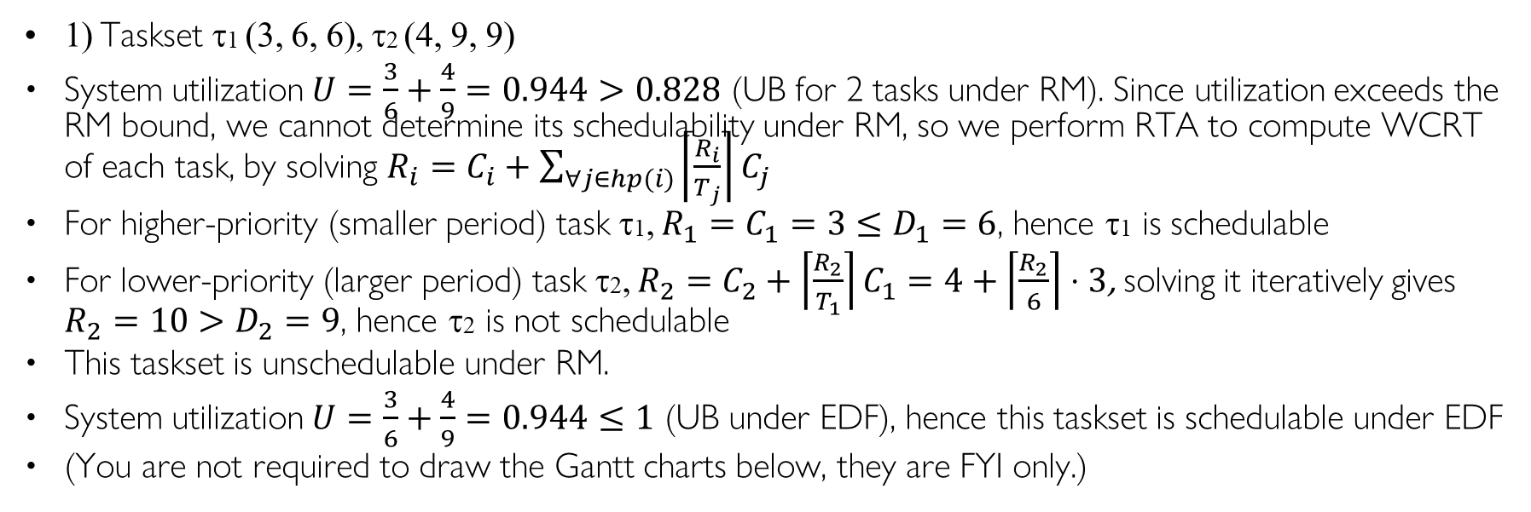
Q1. Schedulability under RM or EDF ANS
1) Taskset τ1 (3, 6, 6), τ2 (4, 9, 9)
System utilization $U=\frac{3}{6}+\frac{4}{9}=0.944>0.828$ (UB for 2 tasks under RM). Since utilization exceeds the RM bound, we cannot determine its schedulability under RM, so we perform RTA to compute WCRT of each task, by solving $R_{i}=C_{i}+\sum_{∀j∈hp(i)}{\left\lceil \frac{R_{i}}{T_{j}}\right\rceil C_{j}}$
For higher-priority (smaller period) task τ1, $R_{1}=C_{1}=3≤D_{1}=6$, hence τ1 is schedulable
For lower-priority (larger period) task τ2, $R_{2}=C_{2}+\left\lceil \frac{R_{2}}{T_{1}}\right\rceil C_{1}=4+\left\lceil \frac{R_{2}}{6}\right\rceil ⋅3$, solving it iteratively gives $R_{2}=10>D_{2}=9$, hence τ2 is not schedulable
This taskset is unschedulable under RM.
System utilization $U=\frac{3}{6}+\frac{4}{9}=0.944≤1$ (UB under EDF), hence this taskset is schedulable under EDF
(You are not required to draw the Gantt charts below, they are FYI only.)
τ1
τ1
0
3
6
9
12
15
18
0
3
6
9
12
15
18
τ2
τ2
0
3
6
9
12
15
18
0
3
6
9
12
15
18
deadline miss
Gantt chart for RM
Gantt chart for EDF

Slide 4
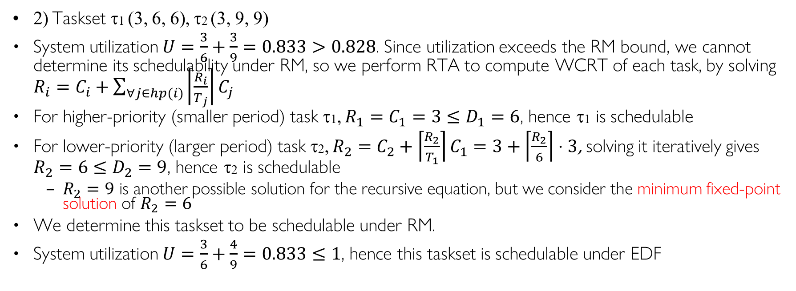
Q1. Schedulability under RM or EDF ANS
2) Taskset τ1 (3, 6, 6), τ2 (3, 9, 9)
System utilization $U=\frac{3}{6}+\frac{3}{9}=0.833>0.828$. Since utilization exceeds the RM bound, we cannot determine its schedulability under RM, so we perform RTA to compute WCRT of each task, by solving $R_{i}=C_{i}+\sum_{∀j∈hp(i)}{\left\lceil \frac{R_{i}}{T_{j}}\right\rceil C_{j}}$
For higher-priority (smaller period) task τ1, $R_{1}=C_{1}=3≤D_{1}=6$, hence τ1 is schedulable
For lower-priority (larger period) task τ2, $R_{2}=C_{2}+\left\lceil \frac{R_{2}}{T_{1}}\right\rceil C_{1}=3+\left\lceil \frac{R_{2}}{6}\right\rceil ⋅3$, solving it iteratively gives $R_{2}=6≤D_{2}=9$, hence τ2 is schedulable
  $R_{2}=9$ is another possible solution for the recursive equation, but we consider the minimum fixed-point solution of $R_{2}=6$
We determine this taskset to be schedulable under RM.
System utilization $U=\frac{3}{6}+\frac{4}{9}=0.833≤1$, hence this taskset is schedulable under EDF
τ1
τ1
0
3
6
9
12
15
18
0
3
6
9
12
15
18
τ2
τ2
0
3
6
9
12
15
18
0
3
6
9
12
15
18
Gantt chart for RM
Gantt chart for EDF (same as RM)

Slide 5
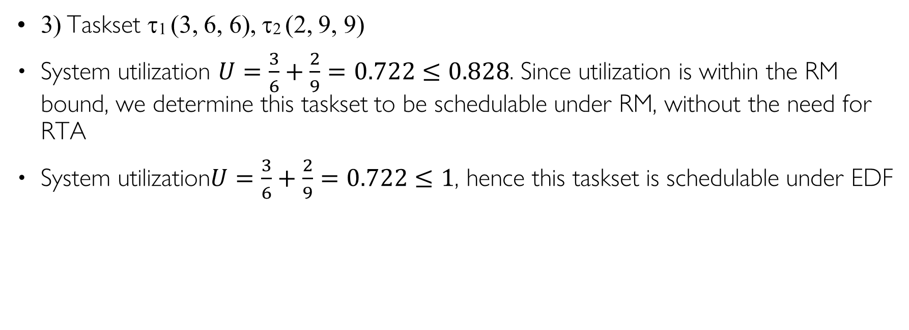
Q1. Schedulability under RM or EDF ANS
3) Taskset τ1 (3, 6, 6), τ2 (2, 9, 9)
System utilization $U=\frac{3}{6}+\frac{2}{9}=0.722≤0.828$. Since utilization is within the RM bound, we determine this taskset to be schedulable under RM, without the need for RTA
System utilization$U=\frac{3}{6}+\frac{2}{9}=0.722≤1$, hence this taskset is schedulable under EDF
τ1
τ1
0
3
6
9
12
15
18
0
3
6
9
12
15
18
τ2
τ2
0
3
6
9
12
15
18
0
3
6
9
12
15
18
Gantt chart for RM
Gantt chart for EDF (same as RM)

Slide 6
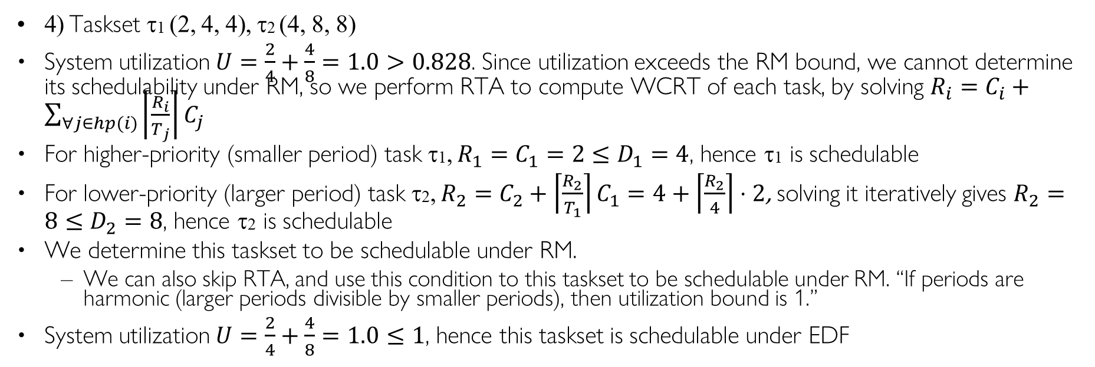
Q1. Schedulability under RM or EDF ANS
4) Taskset τ1 (2, 4, 4), τ2 (4, 8, 8)
System utilization $U=\frac{2}{4}+\frac{4}{8}=1.0>0.828$. Since utilization exceeds the RM bound, we cannot determine its schedulability under RM, so we perform RTA to compute WCRT of each task, by solving $R_{i}=C_{i}+\sum_{∀j∈hp(i)}{\left\lceil \frac{R_{i}}{T_{j}}\right\rceil C_{j}}$
For higher-priority (smaller period) task τ1, $R_{1}=C_{1}=2≤D_{1}=4$, hence τ1 is schedulable
For lower-priority (larger period) task τ2, $R_{2}=C_{2}+\left\lceil \frac{R_{2}}{T_{1}}\right\rceil C_{1}=4+\left\lceil \frac{R_{2}}{4}\right\rceil ⋅2$, solving it iteratively gives $R_{2}=8≤D_{2}=8$, hence τ2 is schedulable
We determine this taskset to be schedulable under RM.
  We can also skip RTA, and use this condition to this taskset to be schedulable under RM. “If periods are harmonic (larger periods divisible by smaller periods), then utilization bound is 1.”
System utilization $U=\frac{2}{4}+\frac{4}{8}=1.0≤1$, hence this taskset is schedulable under EDF
τ1
τ1
0
4
8
12
16
0
4
8
12
16
τ2
τ2
0
4
8
12
16
0
4
8
12
16
Gantt chart for RM
Gantt chart for EDF (same as RM)

Slide 7
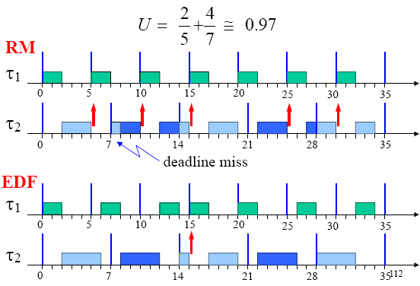
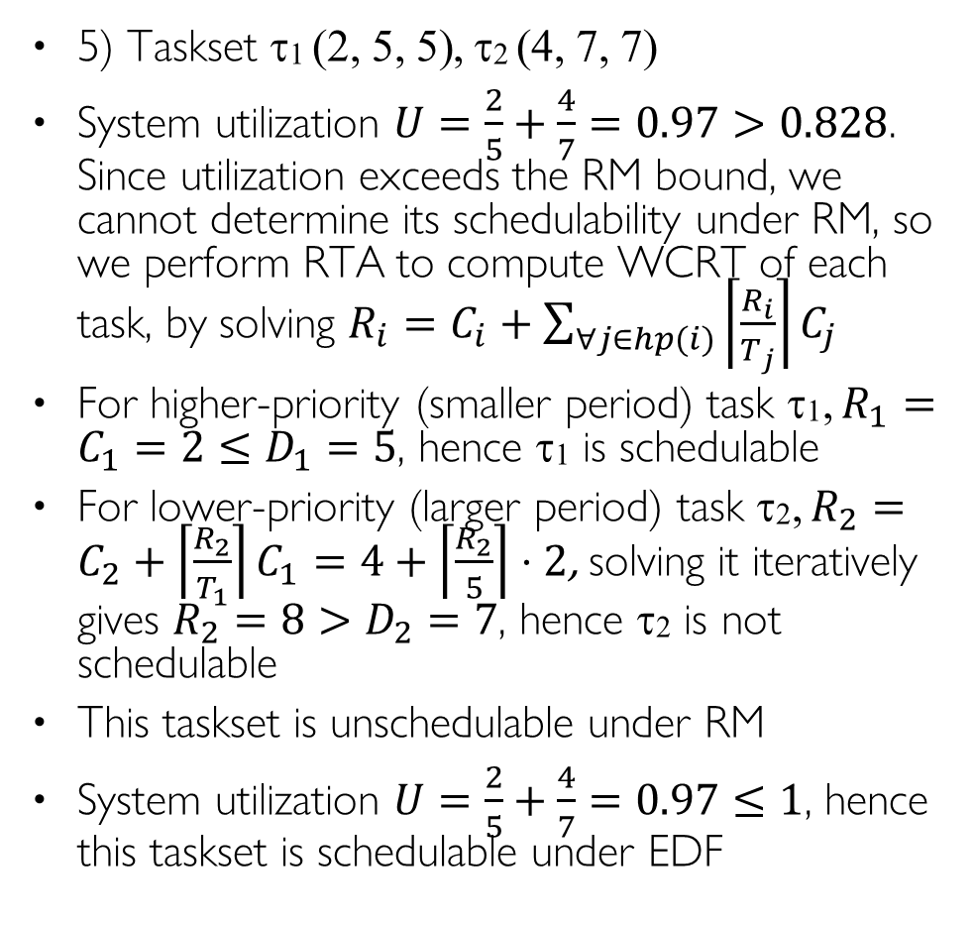
Q1. Schedulability under RM or EDF ANS
5) Taskset τ1 (2, 5, 5), τ2 (4, 7, 7)
System utilization $U=\frac{2}{5}+\frac{4}{7}=0.97>0.828$. Since utilization exceeds the RM bound, we cannot determine its schedulability under RM, so we perform RTA to compute WCRT of each task, by solving $R_{i}=C_{i}+\sum_{∀j∈hp(i)}{\left\lceil \frac{R_{i}}{T_{j}}\right\rceil C_{j}}$
For higher-priority (smaller period) task τ1, $R_{1}=C_{1}=2≤D_{1}=5$, hence τ1 is schedulable
For lower-priority (larger period) task τ2, $R_{2}=C_{2}+\left\lceil \frac{R_{2}}{T_{1}}\right\rceil C_{1}=4+\left\lceil \frac{R_{2}}{5}\right\rceil ⋅2$, solving it iteratively gives $R_{2}=8>D_{2}=7$, hence τ2 is not schedulable
This taskset is unschedulable under RM
System utilization $U=\frac{2}{5}+\frac{4}{7}=0.97≤1$, hence this taskset is schedulable under EDF
>
>
>
>
>
>
>
priority
>
>
>
>
>
>
>
>
>
=
priority
Red arrows indicate preemption

Slide 8
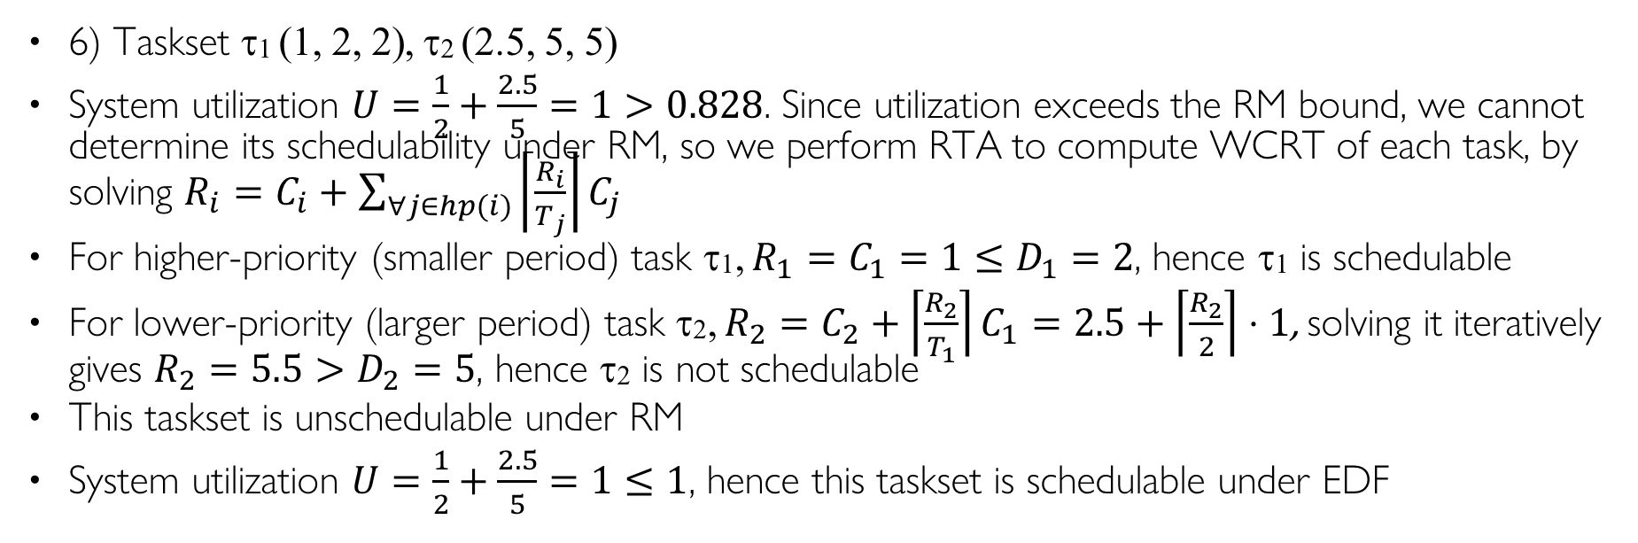
Q1. Schedulability under RM or EDF ANS
6) Taskset τ1 (1, 2, 2), τ2 (2.5, 5, 5)
System utilization $U=\frac{1}{2}+\frac{2.5}{5}=1>0.828$. Since utilization exceeds the RM bound, we cannot determine its schedulability under RM, so we perform RTA to compute WCRT of each task, by solving $R_{i}=C_{i}+\sum_{∀j∈hp(i)}{\left\lceil \frac{R_{i}}{T_{j}}\right\rceil C_{j}}$
For higher-priority (smaller period) task τ1, $R_{1}=C_{1}=1≤D_{1}=2$, hence τ1 is schedulable
For lower-priority (larger period) task τ2, $R_{2}=C_{2}+\left\lceil \frac{R_{2}}{T_{1}}\right\rceil C_{1}=2.5+\left\lceil \frac{R_{2}}{2}\right\rceil ⋅1$, solving it iteratively gives $R_{2}=5.5>D_{2}=5$, hence τ2 is not schedulable
This taskset is unschedulable under RM
System utilization $U=\frac{1}{2}+\frac{2.5}{5}=1≤1$, hence this taskset is schedulable under EDF
τ1
τ1
0
2
4
6
8
10
0
2
4
6
8
10
τ2
τ2
0
2
4
5
6
8
10
0
2
4
5
6
8
10
Gantt chart for RM
deadline miss
Gantt chart for EDF

Slide 9
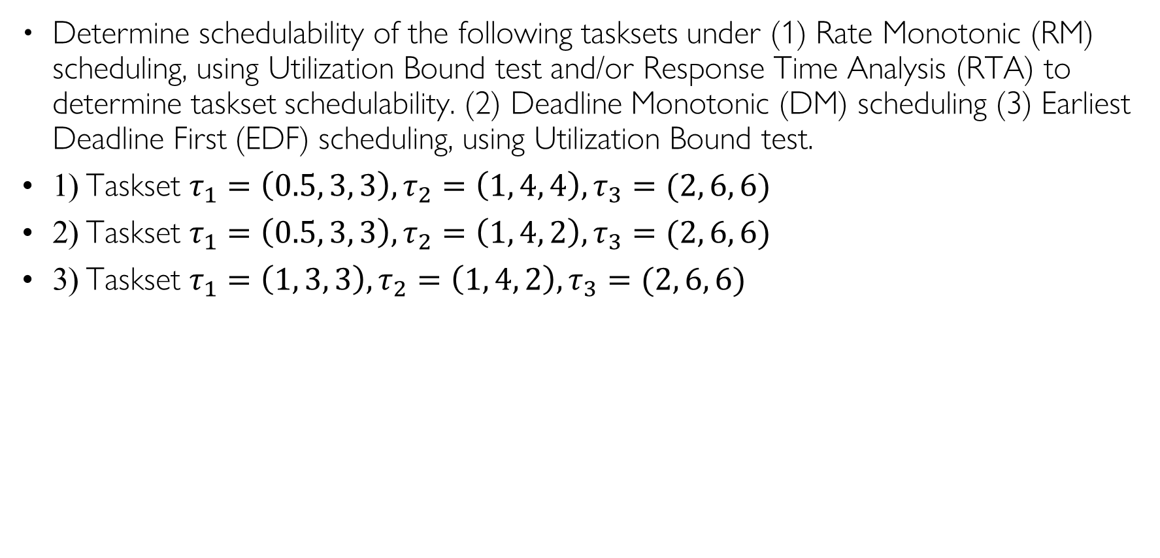
Q2. Schedulability under RM, DM, or EDF
Determine schedulability of the following tasksets under (1) Rate Monotonic (RM) scheduling, using Utilization Bound test and/or Response Time Analysis (RTA) to determine taskset schedulability. (2) Deadline Monotonic (DM) scheduling (3) Earliest Deadline First (EDF) scheduling, using Utilization Bound test.
1) Taskset $τ_{1}=\left(0.5, 3, 3\right), τ_{2}=\left(1, 4, 4\right), τ_{3}=(2, 6, 6)$
2) Taskset $τ_{1}=\left(0.5, 3, 3\right), τ_{2}=\left(1, 4, 2\right), τ_{3}=(2, 6, 6)$
3) Taskset $τ_{1}=\left(1, 3, 3\right), τ_{2}=\left(1, 4, 2\right), τ_{3}=(2, 6, 6)$

Slide 10
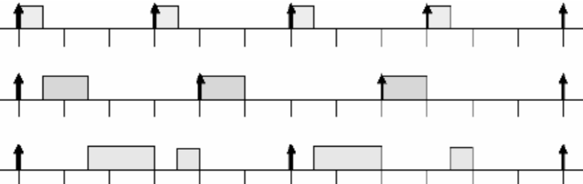
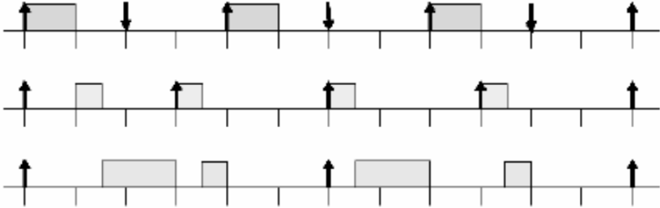


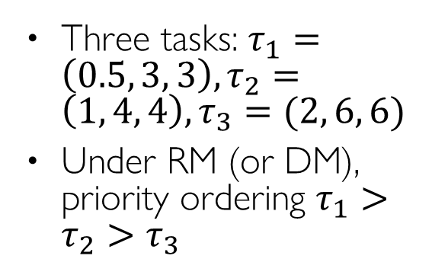


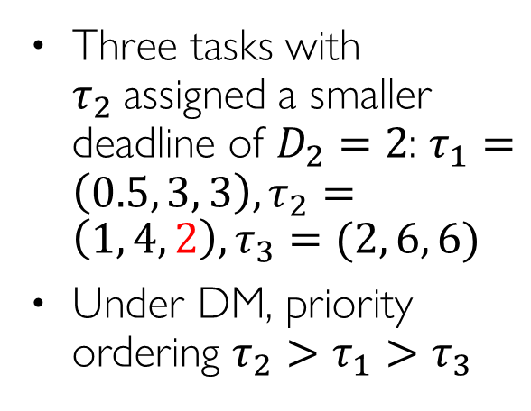


Recall: RM vs. DM Example
Three tasks: $τ_{1}=\left(0.5, 3, 3\right), τ_{2}=\left(1, 4, 4\right), τ_{3}=(2, 6, 6)$
Under RM (or DM), priority ordering $τ_{1}>τ_{2}>τ_{3}$
$$τ_{1}$$
$$τ_{2}$$
$$τ_{3}$$
0
3
6
9
12
Three tasks with $τ_{2}$assigned a smaller deadline of $D_{2}=2$: $τ_{1}=\left(0.5, 3, 3\right), τ_{2}=\left(1, 4, 2\right), τ_{3}=(2, 6, 6)$
Under DM, priority ordering $τ_{2}>τ_{1}>τ_{3}$
$$τ_{2}$$
$$τ_{1}$$
$$τ_{3}$$
0
3
6
9
12

Slide 11
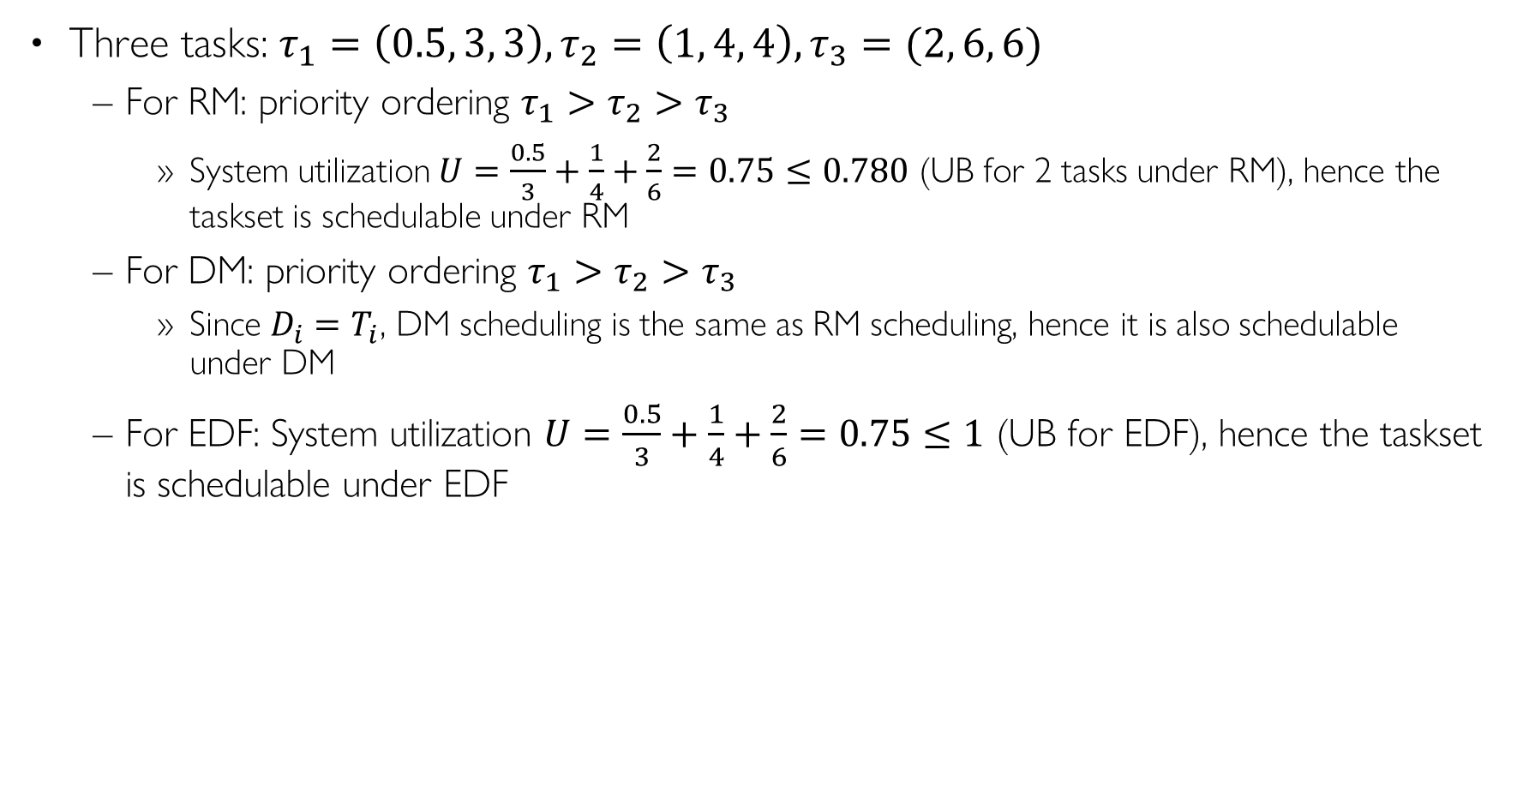
Q2. Schedulability under RM, DM, or EDF ANS
Three tasks: $τ_{1}=\left(0.5, 3, 3\right), τ_{2}=\left(1, 4, 4\right), τ_{3}=(2, 6, 6)$
  For RM: priority ordering $τ_{1}>τ_{2}>τ_{3}$
    System utilization $U=\frac{0.5}{3}+\frac{1}{4}+\frac{2}{6}=0.75≤0.780$ (UB for 2 tasks under RM), hence the taskset is schedulable under RM
  For DM: priority ordering $τ_{1}>τ_{2}>τ_{3}$
    Since $D_{i}=T_{i}$, DM scheduling is the same as RM scheduling, hence it is also schedulable under DM
  For EDF: System utilization $U=\frac{0.5}{3}+\frac{1}{4}+\frac{2}{6}=0.75≤1$ (UB for EDF), hence the taskset is schedulable under EDF
Notes:
0.5/3+1/4+2/6=
R3=2+ceil(R3/3)0.5+ceil(R3/4)1=4

Slide 12
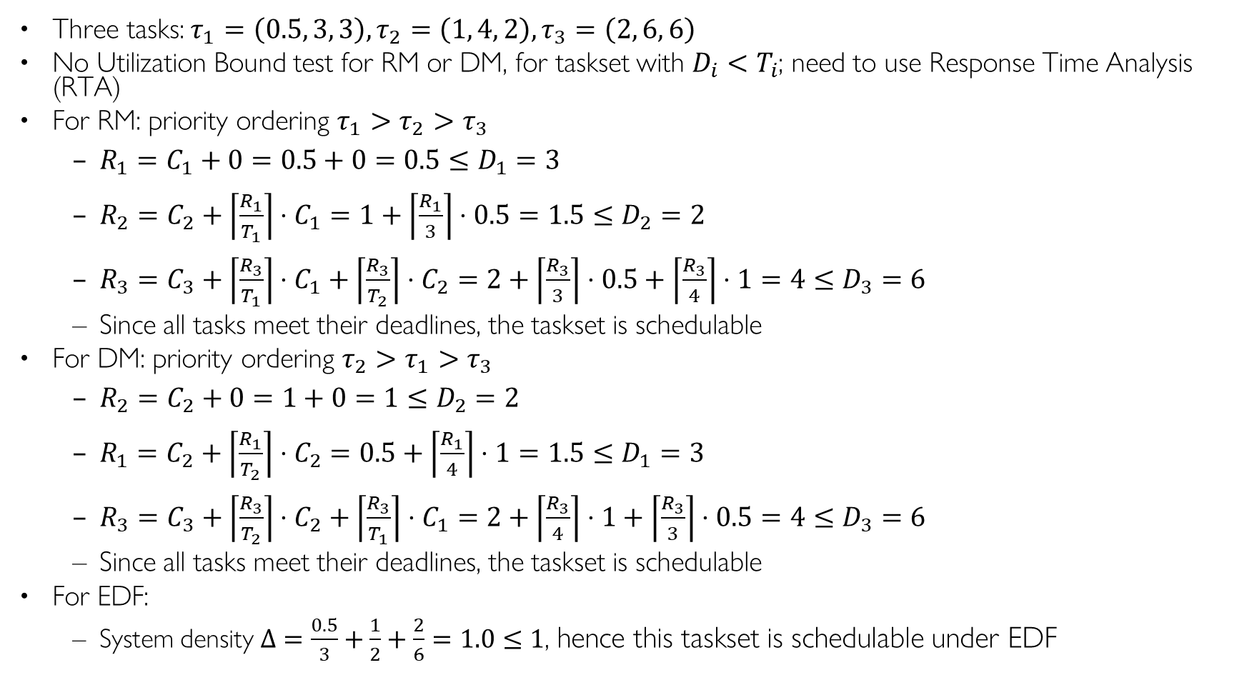
Q2. Schedulability under RM, DM, or EDF ANS
Three tasks: $τ_{1}=\left(0.5, 3, 3\right), τ_{2}=\left(1, 4, 2\right), τ_{3}=\left(2, 6, 6\right)$
No Utilization Bound test for RM or DM, for taskset with $D_{i}<T_{i}$; need to use Response Time Analysis (RTA)
For RM: priority ordering $τ_{1}>τ_{2}>τ_{3}$
  $R_{1}=C_{1}+0=0.5+0=0.5≤D_{1}=3$
  $R_{2}=C_{2}+\left\lceil \frac{R_{1}}{T_{1}}\right\rceil ⋅C_{1}=1+\left\lceil \frac{R_{1}}{3}\right\rceil ⋅0.5=1.5≤D_{2}=2$
  $R_{3}=C_{3}+\left\lceil \frac{R_{3}}{T_{1}}\right\rceil ⋅C_{1}+\left\lceil \frac{R_{3}}{T_{2}}\right\rceil ⋅C_{2}=2+\left\lceil \frac{R_{3}}{3}\right\rceil ⋅0.5+\left\lceil \frac{R_{3}}{4}\right\rceil ⋅1=4≤D_{3}=6$
  Since all tasks meet their deadlines, the taskset is schedulable
For DM: priority ordering $τ_{2}>τ_{1}>τ_{3}$
  $R_{2}=C_{2}+0=1+0=1≤D_{2}=2$
  $R_{1}=C_{2}+\left\lceil \frac{R_{1}}{T_{2}}\right\rceil ⋅C_{2}=0.5+\left\lceil \frac{R_{1}}{4}\right\rceil ⋅1=1.5≤D_{1}=3$
  $R_{3}=C_{3}+\left\lceil \frac{R_{3}}{T_{2}}\right\rceil ⋅C_{2}+\left\lceil \frac{R_{3}}{T_{1}}\right\rceil ⋅C_{1}=2+\left\lceil \frac{R_{3}}{4}\right\rceil ⋅1+\left\lceil \frac{R_{3}}{3}\right\rceil ⋅0.5=4≤D_{3}=6$
  Since all tasks meet their deadlines, the taskset is schedulable
For EDF:
  System density $Δ=\frac{0.5}{3}+\frac{1}{2}+\frac{2}{6}=1.0≤1$, hence this taskset is schedulable under EDF
Notes:
1/3+1/4+2/6=
1/3+1/2+2/6=
0.5/3+1/2+2/6=
No utilization bound test; need to use Response Time Analysis (RTA)
Under RM, priority ordering $τ_{1}>τ_{2}>τ_{3}$
Under RM, priority ordering $τ_{2}>τ_{1}>τ_{3}$

Slide 13
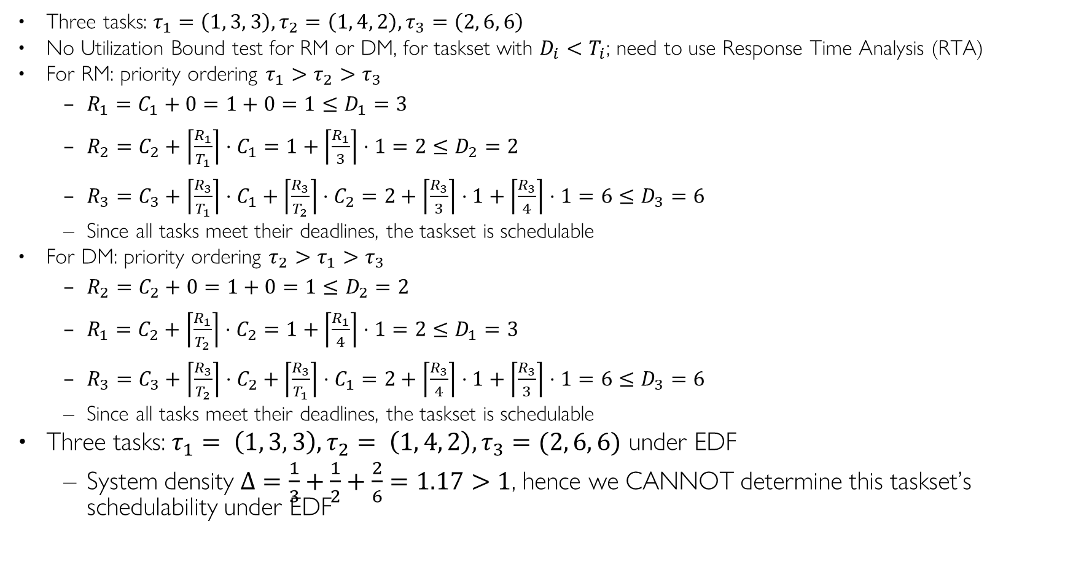
Q2. Schedulability under RM, DM, or EDF ANS
Three tasks: $τ_{1}=\left(1, 3, 3\right), τ_{2}=\left(1, 4, 2\right), τ_{3}=\left(2, 6, 6\right)$
No Utilization Bound test for RM or DM, for taskset with $D_{i}<T_{i}$; need to use Response Time Analysis (RTA)
For RM: priority ordering $τ_{1}>τ_{2}>τ_{3}$
  $R_{1}=C_{1}+0=1+0=1≤D_{1}=3$
  $R_{2}=C_{2}+\left\lceil \frac{R_{1}}{T_{1}}\right\rceil ⋅C_{1}=1+\left\lceil \frac{R_{1}}{3}\right\rceil ⋅1=2≤D_{2}=2$
  $R_{3}=C_{3}+\left\lceil \frac{R_{3}}{T_{1}}\right\rceil ⋅C_{1}+\left\lceil \frac{R_{3}}{T_{2}}\right\rceil ⋅C_{2}=2+\left\lceil \frac{R_{3}}{3}\right\rceil ⋅1+\left\lceil \frac{R_{3}}{4}\right\rceil ⋅1=6≤D_{3}=6$
  Since all tasks meet their deadlines, the taskset is schedulable
For DM: priority ordering $τ_{2}>τ_{1}>τ_{3}$
  $R_{2}=C_{2}+0=1+0=1≤D_{2}=2$
  $R_{1}=C_{2}+\left\lceil \frac{R_{1}}{T_{2}}\right\rceil ⋅C_{2}=1+\left\lceil \frac{R_{1}}{4}\right\rceil ⋅1=2≤D_{1}=3$
  $R_{3}=C_{3}+\left\lceil \frac{R_{3}}{T_{2}}\right\rceil ⋅C_{2}+\left\lceil \frac{R_{3}}{T_{1}}\right\rceil ⋅C_{1}=2+\left\lceil \frac{R_{3}}{4}\right\rceil ⋅1+\left\lceil \frac{R_{3}}{3}\right\rceil ⋅1=6≤D_{3}=6$
  Since all tasks meet their deadlines, the taskset is schedulable
Three tasks: $τ_{1}= \left(1, 3, 3\right), τ_{2}= \left(1, 4, 2\right), τ_{3}=(2, 6, 6)$ under EDF
  System density $Δ=\frac{1}{3}+\frac{1}{2}+\frac{2}{6}=1.17>1$, hence we CANNOT determine this taskset’s schedulability under EDF
Notes:
1/3+1/4+2/6=
1/3+1/2+2/6=
0.5/3+1/2+2/6=
Under RM, priority ordering $τ_{1}>τ_{2}>τ_{3}$
Under RM, priority ordering $τ_{2}>τ_{1}>τ_{3}$

Slide 14
Q3 RM, EDF, LLF
Consider the set of 2 periodic tasks whose period, deadline and WCET parameters are given.
1. For each scheduling algorithm (RM, EDF, LLF), draw the Gantt chart by filling in the table with the task ID that runs in each time slot until time 10, and calculate the WCRT for each task.
2. Under RM scheduling, use utilization bound and Response Time Analysis (RTA) to determine taskset schedulability.
Time | τ₁ Laxity | τ₂ Laxity | Running Task
t=0
t=1
t=2
t=3
t=4
t=5
t=6
t=7
t=8
T=9
Task ID | T=D | C | RM Resp. Time | EDF Resp. Time | LLF Resp. Time
1 | 8 | 3
2 | 10 | 4
RM
EDF
LLF
Time | 0 | 1 | 2 | 3 | 4 | 5 | 6 | 7 | 8 | 9 | 10
Gantt Chart

Slide 15
Q3 RM, EDF, LLF ANS
Consider the set of 2 periodic tasks whose period, deadline and WCET parameters are given.
1. For each scheduling algorithm (RM, EDF, LLF), draw the Gantt chart by filling in the table with the task ID that runs in each time slot until time 10, and calculate the WCRT for each task.
2. Under RM scheduling, determine taskset schedulability using utilization bound and/or Response Time Analysis (RTA) to
Time | τ₁ Laxity | τ₂ Laxity | Running Task
t=0 | 8-0-3=5 | 10-0-4=6 | 1
t=1 | 8-1-2=5 | 10-1-4=5 | 1 (tie)
t=2 | 8-2-1=5 | 10-2-4=4 | 2
t=3 | 8-3-1=4 | 10-3-3=4 | 2 (tie)
t=4 | 8-4-1=3 | 10-4-2=4 | 1
t=5 | T1 done | 10-5-2=3 | 2
t=6 | T1 done | 10-6-1=3 | 2
t=7 | T1 done | T2 done | X
t=8 | 16-8-3=5 | T2 done | 1
T=9 | 16-9-2=5 | T2 done | 1
Task ID | T=D | C | RM Resp. Time | EDF Resp. Time | LLF Resp. Time
1 | 8 | 3 | 3 | 3 | 5
2 | 10 | 4 | 7 | 7 | 7
RM | 1 | 1 | 1 | 2 | 2 | 2 | 2 | X | 1 | 1
EDF | 1 | 1 | 1 | 2 | 2 | 2 | 2 | X | 1 | 1
LLF | 1 | 1 | 2 | 2 | 1 | 2 | 2 | X | 1 | 1
Time | 0 | 1 | 2 | 3 | 4 | 5 | 6 | 7 | 8 | 9 | 10
Gantt Chart

Slide 16
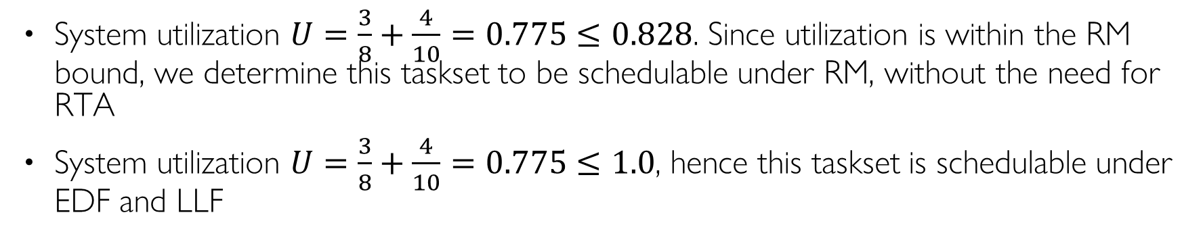
Q3 RM, EDF, LLF ANS
System utilization $U=\frac{3}{8}+\frac{4}{10}=0.775≤0.828$. Since utilization is within the RM bound, we determine this taskset to be schedulable under RM, without the need for RTA
System utilization $U=\frac{3}{8}+\frac{4}{10}=0.775≤1.0$, hence this taskset is schedulable under EDF and LLF

Slide 17
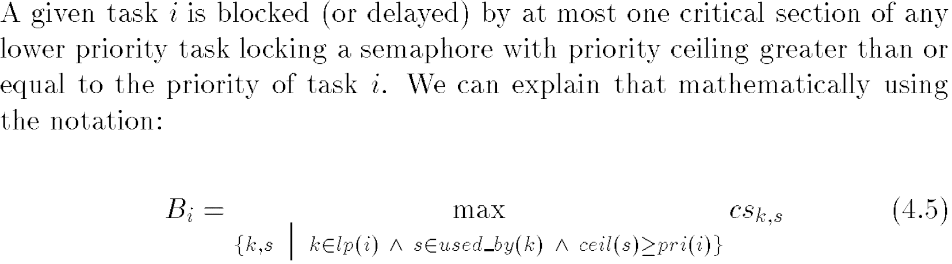
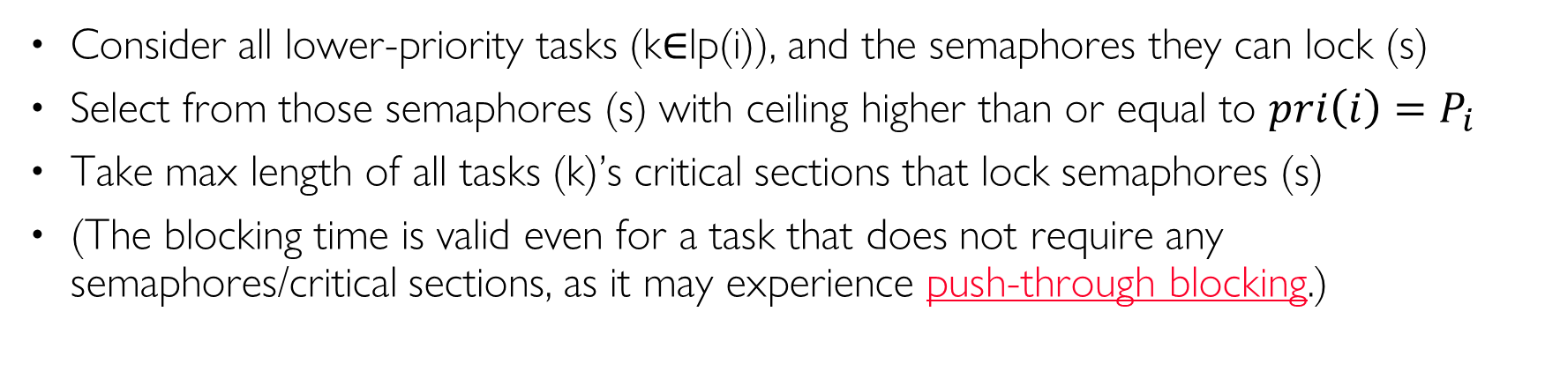
Recall: PCP Blocking Time
Consider all lower-priority tasks (k$∈$lp(i)), and the semaphores they can lock (s)
Select from those semaphores (s) with ceiling higher than or equal to ${pri\left(i\right)=P}_{i}$
Take max length of all tasks (k)’s critical sections that lock semaphores (s)
(The blocking time is valid even for a task that does not require any semaphores/critical sections, as it may experience push-through blocking.)
Notes:
. Blocking delay is MAX length of critical sections of all lower-priority tasks (vs. SUM for PIP)

Slide 18
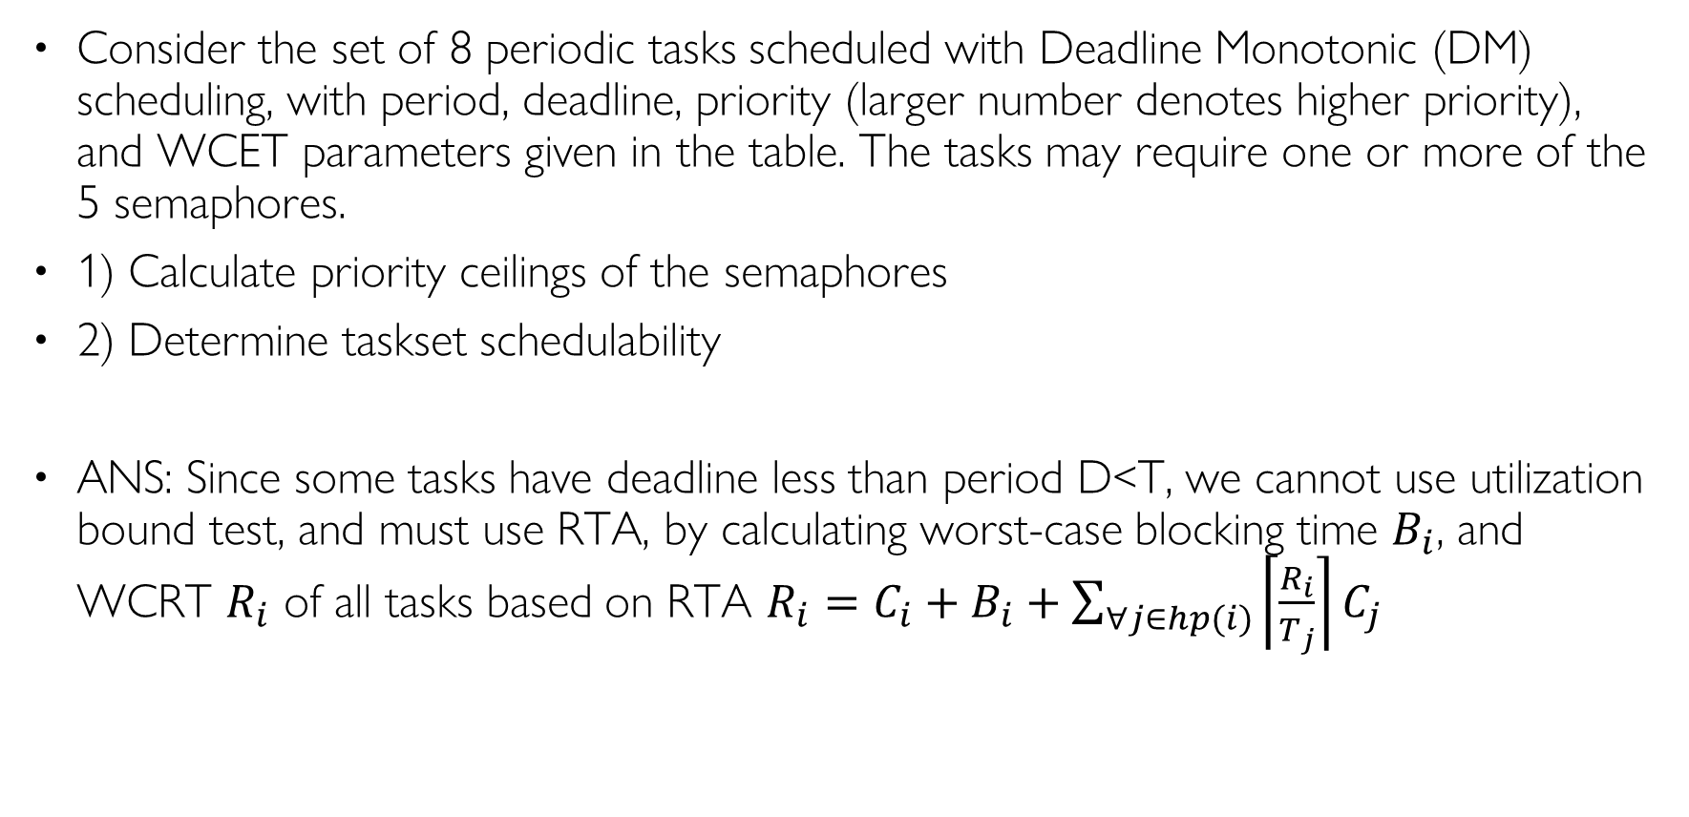
Q5. Schedulability with Shared Resources
Consider the set of 8 periodic tasks scheduled with Deadline Monotonic (DM) scheduling, with period, deadline, priority (larger number denotes higher priority), and WCET parameters given in the table. The tasks may require one or more of the 5 semaphores.
1) Calculate priority ceilings of the semaphores
2) Determine taskset schedulability
ANS: Since some tasks have deadline less than period D<T, we cannot use utilization bound test, and must use RTA, by calculating worst-case blocking time $B_{i}$, and WCRT $R_{i}$ of all tasks based on RTA $R_{i}=C_{i}+B_{i}+\sum_{∀j∈hp(i)}{\left\lceil \frac{R_{i}}{T_{j}}\right\rceil C_{j}}$

Slide 19
Q5. Schedulability with Shared Resources
Task | T | D | C | Prio | sems | CS Len | B | R
A | 250 | 50 | 14 | 8 | s₄ | 1 | 3 | 17
B | 500 | 200 | 50 | 7 | s₃ | 4 | 4 | 68
C | 800 | 400 | 90 | 6 | / | / | 4 | 158
D | 800 | 800 | 20 | 5 | s_{1,}s_{2,}s₄ | 9,3,3 | 13 | 187
E | 1000 | 1000 | 50 | 4 | s₃ | 4 | 13 | 237
F | 2000 | 2000 | 10 | 3 | s₅ | 7 | 13 | 247
G | 2000 | 2000 | 10 | 2 | / | / | 13 | 271
H | 2000 | 2000 | 30 | 1 | s_{2,}s₅ | 13,7 | 0 | 288
sem | Ceiling
s₁
s₂
s₃
s₄
s₅

Slide 20
Q5. Schedulability with Shared Resources ANS
Task | T | D | C | Prio | sems | CS Len | B | R
A | 250 | 50 | 14 | 8 | s₄ | 1 | 3 | 17
B | 500 | 200 | 50 | 7 | s₃ | 4 | 4 | 68
C | 800 | 400 | 90 | 6 | / | / | 4 | 158
D | 800 | 800 | 20 | 5 | s_{1,}s_{2,}s₄ | 9,3,3 | 13 | 187
E | 1000 | 1000 | 50 | 4 | s₃ | 4 | 13 | 237
F | 2000 | 2000 | 10 | 3 | s₅ | 7 | 13 | 247
G | 2000 | 2000 | 10 | 2 | / | / | 13 | 271
H | 2000 | 2000 | 30 | 1 | s_{2,}s₅ | 13,7 | 0 | 288
sem | Ceiling
s₁ | 5
s₂ | 5
s₃ | 7
s₄ | 8
s₅ | 3

Slide 21

Q5. Schedulability with Shared Resources ANS
Each semaphore is assigned a ceiling, equal to maximum priority of all tasks that require it: $C\left(s_{k}\right)=\max{\{P_{j}:τ_{j} uses s_{k}\}}$. Hence we can fill in the semaphore ceiling table.
sem | Ceiling
s₁ | 5
s₂ | 5
s₃ | 7
s₄ | 8
s₅ | 3
Notes:
20+13+14+50+90

Slide 22
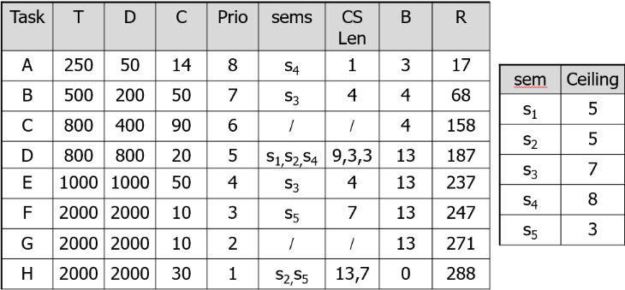
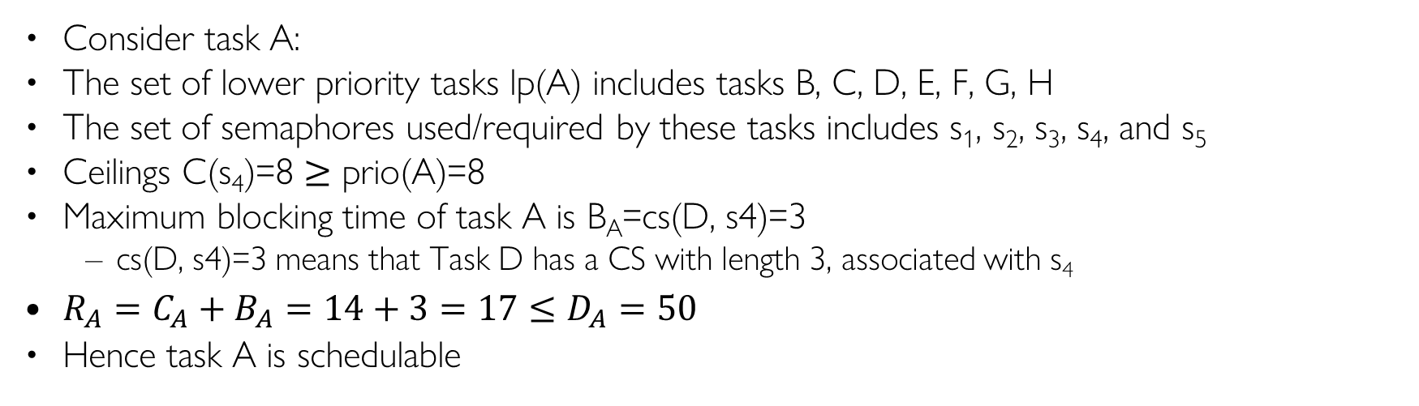
Q5. Task A
Consider task A:
The set of lower priority tasks lp(A) includes tasks B, C, D, E, F, G, H
The set of semaphores used/required by these tasks includes s₁, s₂, s₃, s₄, and s₅
Ceilings C(s₄)=8 ≥ prio(A)=8
Maximum blocking time of task A is B_{A}=cs(D, s4)=3
  cs(D, s4)=3 means that Task D has a CS with length 3, associated with s₄
$R_{A}=C_{A}+B_{A}=14+3=17≤D_{A}=50$
Hence task A is schedulable
Notes:
94 + 14 + 50

Slide 23
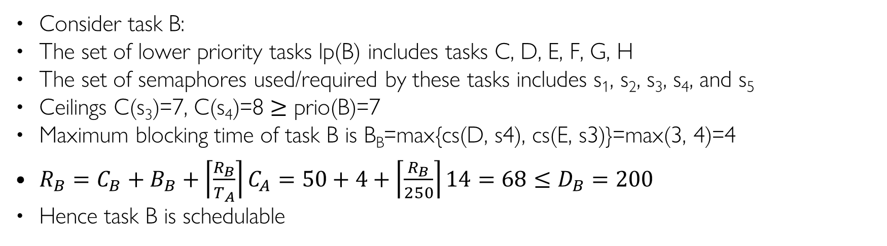
Q5. Task B
Consider task B:
The set of lower priority tasks lp(B) includes tasks C, D, E, F, G, H
The set of semaphores used/required by these tasks includes s₁, s₂, s₃, s₄, and s₅
Ceilings C(s₃)=7, C(s₄)=8 ≥ prio(B)=7
Maximum blocking time of task B is B_{B}=max{cs(D, s4), cs(E, s3)}=max(3, 4)=4
$R_{B}=C_{B}+B_{B}+\left\lceil \frac{R_{B}}{T_{A}}\right\rceil C_{A}=50+4+\left\lceil \frac{R_{B}}{250}\right\rceil 14=68≤D_{B}=200$
Hence task B is schedulable
Notes:
94 + 14 + 50

Slide 24
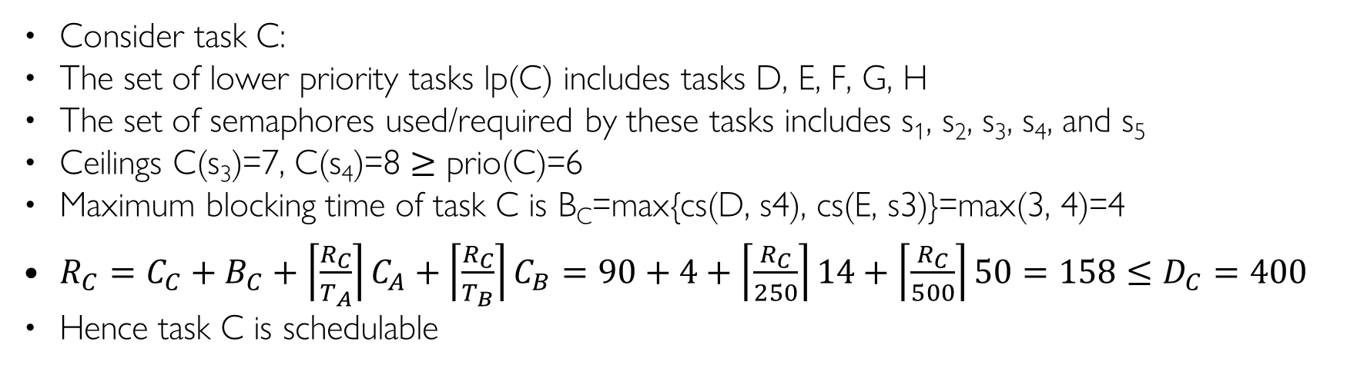
Q5. Task C
Consider task C:
The set of lower priority tasks lp(C) includes tasks D, E, F, G, H
The set of semaphores used/required by these tasks includes s₁, s₂, s₃, s₄, and s₅
Ceilings C(s₃)=7, C(s₄)=8 ≥ prio(C)=6
Maximum blocking time of task C is B_{C}=max{cs(D, s4), cs(E, s3)}=max(3, 4)=4
$R_{C}=C_{C}+B_{C}+\left\lceil \frac{R_{C}}{T_{A}}\right\rceil C_{A}+\left\lceil \frac{R_{C}}{T_{B}}\right\rceil C_{B}=90+4+\left\lceil \frac{R_{C}}{250}\right\rceil 14+\left\lceil \frac{R_{C}}{500}\right\rceil 50=158≤D_{C}=400$
Hence task C is schedulable
Notes:
94 + 14 + 50

Slide 25
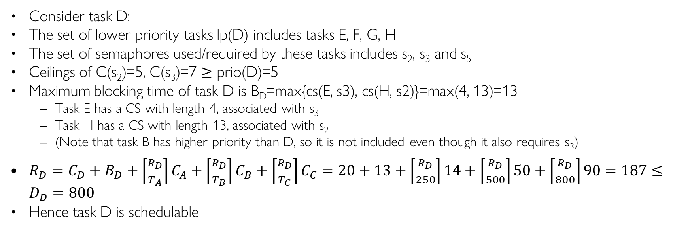
Q5. Task D
Consider task D:
The set of lower priority tasks lp(D) includes tasks E, F, G, H
The set of semaphores used/required by these tasks includes s₂, s₃ and s₅
Ceilings of C(s₂)=5, C(s₃)=7 ≥ prio(D)=5
Maximum blocking time of task D is B_{D}=max{cs(E, s3), cs(H, s2)}=max(4, 13)=13
  Task E has a CS with length 4, associated with s₃
  Task H has a CS with length 13, associated with s₂
  (Note that task B has higher priority than D, so it is not included even though it also requires s₃)
$R_{D}=C_{D}+B_{D}+\left\lceil \frac{R_{D}}{T_{A}}\right\rceil C_{A}+\left\lceil \frac{R_{D}}{T_{B}}\right\rceil C_{B}+\left\lceil \frac{R_{D}}{T_{C}}\right\rceil C_{C}=20+13+\left\lceil \frac{R_{D}}{250}\right\rceil 14+\left\lceil \frac{R_{D}}{500}\right\rceil 50+\left\lceil \frac{R_{D}}{800}\right\rceil 90=187≤D_{D}=800$
Hence task D is schedulable
Notes:
20+13+14+50+90

Slide 26
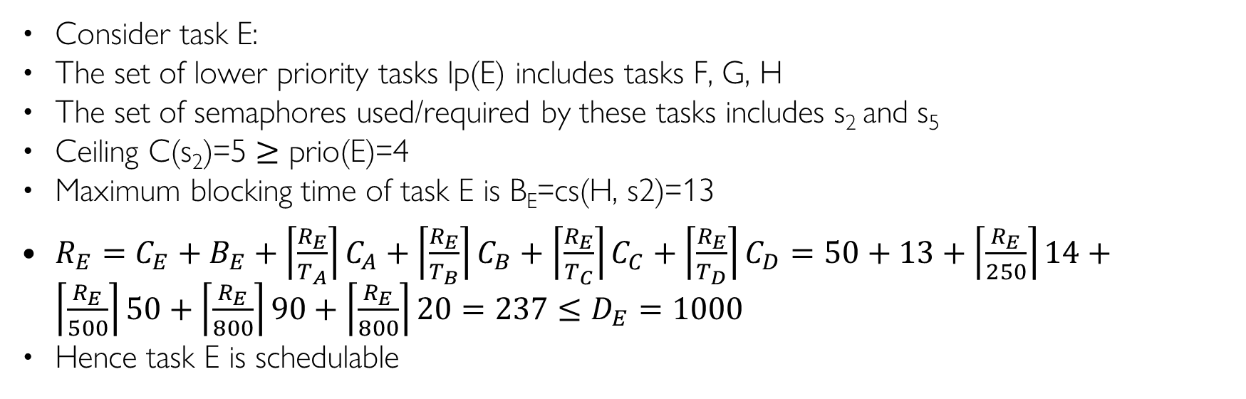
Q5. Task E
Consider task E:
The set of lower priority tasks lp(E) includes tasks F, G, H
The set of semaphores used/required by these tasks includes s₂ and s₅
Ceiling C(s₂)=5 ≥ prio(E)=4
Maximum blocking time of task E is B_{E}=cs(H, s2)=13
$R_{E}=C_{E}+B_{E}+\left\lceil \frac{R_{E}}{T_{A}}\right\rceil C_{A}+\left\lceil \frac{R_{E}}{T_{B}}\right\rceil C_{B}+\left\lceil \frac{R_{E}}{T_{C}}\right\rceil C_{C}+\left\lceil \frac{R_{E}}{T_{D}}\right\rceil C_{D}=50+13+\left\lceil \frac{R_{E}}{250}\right\rceil 14+\left\lceil \frac{R_{E}}{500}\right\rceil 50+\left\lceil \frac{R_{E}}{800}\right\rceil 90+\left\lceil \frac{R_{E}}{800}\right\rceil 20=237≤D_{E}=1000$
Hence task E is schedulable
Notes:
50+13+14+50+90+20

Slide 27
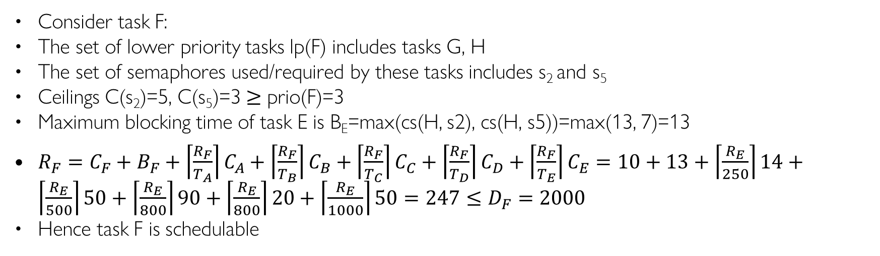
Q5. Task F
Consider task F:
The set of lower priority tasks lp(F) includes tasks G, H
The set of semaphores used/required by these tasks includes s₂ and s₅
Ceilings C(s₂)=5, C(s₅)=3 ≥ prio(F)=3
Maximum blocking time of task E is B_{E}=max(cs(H, s2), cs(H, s5))=max(13, 7)=13
$R_{F}=C_{F}+B_{F}+\left\lceil \frac{R_{F}}{T_{A}}\right\rceil C_{A}+\left\lceil \frac{R_{F}}{T_{B}}\right\rceil C_{B}+\left\lceil \frac{R_{F}}{T_{C}}\right\rceil C_{C}+\left\lceil \frac{R_{F}}{T_{D}}\right\rceil C_{D}+\left\lceil \frac{R_{F}}{T_{E}}\right\rceil C_{E}=10+13+\left\lceil \frac{R_{E}}{250}\right\rceil 14+\left\lceil \frac{R_{E}}{500}\right\rceil 50+\left\lceil \frac{R_{E}}{800}\right\rceil 90+\left\lceil \frac{R_{E}}{800}\right\rceil 20+\left\lceil \frac{R_{E}}{1000}\right\rceil 50=247≤D_{F}=2000$
Hence task F is schedulable
Notes:
10+13+14+50+90+20 +50

Slide 28
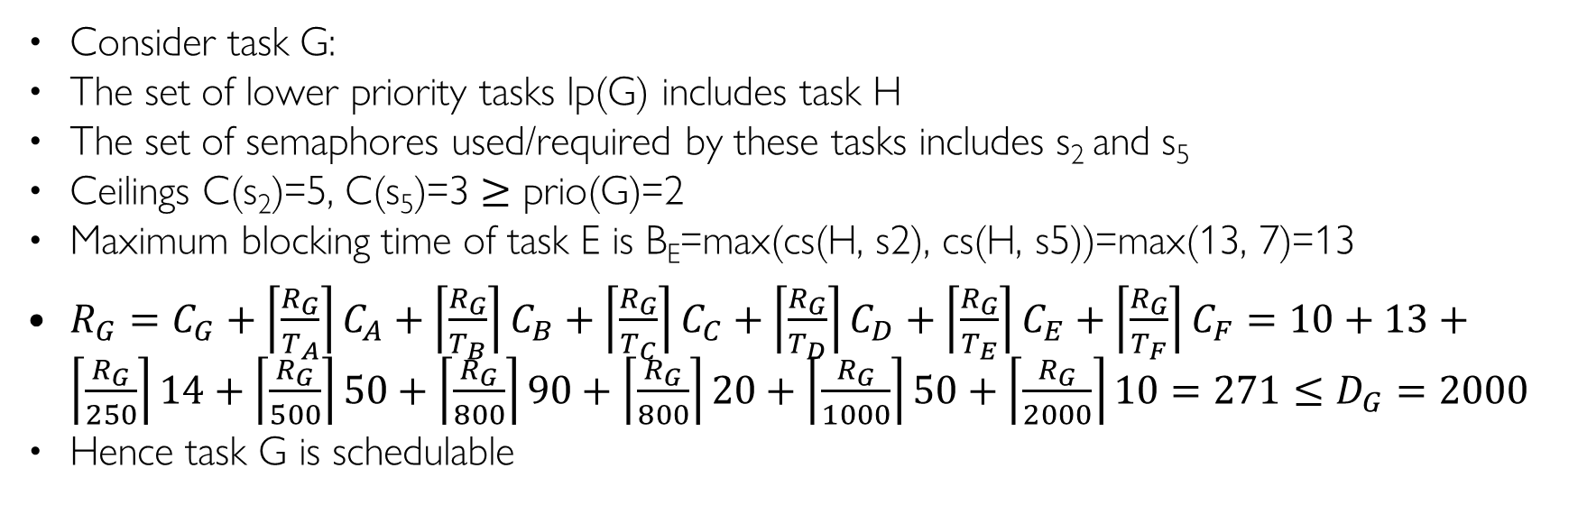
Q5. Task G
Consider task G:
The set of lower priority tasks lp(G) includes task H
The set of semaphores used/required by these tasks includes s₂ and s₅
Ceilings C(s₂)=5, C(s₅)=3 ≥ prio(G)=2
Maximum blocking time of task E is B_{E}=max(cs(H, s2), cs(H, s5))=max(13, 7)=13
$R_{G}=C_{G}+\left\lceil \frac{R_{G}}{T_{A}}\right\rceil C_{A}+\left\lceil \frac{R_{G}}{T_{B}}\right\rceil C_{B}+\left\lceil \frac{R_{G}}{T_{C}}\right\rceil C_{C}+\left\lceil \frac{R_{G}}{T_{D}}\right\rceil C_{D}+\left\lceil \frac{R_{G}}{T_{E}}\right\rceil C_{E}+\left\lceil \frac{R_{G}}{T_{F}}\right\rceil C_{F}=10+13+\left\lceil \frac{R_{G}}{250}\right\rceil 14+\left\lceil \frac{R_{G}}{500}\right\rceil 50+\left\lceil \frac{R_{G}}{800}\right\rceil 90+\left\lceil \frac{R_{G}}{800}\right\rceil 20+\left\lceil \frac{R_{G}}{1000}\right\rceil 50+\left\lceil \frac{R_{G}}{2000}\right\rceil 10=271≤D_{G}=2000$
Hence task G is schedulable
Notes:
10+13+28+50+90+20 +50 + 10

Slide 29
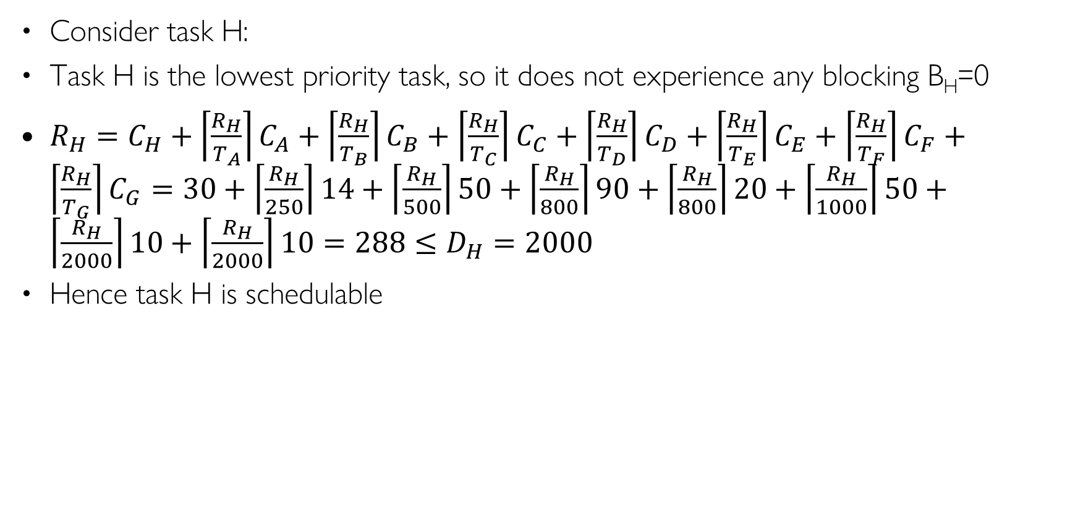
Q5. Task H
Consider task H:
Task H is the lowest priority task, so it does not experience any blocking B_{H}=0
$R_{H}=C_{H}+\left\lceil \frac{R_{H}}{T_{A}}\right\rceil C_{A}+\left\lceil \frac{R_{H}}{T_{B}}\right\rceil C_{B}+\left\lceil \frac{R_{H}}{T_{C}}\right\rceil C_{C}+\left\lceil \frac{R_{H}}{T_{D}}\right\rceil C_{D}+\left\lceil \frac{R_{H}}{T_{E}}\right\rceil C_{E}+\left\lceil \frac{R_{H}}{T_{F}}\right\rceil C_{F}+\left\lceil \frac{R_{H}}{T_{G}}\right\rceil C_{G}=30+\left\lceil \frac{R_{H}}{250}\right\rceil 14+\left\lceil \frac{R_{H}}{500}\right\rceil 50+\left\lceil \frac{R_{H}}{800}\right\rceil 90+\left\lceil \frac{R_{H}}{800}\right\rceil 20+\left\lceil \frac{R_{H}}{1000}\right\rceil 50+\left\lceil \frac{R_{H}}{2000}\right\rceil 10+\left\lceil \frac{R_{H}}{2000}\right\rceil 10=288≤D_{H}=2000$
Hence task H is schedulable
Notes:
30+28+50+90+20 +50 + 10 + 10

Slide 30
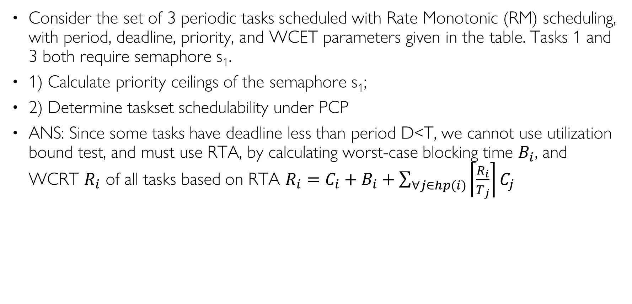
Q6. Schedulability with Shared Resources
Consider the set of 3 periodic tasks scheduled with Rate Monotonic (RM) scheduling, with period, deadline, priority, and WCET parameters given in the table. Tasks 1 and 3 both require semaphore s₁.
1) Calculate priority ceilings of the semaphore s₁;
2) Determine taskset schedulability under PCP
ANS: Since some tasks have deadline less than period D<T, we cannot use utilization bound test, and must use RTA, by calculating worst-case blocking time $B_{i}$, and WCRT $R_{i}$ of all tasks based on RTA $R_{i}=C_{i}+B_{i}+\sum_{∀j∈hp(i)}{\left\lceil \frac{R_{i}}{T_{j}}\right\rceil C_{j}}$
Task | T | D | C | Prio | sems | CS Len | B | R
1 | 100 | 50 | 25 | H | s₁ | 3
2 | 200 | 100 | 50 | M | / | /
3 | 300 | 300 | 100 | L | s₁ | 30
sem | Ceiling
s₁
Notes:
Consider the set of 3 periodic tasks scheduled with RM, with period, deadline, priority, and WCET parameters given in the table. Tasks 1 and 3 both require semaphore s₁. Tasks 1 has critical section length 3, and Tasks 3 has critical section length 30. Under RM scheduling, use utilization bound and/or Response Time Analysis (RTA) to

Slide 31
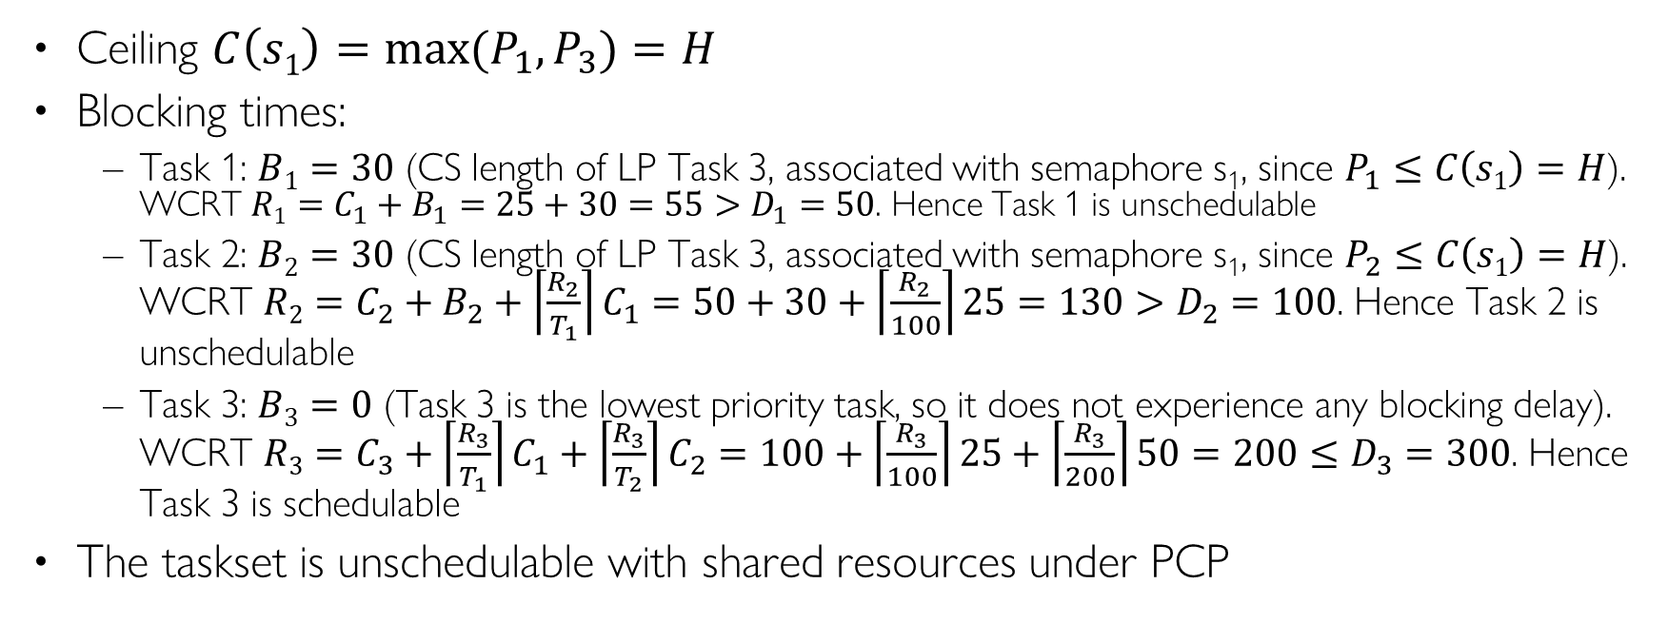
Q6. Schedulability with Shared Resources ANS
Ceiling $C\left(s1\right)=\max{(P_{1}, P_{3})}=H$
Blocking times:
  Task 1: $B1=30$ (CS length of LP Task 3, associated with semaphore s₁, since $P_{1}≤C\left(s1\right)=H$). WCRT $R1=C_{1}+B_{1}=25+30=55>D_{1}=50$. Hence Task 1 is unschedulable
  Task 2: $B2=30$ (CS length of LP Task 3, associated with semaphore s₁, since $P_{2}≤C\left(s1\right)=H$). WCRT $R2=C_{2}+B_{2}+\left\lceil \frac{R_{2}}{T_{1}}\right\rceil C_{1}=50+30+\left\lceil \frac{R_{2}}{100}\right\rceil 25=130>D_{2}=100$. Hence Task 2 is unschedulable
  Task 3: $B3=0$ (Task 3 is the lowest priority task, so it does not experience any blocking delay). WCRT $R3=C_{3}+\left\lceil \frac{R_{3}}{T_{1}}\right\rceil C_{1}+\left\lceil \frac{R_{3}}{T_{2}}\right\rceil C_{2}=100+\left\lceil \frac{R_{3}}{100}\right\rceil 25+\left\lceil \frac{R_{3}}{200}\right\rceil 50=200≤D_{3}=300$. Hence Task 3 is schedulable
The taskset is unschedulable with shared resources under PCP
Task | T | D | C | Prio | sems | CS Len | B | R
1 | 100 | 50 | 25 | H | s₁ | 3 | 30 | 55
2 | 200 | 100 | 50 | M | / | / | 30 | 130
3 | 300 | 300 | 100 | L | s₁ | 30 | 0 | 200
sem | Ceiling
s₁ | H
Notes:
Utilization $U_{1}=\sum_{∀j∈hp(1)}{\frac{C_{j}}{T_{j}}}+\frac{C_{1}+B_{1}}{T_{1}}=\frac{25+30}{100}=0.55≤0.828$ (utilization bound for 2 tasks under RM)

Slide 32
Q7. Schedulability with Shared Resources
Consider the set of 3 periodic tasks scheduled with Rate Monotonic (RM) scheduling, with period, deadline, priority, and WCET parameters given in the table. Tasks 1 and 3 both require semaphore s₁.
1) Calculate priority ceilings of the semaphore s₁;
2) Determine taskset schedulability under PCP
ANS: Since some tasks have deadline less than period D<T, we cannot use utilization bound test, and must use RTA, by calculating worst-case blocking time $B_{i}$, and WCRT $R_{i}$ of all tasks based on RTA $R_{i}=C_{i}+B_{i}+\sum_{∀j∈hp(i)}{\left\lceil \frac{R_{i}}{T_{j}}\right\rceil C_{j}}$
Task | T | D | C | Prio | sems | CS Len | B | R
1 | 100 | 50 | 25 | H | s₁ | 3
2 | 200 | 100 | 50 | M | s₂ | 10
3 | 300 | 300 | 100 | L | s₁, s₂ | 30, 40
sem | Ceiling
s₁
s₂
Notes:
Consider the set of 3 periodic tasks scheduled with RM, with period, deadline, priority, and WCET parameters given in the table. Tasks 1 and 3 both require semaphore s₁. Tasks 1 has critical section length 3, and Tasks 3 has critical section length 30. Under RM scheduling, use utilization bound and/or Response Time Analysis (RTA) to

Slide 33
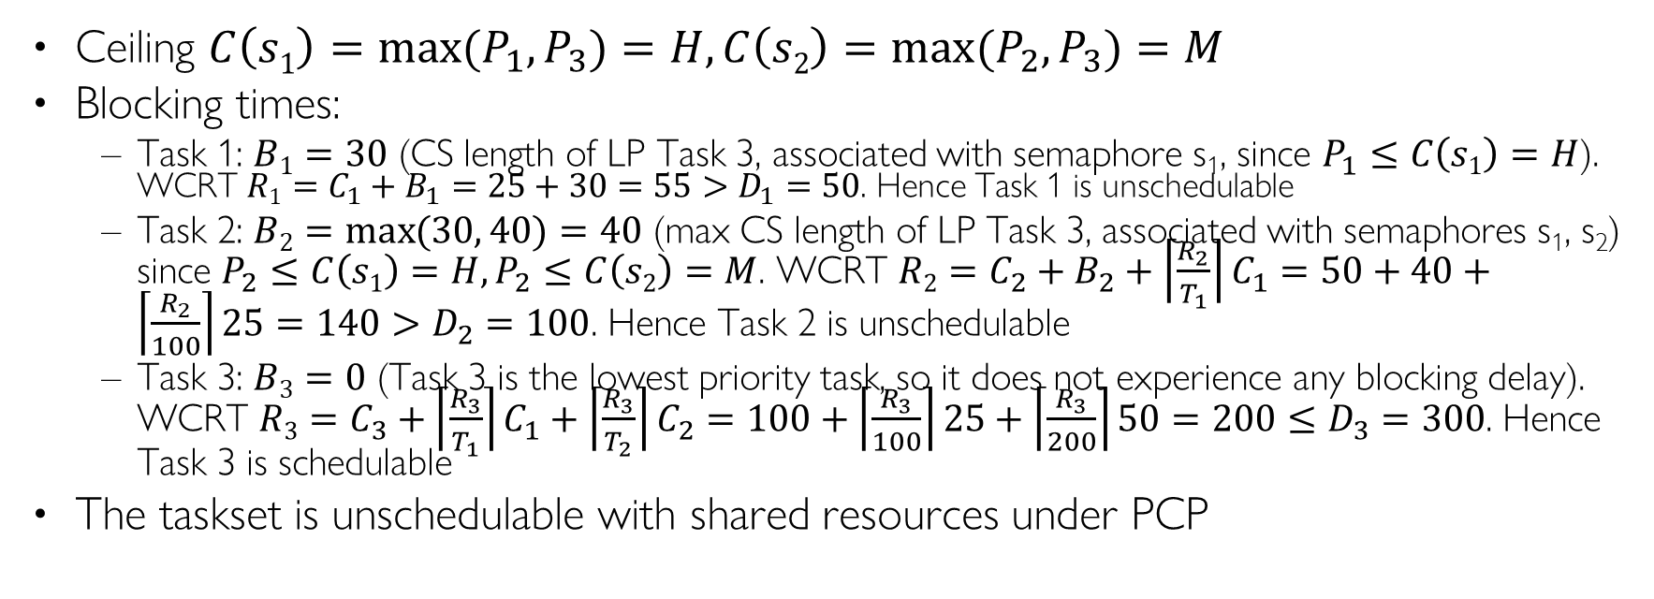
Q7. Schedulability with Shared Resources ANS
Ceiling $C\left(s1\right)=\max{(P_{1}, P_{3})}=H,C\left(s2\right)=\max{(P_{2}, P_{3})}=M$
Blocking times:
  Task 1: $B1=30$ (CS length of LP Task 3, associated with semaphore s₁, since $P_{1}≤C\left(s1\right)=H$). WCRT $R1=C_{1}+B_{1}=25+30=55>D_{1}=50$. Hence Task 1 is unschedulable
  Task 2: $B2=\max{(30, 40)}=40$ (max CS length of LP Task 3, associated with semaphores s₁, s₂) since $P_{2}≤C\left(s1\right)=H,P_{2}≤C\left(s2\right)=M$. WCRT $R2=C_{2}+B_{2}+\left\lceil \frac{R_{2}}{T_{1}}\right\rceil C_{1}=50+40+\left\lceil \frac{R_{2}}{100}\right\rceil 25=140>D_{2}=100$. Hence Task 2 is unschedulable
  Task 3: $B3=0$ (Task 3 is the lowest priority task, so it does not experience any blocking delay). WCRT $R3=C_{3}+\left\lceil \frac{R_{3}}{T_{1}}\right\rceil C_{1}+\left\lceil \frac{R_{3}}{T_{2}}\right\rceil C_{2}=100+\left\lceil \frac{R_{3}}{100}\right\rceil 25+\left\lceil \frac{R_{3}}{200}\right\rceil 50=200≤D_{3}=300$. Hence Task 3 is schedulable
The taskset is unschedulable with shared resources under PCP
Task | T | D | C | Prio | sems | CS Len | B | R
1 | 100 | 50 | 25 | H | s₁ | 3 | 30 | 55
2 | 200 | 100 | 50 | M | s₂ | 10 | 40 | 140
3 | 300 | 300 | 100 | L | s₁, s₂ | 30, 40 | 0 | 200
sem | Ceiling
s₁ | H
s₂ | M
Notes:
Utilization $U_{1}=\sum_{∀j∈hp(1)}{\frac{C_{j}}{T_{j}}}+\frac{C_{1}+B_{1}}{T_{1}}=\frac{25+30}{100}=0.55≤0.828$ (utilization bound for 2 tasks under RM)

Slide 34
Q8. Schedulability with Shared Resources
Consider the set of 3 periodic tasks scheduled with Rate Monotonic (RM) scheduling, with period, deadline, priority, and WCET parameters given in the table. Tasks 1 and 3 both require semaphore s₁.
1) Calculate priority ceilings of the semaphore s₁;
2) Determine taskset schedulability under PCP
ANS: Since some tasks have deadline less than period D<T, we cannot use utilization bound test, and must use RTA, by calculating worst-case blocking time $B_{i}$, and WCRT $R_{i}$ of all tasks based on RTA $R_{i}=C_{i}+B_{i}+\sum_{∀j∈hp(i)}{\left\lceil \frac{R_{i}}{T_{j}}\right\rceil C_{j}}$
Task | T | D | C | Prio | sems | CS Len | B | R
1 | 100 | 50 | 25 | H | s₁, s₂ | 3, 4
2 | 200 | 100 | 50 | M | s₂ | 10
3 | 300 | 300 | 100 | L | s₁, s₂ | 30, 40
sem | Ceiling
s₁
s₂
Notes:
Consider the set of 3 periodic tasks scheduled with RM, with period, deadline, priority, and WCET parameters given in the table. Tasks 1 and 3 both require semaphore s₁. Tasks 1 has critical section length 3, and Tasks 3 has critical section length 30. Under RM scheduling, use utilization bound and/or Response Time Analysis (RTA) to

Slide 35
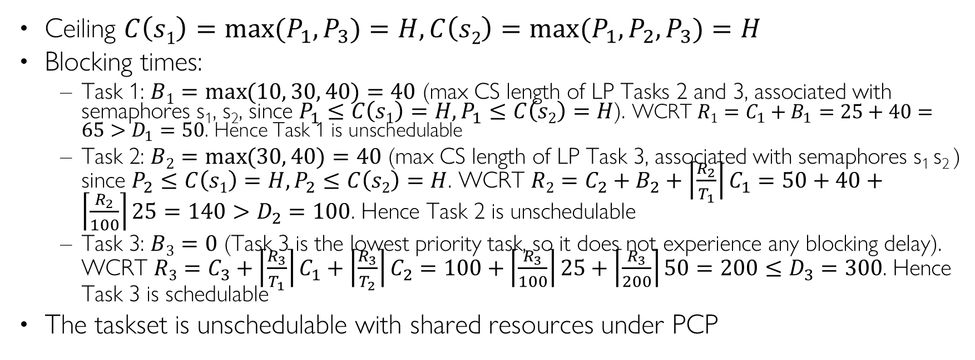
Q8. Schedulability with Shared Resources ANS
Ceiling $C\left(s1\right)=\max{(P_{1}, P_{3})}=H,C\left(s2\right)=\max{(P_{1}, P_{2}, P_{3})}=H$
Blocking times:
  Task 1: $B1=\max{(10, 30, 40)}=40$ (max CS length of LP Tasks 2 and 3, associated with semaphores s₁, s₂, since $P_{1}≤C\left(s1\right)=H,P_{1}≤C\left(s2\right)=H$). WCRT $R1=C_{1}+B_{1}=25+40=65>D_{1}=50$. Hence Task 1 is unschedulable
  Task 2: $B2=\max{(30, 40)}=40$ (max CS length of LP Task 3, associated with semaphores s₁ s₂ ) since $P_{2}≤C\left(s1\right)=H,P_{2}≤C\left(s2\right)=H$. WCRT $R2=C_{2}+B_{2}+\left\lceil \frac{R_{2}}{T_{1}}\right\rceil C_{1}=50+40+\left\lceil \frac{R_{2}}{100}\right\rceil 25=140>D_{2}=100$. Hence Task 2 is unschedulable
  Task 3: $B3=0$ (Task 3 is the lowest priority task, so it does not experience any blocking delay). WCRT $R3=C_{3}+\left\lceil \frac{R_{3}}{T_{1}}\right\rceil C_{1}+\left\lceil \frac{R_{3}}{T_{2}}\right\rceil C_{2}=100+\left\lceil \frac{R_{3}}{100}\right\rceil 25+\left\lceil \frac{R_{3}}{200}\right\rceil 50=200≤D_{3}=300$. Hence Task 3 is schedulable
The taskset is unschedulable with shared resources under PCP
Task | T | D | C | Prio | sems | CS Len | B | R
1 | 100 | 50 | 25 | H | s₁, s₂ | 3, 4 | 40 | 65
2 | 200 | 100 | 50 | M | s₂ | 10 | 40 | 140
3 | 300 | 300 | 100 | L | s₁, s₂ | 30, 40 | 0 | 200
sem | Ceiling
s₁ | H
s₂ | H
Notes:
Utilization $U_{1}=\sum_{∀j∈hp(1)}{\frac{C_{j}}{T_{j}}}+\frac{C_{1}+B_{1}}{T_{1}}=\frac{25+30}{100}=0.55≤0.828$ (utilization bound for 2 tasks under RM)

