Slide 1
CSC 112: Computer Operating Systems
Lecture 2
Processes and Threads
Department of Computer Science,
Hofstra University
Acknowledgement: Lecture slides based on UC Berkeley CS 162: Operating Systems and System Programming

Slide 2
Overview
Process concept
Process state
Process API (creation, wait)
Process tree

Slide 3
Process
Program is a static entity stored on disk (executable file), process is active
  Program becomes process when executable file loaded into memory
  Process is an abstraction of CPU
Execution of program started via Graphic User Interface (GUI) mouse clicks, command line entry of its name, etc
A physical CPU is shared by many processes
  Time sharing: run one process for a little while, then run another one, and so forth.
  Processes believe they are using CPU alone

Slide 4
Process
CPU
Memory
A program becomes a process when it is selected to execute and loaded into memory.
A process has an address space
Program Counter (PC)
code
static data
heap
stack
Process
Loading:
Takes on-disk program
and reads it into the address space of process
code
static data
Program
Disk
Notes:
address space is the range of memory assigned to a process

Slide 5
Process
Process: a running program
Consists of:
  Stack: Temporary data, e.g., function parameters, return addresses, local variables
  Heap: Dynamically allocated memory
  Static data: Global variables
  Code: Instructions
  Registers: SP (Stack Pointer), PC (Program counter)
0xFFFFFFFF
stack
(temporary data)
SP (Stack Pointer)
32-bit memory
address space
heap
(dynamic allocated mem)
static data
(data segment)
code
(text segment)
PC (Program Counter)
0x00000000
Notes:
Malloc to define, but you also need to free it.
Trampoline includes the code to transition in and out of the kernel
Trapframe saves the state of the process
general purpose reg

Slide 6
Process
struct proc {
struct spinlock lock; // p->lock must be held when using these:
enum procstate state; // Process state
void *chan; // If non-zero, sleeping on chan
int killed; // If non-zero, have been killed
int xstate; // Exit status to be returned to parent's wait
int pid; // Process ID
// wait_lock must be held when using this:
struct proc *parent; // Parent process
// these are private to the process, so p->lock need not be held.
uint64 kstack; // Virtual address of kernel stack
uint64 sz; // Size of process memory (bytes)
pagetable_t pagetable; // User page table
struct trapframe *trapframe; // data page for trampoline.S
struct context context; // swtch() here to run process
struct file *ofile[NOFILE]; // Open files
struct inode *cwd; // Current directory
char name[16]; // Process name (debugging)
};
A process is represented by a process control block (PCB)
  Process ID (PID, unique)
  State
  Parent process pointer
  Opened files
  Many other fields
  PCB in XV6 does not include pointers to child processes for simplicity, but PCB in Linux include them for convenient references to its child processes
XV6 (proc.h)
Notes:
You can find PCB in most of modern OSs
the PCB simply serves as the repository for any information that may vary from process to process.

Slide 7
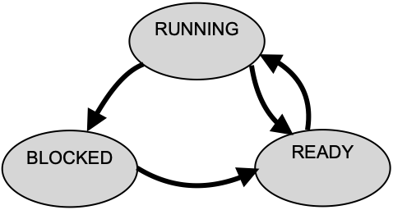
Process States
Process has different states
  READY
    Ready to run and pending for running
  RUNNING
    Being executed by OS
  BLOCKED
    Suspended due to some other events, e.g., I/O requests
Process 0
I/O
Process 1
Running
Ready
Request
CPU switch
I/O processing
Running
Block
I/O Done
Scheduled
Ready
I/O request
Running
Descheduled
Done
Done
I/O request
completion
What is a Process in an Operating System?
https://www.youtube.com/watch?v=vLwMl9qK4T8
Notes:
This final state can be useful as it allows other processes
(usually the parent that created the process) to examine the return code
of the process and see if the just-finished process executed successfully
(usually, programs return zero in UNIX-based systems when they have
accomplished a task successfully, and non-zero otherwise).
ZOMBIE
Completed execution but still has an entry in the system.

Slide 8
Process API
Process API to manipulate processes
  CREATE
    Create a new process, e.g., double click, a command in terminal
  WAIT
    Wait for a process to stop
    Like I/O request
  DESTROY
    Kill the processes
  STATUS
    Obtain the information of a process
  OTHERS
    Suspend or resume a process

Slide 9
Process Creation
A process is created by another process, parent process or calling process
Process creation relies on two system calls
  fork()
    Create a new process and clone its parent process
  exec()
    Overwrite the created process with a new program

Slide 10
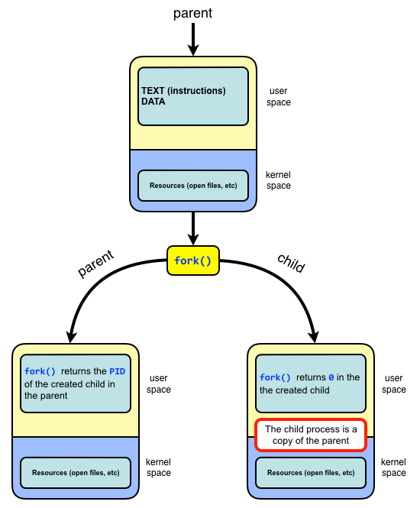
fork()
A function without any arguments
  ret = fork()
Both parent process and child process continue to execute the instruction following the fork()
The return value indicates which process it is (parent or child)
  ret > 0 (pid of child process): code running in the parent process,
  ret == 0: code running in the newly-created child process
  ret == -1: an error or failure occurred when creating new process
Fun analogy: imaging you are a process after fork, but you don’t know if you are the child or parent process, as if you are running inside of a Matrix. But you can identify which process you are running, by looking up to the sky and see the ret value from fork()
Child process is a duplicate of its parent process and has same
  instructions, data, stack
Child and parents have different
  PIDs, memory spaces
Notes:
fork() returns 0 in child process and process ID of child process in parent process.

Slide 11

fork()
Output
int main(int argc, char *argv[])
{
printf("hello world (pid:%d)\n", (int) getpid());
  int ret = fork();
  if (ret < 0) {
  // fork failed; exit
  fprintf(stderr, "fork failed\n"); exit(1);
  } else if (pid == 0) {
  // child (new process)
  printf("hello, I am child (pid:%d)\n", (int) getpid());
  } else {
  // parent goes down this path (original process)
  printf("hello, I am parent of %d (pid:%d)\n", ret, (int) getpid());
  }
  return 0;
}
Assuming no error (ret >= 0):
Code inside if(ret == 0){} block is executed by Child process
Code inside if(ret > 0){} block is executed by Parent process
Code outside of if-then-else blocks is executed by both Child and Parent
Child Process
Parent Process
Notes:
Point the next instruction after fork()

Slide 12
wait()
Let the parent process wait for the completion of the child process
  pid = wait()
wait() suspends the execution of the calling process until one of its child processes terminates.
  When a child process terminates, wait() retrieves its termination status and allows the system to clean up the resources associated with that child. If the parent does not call wait() to collect the child's exit status, the child becomes a zombie process, which means its PCB persists in the process table, even though it is no longer running.
    While zombie processes do not consume processor or memory resources, they occupy entries in the process table. The process table is of finite size, and if too many zombie processes accumulate, it can prevent new processes from being created.
  If there are multiple child processes, wait() does not allow the parent to specify which child process to wait for. waitpid(pid) is an advanced version of wait. It allows the parent process to specify which child process (or group of processes) it wants to wait for.
Parent
fork()
wait()
Child
Parent
Notes:
It will reap any terminated child arbitrarily. process (preventing it from becoming a zombie process

Slide 13
wait()
int main(int argc, char *argv[])
{
printf("hello world (ret:%d)\n", (int) getpid());
int pid = fork();
if (pid < 0) {
// fork failed; exit
fprintf(stderr, "fork failed\n");
exit(1);
} else if (pid == 0) {
// child (new process)
printf("hello, I am child (pid:%d)\n", (int) getpid());
sleep(1);
} else {
// parent goes down this path (original process). wc (wait child) stores pid of the child process waited by parent
int wc = wait(NULL); //wc contains pid of the child process being waited for by parent process
printf("hello, I am parent of %d (wc:%d) (pid:%d)\n", pid, wc, (int) getpid());
}
return 0;
}
Child process sleeps for 1 second
Parent process waits for the child process to finish sleeping
Child Process
Parent Process

Slide 14
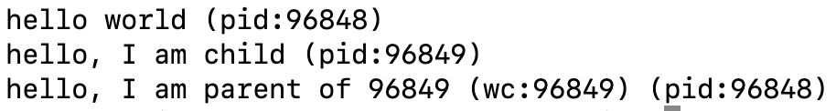
wait()
Without wait(): it is nondeterministic which process (parent or child) runs first
With wait(): child runs first, and parents waits for child to finish
Fork() system call tutorial
https://www.youtube.com/watch?v=xVSPv-9x3gk

Slide 15
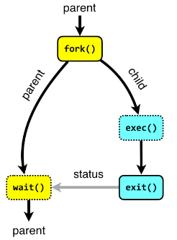
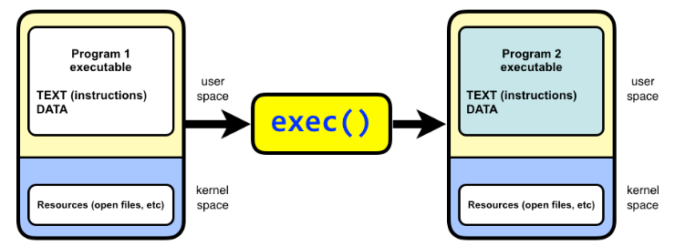
exec()
exec(cmd, argv) replaces the current process image with a new process image specified by the path to an executable file.
  It does not return. It starts to execute the new program.
There is a family of exec(), e.g., execl(), execvp()
  execl() takes a variable number of arguments that represent the program name and its arguments.
    int execl(const char *path, const char *arg, ..., NULL);
  execvp() takes an array of arguments instead of a variable-length argument list
    int execvp(const char *file, char *const argv[]);
Notes:
You may not have the exec command instead you have several alternatives you can use in different situations
Returns if errors occur
Replace current data and code with new in specified file, i.e., it loads a new program into the current process
exec(cmd, argv)

Slide 16
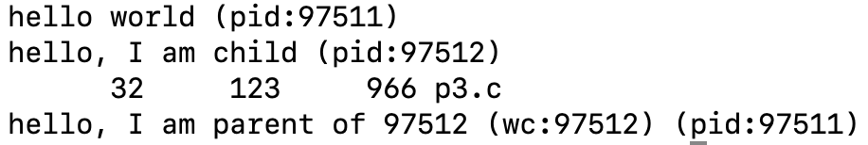
exec() Example
int main(int argc, char *argv[])
{
  printf("hello world (pid:%d)\n", (int) getpid());
  int pid = fork();
  if (pid < 0) {
  // fork failed; exit
  fprintf(stderr, "fork failed\n"); exit(1);
  } else if (pid == 0) { // child (new process)
  printf("hello, I am child (pid:%d)\n", (int) getpid());
  char *myargs[3];
  myargs[0] = strdup(“wc”); // program: ”wc“ (word count)
  myargs[1] = strdup(“p3.c”); // argument: file to count
  myargs[2] = NULL; // marks end of array
  execvp(myargs[0], myargs); // run word count
  printf(“This line will never be executed.");
  } else { // parent
  int rc_wait = wait(NULL);
  printf(“hello, I am parent of %d (rc_wait:%d) (pid:%d)\n”, rc, rc_wait, (int) getpid());}
  return 0;
}
In the child process (rc == 0), the execvp() function replaces the current process image with the program named “wc“, a program that counts Lines, Words, and Bytes in a file, with output format: [lines] [words] [bytes] [filename].
The arguments for the program are passed as an array (args[]), where the first element is the program name “wc” and subsequent elements are its arguments. The array must end with NULL.
After call to execvp(), the whole child process address space is overwritten and replaced by the wc program, so the line “printf(“This line will never be executed.");“ will never be executed.
Minor point: strdup() allocates memory on the heap and stores a copy of the string there. This is done to ensure that the strings are stored in memory that can be safely modified or freed later if needed. In this program, strdup() is not strictly necessary, and you can pass strings directly to myargs without using `strdup`, since the strings are read only and not modified later.
Output:
Notes:
In Child process: exec() replaces the current process image with a new program called SOME_COMMAND. The child process will execute the command and terminate. The code following it (e.g., printf("Child\n")) will not be executed because it is now running SOME_COMMAND, not the code shown in the text box.
b. Describe the function of execl in your own words (Hint: read the man page).
The exec family of functions replaces the current process image with a new process image. execl is a function that allows the caller to pass command line parameters to the executed program, which appear as argv array in main.
Also describe the content of the second parameter passed to execl
The second parameter is given as const char *arg0. Like printf, execl is a function with a variable number of arguments. The first one ("path") is always the Unix path of the process to execute, the subsequent ones are a list of arguments passed as argv[0], argv[1], …
The second parameter, accessible as argv[0]in the called program, by convention always contains the name of the executed program (e.g., "vim").
The command line parameters given, e.g., in the shell appear as
argv[1]…

Slide 17
IO redirection and pipe
By separating fork() and exec(), we can manipulate various settings just before executing a new program and make the IO redirection and pipe possible. (details omitted.)
  IO redirection: output of the left command redirected to be written to the file on the right
  Pipe: output of the left command passed as input to the right command
% cat w3.c > newfile.txt
% echo hello world | wc
Notes:
Windows has similar one, but different implementation philosophy, createprocess
standard output
Really easy to implement
On early PDP-7 computer, it only needs 27 lines of assembly code
1965

Slide 18
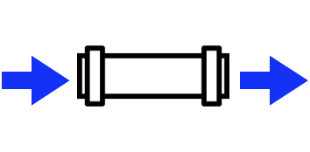

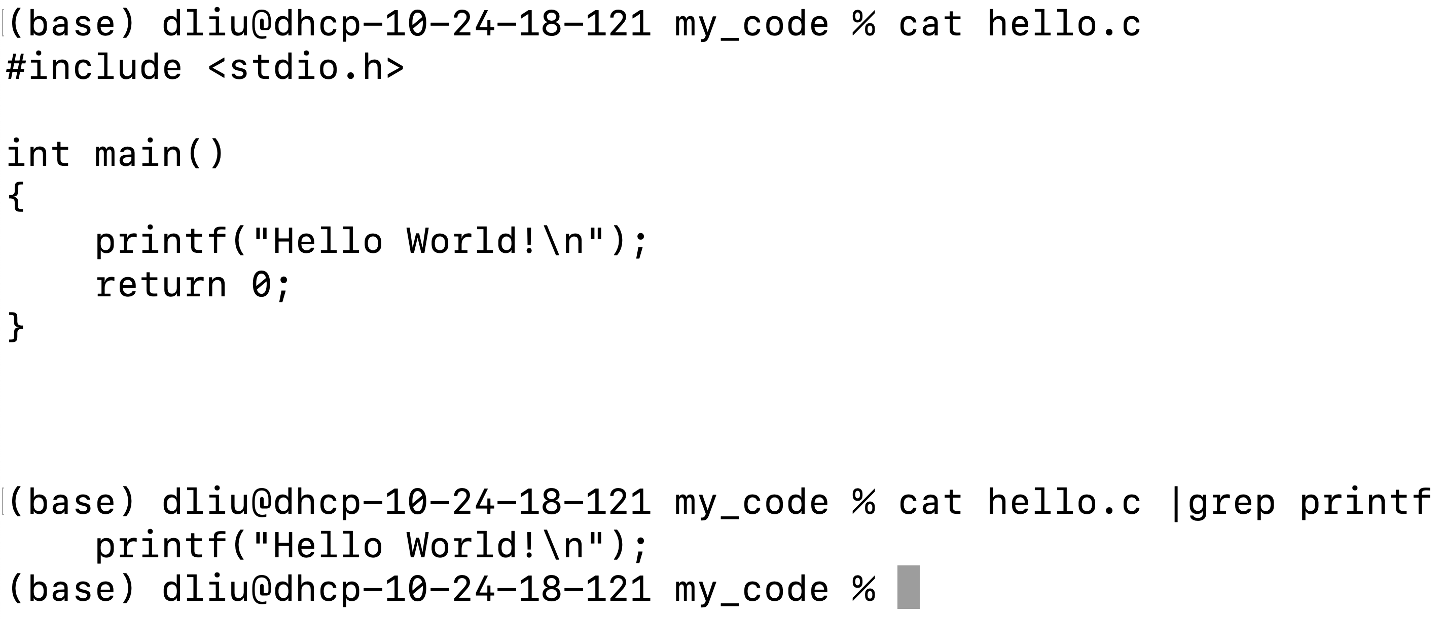
pipe
A communication method between two processes
Write
Read
Child Process (left)
Child Process (right)
Command “cat” prints out content of hello.c file
Output of “cat” command passed through the pipe
to command “grep” to search for any lines that
contain “printf”

Slide 19
Process Tree

Slide 20
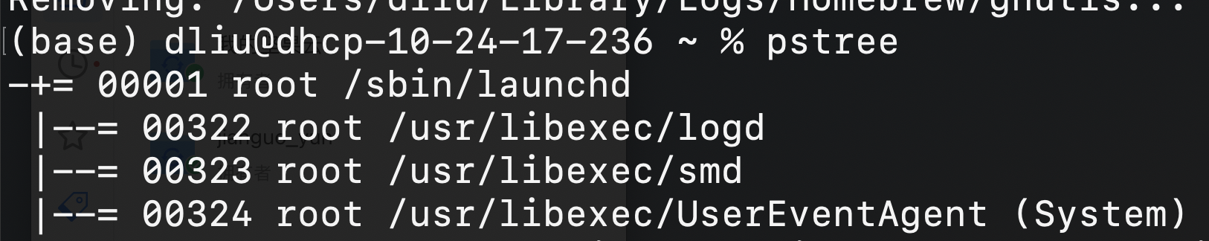
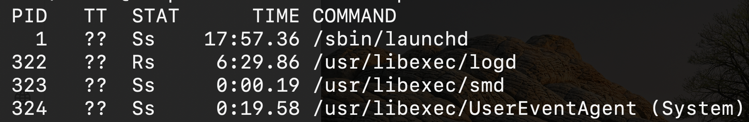
Process Tree
% pstree (to show the process tree in a hierarchy)
% ps (to show all processes as a flat list)
Notes:
percent sign

Slide 21
User/Kernel Mode Separation
User mode: restricted, limited operations
  Processes start in user mode
Kernel mode: privileged, not restricted
  OS starts in kernel mode
What if a process wants to perform some restricted operations?
  System calls: Allow the kernel services to provide some functionalities to user programs

Slide 22
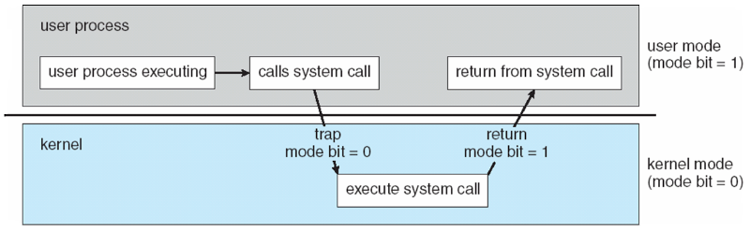
User/Kernel Mode Separation
A process starts in user mode
If it needs to perform a restricted operation, it calls a system call by executing a trap instruction.
The state and registers of the calling process are stored, the system enters kernel mode, OS completes the syscall work.
Return from syscall, restore the states and registers of the process, and resume the execution of the process

Slide 23
Process Scheduling
Switching Between Processes
Cooperative approach
  Trust process to relinquish processor time to OS through yield()
Non-cooperative approach
  The OS takes control periodically, e.g., timer interrupter
Notes:
When a process is running on cpu, this means the process is not running

Slide 24
Process Summary
In OS, process is a running program and has an address space
We use process API to create and manage processes
Fork() to duplicate a process, exec() to replace the command
Process scheduling

Slide 25
What’s in a process?
A process consists of:
  an address space
  the code for the running program
  the data for the running program
  at least one thread
    Registers, IP
    Floating point state
    Stack and stack pointer
  a set of OS resources
    open files, network connections, sound channels, …
Today: decompose process from threads of control
Notes:
(other resources…)

Slide 26
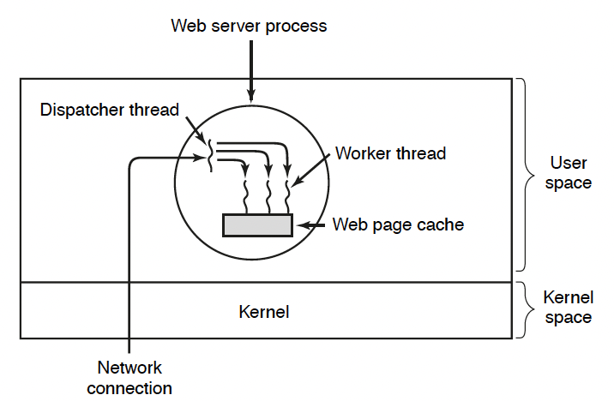
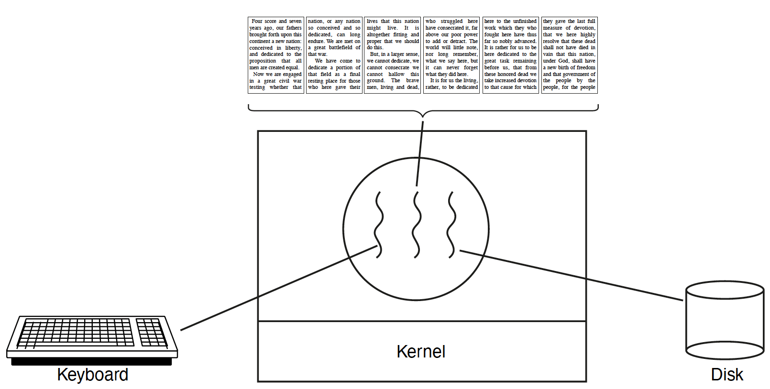
Concurrency
Imagine a web server that handles multiple requests concurrently
  Multiple worker threads: while waiting for the credit card server to approve a purchase for one client, it could be retrieving the data requested by another client from disk, and assembling the response for a third client from cached information
Imagine a web client (browser), which might like to initiate multiple requests concurrently
Imagine a parallel program running on a multiprocessor, which might like to employ parallelism = “true concurrency”
  For example, multiplying a large matrix – split the output matrix into k regions and compute the entries in each region concurrently using k processors
Thread for Displaying
Thread for disk IO
Thread for keyboard input
Web Server
Web Browser

Slide 27
What’s needed?
In each of these examples of concurrency (web server, web client, parallel program):
  Everybody wants to run the same code
  Everybody wants to access the same data
  Everybody has the same privileges
  Everybody uses the same resources (open files, network connections, etc.)
But you’d like to have multiple hardware execution states:
  an execution stack and stack pointer (SP)
    traces state of procedure calls made
  program counter (PC), indicating the next instruction
  a set of general-purpose processor registers and their values
Creating multiple processes is inefficient
Key idea: separate the concept of a process (address space, etc.) from that of a minimal “thread of control” (execution state: PC, etc.)
This execution state is usually called a thread, or sometimes, a lightweight process
Notes:
Given the process abstraction as we know it:
create several processes
cause each to map to the same physical memory to share data
see the MapViewOfFile() system call for one way to do this (kind of)
This is like making a pig fly – it’s really inefficient
space: _KPROCESS, page tables, etc.
time: creating OS structures, initializing addr space, etc.
Some equally bad alternatives for some of the examples:
Entirely separate web servers
Manually programmed asynchronous programming (non-blocking I/O) in the web client (browser)

Slide 28
Processes and Threads
Modern OSes support two entities:
  the process, which defines the address space and general process attributes (such as open files, etc.)
  the thread, which defines a sequential execution stream within a process
A thread is bound to a single process / address space
  address spaces, however, can have multiple threads executing within them
  threads in the same process share the same address space, making it easy to share data among them
Threads become the unit of scheduling
  processes / address spaces are just containers in which threads execute

Slide 29
Processes and Threads
Multiple threads within a process will share
  Process ID
  The address space: code, most data (heap)
  Open files (file descriptors)
  Current working directory
  Other resources
Each thread has its own:
  Thread ID (TID)
  Set of registers, including Program Counter and Stack Pointer
  Stack for local variables and return addresses
Advantages
  Efficient and fast resource sharing
  Efficient utilization of many CPU cores with only one process
  Less context switching overheads

Slide 30
(old) Process address space
0xFFFFFFFF
stack
(dynamic allocated mem)
SP (Stack Pointer)
address space
heap
(dynamic allocated mem)
static data
(data segment)
code
(text segment)
PC (Program Counter)
0x00000000

Slide 31
(new) Process address space with threads
thread 1 stack
SP (T1)
0xFFFFFFFF
thread 2 stack
SP (T2)
thread 3 stack
SP (T3)
address space
heap
(dynamic allocated mem)
static data
(data segment)
0x00000000
code
(text segment)
PC (T2)
PC (T1)
PC (T3)

Slide 32
Process/thread separation
Concurrency (multithreading) is useful for:
  handling concurrent events (e.g., web servers and clients)
  building parallel programs (e.g., matrix multiply, ray tracing)
  improving program structure
Multithreading is useful even on a uniprocessor
  even though only one thread can run at a time, multiple threads may be executed in a time-sharing schedule, so they appear to run concurrently
Supporting multithreading – that is, separating the concept of a process (address space, files, etc.) from that of a minimal thread of control (execution state), is a big win
  creating concurrency does not require creating new processes
  faster / better / cheaper

Slide 33
POSIX pthreads API
POSIX thread -> pthread
A Portable Operating System Interface (POSIX) library (IEEE 1003.1c), written in C language
Pthread library: 60+ functions, API specifies behavior of the thread library
API | Functionality
pthread_create | Create a new thread in the caller’s address space
pthread_exit | Terminate the calling thread
pthread_join | Wait for a thread to terminate
pthread_mutex_lock | Lock a mutex
pthread_mutex_unlock | Unlock a mutex
sem_wait | Wait on a semaphore
sem_post | Signal or post on a semaphore
pthread_cond_wait | Wait on a condition variable
pthread_cond_signal | Wake up one thread waiting on a condition variable
pthread_cond_broadcast | Wake up all threads waiting on a condition variable
Notes:
pthread_mutex_init
Create a new mutex
pthread_mutex_destroy
Destroy a mutex
t = pthread_create(attributes, start_procedure)
creates a new thread of control
new thread begins executing at start_procedure
pthread_cond_wait(condition_variable)
the calling thread blocks, sometimes called thread_block()
pthread_signal(condition_variable)
starts the thread waiting on the condition variable
pthread_exit()
terminates the calling thread
pthread_wait(t)
waits for the named thread to terminate

Slide 34
Pthread Fork-Join Pattern
void *mythread(void *arg) {
printf("%s\n", (char *) arg);
return NULL;
}
int main(int argc, char *argv[]) {
pthread_t p1, p2;
printf("main: begin\n");
pthread_create(&p1, NULL, mythread, "A");
pthread_create(&p2, NULL, mythread, "B");
// join waits for the threads to finish
pthread_join(p1, NULL);
pthread_join(p2, NULL);
printf("main: end\n");
}
create
exit
join
Main thread creates multiple sub-threads, passing them args to work on… then joins with them to collect results.

Slide 35
“Where do threads come from?”
The kernel is responsible for creating/managing threads
  for example, the kernel call to create a new thread would
    allocate an execution stack within the process address space
    create and initialize a Thread Control Block
      stack pointer, program counter, register values
    stick it on the ready queue
  we call these kernel threads

Slide 36
“Where do threads come from?” (2)
Threads can also be managed at the user level (that is, entirely from within the process)
  a library linked into the program manages the threads
    because threads share the same address space, the thread manager doesn’t need to manipulate address spaces (which only the kernel can do)
    threads differ (roughly) only in hardware contexts (PC, SP, registers), which can be manipulated by user-level code
    the Linux thread package multiplexes user-level threads on top of kernel thread(s), which it treats as “virtual processors”
  we call these user-level threads

Slide 37
Kernel threads
OS now manages threads and processes
  all thread operations are implemented in the kernel
  OS schedules all of the threads in a system
    if one thread in a process blocks (e.g., on I/O), the OS knows about it, and can run other threads from that process
    possible to overlap I/O and computation inside a process
Kernel threads are cheaper than processes
  less state to allocate and initialize
But, they’re still expensive for fine-grained use (e.g., orders of magnitude more expensive than a procedure call)
  thread operations are all system calls
    context switch
    argument checks
  must maintain kernel state for each thread

Slide 38
User-level threads
To make threads cheap and fast, they may be implemented at the user level
  managed entirely by user-level library, e.g., libpthreads.a
User-level threads are small and fast
  each thread is represented simply by a PC, registers, a stack, and a small thread control block (user-space TCB)
  creating a thread, switching between threads, and synchronizing threads are done via procedure calls
    no kernel involvement is necessary!
  user-level thread operations can be 10-100x faster than kernel threads as a result
The OS kernel scheduler schedules the kernel threads; the user-level thread scheduler within each process schedules the user-level threads within the time intervals that the underlying kernel thread runs.
  it uses queues to keep track of the thread states: run, ready, wait. Just like the OS kernel scheduler, but implemented as a user-level library
Example implementations of user-level threads
  Fibers, co-routines
FANG Interview Question | Process vs Thread
https://www.youtube.com/watch?v=4rLW7zg21gI
Notes:
The kernel believes the user-level process is just a normal process running code
But, this code includes the thread support library and its associated thread scheduler

Slide 39
Summary
Processes
  In OS, process is a running program and has an address space
  We use process API to create and manage processes
  Fork() to duplicate a process, exec() to replace the command
Threads:
  Multiple threads per process / address space
  Kernel threads are much more efficient than processes, but they’re still not cheap
    all operations require a kernel call and parameter verification
  User-level threads are very efficient
Notes:
What is Thread Synchronization?
https://www.youtube.com/watch?v=8_CRd1R5g98
fast
great for common-case operations
creation, synchronization, destruction
can suffer in uncommon cases due to kernel obliviousness
I/O
preemption of a lock-holder

