Slide 1
CSC 112: Computer Operating Systems
Lecture 1
What is an Operating System?
Department of Computer Science,
Hofstra University
Acknowledgement: Lecture slides based on UC Berkeley CS 162: Operating Systems and System Programming

Slide 2
Syllabus
Textbook: Operating Systems: Principles and Practice (2nd Edition) Anderson and Dahlin
  Not strictly required
  PPT files contain all relevant materials
Topics covered
  OS Concepts: How to Navigate as a Systems Programmer!
    Process, I/O, Networks and Virtual Machines
  Concurrency
    Threads, scheduling, locks, deadlock, scalability, fairness
  Address Space
    Virtual memory, address translation, protection, sharing
  File Systems
    I/O devices, file objects, storage, naming, caching, performance, paging, transactions, databases
  Distributed Systems
    Protocols, N-Tiers, RPC, NFS, DHTs, Consistency, Scalability, multicast
  Reliability & Security
    Fault tolerance, protection, security
  Cloud Infrastructure

Slide 3
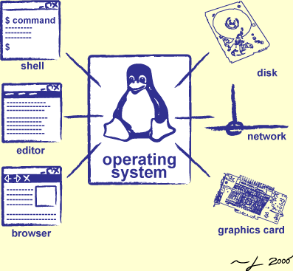
Goals for Today
What is an Operating System?
  And – what is it not?
What makes Operating Systems so exciting?
Oh, and “How does this class operate?”
Interactive is important!
Ask Questions!
Slides courtesy of David Culler, Anthony D. Joseph, John Kubiatowicz, AJ Shankar, George Necula, Alex Aiken, Eric Brewer, Ras Bodik, Ion Stoica, Doug Tygar, and David Wagner.

Slide 4
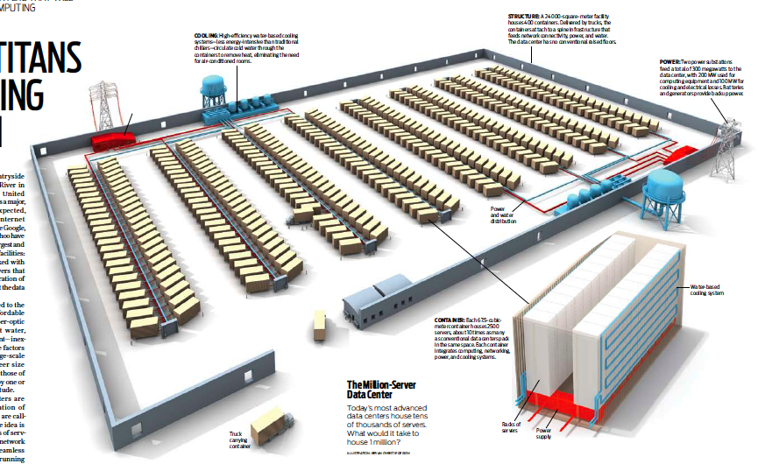
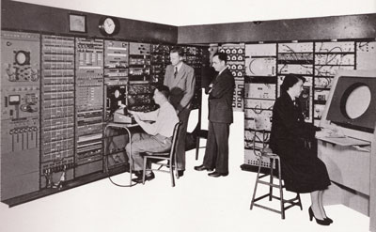
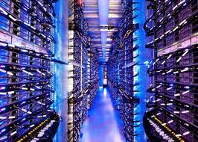
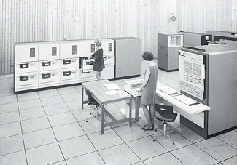
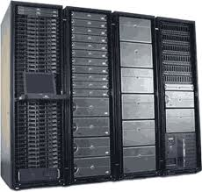
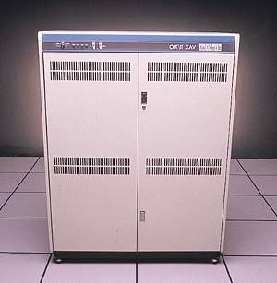
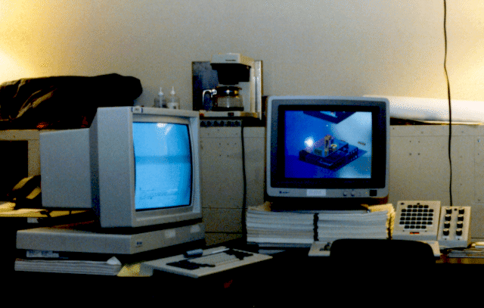
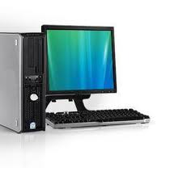
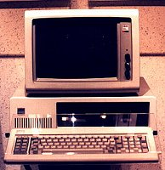
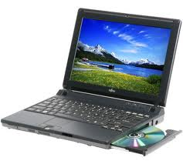
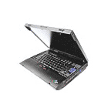
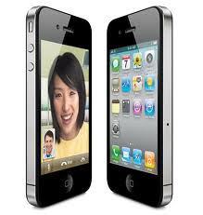


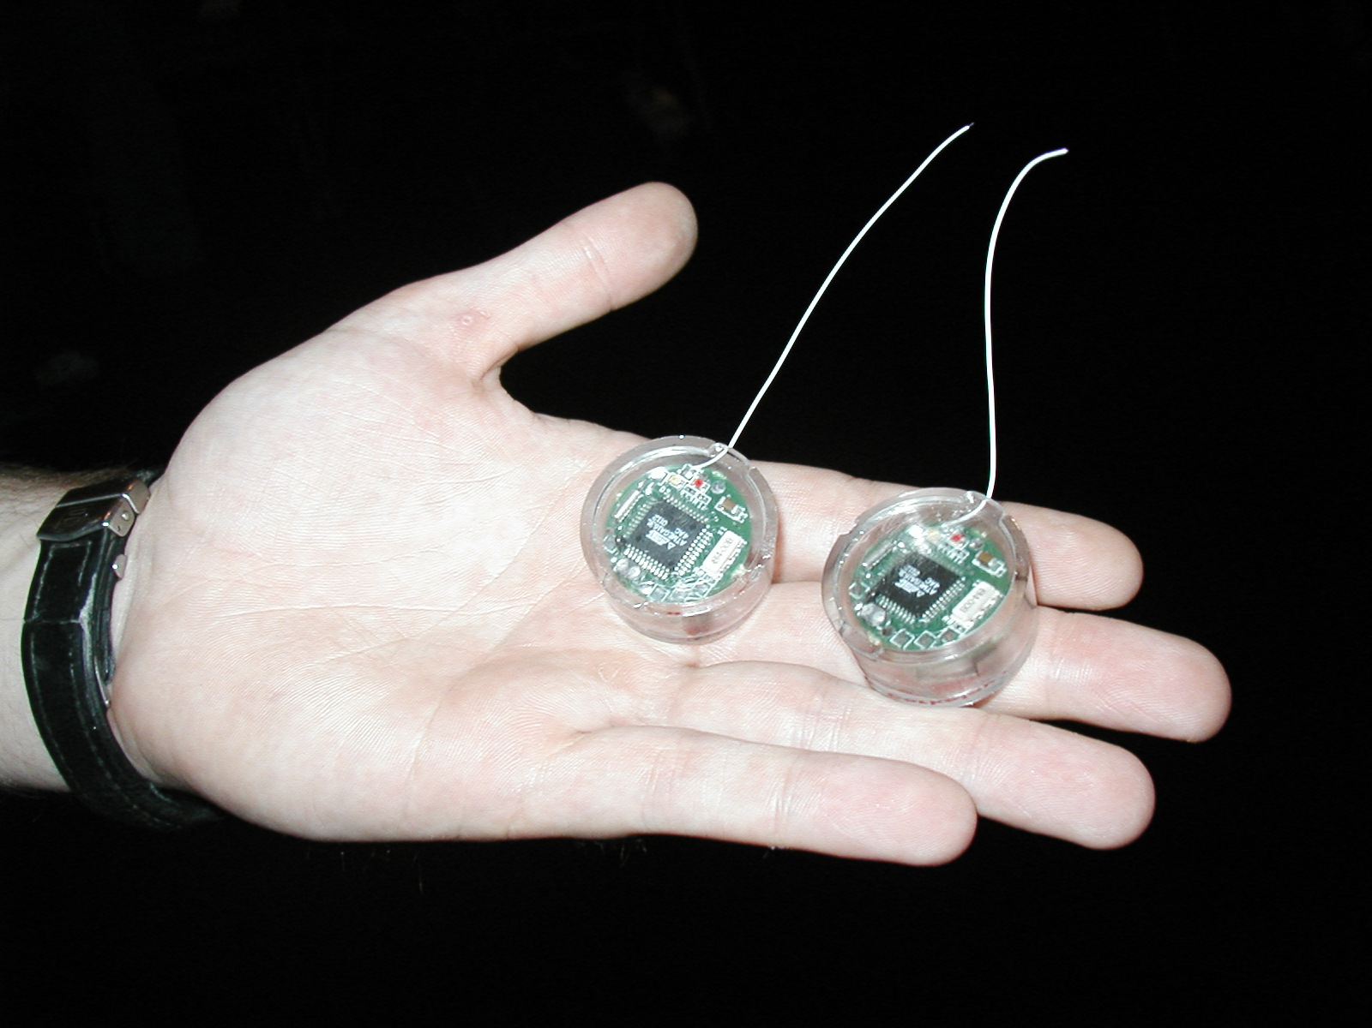
Across Incredible Diversity
Computers
Per Person
Number crunching, Data Storage, Massive Inet Services,
ML, …
1:10⁶
Mainframe
Bell’s Law: New computer class every 10 years
Mini
1:10³
Workstation
Productivity,
Interactive
PC
Laptop
1:1
PDA
Cell
Streaming from/to the physical world
10³:1
years
Mote!
The Internet of Things!

Slide 5
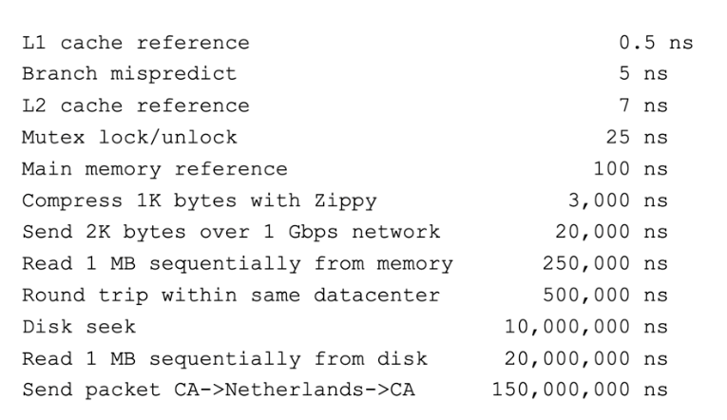
And Range of Timescales
Jeff Dean: “Numbers Everyone Should Know”

Slide 6
Operating Systems are at the Heart of it All!
Make the incredible advance in the underlying technology available to a rapidly evolving body of applications
  Provide consistent abstractions to applications, even on different hardware
  Manage sharing of resources among multiple applications
The key building blocks:
  Processes
  Threads, Concurrency, Scheduling, Coordination
  Address Spaces
  Protection, Isolation, Sharing, Security
  Communication, Protocols
  Persistent storage, transactions, consistency, resilience
  Interfaces to all devices

Slide 7

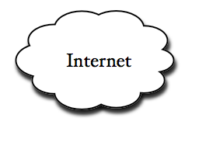
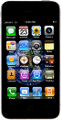

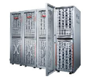
Example: What’s in a Search Query?
DNS
Servers
Datacenter
DNS
request
create
result
page
Search
Index
Page store
Load
balancer
Ad Server
Complex interaction of multiple components in multiple administrative domains
  Systems, services, protocols, …
Notes:
In this course we are not focusing on a single node system but on the end-to-end system. The reason is very simple: today the majority of applications we use does not run on our system. Social networks, e-mail, google docs, online gamming, etc.

Slide 8
But: What is an operating system?

Slide 9
One Definition of an Operating System
Special layer of software that provides application software access to hardware resources
  Convenient abstraction of complex hardware devices
  Protected access to shared resources
  Security and authentication
  Communication
appln
appln
appln
OS
Hardware

Slide 10
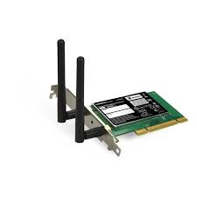
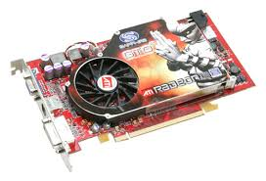
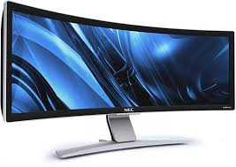

Hardware/Software Interface
Running Program
Software
Instruction Set Architecture (ISA)
Hardware
Memory
Page
Table
& TLB
Processor
Cache
The OS abstracts these hardware details from the application
OS Memory
Ctrlr
Networks
Storage
Displays
Inputs

Slide 11

What is an Operating System?
Illusionist
  Provide clean, easy-to-use abstractions of physical resources
    Infinite memory, dedicated machine
    Higher level objects: files, users, messages
    Masking limitations, virtualization

Slide 12
OS Basics: Virtualizing the Machine
Compiled
Program
System Libs
Process: Execution environment with restricted rights provided by OS
Threads
Address Spaces
Files
Sockets
Operating System
ISA
Processor
PgTbl
& TLB
Storage
Networks
Memory
Hardware
OS Mem
I/O Ctrlr

Slide 13
Compiled Program’s View of the World
Compiled
Program
System Libs
Process: Execution environment with restricted rights provided by OS
Threads
Address Spaces
Files
Sockets
Operating System
ISA
Application’s “machine” is the process abstraction provided by the OS
Each running program runs in its own process
Processes provide nicer interfaces than raw hardware
Processor
PgTbl
& TLB
Storage
Networks
Memory
Hardware
OS Mem
I/O Ctrlr

Slide 14

System Programmer’s View of the World
Program
System Libs
Linker
Compiler
Process: Execution environment with restricted rights provided by OS
Threads
Address Spaces
Files
Sockets
Operating System
ISA
Application’s “machine” is the process abstraction provided by the OS
Each running program runs in its own process
Processes provide nicer interfaces than raw hardware
Processor
PgTbl
& TLB
Storage
Networks
Memory
Hardware
OS Mem
I/O Ctrlr

Slide 15
What’s in a Process?
A process consists of:
Address Space
One or more threads of control executing in that address space
Additional system state associated with it
  Open files
  Open sockets (network connections)
  …

Slide 16
Operating System’s View of the World
Compiled
Program 1
Compiled
Program 2
System Libs
System Libs
Compiler
Process 1
Process 2
Threads
Address Spaces
Files
Sockets
Threads
Address Spaces
Files
Sockets
Operating System
ISA
Processor
PgTbl
& TLB
Storage
Networks
Memory
Hardware
OS Mem
I/O Ctrlr

Slide 17
Operating System’s View of the World
Running
Program 1
Running
Program 2
OS translates from hardware interface to application interface
OS provides each running program with its own process
System Libs
System Libs
Compiler
Process 1
Process 2
Threads
Address Spaces
Files
Sockets
Threads
Address Spaces
Files
Sockets
Operating System
ISA
Processor
PgTbl
& TLB
Storage
Networks
Memory
Hardware
OS Mem
I/O Ctrlr

Slide 18

What is an Operating System?
Illusionist
  Provide clean, easy-to-use abstractions of physical resources
    Infinite memory, dedicated machine
    Higher level objects: files, users, messages
    Masking limitations, virtualization
Referee
  Manage protection, isolation, and sharing of resources
    Resource allocation and communication

Slide 19
OS Basics: Running a Process
Compiled
Program 1
Compiled
Program 2
System Libs
System Libs
Compiler
Process 1
Process 2
Threads
Address Spaces
Files
Sockets
Threads
Address Spaces
Files
Sockets
Operating System
ISA
Processor
PgTbl
& TLB
Storage
Networks
Memory
Hardware
I/O Ctrlr

Slide 20
OS Basics: Switching Processes
Compiled
Program 1
Compiled
Program 2
System Libs
System Libs
Compiler
Process 1
Process 2
Threads
Address Spaces
Files
Sockets
Threads
Address Spaces
Files
Sockets
Operating System
ISA
Processor
PgTbl
& TLB
Storage
Networks
Memory
Hardware
OS
Mem
I/O Ctrlr

Slide 21
OS Basics: Switching Processes
Compiled
Program 1
Compiled
Program 2
System Libs
System Libs
Compiler
Process 1
Process 2
Threads
Address Spaces
Files
Sockets
Threads
Address Spaces
Files
Sockets
Operating System
ISA
Processor
PgTbl
& TLB
Storage
Networks
Memory
Hardware
OS
Mem
I/O Ctrlr

Slide 22
OS Basics: Switching Processes
Compiled
Program 1
Compiled
Program 2
System Libs
System Libs
Compiler
Process 1
Process 2
Threads
Address Spaces
Files
Sockets
Threads
Address Spaces
Files
Sockets
Operating System
ISA
Processor
PgTbl
& TLB
Storage
Networks
Memory
Hardware
OS
Mem
I/O Ctrlr

Slide 23
OS Basics: Switching Processes
Compiled
Program 1
Compiled
Program 2
System Libs
System Libs
Compiler
Process 1
Process 2
Threads
Address Spaces
Files
Sockets
Threads
Address Spaces
Files
Sockets
Operating System
ISA
Processor
PgTbl
& TLB
Storage
Networks
Memory
Hardware
OS
Mem
I/O Ctrlr

Slide 24
OS Basics: Protection
Compiled
Program 1
Compiled
Program 2
System Libs
System Libs
Compiler
Process 1
Process 2
Threads
Address Spaces
Files
Sockets
Threads
Address Spaces
Files
Sockets
Operating System
ISA
Processor
PgTbl
& TLB
Storage
Networks
Memory
Hardware
OS
Mem
I/O Ctrlr

Slide 25
OS Basics: Protection
Segmentation fault (core dumped)
Compiled
Program 1
Compiled
Program 2
System Libs
System Libs
Compiler
Process 1
Process 2
Threads
Address Spaces
Files
Sockets
Threads
Address Spaces
Files
Sockets
Operating System
ISA
Processor
PgTbl
& TLB
Storage
Networks
Memory
Hardware
OS
Mem
I/O Ctrlr

Slide 26
OS Basics: Protection
Process 1
Process 2
Process 3
OS isolates processes from each other
OS isolates itself from other processes
… even though they are actually running on the same hardware!
Software
OS Hardware Virtualization
Hardware
ISA
Memory
Processor
Protection Boundary
OS Memory
Ctrlr
Networks
Displays
Storage
Inputs

Slide 27

What is an Operating System?
Illusionist
  Provide clean, easy-to-use abstractions of physical resources
    Infinite memory, dedicated machine
    Higher level objects: files, users, messages
    Masking limitations, virtualization
Referee
  Manage protection, isolation, and sharing of resources
    Resource allocation and communication
Glue
  Common services
    Storage, Window system, Networking
    Sharing, Authorization
    Look and feel

Slide 28
OS Basics: I/O
Process 1
Process 2
Process 3
Software
OS Hardware Virtualization
Hardware
ISA
Memory
OS provides common services in the form of I/O
Processor
Protection Boundary
OS Memory
Ctrlr
Networks
Displays
Storage
Inputs

Slide 29
OS Basics: Look and Feel
Compiled
Program
System Libs
Compiler
Process: Execution environment with restricted rights provided by OS
Threads
Address Spaces
Files
Sockets
Windows
Operating System
ISA
Processor
PgTbl
& TLB
Storage
Networks
Displays
Memory
Hardware
OS Mem
I/O Ctrlr

Slide 30

OS Basics: Background Management
Compiled
Program
System Libs
Compiler
Process: Execution environment with restricted rights provided by OS
Threads
Address Spaces
Files
Sockets
Windows
Operating System
Network Manager
Power Manager
ISA
Processor
PgTbl
& TLB
Storage
Networks
Displays
Battery
Memory
Hardware
OS Mem
I/O Ctrlr

Slide 31
Why take CS112?
Some of you will actually design and build operating systems or components of them.
  Perhaps more now than ever
Many of you will create systems that utilize the core concepts in operating systems.
  Whether you build software or hardware
  The concepts and design patterns appear at many levels
All of you will build applications, etc. that utilize operating systems
  The better you understand their design and implementation, the better use you’ll make of them.

Slide 32
What makes Operating Systems Exciting and Challenging?

Slide 33
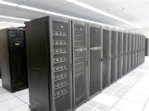
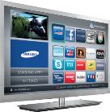

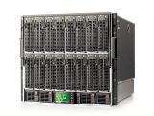

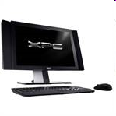


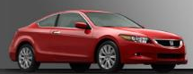

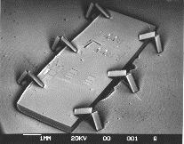

Societal Scale Information Systems
(Or the “Internet of Things”?)
Massive Cluster
The world is a large distributed system
  Microprocessors in everything
  Vast infrastructure behind them
Gigabit Ethernet
Clusters
Massive Cluster
Clusters
Gigabit Ethernet
Internet
Connectivity
Scalable, Reliable,
Secure Services
Databases
Information Collection
Remote Storage
Online Games
Commerce
…
MEMS for
Sensor Nets
Notes:
Of the enormous variety of CITRIS projects going on at Berkeley, I will present one set that is tied together by this picture: the design, construction and use of MEMS devices, the sensor networks containing them, and making the information from these networks available to widely distributed users as scalable, reliable and secure services.
The name we give to such an integrated system is a Societal Scale Information System, a name meant to evoke its scale – enormous - and purpose – benefiting people and the economy.
I will leave the details of all the specific applications that Ruzena mentioned, be it to energy efficiency or education or disaster response the social sciences, and indeed most details, to later talks and posters.

Slide 34
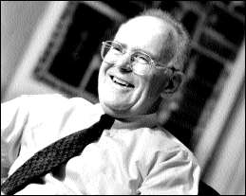
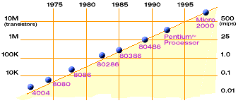
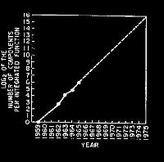
Technology Trends: Moore’s Law
Moore’s Law
2X transistors/Chip Every 1.5 years
Called “Moore’s Law”
Gordon Moore (co-founder of Intel) predicted in 1965 that the transistor density of semiconductor chips would double roughly every 18 months
Microprocessors have become smaller, denser, and more powerful

Slide 35
Big Challenge: Slowdown in Joy’s law of Performance
3X
From Hennessy and Patterson, Computer Architecture: A Quantitative Approach, 4th edition, Sept. 15, 2006
⇒ Sea change in chip design: multiple “cores” or processors per chip
VAX : 25%/year 1978 to 1986
RISC + x86 : 52%/year 1986 to 2002
RISC + x86 : ??%/year 2002 to present

Slide 36
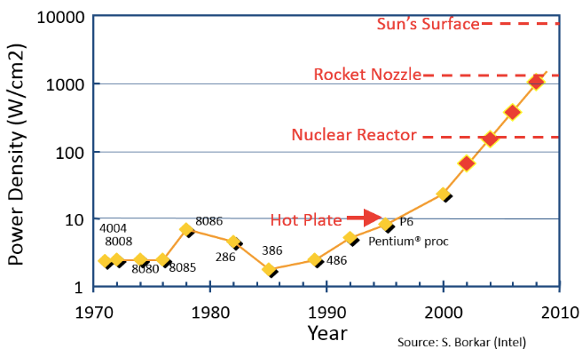
Another Challenge: Power Density
Moore’s law extrapolation
  Potential power density reaching amazing levels!
Flip side: battery life very important
  Moore’s law yielded more functionality at equivalent
  (or less) total energy consumption

Slide 37
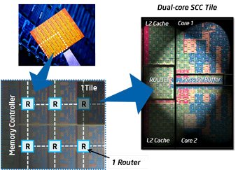
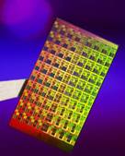
ManyCore Chips: The future arrived in 2007
Intel 80-core multicore chip (Feb 2007)
  80 simple cores
  Two FP-engines / core
  Mesh-like network
  100 million transistors
  65nm feature size
Intel Single-Chip Cloud
Computer (August 2010)
  24 “tiles” with two cores/tile
  24-router mesh network
  4 DDR3 memory controllers
  Hardware support for message-passing
How to program these?
  Use 2 CPUs for video/audio
  Use 1 for word processor, 1 for browser
  76 for virus checking???
Parallelism must be exploited at all levels
Amazon X1 instances (2016)
  128 virtual cores, 2 TB RAM

Slide 38
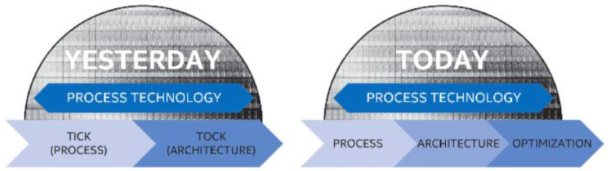
But then Moore’s Law Ended…
Moore’s Law has (officially) ended -- Feb 2016
  No longer getting 2 x transistors/chip every 18 months…
  or even every 24 months
May have only 2-3 smallest geometry fabrication plants left:
  Intel and Samsung and/or TSMC
Vendors moving to 3D stacked chips
  More layers in old geometries

Slide 39
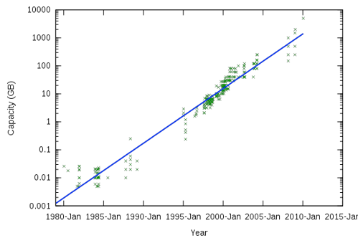
Storage Capacity is Still Growing!

Slide 40
Society is Increasingly Connected…

Slide 41
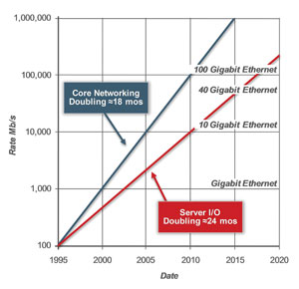
Network Capacity Still Increasing
(source: http://www.ospmag.com/issue/article/Time-Is-Not-Always-On-Our-Side )
Notes:
Networking bandwidth is expected to also outpace the CPU power, so more bandwidth per core.

Slide 42
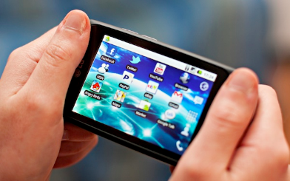
Not Only PCs connected to the Internet
In 2011, smartphone shipments exceeded PC shipments!
2011 shipments:
  487M smartphones
  414M PC clients
    210M notebooks
    112M desktops
    63M tablets
  25M smart TVs
4 billion phones in the world → smartphones over next few years
Then…
1.53B in 2017
262.5M in 2017
164M in 2017
39.5M in 2017

Slide 43
People-to-Computer Ratio Over Time
Computers
Per Person
Number crunching, Data Storage, Massive Inet Services,
ML, …
1:10⁶
Mainframe
Mini
1:10³
Workstation
Productivity,
Interactive
PC
Laptop
1:1
PDA
Cell
Streaming from/to the physical world
10³:1
years
Mote!
The Internet of Things!
Bell’s Law: new computer class per 10 years

Slide 44
Challenge: Complexity
Applications consisting of…
  … a variety of software modules that …
  … run on a variety of devices (machines) that
    … implement different hardware architectures
    … run competing applications
    … fail in unexpected ways
    … can be under a variety of attacks
Not feasible to test software for all possible environments and combinations of components and devices
  The question is not whether there are bugs but how serious are the bugs!

Slide 45
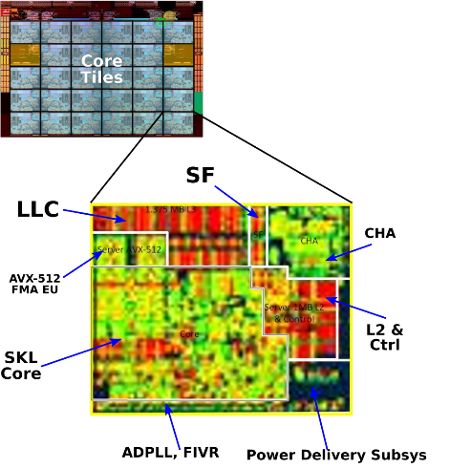
The World Is Parallel: Intel SkyLake (2017)
Up to 28 Cores, 56 Threads
  694 mm² die size (estimated)
Many different instructions
  Security, Graphics
Caches on chip:
  L2: 28 MiB
  Shared L3: 38.5 MiB
  (non-inclusive)
  Directory-based cache coherence
Network:
  On-chip Mesh Interconnect
  Fast off-chip network directlry supports 8-chips connected
DRAM/chips
  Up to 1.5 TiB
  DDR4 memory

Slide 46
Recall: Increasing Software Complexity
New Versions usually (much) larger older versions!
Cars getting really complex!
Millions of Lines of Code
(source https://informationisbeautiful.net/visualizations/million-lines-of-code/)

Slide 47
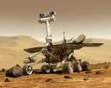
Example: Some Mars Rover (“Pathfinder”) Requirements
Pathfinder hardware limitations/complexity:
  20Mhz processor, 128MB of DRAM, VxWorks OS
  cameras, scientific instruments, batteries, solar panels, and locomotion equipment
  Many independent processes work together
Can’t hit reset button very easily!
  Must reboot itself if necessary
  Must always be able to receive commands from Earth
Individual Programs must not interfere
  One buggy module should not crash critical modules, e.g., antenna positioning software!
Further, all software may crash occasionally
  Automatic restart with diagnostics sent to Earth
  Periodic checkpoint of results saved?
Certain functions time critical:
  Need to stop before hitting something
  Must track orbit of Earth for communication
A lot of similarity with the Internet of Things?
  Complexity, QoS, Inaccessbility, Power limitations … ?
Notes:
Distance 186 light secs to 21 light minutes one-way
Nearly two earth years

Slide 48
Questions
Does the programmer need to write a single program that performs many independent activities?
Does every program have to be altered for every piece of hardware?
Does a faulty program crash everything?
Does every program have access to all hardware?
Hopefully, no!
Operating Systems help the programmer write robust programs!

Slide 49
OS Abstracts the Underlying Hardware
Processor → Thread
Memory → Address Space
Disks, SSDs, … → Files
Networks → Sockets
Machines → Processes
OS as an Illusionist:
  Remove software/hardware quirks (fight complexity)
  Optimize for convenience, utilization, reliability, … (help the programmer)
For any OS area (e.g. file systems, virtual memory, networking, scheduling):
  What hardware interface to handle? (physical reality)
  What’s software interface to provide? (nicer abstraction)
Application
Operating System
Hardware
Abstract Machine Interface
Physical Machine Interface

Slide 50
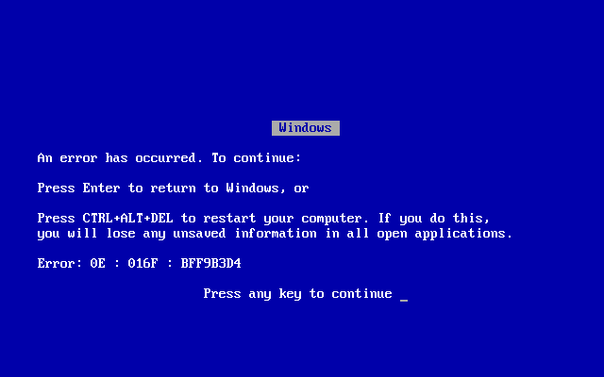
OS Protects Processes and the Kernel
Run multiple applications and:
  Keep them from interfering with or crashing the operating system
  Keep them from interfering with or crashing each other

Slide 51
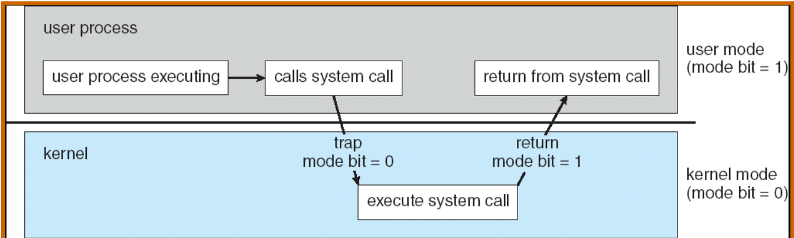
Basic Tool: Dual-Mode Operation
Hardware provides at least two modes:
  Kernel Mode (or “supervisor” mode)
  User Mode
Certain operations are prohibited when running in user mode
  Changing the page table pointer, disabling interrupts, interacting directly w/ hardware, writing to kernel memory
Carefully controlled transitions between user mode and kernel mode
  System calls, interrupts, exceptions

Slide 52
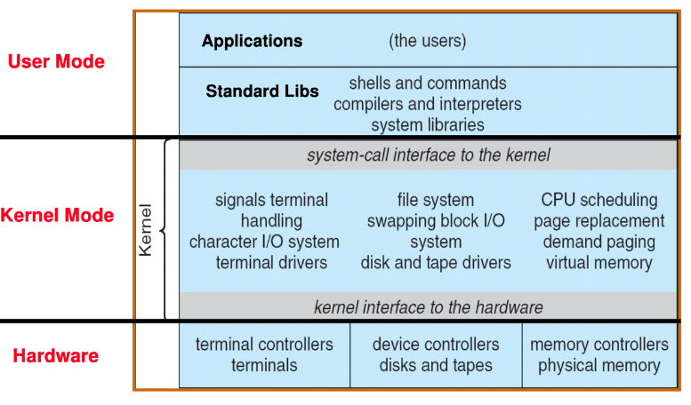
UNIX System Structure

Slide 53
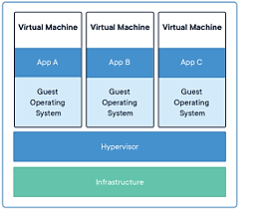
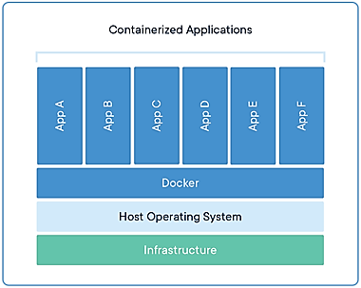
Virtualization: Execution Environments for Systems
Additional layers of protection and isolation can help further manage complexity

Slide 54
What is an Operating System,… Really?
Most Likely:
  Memory Management
  I/O Management
  CPU Scheduling
  Communications? (Does Email belong in OS?)
  Multitasking/multiprogramming?
What about?
  File System?
  Multimedia Support?
  User Interface?
  Internet Browser?

Slide 55
Operating System Definition (Cont.)
No universally accepted definition
“Everything a vendor ships when you order an operating system” is good approximation
  But varies wildly
“The one program running at all times on the computer” is the kernel
  Everything else is either a system program (ships with the operating system) or an application program

Slide 56
“In conclusion…Operating Systems:”
Provide convenient abstractions to handle diverse hardware
  Convenience, protection, reliability obtained in creating the illusion
Coordinate resources and protect users from each other
  Using a few critical hardware mechanisms
Simplify application development by providing standard services
Provide fault containment, fault tolerance, and fault recovery

