Slide 1
Lecture 7
Hash Tables
Department of Computer Science
Hofstra University

Slide 2
Lecture Goals
Describe why hash tables are valuable
Describe the role of a hash function and the hash code
Describe Java’s Hash Code Conventions
Describe Java’s implementations of hash code
Describe alternative methods for handling collisions in a Hash Table
Identify other challenges associated with Hash Tables
Explain the difference between a Hash Set, Hash Map and Hash Table
Notes:
What is a HashTable Data Structure - Introduction to Hash Tables , Part 0
https://www.youtube.com/watch?v=MfhjkfocRR0 -- video about hashtable

Slide 3
Motivation
Find Ada
Option 1: brute force linear search
Take long time for big array
What if we happen to know the index of the value?
Ada -> 8
?
myData = Array[8]
Jan
Tim
Mia
Sam
Leo
Ted
Bea
Lou
Ada
Ada
Ada
Max
Zoe
0
1
2
3
4
5
6
7
8
9
10
Very fast
If you know where in memory the array starts, you can easily determine the address of any element using the index. Accessing an address is an O(1) operation, and independent of array size.
How can you know which elements of the array contains the value you are looking for?
Option 2: hash table
Hash tables in 4 minutes
https://www.youtube.com/watch?v=knV86FlSXJ8
Hashing | Set 1 (Introduction) | GeeksforGeeks
https://www.youtube.com/watch?v=wWgIAphfn2U
Each index number can be calculated using the value itself. So the index number is in some way related to the data

Slide 4

Hash Table
Save items in a key-indexed table (index is a function of the key).
Hash function is the method for computing array index from key.
char | Unicode
… | …
'a' | 97
'b' | 98
'c' | 99
… | ...
Let’s repopulate the array to be a hash table with following hash function:
Index number = sum Unicodes Mod array size
Mia
M 77
i 105
a 97
279
4
Tim
T 84
i 105
m 109
298
1
Bea
B 66
e 101
a 97
264
0
Zoe
Z 90
o 111
e 101
302
5
Jan
J 74
a 97
n 110
281
6
Ada
A 65
d 100
a 97
262
9
key
# of elements in array
Leo
L 76
e 101
o 111
288
2
K mod N is a common hash function
Sam
S 83
a 97
m 109
289
3
Lou
L 76
o 111
u 117
304
7
Max
M 77
a 97
x 120
294
8
Ted
T 84
e 101
d 100
285
10
Bea
Tim
Leo
Sam
Mia
Zoe
Jan
Lou
Ada
Ada
Max
Ada
Ted
0
1
2
3
4
5
6
7
8
9
10

Slide 5
Hash Table (Contd.)
Index number = sum Unicodes Mod array size
Find Ada
Hash tables are often used to store <key, value> pairs, which can be the objects in java. Key is just one of the object’s property
Ada = (65 + 100 + 97) = 262
262 Mod 11 = 9
Ada
03/27/1969
Inventor
myData = Array[9]
Bea
10/12/1955
Astronomer
Tim
11/02/1986
Inventor
Leo
05/12/1966
Philosopher
Sam
10/12/1951
Biologist
Mia
04/09/1977
Physicist
Zoe
10/12/1965
Inventor
Jan
10/12/1990
Philosopher
Lou
02/13/1943
Biologist
Ada
Ada
03/27/1969
Inventor
Ada
Bea
Tim
Leo
Sam
Mia
Zoe
Jan
Lou
Max
06/24/1971
Scientist
Ada
Ted
12/06/1998
Actress
Ada
Ada
Max
Ada
Ted
Key Value
0
1
2
3
4
5
6
7
8
9
10
Hash Funtion
Hash Code
Array
Index
Key
Hash Algorithm
Mod

Slide 6
Hash Function
Calculation applied to a key to transform it into an address (array/table index).
Idealistic goal: Scramble the keys uniformly to produce a table index.
key
Hash
Function
Efficiently computable.
Each table index equally likely for each key.
Ex. Phone numbers.
Bad: first three digits.
Better: last three digits.
But actually, in most cases, you want to find the way to use all the data
table index
Practical challenge: need different approach for each key type.
For numeric keys, divide the key by the number of available addresses, n, and take the remainder.
address = key Mod n
For alphanumeric keys, divide the sum of Unicodes in a key by the number of available addresses, n, and take the remainder.
Folding method divides key into equal parts then adds the parts together
  The telephone number 5164635712 becomes 51+64+63+57+12 = 247
  Depending on size of table, may then divide by some constant and take remainder
  ensures that all the digits contribute to the hash code
6

Slide 7
Java’s Hash Code Conventions
All Java classes inherit a method hashCode(), which returns a 32-bit int.
Requirement. If x.equals(y), then (x.hashCode() == y.hashCode()).
== tests for reference equality (whether they are the same object).
.equals() tests for value equality (whether they are logically "equal").
Highly desirable. If !x.equals(y), then (x.hashCode() != y.hashCode()).
collision
x
y
Note that it is generally necessary to override the hashCode method whenever this method is overridden, so as to maintain the general contract for the hashCode method, which states that equal objects must have equal hash codes.
Meets the two requirements for Java. But it doesn’t meet the idea that every table position should be equally likely mapped from the keys.
x.hashCode()
y.hashCode()
Default implementation. Memory address of x.
Legal (but poor) implementation. Always return 17.
Customized implementations. Integer, Double, String, File, URL, Date, …
User-defined types. Users are on their own.
collision
7

Slide 8


Implementing Hash Code: Integers, Booleans
Java library implementation
public final class Integer {
private final int value;
...
public int hashCode(){
return value;
}
}
public final class Boolean {
private final boolean value;
...
public int hashCode() {
if (value) return 1231; else return 1237;
}
}
Two large prime numbers
1. avoid collision
(e.g., better than 1000 and 2000.)
1000 mod 8 = 2000 mod 8
1000 mod 10 = 2000 mod 10
1000 mod 20 = 2000 mod 20
2. larger impact on the hash code of a composite object (e.g., better than 0 and 1)
class InterviewCandidate {
String candidateName;
Boolean isSelected;
}
To write the hashcode for this class, typically you will find hashcode for candidateName, hashcode for isSelected, multiply them with some prime number and then add them up

Slide 9

Implementing Hash Code: Doubles
Java library implementation
public final class Double {
private final double value;
...
public int hashCode() {
long bits = doubleToLongBits(value);
return (int) (bits ^ (bits >>> 32));
}
}
1. convert to IEEE 64-bit representation.
2. xor most significant 32-bits with least significant 32-bits.
a | b | a^b
0 | 0 | 0
0 | 1 | 1
1 | 0 | 1
1 | 1 | 0
XOR is a binary operation, it stands for "exclusive or", that is to say the resulting bit evaluates to one if only exactly one of the bits is set.
10.24
01000000 00100100 01111010 11100001
01000111 10101110 00010100 01111011
01000000 00100100 01111010 11100001
return 126512794
all the digits contribute to the hash code
XOR
01000111 10101110 00010100 01111011
00000111 10001010 01101110 10011010

Slide 10
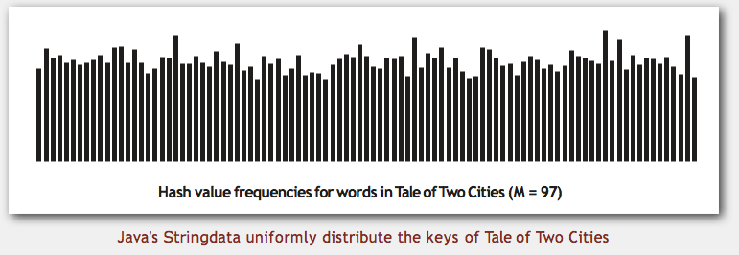

Implementing Hash Code: Strings
Java library implementation
public final class String {
private final char[] s;
...
public int hashCode() {
int hash = 0;
for (int i = 0; i < length(); i++)
hash = s[i] + (31 * hash);
return hash;
}
}
char | Unicode
… | …
'a' | 97
'b' | 98
'c' | 99
… | ...
i^{th} character of s
Horner's method to hash string of length n: n multiplies/adds.
Equivalent to h = s[0] · 31^{n–1} + … + s[n – 3] · 31² + s[n – 2] · 31¹ + s[n – 1] · 31⁰.
Ex.
String s = "call";
int code = s.hashCode();
3045982 = 99·31³ + 97·31² + 108·31¹ + 108·31⁰
= 108 + 31· (108 + 31 · (97 + 31 · (99)))
(Horner's method)
return 3045982
It involves all the characters of the string in computing the hash function.
10

Slide 11
Implementing Hash Code: Strings (Contd.)
Java library implementation
public final class String {
private final char[] s;
private int hash = 0;
...
public int hashCode() {
int h = hash;
if (h != 0) return h;
for (int i = 0; i < length(); i++)
h = s[i] + (31 * h);
hash = h;
return h;
}
}
cache of hash code
return cached value
store cache of hash code
Performance optimization.
  Cache the hash value in an instance variable.
  Return cached value.
11

Slide 12

Implementing Hash Code: User-defined Types
Java library implementation
31 is a prime number. The product of a prime with any other number has the best chance of being unique. The value was chosen for better distribution.
A nice property of 31 is that the multiplication can be replaced by a shift and a subtraction for better performance: 31 * i == (i << 5) - i.
Using primes is an old technique.
public final class Transaction {
private final String who;
private final Date when;
private final double amount;
public int hashCode() {
int hash = 17;
hash = 31 * hash + who.hashCode();
hash = 31 * hash + when.hashCode();
hash = 31 * hash + ((Double) amount).hashCode();
return hash;
}
}
nonzero constant
for reference types, use hashCode()
for primitive types, use hashCode() of wrapper type
typically a small prime
"Standard" recipe for user-defined types. (works well and used in java libraries)
Combine each significant field using the 31x + y rule.
If field is a primitive type, use wrapper type hashCode().
If field is null, return 0.
If field is a reference type, use hashCode().
If field is an array, apply to each entry.
Basic rule. Need to use the whole key to compute hash code;
applies rule recursively
or use Arrays.deepHashCode()

Slide 13



Modular Hashing
Hash code: an int between -2³¹ and 2³¹ - 1.
M is the size of the array, which is typically a prime or power of 2
Hash function: an int between 0 and M - 1 (for use as array index).
Hash
Funtion
Since our goal is an array index, not a 32-bit integer, we combine hashCode() with modular hashing produce integers between 0 and M-1, which is used as an array/table index.
Key
Hash Algorithm
Hash Code
Mod
private int hash(Key key) {
return key.hashCode() % M;
}
The % operator returns a non-positive integer if its first argument is negative, and this would create an array index out-of-bounds error.
Array
Index
bug
1-in-a-billion bug
private int hash(Key key) {
return Math.abs(key.hashCode()) % M;
}
the absolute value of Integer.MIN_VALUE is itself! Famously, hashCode() of "polygenelubricants" is -2³¹
correct
private int hash(Key key) {
return (key.hashCode() & 0x7fffffff) % M;
}
The code masks off the sign bit (to turn the 32-bit integer into a 31-bit nonnegative integer) and then computing the remainder when dividing by M

Slide 14
Absolute value of Integer.MIN_VALUE is itself
Integer representation: In Java, integers are stored using 32 bits in two's complement format.
Range of int: The range of int in Java is from -2^31 to 2^31 - 1, which is -2,147,483,648 to 2,147,483,647.
Integer.MIN_VALUE: This constant represents the minimum value an int can hold, which is -2,147,483,648.
No positive counterpart: There is no positive 32-bit integer that can represent 2,147,483,648 (which would be the absolute value of -2,147,483,648).
The Math.abs() Function
  When you try to get the absolute value of Integer.MIN_VALUE using Math.abs(), here's what happens:
    int minValue = Integer.MIN_VALUE;
    int absValue = Math.abs(minValue);
    System.out.println(minValue == absValue); // This prints true

Slide 15
Collision and Resolution: Open Addressing
Collision: two distinct keys hashing to same index.
Solution: Linear probing
Idea: Just put it in the next open spot
0
1
2
3
4
5
6
7
8
9
10
11
M = 12
insert L hash(L) = 4
I
X
L
M
E
R
F
G
insert I hash(I) = 1
insert E hash(E) = 8
Collision!
Search hit
(return corresponding value)
Search miss
(return null)
insert M hash(M) = 5
insert X hash(X) = 4
insert F hash(F) = 10
Search E hash(E) = 8
Idea for search: Search the hashed table index, and if occupied but no match, try the next spot until the next spot is empty or is the hashed table index (i.e., loops back and the table is full).
insert G hash(G) = 11
Search X hash(X) = 4
insert R hash(R) = 10
Search Y hash(Y) = 5

Slide 16
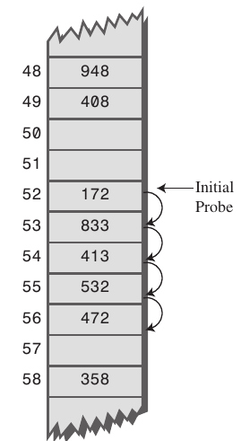
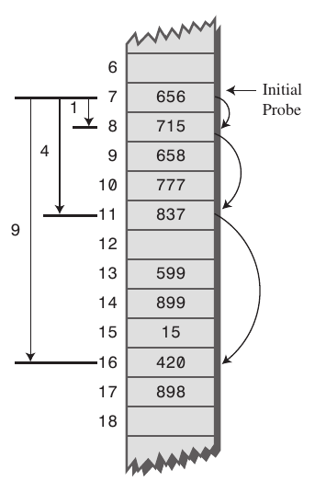
Primary Clustering and Secondary Clustering
Primary clustering is the tendency for a collision resolution scheme such as linear probing to create long runs of filled slots near the hash position of keys.
  If the primary hash index is x, subsequent probes go to x+1, x+2, x+3 and so on, this results in Primary Clustering.
  Once the primary cluster forms, the bigger the cluster gets, the faster it grows. And it reduces the performance.
Secondary clustering is the tendency for a collision resolution scheme such as quadratic probing to create long runs of filled slots away from the hash position of keys.
  If the primary hash index is x, probes go to x+1, x+4, x+9, x+16, x+25 and so on, this results in Secondary Clustering.
Primary clustering
Secondary clustering

Slide 17
Linear Probing: Primary Clustering
What is the probability of next key going in each slot?
Hash(k) = k mod 7
All keys equally likely
Cluster is a contiguous block of items.
1/7
1/7
1/7
1/7
1/7
1/7
1/7
Observation. New keys likely to hash into middle of big clusters.
0
1
2
3
4
5
6
Higher insert and search costs - O(n)
24
1/7
1/7
1/7
1/7
2/7
1/7
1/7
1/7
0
1/7+1/7
0
1
2
3
4
5
6
24
4
12
1/7+1/7
+1/7+
1/7
1/7
1/7
1/7
1/7
0
0
4/7
0
1/7
1/7
1/7
0
1
2
3
4
5
6

Slide 18
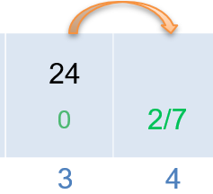
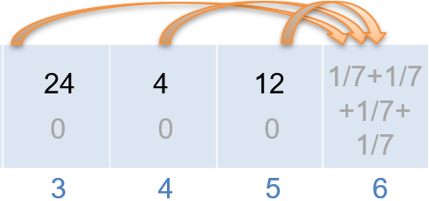
Linear Probing: Primary Clustering Explanations
Case 1: Probability of placing into position 4 = prob(hashing into 3) + prob(hashing into 4) = 1/7+1/7 = 2/7
Case 2: Probability of placing into position 6 = prob(hashing into 3) + prob(hashing into 4) + prob(hashing into 5) + prob(hashing into 6) = 1/7+1/7+1/7+1/7=4/7
Case 1
Case 2

Slide 19
Linear Probing: Primary Clustering (Contd.)
Three methods to mitigate the problem
1. Better-designed hash function
3. Resize the hash table when it’s “full”
2. Alternative probing methods
Total number of items stored
Load factor =
Size of the array
Open addressing
linear probing
  try next open spot
Plus 3 rehash
  skip 3 spots, not just next open spot
Quadratic probing
  skip (failed attempts)² spots, i.e, 1², 2², 3²
Double hashing
  apply a second hash function to key when a collision occurs
Repopulate the items into a larger array, when load factor > 70%

Slide 20
Linear Probing: Delete
How to delete item from a hash table?
0
1
2
3
4
5
6
7
8
9
10
11
R
I
L
M
X
E
F
G
X
M = 12
deleted
deleted
deleted
deleted
deleted
Delete M hash(M) = 5
Search X hash(X) = 4
Search hit
(return corresponding value)
Search stops
Method 1: mark the spot as “empty but deleted”. Probing is continued when encountering such spot. An add operation can store data in such spot.
Method 2:
Find and remove the desired element
Go to the next spot
If the spot is empty, quit
If the spot is full, delete the element in that spot and re-add it to the hash table using the normal means. The item must be removed before re-adding, because it is likely that the item could be added back into its original spot.
Repeat step 2.
Table pollution issue: These deleted flags may bridge together otherwise unrelated data (different hashcodes). In the worst case, search is linear time.
The only solution is to repopulate the key-value pairs into a new table, and discard the old one.
This technique keeps your table tidy at the expense of slightly slower deletions.

Slide 21
Closed Addressing: Separate Chaining
Use an array of M linked lists.
0
I
Insert: put in the end of hashed chain (or in sorted order)
1
2
Search: need to search only hashed chain
3
The size of the array can be smaller than the stored number.
L
X
M = 12
4
insert L hash(L) = 4
5
M
insert I hash(I) = 1
6
insert E hash(E) = 8
7
insert M hash(M) = 5
8
E
insert X hash(X) = 4
insert F hash(F) = 10
Search E hash(E) = 8
9
F
R
insert G hash(G) = 11
Search X hash(X) = 4
10
insert R hash(R) = 10
Search Y hash(Y) = 5
11
G
Hashing | Set 2 (Separate Chaining) | GeeksforGeeks
https://www.youtube.com/watch?v=_xA8UvfOGgU
Notes:
Variant: Hash to two positions, insert key in shorter of the two chains.
Hashing | Set 2 (Separate Chaining) | GeeksforGeeks

Slide 22
Separate Chaining vs Linear Probing
Separate chaining.
  Easier to implement delete.
  Performance degrades gracefully.
  less sensitive to poorly-designed hash function
Linear probing.
  Less wasted space.
  Better cache performance
“With a bad choice of hash function, primary clustering can cause the performance of the table to degrade significantly. While chaining can still suffer from bad hash functions, it's less sensitive to elements with nearby hash codes, which don't adversely impact the runtime.”
“In practice, linear probing is typically significantly faster than chaining due to locality of reference, although it has the primary clustering problem. It's faster to access a series of elements in an array than it is to follow pointers in a linked list, so linear probing tends to outperform chaining even if it has to investigate more elements. Another win in chaining is that the insertions into a linear probing hash table don't require any new allocations.”
With linear probing, an array occupies contiguous memory locations; with separate chaining, a linked list occupies non-contiguous memory locations.

Slide 23
Hashing Tutorial Videos
Hashing | Set 2 (Separate Chaining) | GeeksforGeeks
  https://www.youtube.com/watch?v=_xA8UvfOGgU
Hashing | Set 3 (Open Addressing) | GeeksforGeeks
  https://www.youtube.com/watch?v=Dk57JonwKNk
Hashing Animations | Data Structure | Visual How
  https://www.youtube.com/watch?v=VeYKEMY2F9k
Linear Probing in Hashing Animations | Data Structure | Visual How
  https://www.youtube.com/watch?v=98Y0UDZ9vvs
Quadratic Probing Hashing Animations | Data Structure | Visual How
  https://www.youtube.com/watch?v=0CFJAkpnhBg
Separate Chaining in Hashing Animations | Data Structure | Visual How
  https://www.youtube.com/watch?v=LRtKQdsJC3o

